Slide 1

OLA RIDE ANALYTICS
Business Performance & Insights
Data-Driven Analysis using Python, SQL, Power BI & Streamlit
Burhanuddin Farigh

Slide 2
Business Problem
Understand ride demand patterns over time
Identify key revenue drivers
Analyze vehicle performance
Evaluate customer and driver experience
Enable data-driven business decisions

Slide 3
Dataset Summary
~64,000 completed ride records
Covers:
  Vehicle type
  Ride distance
  Booking value (revenue)
  Payment method
  Customer & driver ratings
  Time attributes (day, hour)

Slide 4
Analytical Approach
1
2
Python
SQL
Data cleaning & validation
Analytical querying & aggregation
3
4
Power BI
Streamlit
Interactive dashboards
Presentation & insight showcase

Slide 5
SQL Used For
Example SQL Queries
Ride volume analysis
Revenue aggregation
Top customers identification
SELECT COUNT(*) FROM ola_rides;
SELECT payment_method, SUM(booking_value) FROM ola_rides GROUP BY payment_method;
SELECT customer_id, SUM(booking_value) FROM ola_rides GROUP BY customer_id ORDER BY SUM(booking_value) DESC LIMIT 5;
Payment method contribution
Rating distributions

Slide 6

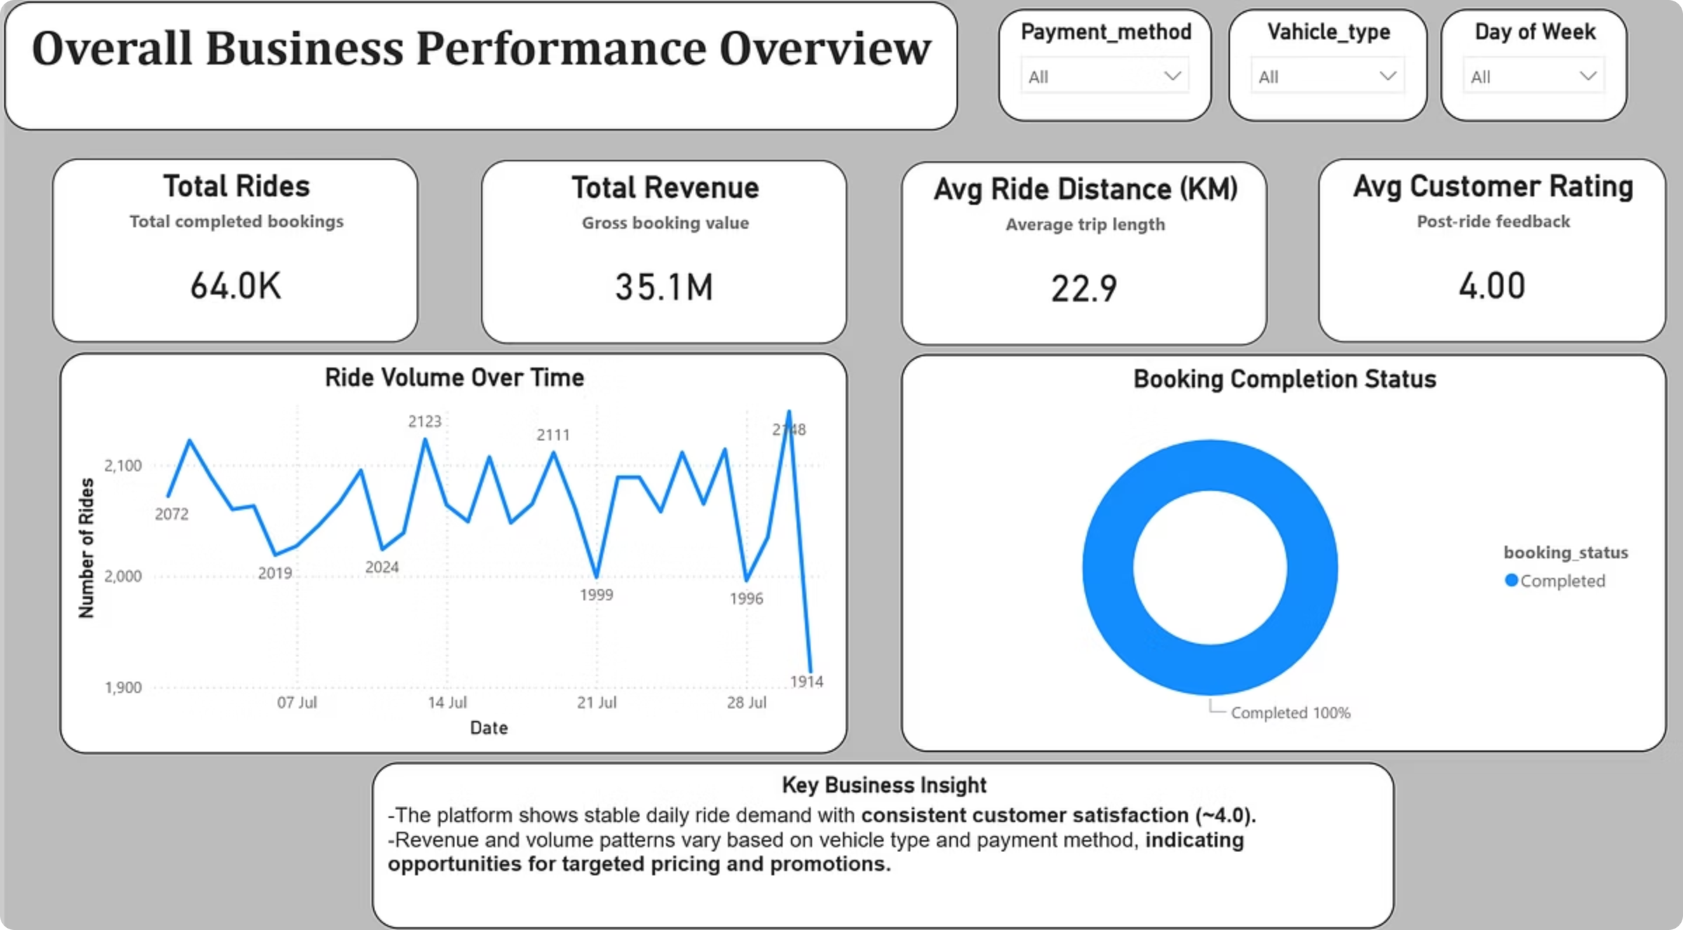
Key Insights
~2,000–2,150 rides per day
100% completed bookings
Stable ride demand over time

Slide 7
Recommendations
Promote UPI payments during peak hours
Incentivize drivers on high-demand weekdays
Encourage premium vehicles for long-distance rides
Launch loyalty programs for top customers

Slide 8
Conclusion
Stable ride demand and strong revenue base
High customer satisfaction
Clear opportunities for optimization
Data-driven decision support achieved

Slide 9
Thank You

