Slide 1
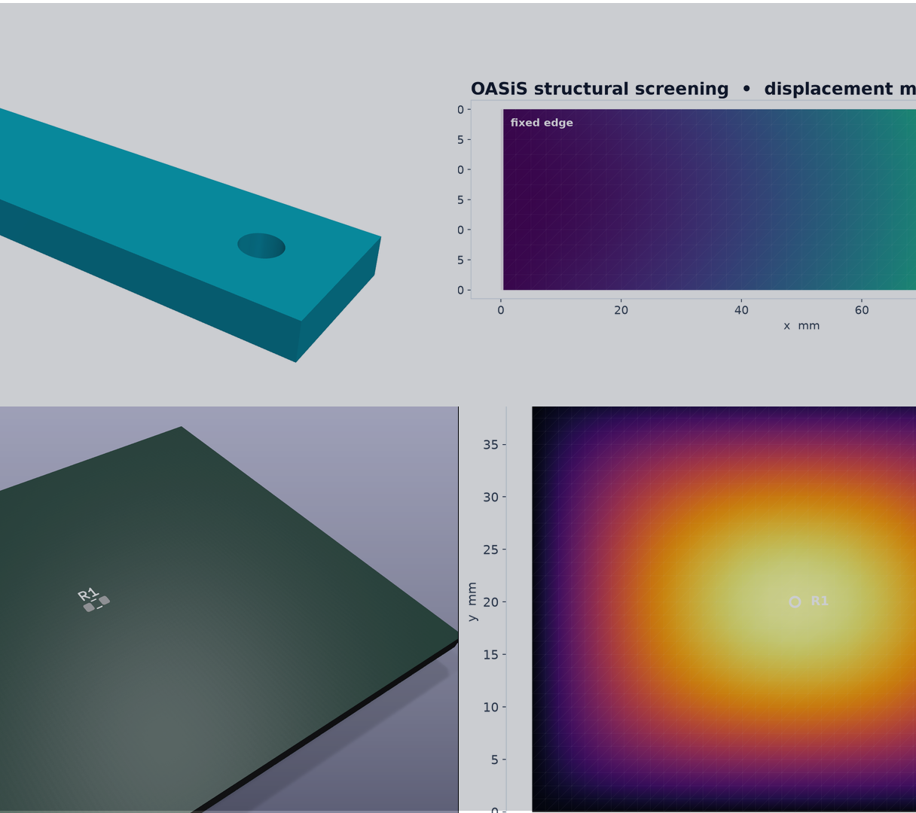
WRIGHT
Engineering MCP qualification
Ten qualified integrations and three verified product design chains
8 September 2026
Notes:
Source: Wright committed curation report and process-chains-linux.json evidence dated 2026-09-08. Output images are renders of artifacts regenerated from the same committed chain runner; the deterministic STL and VTU outputs match the authoritative evidence hashes.

Slide 2
STATUS • 8 SEPTEMBER 2026
Engineering MCP portfolio status
A deliberately small supported baseline from 77 reviewed integrations
10
qualified engineering MCP servers
3
verified product design chains
30 / 30
successful MCP calls
WRIGHT • ENGINEERING MCP QUALIFICATION
02
Notes:
Source: Wright committed curation report and process-chains-linux.json evidence dated 2026-09-08. Output images are renders of artifacts regenerated from the same committed chain runner; the deterministic STL and VTU outputs match the authoritative evidence hashes.
Counts: curated 10, follow up 55, remove 12.

Slide 3
STATUS • 8 SEPTEMBER 2026
Ten integrations form the supported baseline
Five were exercised together in the product design chains
USED IN CHAINS
INDEPENDENTLY QUALIFIED
BREP MCP
Autodesk Product Help MCP
parametric solid CAD
requirements and design guidance
OASiS Open FEM Agent
Blender 3D Mesh Copilot
structural and thermal screening
mesh design
AutoCAD MCP Pro
FreeCAD Python Server
DXF drawing and controlled revision
solid CAD
KiCad MCP
OpenSCAD Rendering Engine
PCB, audit and fabrication output
scripted CAD
ROSBag MCP
Rhino MCP
test and field evidence
standalone solid 3DM
WRIGHT • ENGINEERING MCP QUALIFICATION
03
Notes:
Source: Wright committed curation report and process-chains-linux.json evidence dated 2026-09-08. Output images are renders of artifacts regenerated from the same committed chain runner; the deterministic STL and VTU outputs match the authoritative evidence hashes.

Slide 4
STATUS • 8 SEPTEMBER 2026
Three product design chains
Each transition carried verified identity, revision, units and artifact hashes
1 MECHANICAL
BREP CAD
→
OASiS FEA
→
AutoCAD review
2 ELECTRONICS
KiCad PCB
→
BREP enclosure
→
OASiS thermal
→
ROS validation
3 FIELD FEEDBACK
AutoCAD rev A
→
ROS evidence
→
AutoCAD rev B
7 handoffs accepted
7 corrupted manifests rejected
WRIGHT • ENGINEERING MCP QUALIFICATION
04
Notes:
Source: Wright committed curation report and process-chains-linux.json evidence dated 2026-09-08. Output images are renders of artifacts regenerated from the same committed chain runner; the deterministic STL and VTU outputs match the authoritative evidence hashes.

Slide 5
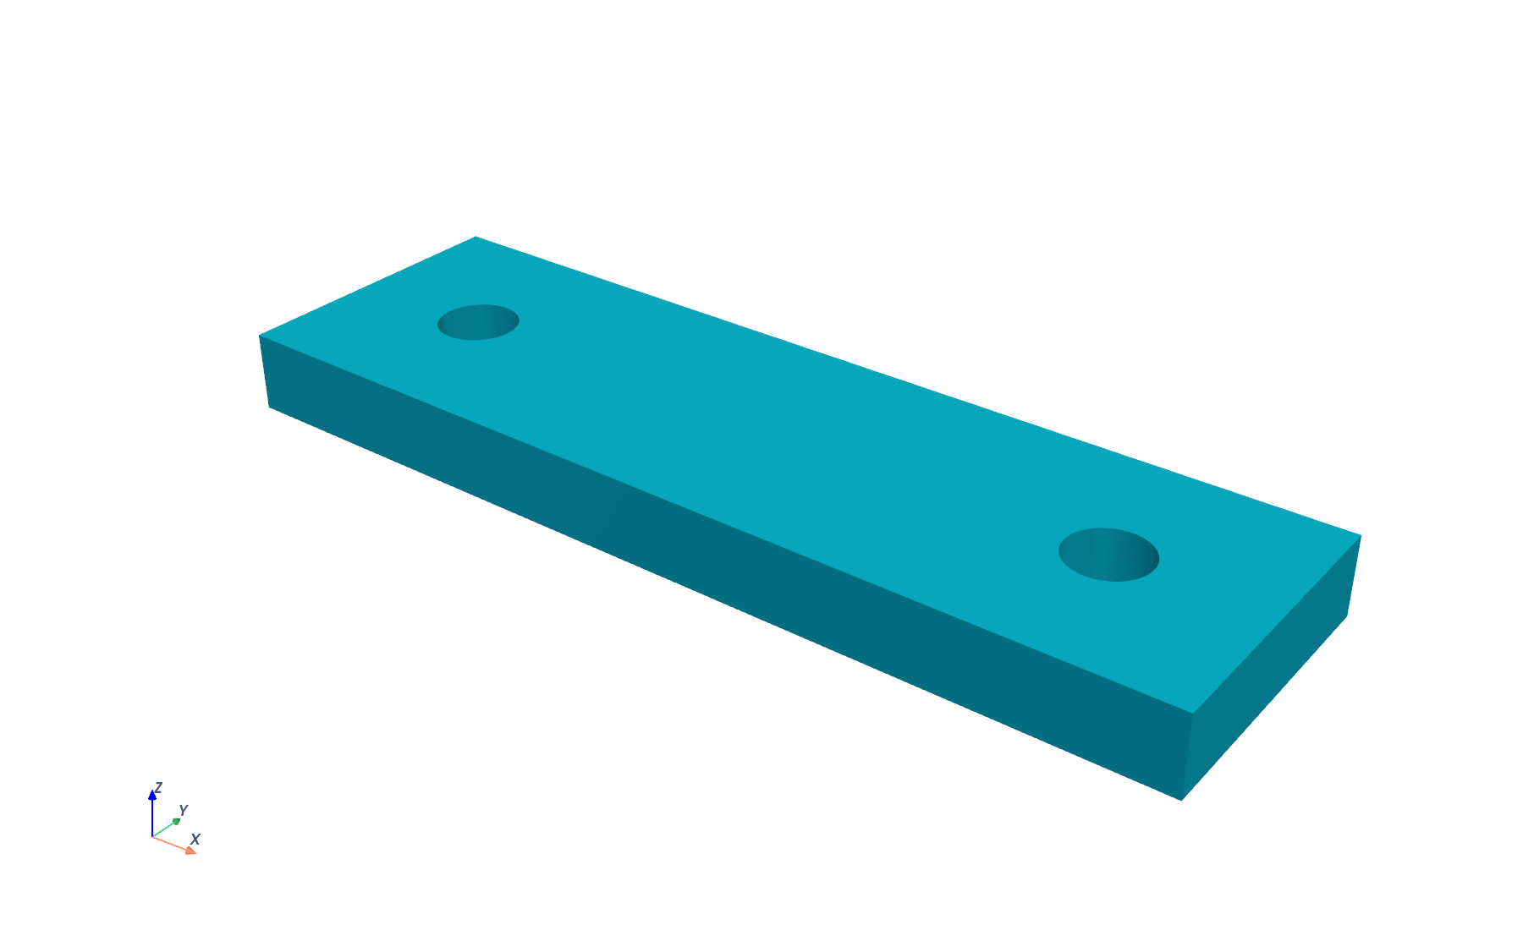
STATUS • 8 SEPTEMBER 2026
Mechanical chain • CAD output
BREP generated the bracket and AutoCAD reproduced its review geometry
100 × 30 × 8
millimetre solid envelope
2 × Ø8
through holes at x 15 and 85 mm
23,196.09 mm³
measured STL volume • within 0.2% oracle
WRIGHT • ENGINEERING MCP QUALIFICATION
05
Notes:
Source: Wright committed curation report and process-chains-linux.json evidence dated 2026-09-08. Output images are renders of artifacts regenerated from the same committed chain runner; the deterministic STL and VTU outputs match the authoritative evidence hashes.
Mechanical STL SHA-256: e69b79332f7ab55355cb64ab1365face79afe61bc4282e3016a8093c9b4a38d9.

Slide 6
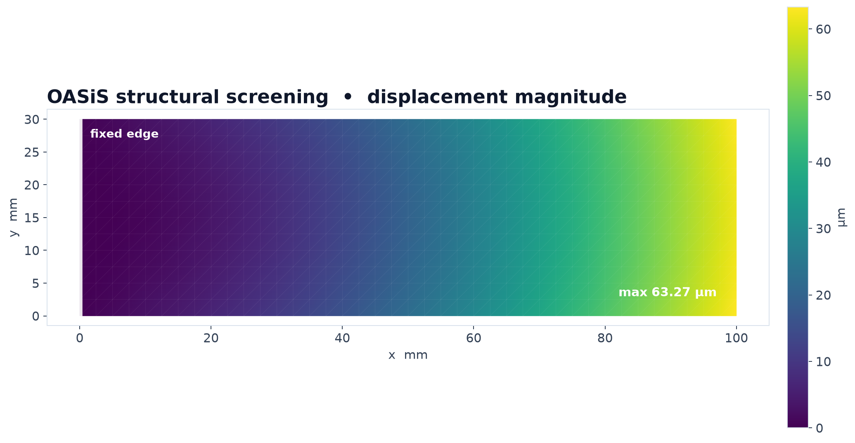
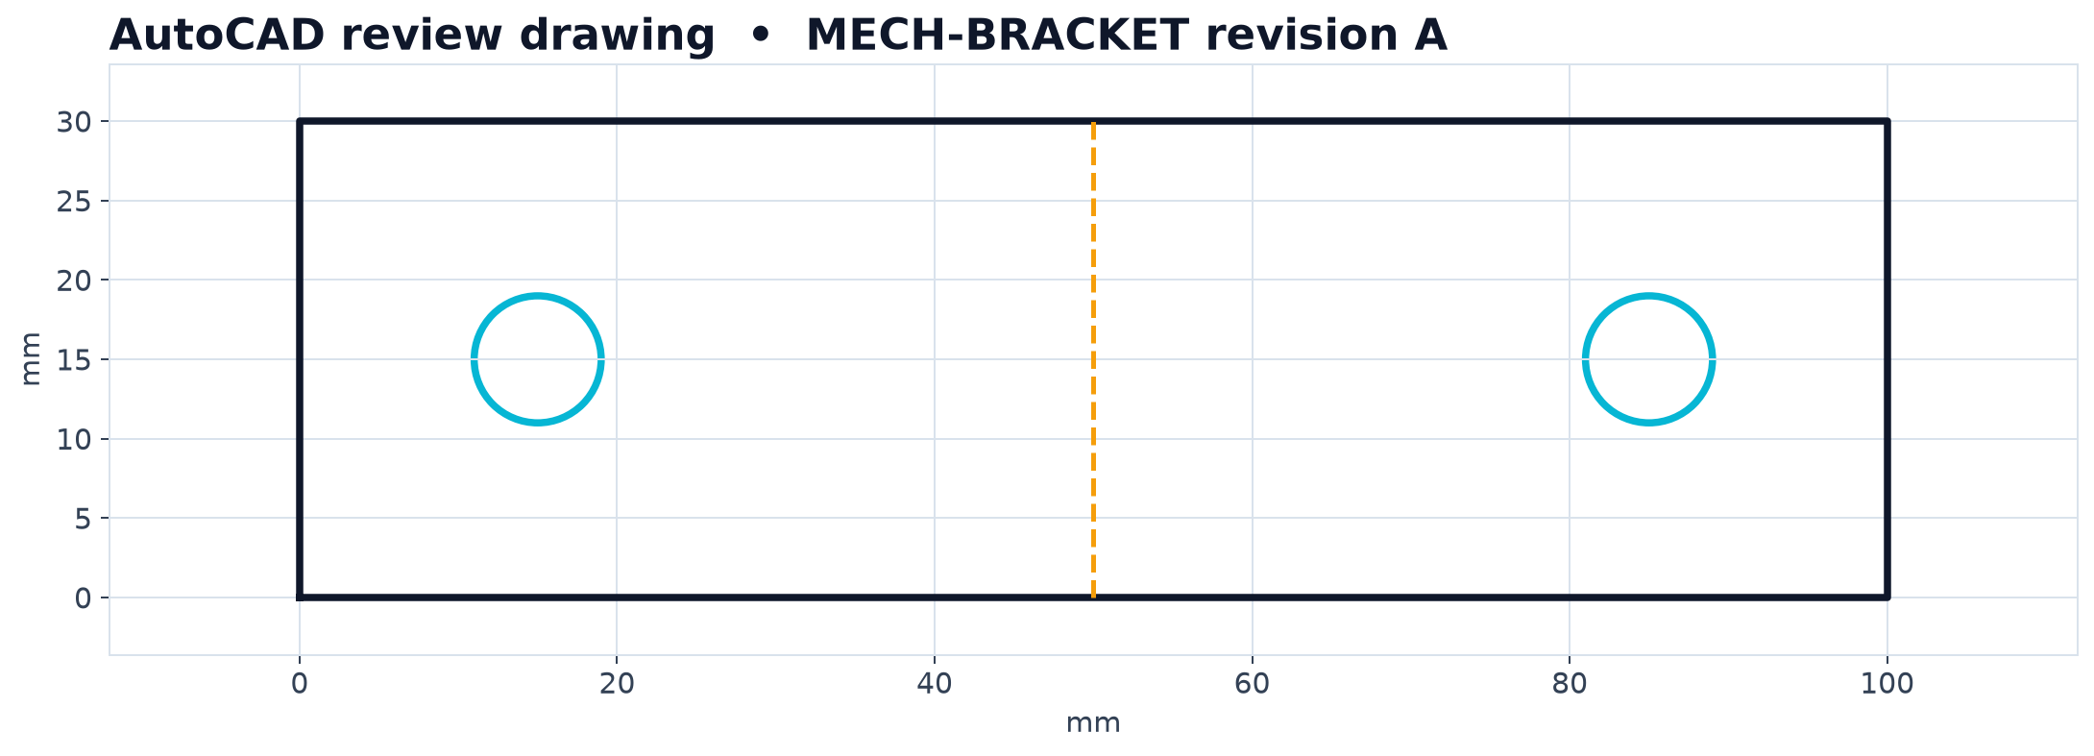
STATUS • 8 SEPTEMBER 2026
Mechanical chain • screening and review
The fixed boundary remained zero and the drawing retained the CAD envelope and holes
63.27 µm
maximum displacement
0 micrometres
fixed edge maximum
Screening model • mounting holes excluded
WRIGHT • ENGINEERING MCP QUALIFICATION
06
Notes:
Source: Wright committed curation report and process-chains-linux.json evidence dated 2026-09-08. Output images are renders of artifacts regenerated from the same committed chain runner; the deterministic STL and VTU outputs match the authoritative evidence hashes.
Structural VTU SHA-256: 40cd83773e12d817cf234943e171c19a19d5b8145fd7bb19bc535d2efb2906b0.

Slide 7
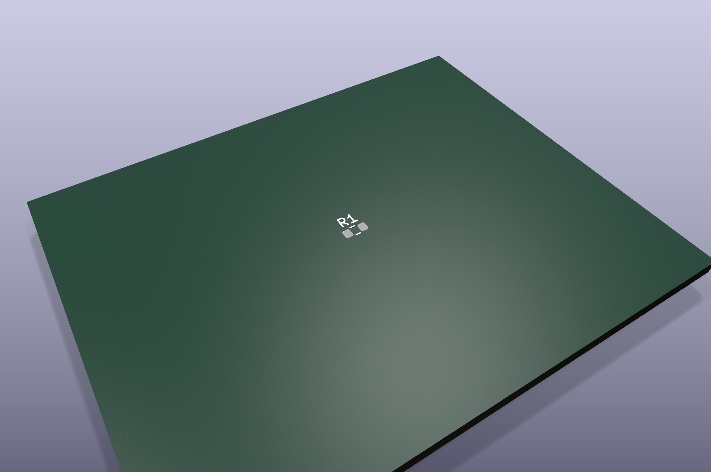
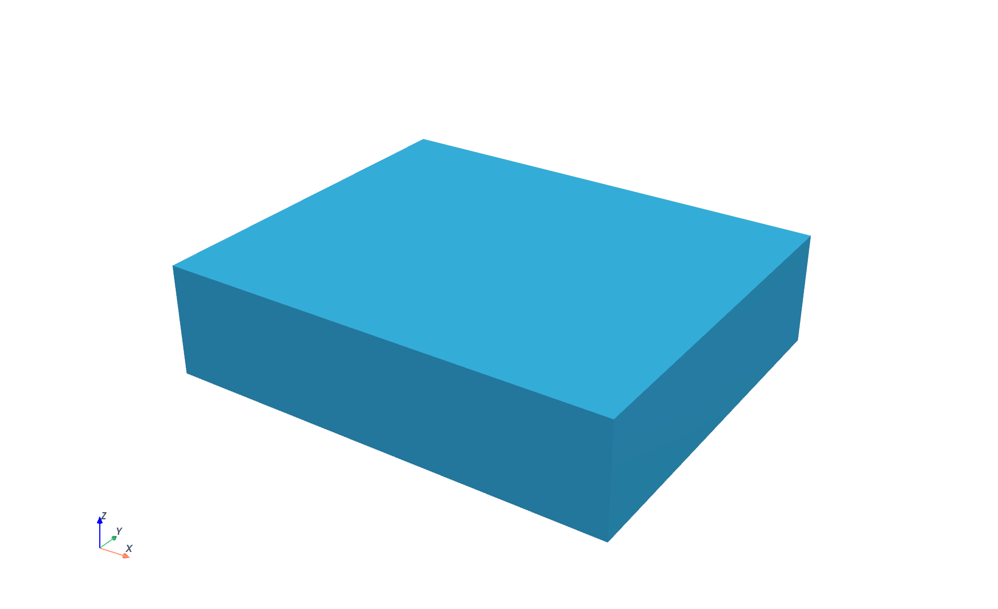
STATUS • 8 SEPTEMBER 2026
Electronics chain • PCB and enclosure
KiCad produced the board and manufacturing package before the BREP enclosure handoff
50 × 40 mm
PCB with R1 at center
60 × 50 × 15 mm
enclosure envelope
24 Gerbers + 1 drill file
WRIGHT • ENGINEERING MCP QUALIFICATION
07
Notes:
Source: Wright committed curation report and process-chains-linux.json evidence dated 2026-09-08. Output images are renders of artifacts regenerated from the same committed chain runner; the deterministic STL and VTU outputs match the authoritative evidence hashes.

Slide 8
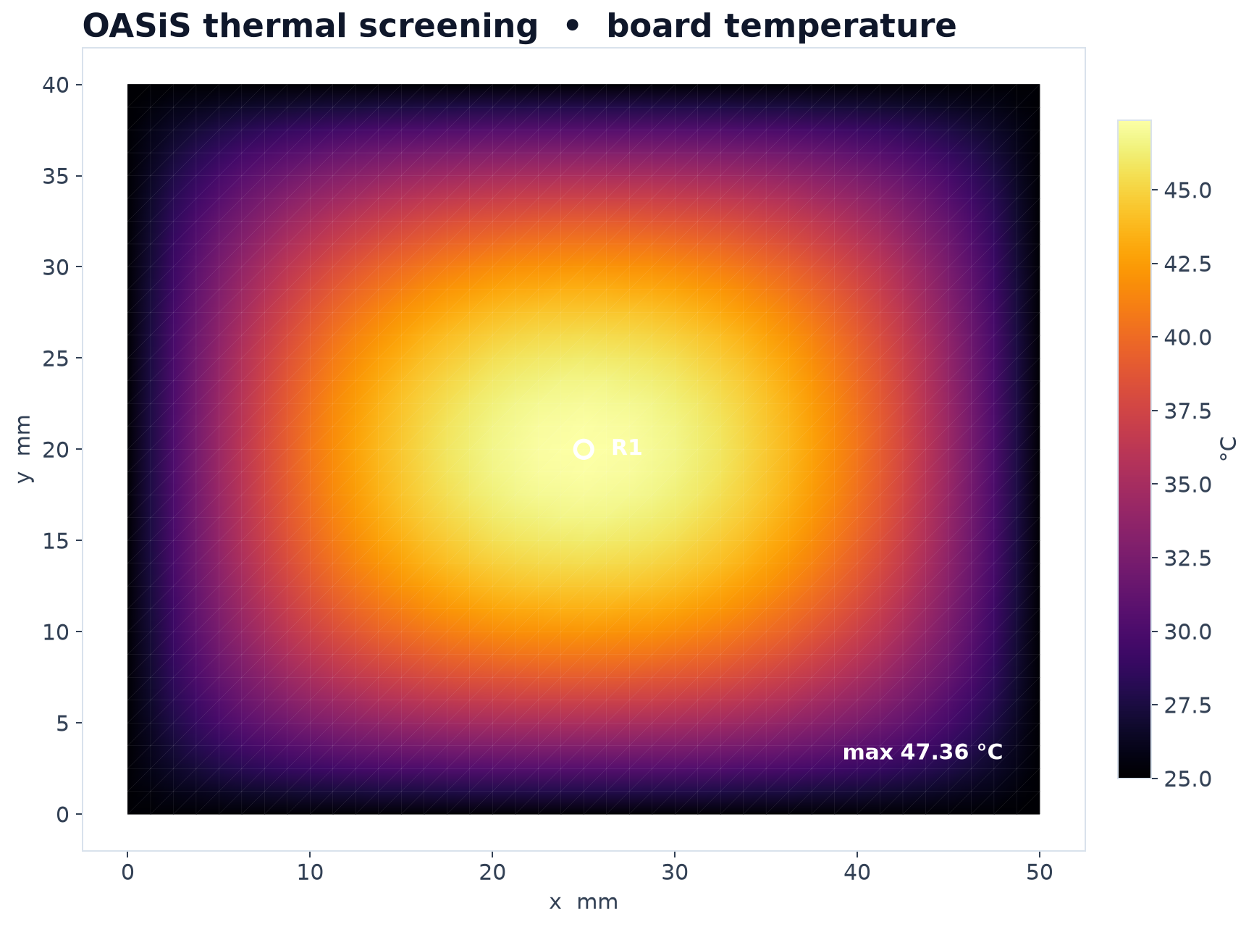
STATUS • 8 SEPTEMBER 2026
Electronics chain • thermal result and ROS trace
The deterministic test record bound the board, enclosure and simulation hashes
47.36 °C
maximum board temperature
85.00 °C
validation limit • passed
ROS validation trace
design • revision • 3 artifact hashes
Board-level screening case
WRIGHT • ENGINEERING MCP QUALIFICATION
08
Notes:
Source: Wright committed curation report and process-chains-linux.json evidence dated 2026-09-08. Output images are renders of artifacts regenerated from the same committed chain runner; the deterministic STL and VTU outputs match the authoritative evidence hashes.
Thermal VTU SHA-256: 25be03922ed6701023b948142bb3e2150a1daafe139ba3036876d42e16446208.

Slide 9
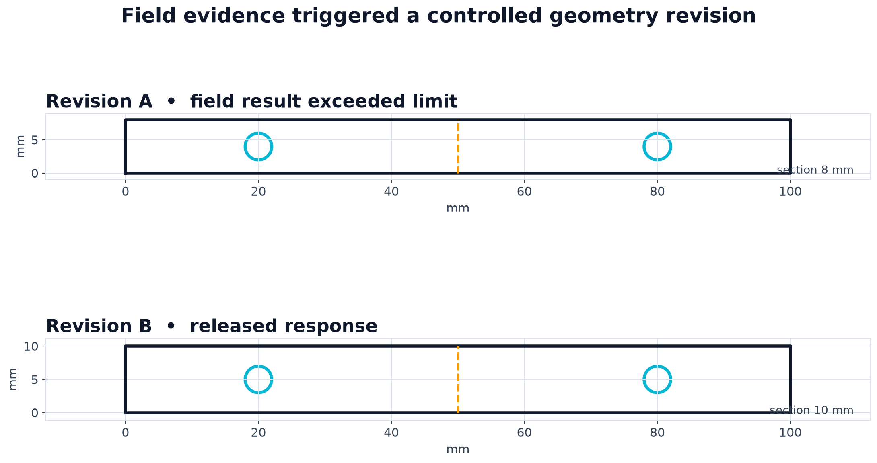
STATUS • 8 SEPTEMBER 2026
Field feedback chain • evidence controlled revision
A measured limit violation caused a traceable geometry change from revision A to B
1.8 mm
measured deflection
1.0 mm
allowable limit
8 → 10 mm
section thickness
Revision A retained • B released
WRIGHT • ENGINEERING MCP QUALIFICATION
09
Notes:
Source: Wright committed curation report and process-chains-linux.json evidence dated 2026-09-08. Output images are renders of artifacts regenerated from the same committed chain runner; the deterministic STL and VTU outputs match the authoritative evidence hashes.

Slide 10
STATUS • 8 SEPTEMBER 2026
Next qualification cycle
Protect the supported baseline and require new servers to improve a real design chain
1
Requalify the ten
Repeat launch, schema and artifact checks on a fixed cadence
Current operating boundary
2
Maintain the three chains
Linux container scopes are qualified
FEA results are screening evidence
KiCad DRC is outside the current case
Repeat user adoption is not yet measured
Physical MHS operation remains unqualified
Run them as regression scenarios with stable inputs and thresholds
3
Add one candidate at a time
Require a clean-container pass and a role in a realistic workflow
4
Increase scenario realism
Add KiCad DRC, richer CAD assemblies and physical comparison data
Supported baseline • 10 servers • 3 chains
WRIGHT • ENGINEERING MCP QUALIFICATION
10
Notes:
Source: Wright committed curation report and process-chains-linux.json evidence dated 2026-09-08. Output images are renders of artifacts regenerated from the same committed chain runner; the deterministic STL and VTU outputs match the authoritative evidence hashes.

