Slide 1
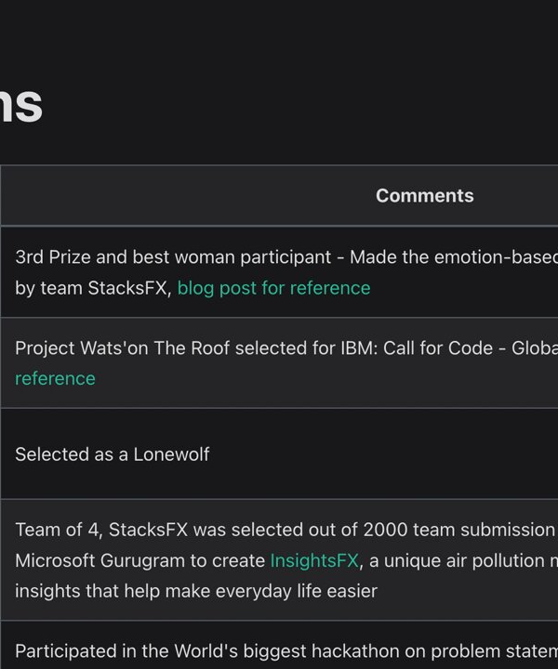
Enhancing the Moya AI Framework at Hackii
An introductory slide showcasing our team's contributions to the Moya AI framework at the HackiiIT hackathon

Slide 2



Our Problem Statement
Extend Moya's functionalities
Reduce development overhead
Improve usability and accessibility
Implement new agent capabilities and integrations to enhance the out-of-the-box value of the Moya AI framewor
Avoid the need for others to build features that are now available in the Moya framework
Make the Moya framework more user-friendly and accessible to a wider range of developers
By developing new modules and capabilities for the Moya AI framework, we aim to drive forward its value and usability, making it a more attractive and powerful tool for building multi-agent systems

Slide 3
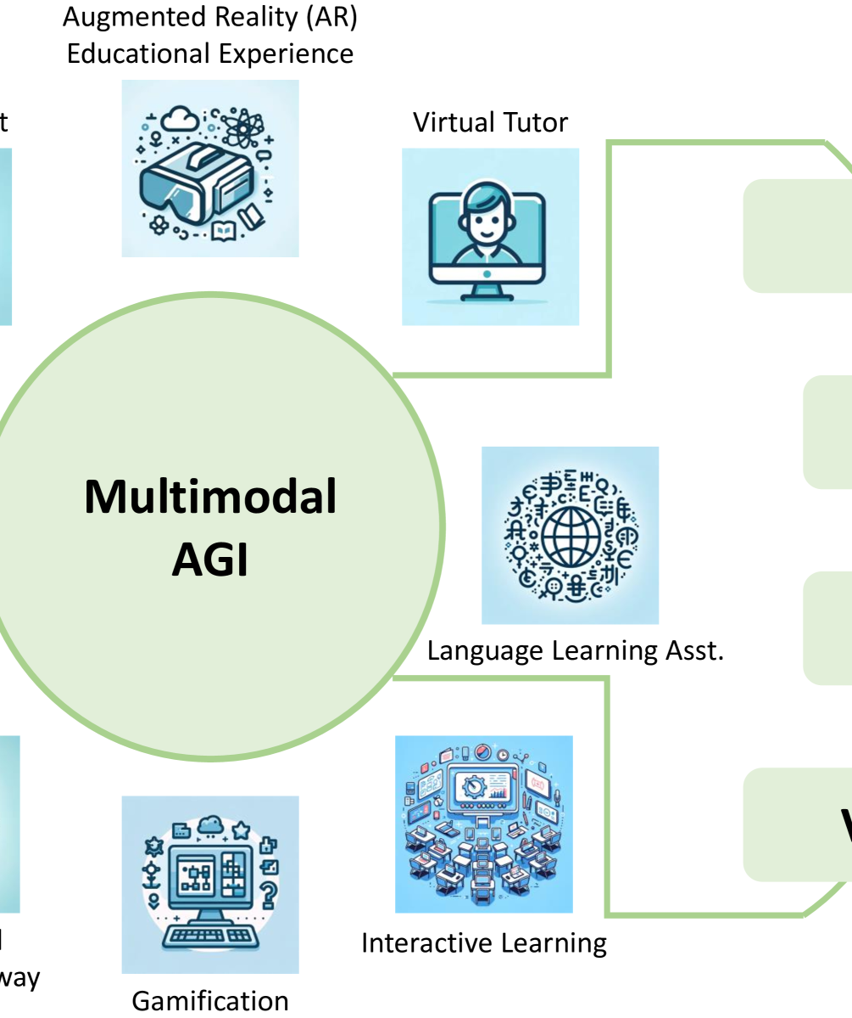
Moya AI Framework
Moya is a powerful framework for building multi-agent systems that integrate multiple AI agents. It allows these agents to collaborate or operate independently, enabling them to solve complex problems more efficiently. The Moya framework provides a unified platform for coordinating and orchestrating the interactions between various AI agents, ensuring seamless communication and information sha

Slide 4



Moya Agent Capabilities
ClaudeAgent
HuggingFaceAgent
Utilizes Anthropic's Claude API for conversational capabilities, supports synchronous and streaming response generation, integrates with Moya tool registry with RAG and webcrawl.
Leverages Hugging Face's NLP models and Inference API, supports synchronous and streaming response generation, integrates with Moya tool registry, implements quantization for efficient local inferen
OpenAI Azure
Search Tool and RAG
Utilizes OpenAi's API for text generation capabilities, supports synchronous and streaming response generation, integrates with Moya tool registry. Also has RAG and webcrawl.
Provides web search capabilities for agents, supports both paid (SerpAPI) and free (DuckDuckGo) search options, returns formatted search results in JSON format. In addition to the implemented RAG, this forms a powerful tool.
The Moya framework includes a diverse set of agent implementations, each with unique capabilities and features, enabling the development of powerful and versatile multi-agent systems.

Slide 5
New Module Development
OpenAI Agent with RAG and webcrawl
Enable with RAG and webcrawl, this agent synchronously accesses documents, augmenting its knowledge by navigating the web and editing retrieved information.
ClaudeAgent with RAG and webcrawl
Enabled with RAG and webcrawl, this agent synchronously accesses documents, augmenting its knowledge by navigating the web and editing retrieved information.
DeepSeekAgent
An implementation of an intelligent conversational agent using DeepSeek's API, with features like support for synchronous and streaming response generation, and integration with the Moya tool registry
HuggingFaceAgent
An intelligent conversational agent leveraging Hugging Face's models and Inference API, with features like support for synchronous and streaming response generation, and integration with the Moya tool registry
Text Autocomplete Tool
A lightweight text completion assistant designed to predict the next few words of a given sentence, leveraging the OllamaAgent powered by locally hosted language models
Search Tool
A web search tool that supports both paid (SerpAPI) and free (DuckDuckGo) search options, and can be integrated with the Moya tool registry.
Vector Stores
A unified, tech-agnostic vector store class to run both ChromaDB and FAISS index, used by the RAG Search Tool.
Agent Consultation Tool
Enables agents to communicate with and consult other agents, allowing for the creation of specialized agent ecosystems where agents can leverage each other's capabilities to solve complex problems
Math Tool
Enables the agent to solve math problems by leveraging SymPy.

Slide 6



HuggingFaceAgent
Leverages Hugging Face's Powerful NLP Models
Supports Synchronous and Streaming Responses
Integrates with Moya Framework
Efficient Local Inference with Quantization
Utilizes state-of-the-art Hugging Face models for various natural language processing tasks
Provides both synchronous and real-time streaming response generation capabilities
Seamlessly integrates with the Moya tool registry for extended functionalities
Implements quantization options for fast and efficient inference on local devices
The HuggingFaceAgent is a powerful integration of Hugging Face's versatile NLP models within the Moya ecosystem, enabling flexible conversational flows, real-time streaming, and efficient local inference.

Slide 7
Text Autocomplete Tool for Moya
Overview of Text Autocomplete Tool
A lightweight text completion assistant designed to predict the next few words of a given sentence, integrated with the Moya framework and powered by the OllamaAgent and local language model
Key Features
Predicts 5-6 words to extend a sentence, ensures completion aligns with user's writing style, focuses on sentence continuation, and provides grammatically correct and contextually meaningful output
Configuration Details
Uses the 'mistral:latest' model, temperature set to 0.3, base URL configured as 'http://localhost:11434', and a context window limited to 1024 tokens
Workflow: Initializing, Cleaning, Completing, and Caching
Initializes the OllamaAgent, cleans the input text, queries the agent for completion, and caches the results to minimize redundant API calls
Error Handling and Best Practices
Gracefully handles errors, ensures the OllamaAgent server is running, and recommends using concise yet informative input text for improved performance

Slide 8
RAG Search Tool: Efficient Knowledge Retrieval for Question-Answering
Embedding Function
Use Langchain's OllamaEmbeddings to create an embedding function that converts documents and queries into embeddings
Vector Store
Create a FAISS or ChromaDB vector store to store the document embeddings for efficient similarity search.
Load Documents
Use the vector store's `load_file()` method to load documents into the vector store.
Vector Search Tool
Add the VectorSearchTool to the agent's tool registry to enable searching the vector store for similar documents
Search and Retrieve
Use the VectorSearchTool's `search_vectorstore()` method to find the k most similar documents to a given query

Slide 9



BidOrchestrator Documentation
The core concepts of the BidOrchestrator include a bidding system where agents bid on user requests with confidence scores, dynamic team formation to create teams when multiple agents would be beneficial, and performance learning to improve over time by tracking agent performa
When a user message arrives, the orchestrator requests confidence scores from all available agents, running in parallel for faster response. For agents without a `bid_on_task` method, it estimates confidence based on keyword overlap between the message and agent description, as well as the agent's historical perform
The orchestrator makes a key decision on whether to use a single agent or form a team. It uses a single agent when one agent has significantly higher confidence (>0.7 and 0.2+ higher than others) or only one agent is available. It forms a team when multiple agents have similar high confidence scores or no single agent is highly confident (below the team thresh
The BidOrchestrator represents a dynamic approach to agent orchestration, using a marketplace model where agents compete and collaborate to handle user requests
Introduction to the BidOrchestrator
Core Concepts
Workflow: Bid Collection
Workflow: Agent Selection
Workflow: Processing
Workflow: Performance Learning
Configuration Parameters
Bidding Algorithm
For single agent processing, the orchestrator simply passes the request to the chosen agent, supports streaming responses, and tracks performance metrics. For team-based processing, it collects responses from all team members in parallel, synthesizes the responses into a coherent answer, and uses a dedicated synthesis agent if available, or combines the highest confidence response with insights from o
The orchestrator continuously updates performance metrics for agents, tracking average response time and maintaining success rates (which can be updated with user feedback). It uses this data to influence future agent selecti
Key parameters that control the BidOrchestrator's behavior include `min_confidence` (minimum confidence needed for an agent to handle a request), `team_threshold` (confidence threshold for team formation), `max_team_size` (maximum number of agents in a team), and `parallel_bidding` (whether to collect bids in paral
The confidence calculation combines a base confidence score (0.1), word overlap between the user query and agent description (up to 0.5), and a historical performance factor (up to 0.4). This creates a balanced approach where teams form only when genuinely beneficial, rather than for every requ

Slide 10




Dynamic Tool Registration in Moya
Runtime Tool Registration
Function-Based Tools
Auto-Documentation
Parameter Validation
Register new tools during program execution
Convert Python functions into agent-callable tools
Automatically generates tool descriptions from function docstring
Ensures tool parameters are properly formatted for LLM consumptio
Dynamic Tool Registration in Moya allows developers to extend agent capabilities by registering custom tools at runtime, without modifying the framework code. This powerful feature enables the addition of domain-specific functions as tools that agents can discover and utilize during conversations

Slide 11
SearchTool: Powerful Web Search for Agents
Web Search Capabilities
The SearchTool provides web search functionality for agents, supporting both paid (SerpAPI) and free (DuckDuckGo) search options
Formatted Search Results
The SearchTool returns search results in a formatted JSON format, making it easy to integrate with other tools and applications
Moya Tool Registry Integration
The SearchTool integrates with the Moya tool registry, allowing it to be easily used in conjunction with other tools and services
Flexible Search Methods
The SearchTool provides two search methods: `search_web()` for paid SerpAPI search, and `search_web_free()` for free DuckDuckGo search
Configuration and Registration
The `configure_search_tools()` method allows you to configure the search tools and register them with the tool registry

Slide 12



Medical agent
Inter-agent communication
Agent Consultation Too
Agent
Math Agent
Code agent
Expertise assessment for agents
Agent discovery and capabilities

Slide 13



Conclusion: Quirky Solutions and Significant Contributions to Moya AI
Quirky yet practical solutions
Significant contributions to Moya AI
Adaptable and versatile
Developed unique approaches to tackle real-world challenges faced by Moya AI
Our innovative ideas and implementations have had a measurable impact on the project's progres
Demonstrated the ability to create flexible solutions that cater to Moya AI's evolving need
In conclusion, we have successfully implemented quirky yet practical solutions and made significant contributions to the advancement of Moya AI, showcasing our adaptability and versatility in tackling complex challenges

