Slide 1

AIR QUALITY PREDICTION
Using Linear Regression
21MAT117
Mathematics for Intelligent Systems

Slide 2
MEET THE TEAM
S HARI SANKAR - AM.EN.U4AIE21056
K SUBHASH - AM.EN.U4AIE21036
SAI MANASA SOUMYA - AM.EN.U4AIE21057
CHERISHMA AKSHAYA - AM.EN.U4AIE21051
R RAKESH - AM.EN. U4AIE21052

Slide 3
TABLE OF CONTENTS
3
1
2
METHODOLOGY
INTRODUCTION
DATASET
6
4
5
RESULTS
CONCLUSION
REFERENCES

Slide 4
INTRODUCTION
01
Understanding Humidity, discussing the problem and the objective of the project

Slide 5
Air Quality security has gotten one of the foremost fundamental exercises for the administration in numerous mechanical and concrete zones in today’s world.
With this expanding pollution on the earth, we also had different executing models that can record data about centralizations of air pollutants (SO2, NO2, etc.). The affidavit of those unsafe gases is noticeable all around; is influencing the character of individuals' lives, particularly in urban territories.
Of late, numerous specialists began to study about this concern and mentioned several measures to manage these conditions with the assistance of the presidency and native people.
Data Analytics is a leading approach as it includes natural detecting systems and sensor information accessible. During this paper, Machine Learning strategies are utilized to predict the ratio with relation to other components present in the earth’s atmosphere.
Mainly 14 factors which are present in an Air Quality Dataset and a few other atmospheric components encompass an adverse effect on the ratio. Human skin and mucous layers of the eyes supports different ratio in the numerous atmospheric conditions. Thus, it's very necessary to grasp how various factors will make an effect on the relative humidity.

Slide 6



UNDERSTANDING THE PROBLEM
OBJECTIVE
HUMIDITY
Humans are very sensitive to humidity, as the skin relies on the air to get rid of moisture. The process of sweating is your body's attempt to keep cool and maintain its current temperature.
If the air is at 100-percent relative humidity, sweat will not evaporate into the air. As a result, we feel much hotter than the actual temperature when the relative humidity is high. If the relative humidity is low, we can feel much cooler than the actual temperature because our sweat evaporates easily, cooling us off.
To predict the relative humidity at a given point of time using all the attributes affecting relative humidity.
feels like 21 °C
24 °C
0 %
feels like 27 °C
24 °C
100 %

Slide 7
DATASET
02
Description and Analysis of the data obtained from the UCI Repository

Slide 8
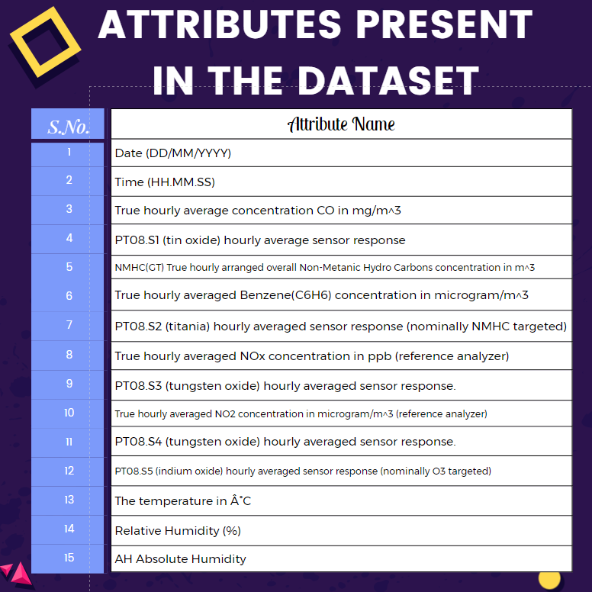
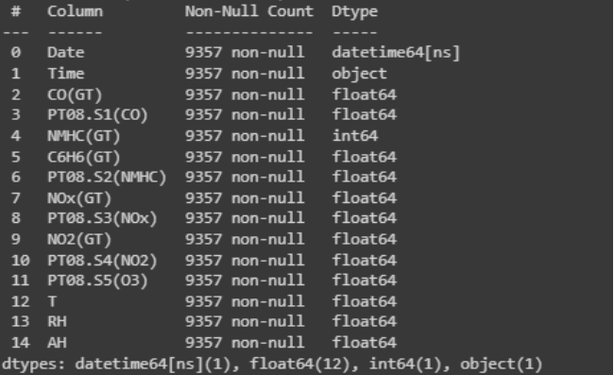
DATA DESCRIPTION
The air quality dataset for this project is collected from the UCI repository.
The dataset contains data of average hourly responses of different elements in the air for nearly one year from March 2018 to April 2019.
Dataset consists of 9357 rows and 15 columns.
The count and data type of every attribute is given below :

Slide 9

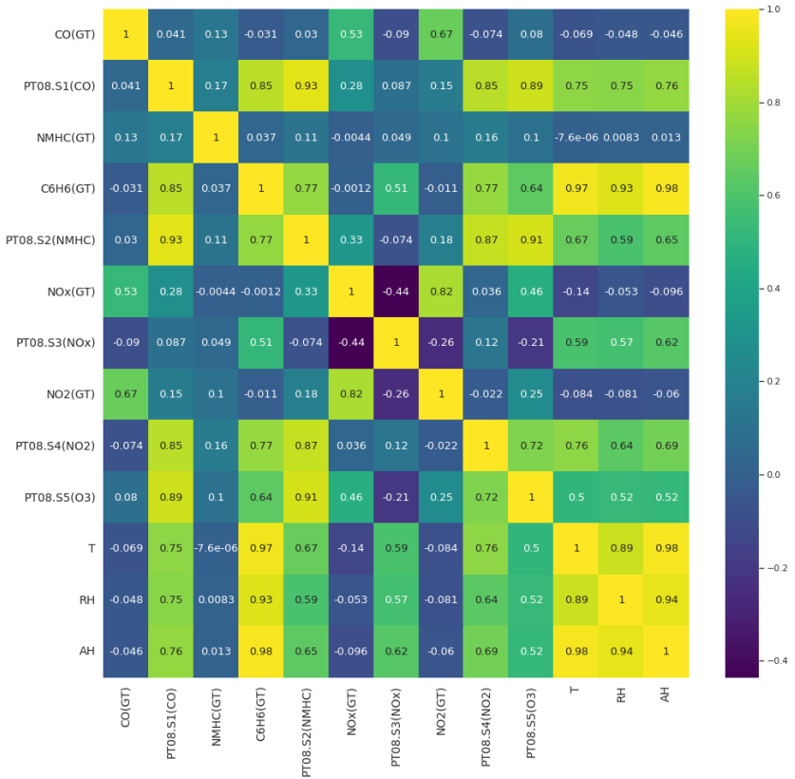
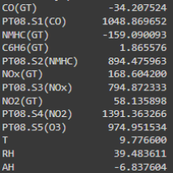
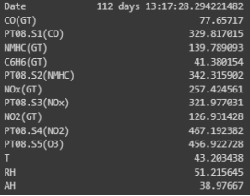
Dataset Analysis
The mean [fig (a)] and standard deviation [fig(b)] of all the attributes presents in the data set in given below :
(a)
(b)
A correlation matrix is simply a table which displays the correlation coefficients for different variables. The matrix depicts the correlation between all the possible pairs of values in a table. It is a powerful tool to summarize a large dataset and to identify and visualize patterns in the given data.

Slide 10
METHODOLOGY
03
Data preprocessing and discussing the flow of the prediction process.

Slide 11
The below flowchart represents the steps involved in the prediction process-
SELECTION OF FEATURE VARIABLES
DATA PREPROCESSING
SPLITTING OF DATA INTO TEST & TRAIN
REGRESSION ANALYSIS USING VARIOUS MODELS

Slide 12
Data Preprocessing and Feature Selection
It is a technique used in data mining that involves transforming raw data into an understandable format.
The data is cleansed through processes such as filling in missing values, smoothing the noisy data, or resolving the inconsistencies in the data.
As it contains some missing value, the dataset is cleaned, and decimal values are converted into proper float values.
As a part of feature selection, we have dropped the attribute time and date from our data set using python. This attribute will not be used in any of the prediction models which we are developing.
Splitting of data into test and train
After the data is processed, it is split into two categories training and testing. This is done to train the model which is being used and to measure parameters like RMSE, Accuracy etc.
Typically, while separating a data set into a training dataset and testing dataset, most of the data is used for the training process, and a smaller portion of the data is used for testing. After a model has been made by using this training set, we test the model by making predictions against the test set.
In the prediction models developed, the data set has been split in such a way that the test size consists of 33% of the whole dataset. The rest of the data set is being used up for training the models that are being developed. The random state for splitting the data set is 42.

Slide 13
Models used for the Prediction
THE FEATURES USED FOR PREDICTION IS : CO(GT), C6H6(GT), PT08.S2(NMHC), NOx (GT), PT08.S3(NOx), NO2(GT), PT08.S4(NO2), PT08.S5(O3), T, AH.
THE TOTAL NUMBER OF MODELS USED FOR THE PREDICTION IS : 29
In the initial 10 models, we have taken each attribute individually for predicting the dependent variable i.e., relative humidity. The accuracy MSE and RMSE for each individual independent variable are recorded. The accuracy among different attributes is compared and the best model is selected.
In the next 9 models, we have taken set of 2 attributes at a time from the independent variables and fitted the model. The best model out of all the model is selected.
In the next 8 models, we have taken set of 3 attributes at a time from the independent variables and fitted the model. The best model out of each is taken by comparing the accuracy.
A model in which we are using every independent variables of the data sheet is also being used. The accuracy RMSE and MSE of the model is also recorded.
A model based on polynomial regression of degree 2 is also used for prediction of relative humidity. The RMSE, MSE and accuracy of the model is recorded.

Slide 14
RESULTS
04
Results and analysis of the various models in the prediction process

Slide 15
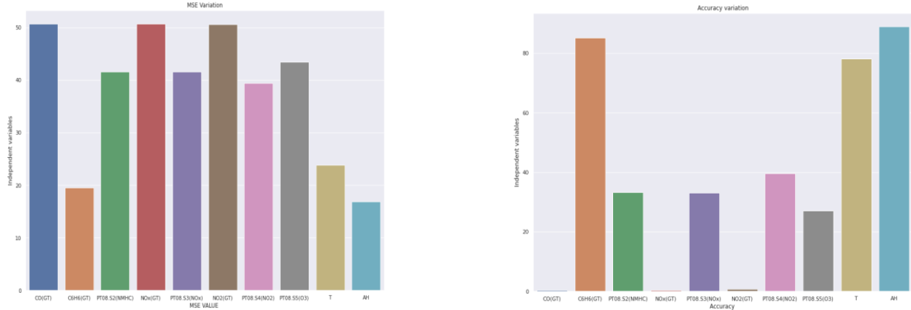
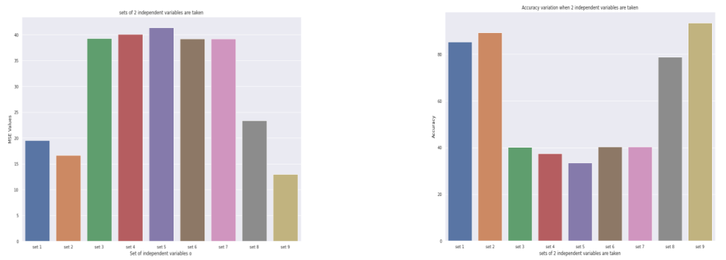
A bar graph showing the Accuracy and MSE for various independent variables among the first 10 models are shown below :
A bar graph showing the variation of accuracy and MSE while taking set of 2 independent variables are shown below

Slide 16
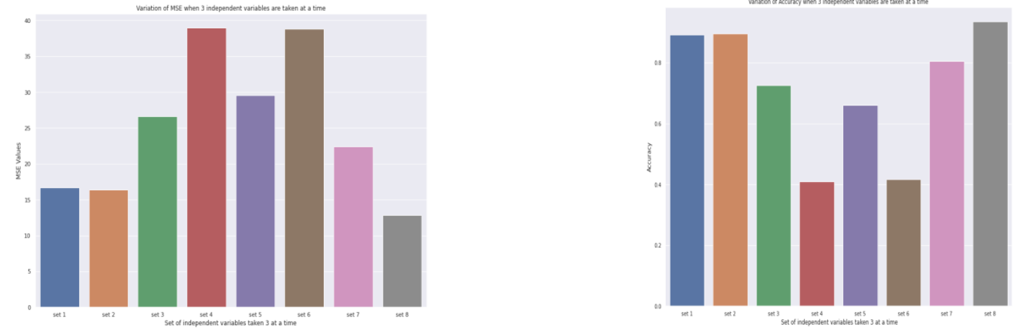
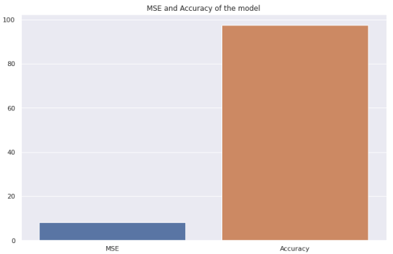
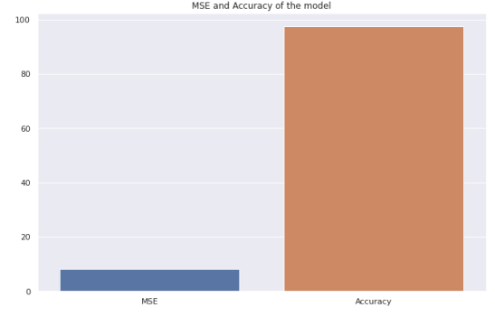
A bar graph showing the variation of accuracy and RMSE while taking set of 3 independent variables are shown below –
A bar graph showing the accuracy and MSE of the model in which every independent variable is used is shown below :
A bar graph showing the accuracy and MSE of polynomial regression model with degree 2 is also shown :

Slide 17
CONCLUSION & DISCUSSIONS
05
Analysis of the Accuracy and RMSE values of the results obtained.

Slide 18
From the initial 10 models where we have used each independent variable individually, we can conclude that the best model when each individual feature is taken into consideration is that when the independent feature is Absolute humidity.
The accuracy of the above model comes out to be 88.98% and the RMSE value comes out to be 16.85.
From the models where set of two independent variables are used, the most accurate model comes out to be the one where the independent variables are Temperature and Absolute humidity.
The accuracy of the above model comes out to be 93.48% and the RMSE value comes out to be 12.96
From the models where set of three independent variables are used, the most accurate model comes out to be the one where the independent variables are PT08.S5, Temperature and Absolute humidity.
The accuracy of the above model comes out to be 93.62% and the RMSE value comes out to be 12.82
Out of all the models discussed above the one with the high accuracy is the one where we have taken every independent variable together as it presents with an accuracy of 97.47%

Slide 19
REFERENCES
06
A Bibliography and the list of all sources used in this project.

Slide 20
REFERENCES
https://github.com/MananJethwani/air_quality_prediction-linear-regression-
http://www.ijstr.org/final-print/mar2020/Air-Quality-Prediction-Through-Regression-Model.pdf
https://github.com/ishanag9/air-quality-prediction
https://www.kaggle.com/code/sayakchakraborty/air-quality-prediction-of-relative-humidity/notebook
DATASET LINKS
https://archive.ics.uci.edu/ml/datasets/air+quality
PYTHON CODE
https://colab.research.google.com/drive/1FJrIIfJV5c0puhjr3nMg0XJxYfOqoY12?usp=sharing

Slide 21

NAMAH SHIVAYA

