Slide 1
NGS : DOWNSTREAM PROCESSING

Slide 2
The plan…
Downstream analysis
Gene sets
Transcriptome studies
Cistrome/Epigenome studies
Function enrichment
GSEA, DAVID, IPA
STRING, Cytoscape
Downstream processing
Genome coordinate sets
NGS alignment files (reads/tags)
ChIP-Seq peaks
BEDTools
Galaxy
UCSC Table browser

Slide 3
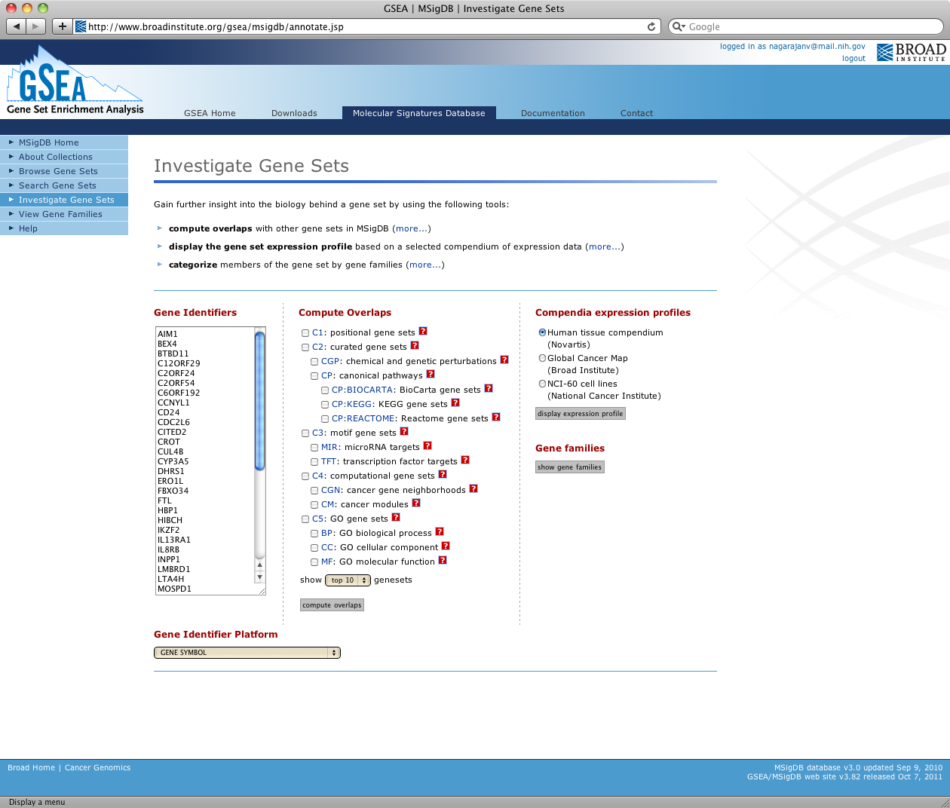

Slide 4
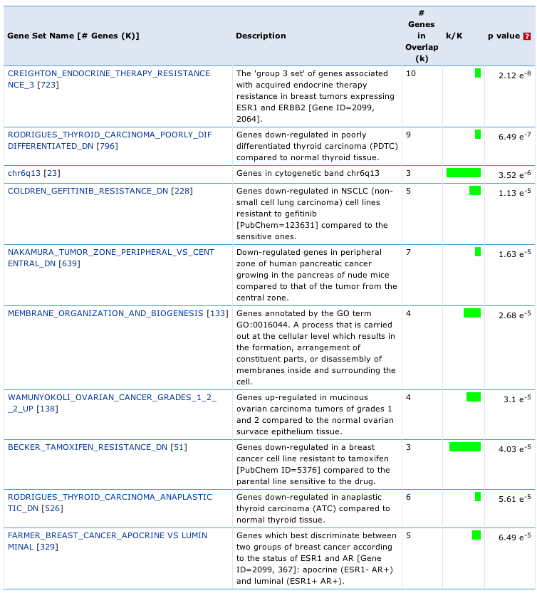
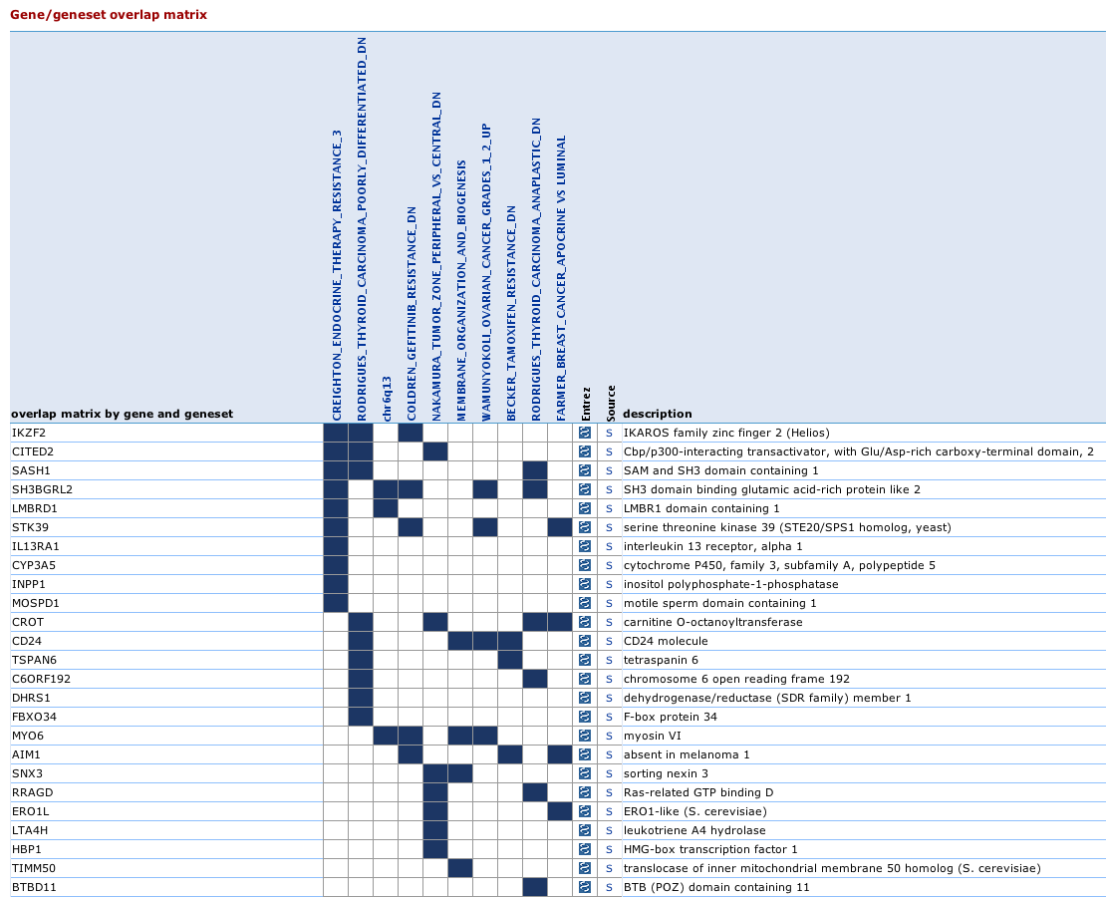
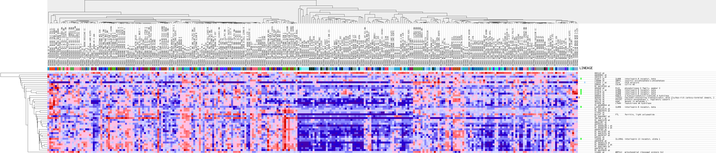
GSEA

Slide 5
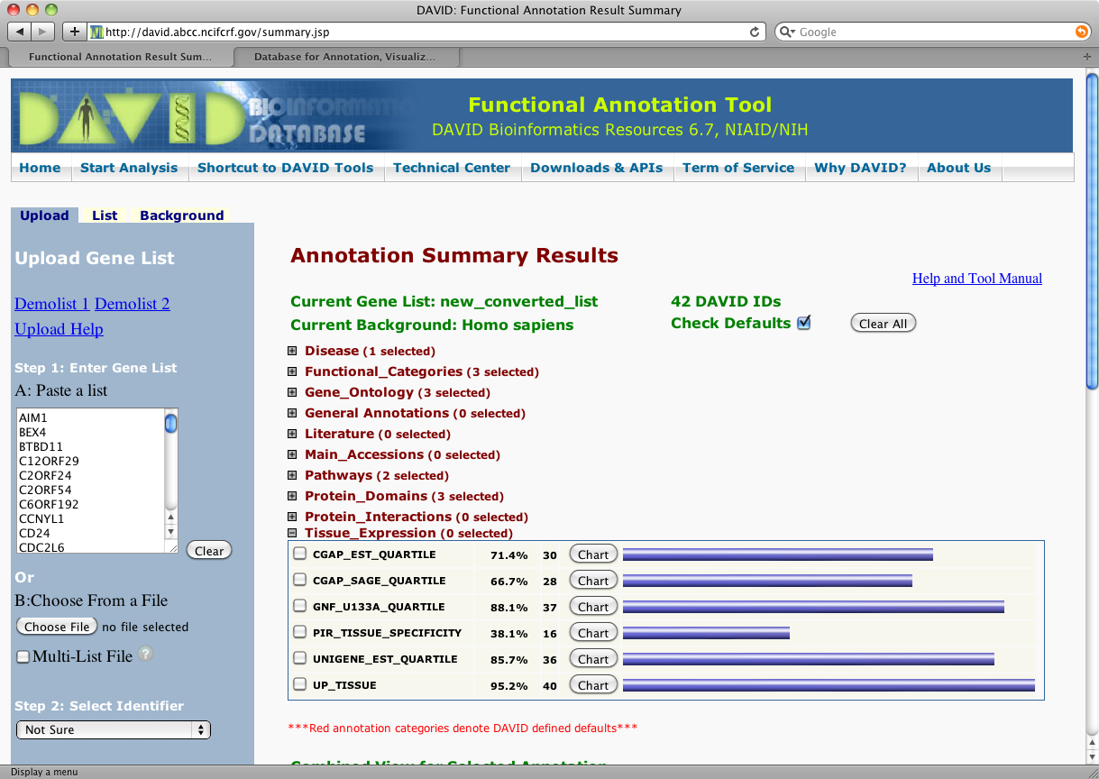
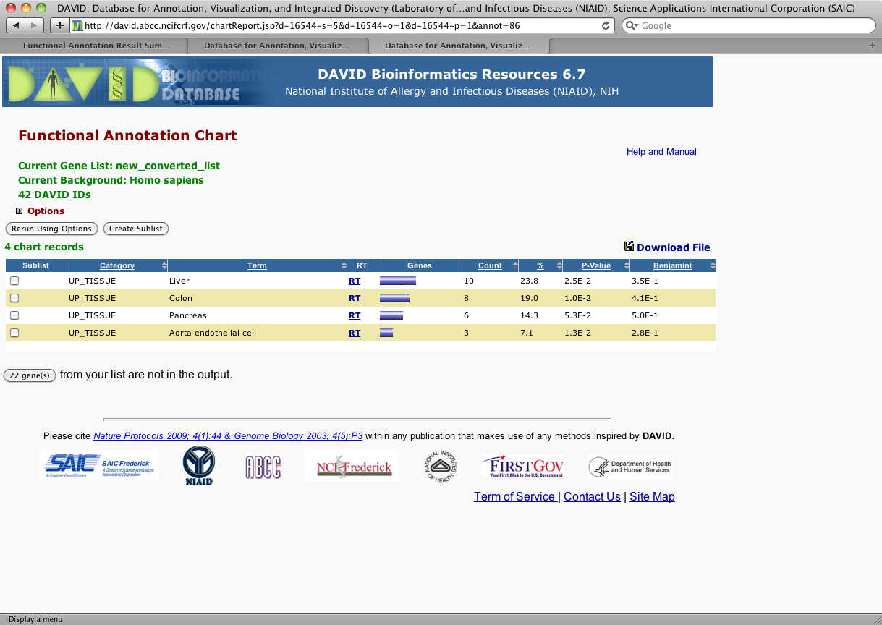
DAVID

Slide 6
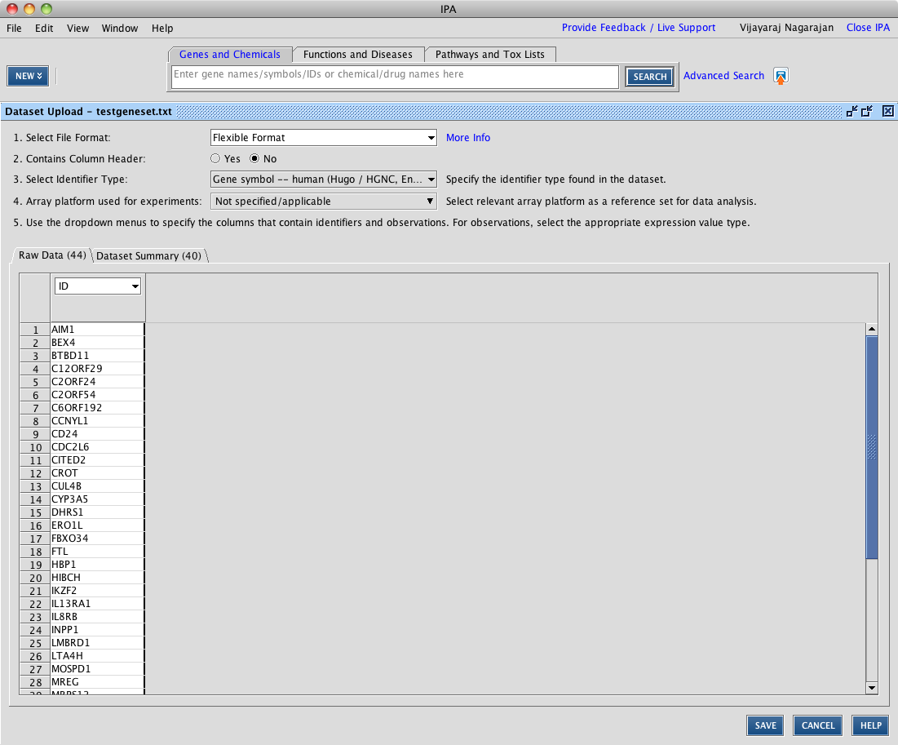
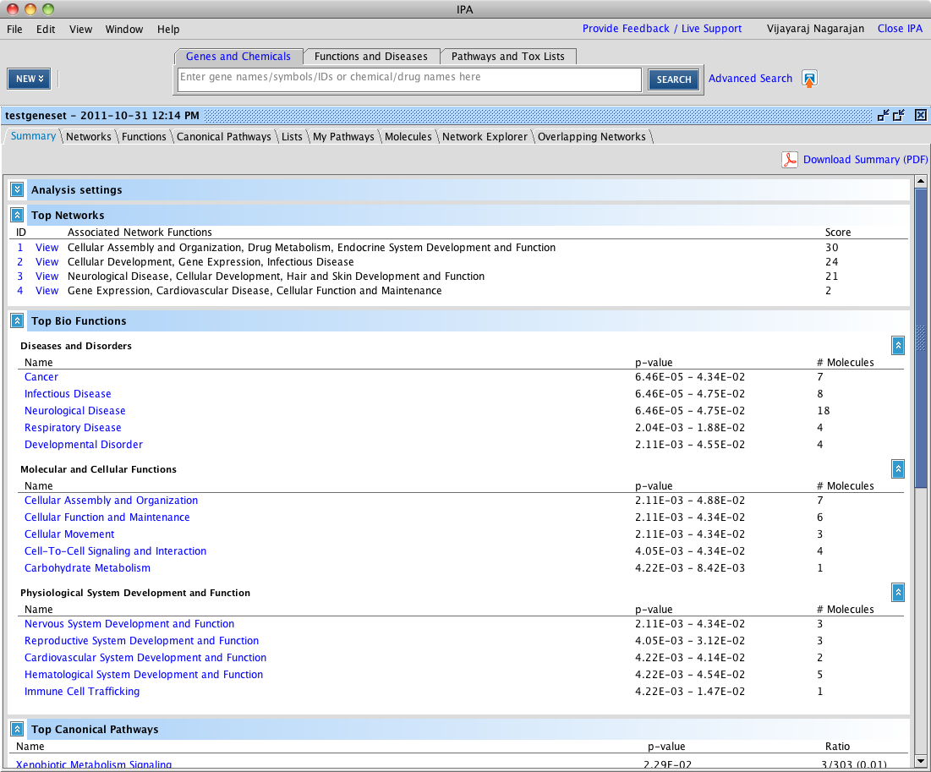
IPA

Slide 7
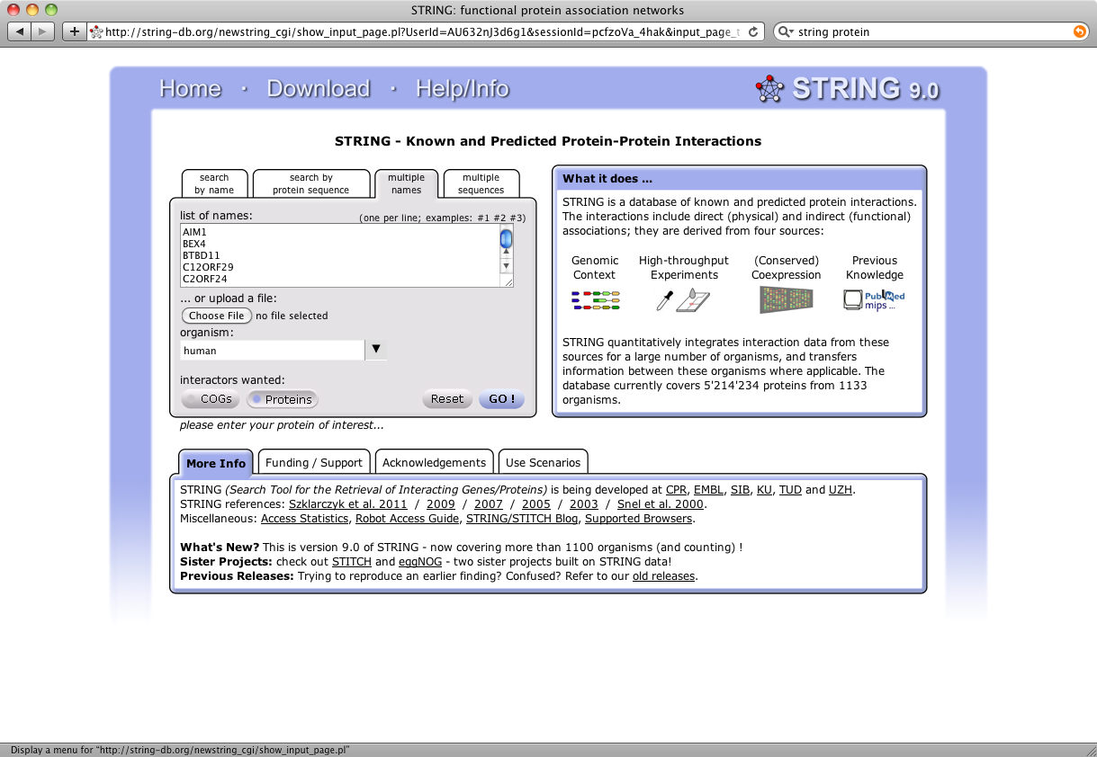
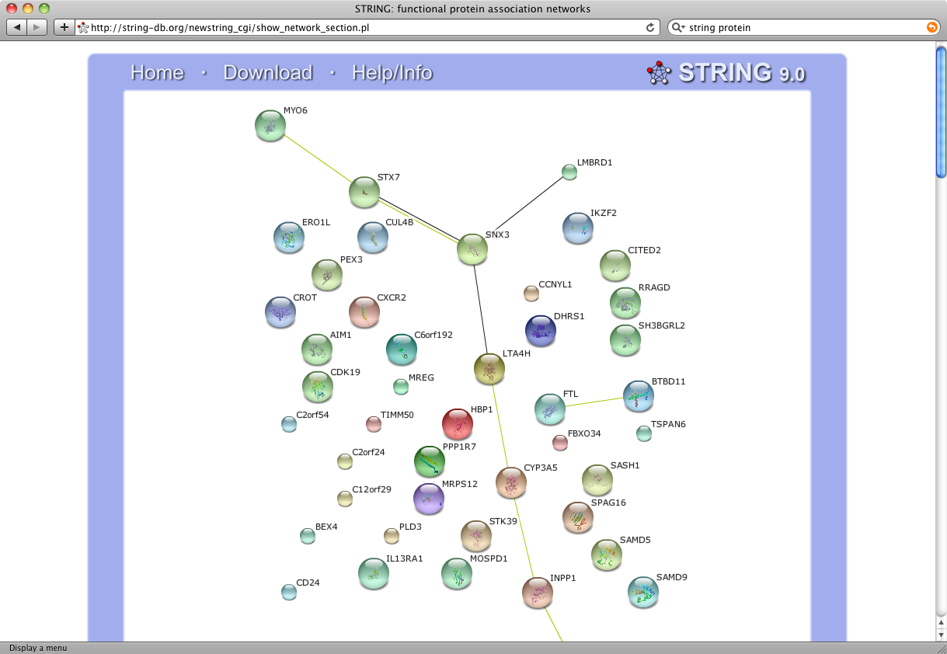
STRING

Slide 8
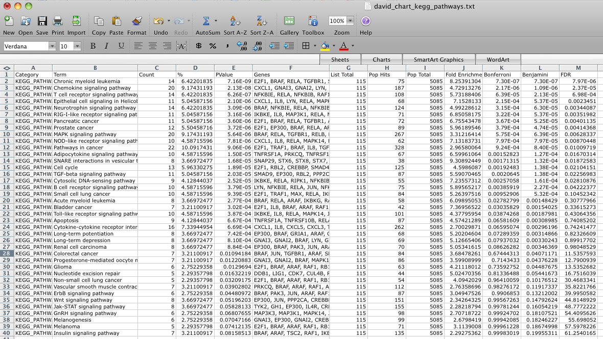
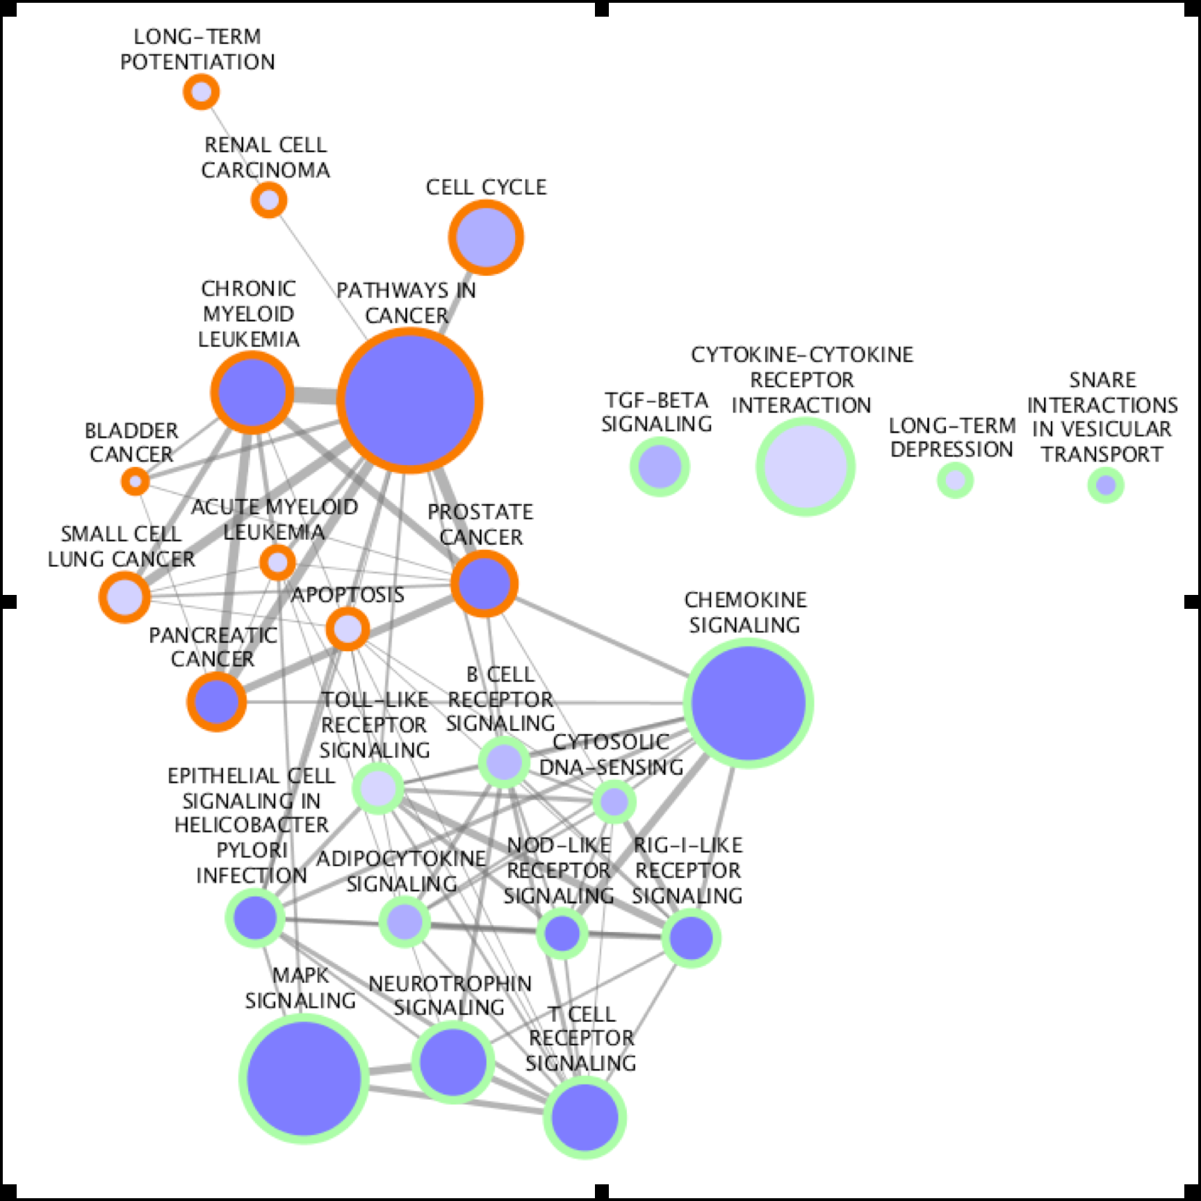
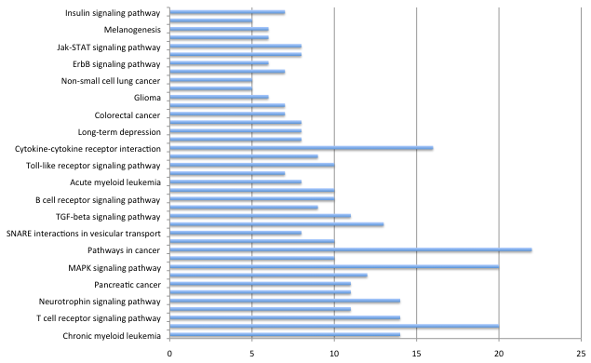
Cytoscape

Slide 9
BED-Tools
Command line
Open source
A variety of input formats (BED, BEDPE, SAM/BAM, GFF, VCF)
Things we could do…
Intersect, Union
Merge
Coverage
Subtract
Convert
Closest
Shuffle
Group, Sort

