Slide 1
Weighted Correlation Network Analysis and Systems Biologic Applications

Slide 2
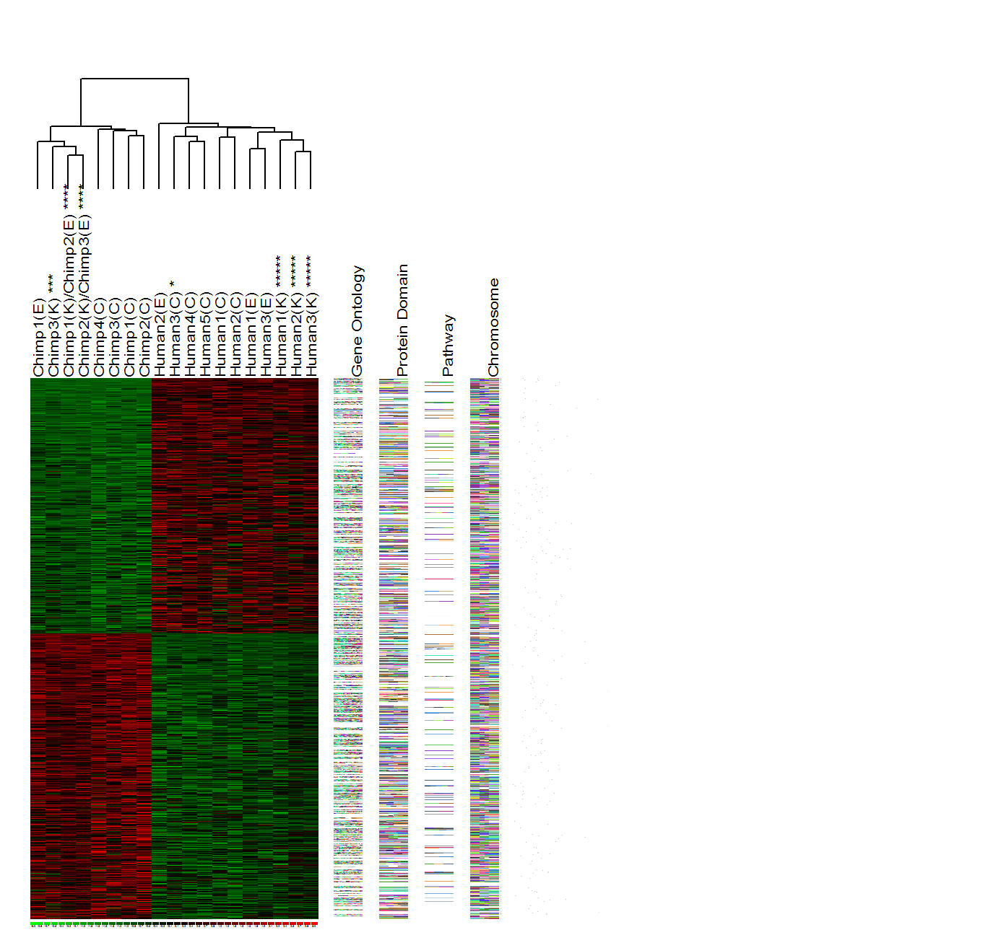
Standard differential expression analyses seek to identify individual genes
Control
Experimental
Each gene is treated as an individual entity
Often misses the forest for the trees: Fails to recognize that thousands of genes can be organized into relatively few modules

Slide 3
Philosophy of Weighted Gene Co-Expression Network Analysis
Understand the “system” instead of reporting a list of individual parts
Describe the functioning of the engine instead of enumerating individual nuts and bolts
Focus on modules as opposed to individual genes
this greatly alleviates multiple testing problem
Network terminology is intuitive to biologists

Slide 4
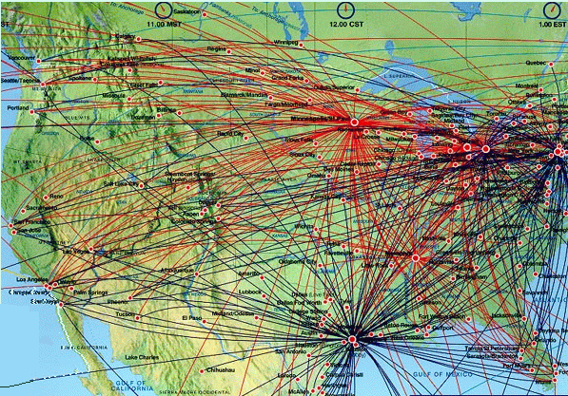
Flight connections and hub airports
The nodes with the largest number of links (connections) are most important!
**Slide courtesy of AL Barabasi

Slide 5
What is weighted gene co-expression network analysis?

Slide 6
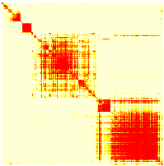
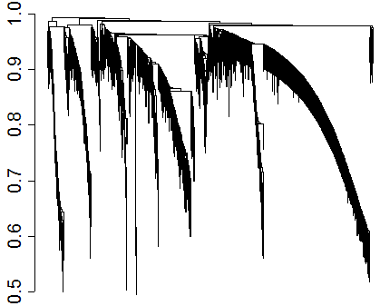
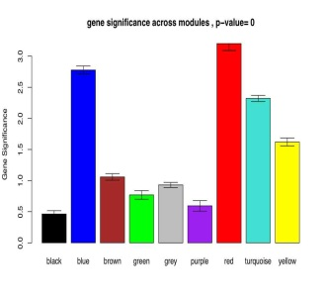
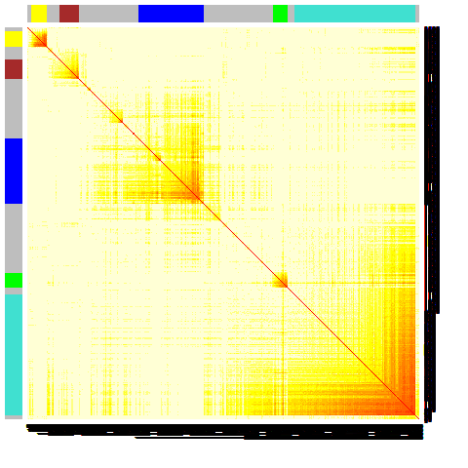
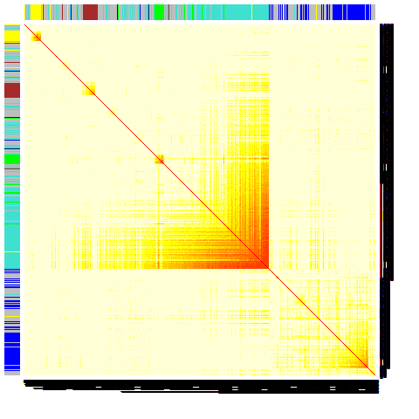
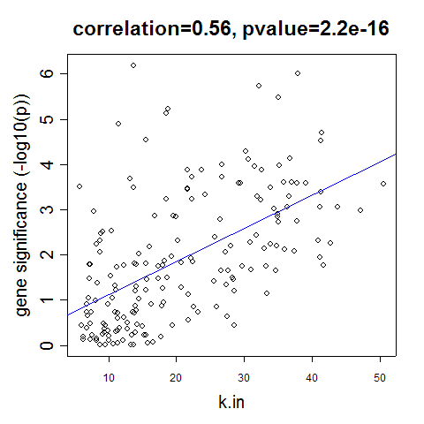
Construct a network
Rationale: make use of interaction patterns between genes
Identify modules
Rationale: module (pathway) based analysis
Relate modules to external information
Array Information: Clinical data, SNPs, proteomics
Gene Information: gene ontology, EASE, IPA
Rationale: find biologically interesting modules
Study Module Preservation across different data
Rationale:
Same data: to check robustness of module definition
Different data: to find interesting modules.
Find the key drivers in interesting modules
Tools: intramodular connectivity, causality testing
Rationale: experimental validation, therapeutics, biomarkers

Slide 7
Weighted correlation networks are valuable for a biologically meaningful…
reduction of high dimensional data
expression: microarray, RNA-seq
gene methylation data, fMRI data, etc.
integration of multiscale data
expression data from multiple tissues
SNPs (module QTL analysis)
Complex phenotypes

Slide 8
Review of weighted correlation network analysis

Slide 9
Content
Comparison of co-expression measures: mutual information, correlation, and model based indices
L. Song, P. Langfelder et al 2012 BMC Bioinformatics (2012), 13:328.
Comparing Statistical Methods for Constructing Large Scale Gene Networks (2012)
Allen JD, Xie Y, Chen M, Girard L, Xiao G PLoS ONE 7(1): e29348. doi:10.1371
Aging effects on DNA methylation modules in human brain and blood tissue.
Genome Biol. 2012 Oct 3;13(10):R97. PMID: 23034122
When Is Hub Gene Selection Better than Standard Meta-Analysis?
Langfelder et al (2013) PLoS ONE 8(4): e61505.

Slide 10
Content
Comparison of co-expression measures: mutual information, correlation, and model based indices
L. Song, P. Langfelder et al 2012 BMC Bioinformatics (2012), 13:328.

Slide 11
Network=Adjacency Matrix
A network can be represented by an adjacency matrix, A=[a_{ij}], that encodes whether/how a pair of nodes is connected.
A is a symmetric matrix with entries in [0,1]
For unweighted network, entries are 1 or 0 depending on whether or not 2 nodes are adjacent (connected)
For weighted networks, the adjacency matrix reports the connection strength between node pairs
Our convention: diagonal elements of A are all 1.

Slide 12
Two types of weighted correlation networks
Default values: β=6 for unsigned and β =12 for signed networks.
We prefer signed networks…
Zhang et al SAGMB Vol. 4: No. 1, Article 17.

Slide 13

Mutual information: an information theory concept
Measures the mutual dependency of two random variables.
For categorical variable DX, DY:
p(ldx_{r}), p(ldy_{c}) stands for the frequency of the r-th and c-th level of dx, dy.
Entropy(dx, dy) stands for the joint entropy of variable dx and dy.
For continuous variable, e.g. gene expression data, it is not straightforward to estimate MI.
Need to choose variable discretization method.
Need to choose entropy estimation method.
Estimate of MI depends on sample size: poor estimate for small sample size
Estimation is computational challenging.
> =0

Slide 14
Advantages of the correlation coefficient and mutual information when it comes to relating two numeric variables
Correlation Mutual Information
Requires few observations
Can detect general,
non-linear relationship
No hidden parameters
Easy p-value calculation
Sign of relations
Robust to outliers*
* Spearman correlation and biweight midcor are particularly robust.

Slide 15
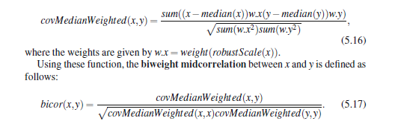
*Biweight midcorrelation (bicor)
A robust alternative to the Pearson correlation.
Definition based on
median instead of mean.
Assign weights to observations, values close to median receive large weights.
Reviewed in chapter 5 in book “Weighted Network Analysis”
Well known since the seventies: e.g. book: "Data Analysis and Regression: A Second Course in Statistics", Mosteller and Tukey, Addison-Wesley, 1977, pp. 203-209
Langfelder et al 2012: Fast R Functions For Robust Correlations And Hierarchical Clustering. J Stat Softw 2012, 46(i11):1–17.

Slide 16
Here we address the following questions
Is correlation or mutual information a better measurement for expression data?
Assess gene-gene relationship
Identify co-expression network modules
Are there any alternative methods measuring non-linear relationships?
Polynomial and spline regression models

Slide 17

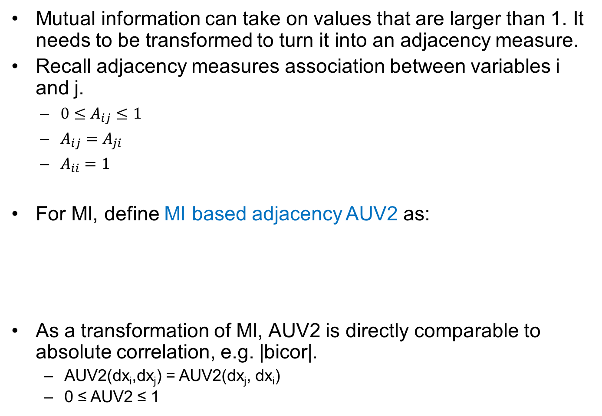
Define MI based adjacency
Mutual information can take on values that are larger than 1. It needs to be transformed to turn it into an adjacency measure.
Recall adjacency measures association between variables i and j.
$0≤A_{ij}≤1$
$A_{ij}=A_{ji}$
$A_{ii}=1$
For MI, define MI based adjacency AUV2 as:
As a transformation of MI, AUV2 is directly comparable to absolute correlation, e.g. |bicor|.
AUV2(dx_{i},dx_{j}) = AUV2(dx_{j}, dx_{i})
0 ≤ AUV2 ≤ 1

Slide 18
Detect gene pairwise relationships

Slide 19
Empirical expression data to compare cor with MI
8 data sets from human, mouse and yeast.
Data set | Number of observations
Brain cancer | 55
SAFHS (healthy whole blood) | 1084
Neurological disease | 346
Yeast | 44
Mouse adipose | 239
Mouse brain | 221
Mouse liver | 272
Mouse muscle | 252
Tissue-specific mouse data sets were generated by the lab of Dr. Jake Lusis at UCLA.
Ghazalpour A, Doss S, Zhang B, Plaisier C, Wang S, Schadt E, Thomas A, Drake T, Lusis A, Horvath S: Integrating Genetics and Network Analysis to Characterize Genes Related to MouseWeight. PloS Genetics 2006, 2(2):8.

Slide 20
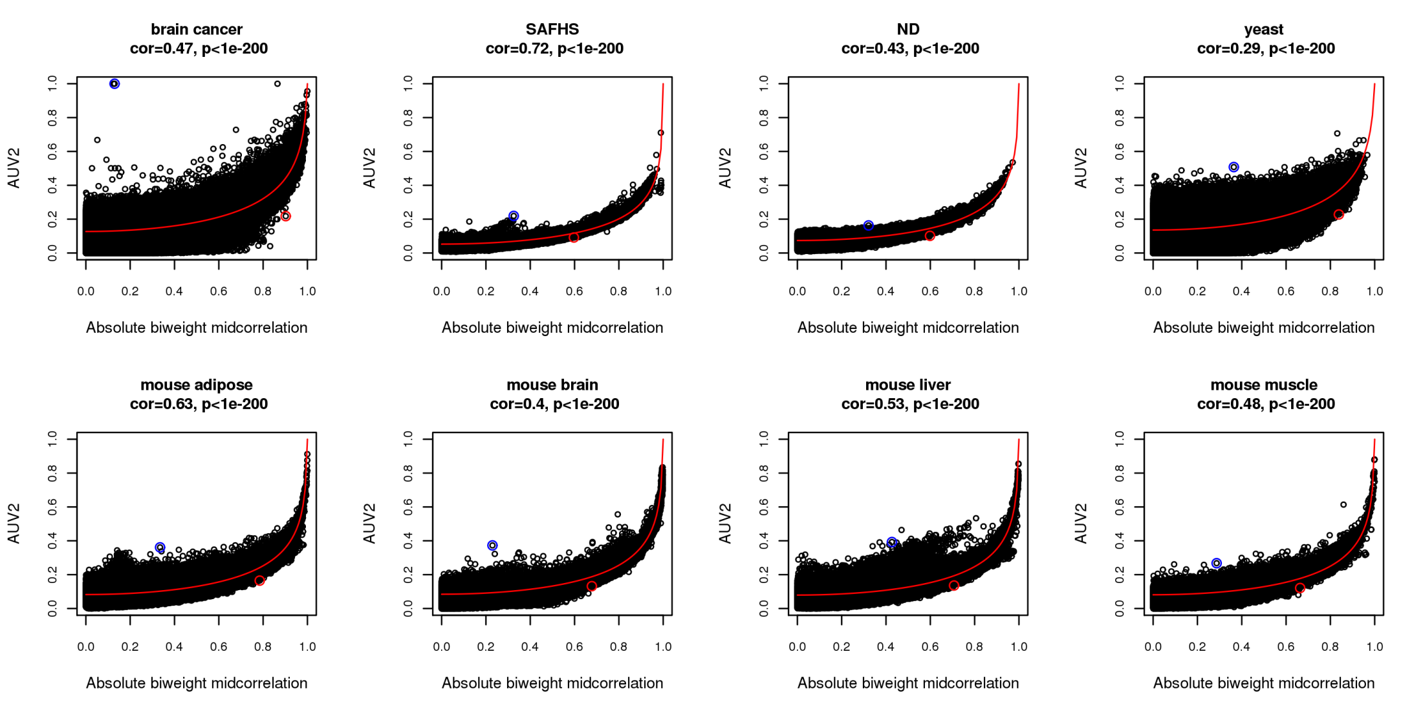
Mutual information vs. biweight midcorrelation in 8 empirical data sets.
Circles in the plot below represent gene pairs.
Most gene pairs satisfy linear relationships.
Circles in the plot below represent gene pairs.
Mutual information has strong association with correlation.
Most gene pairs satisfy linear relations.
There are cases where correlation and MI strongly disagree (blue and red circles).

Slide 21
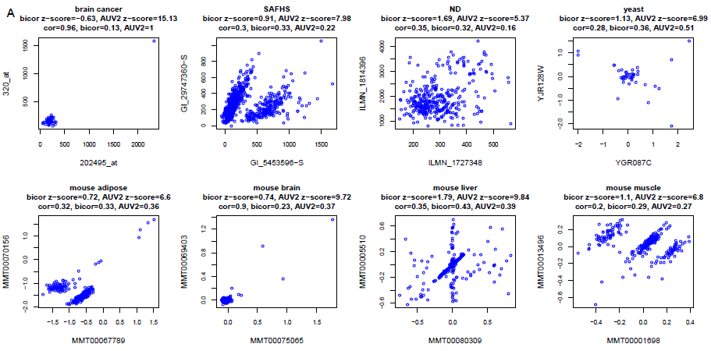
Expression of gene pairs with most extreme AUV2 and insignificant bicor.
Gene pairs are taken from blue circles in the previous plot.
Messages: 1) this estimate of MI is susceptible to outliers, 2) MI may detect unusual dependence patterns (which might represent technical artefacts).

Slide 22
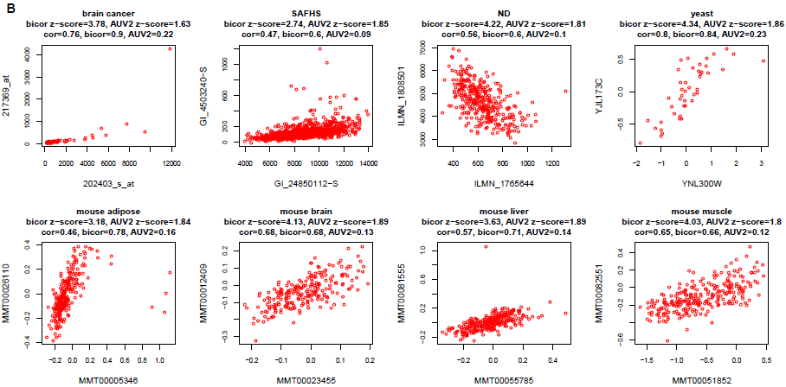
Expression of gene pairs with most extreme bicor and insignificant AUV2.
Gene pairs are taken from red circles in the previous plot.
Message: MI misses linear relationships that are detected by bicor.

Slide 23
Recall that WGCNA typically uses the topological overlap dissimilarity as input of hierarchical clustering
Generalized to the case of weighted networks in Zhang et al (2005, Statistical Applications in Genetics and Molecular Biology: Vol. 4: No. 1, Article 17).
Generalized to higher order interactions in Yip et al (2006 BMC Bioinformatics 2007, 8:22)

Slide 24
Which measure is better at identifying biologically meaningful modules?

Slide 25
To judge the biological meaning of modules, we assess their enrichment with respect to gene ontology categories
as described in step 3 of the following

Slide 26
Construct a network
Rationale: make use of interaction patterns between genes
Identify modules
Rationale: module (pathway) based analysis
Relate modules to external information
Array Information: Clinical data, SNPs, proteomics
Gene Information: gene ontology, EASE, IPA
Rationale: find biologically interesting modules
Study Module Preservation across different data
Rationale:
Same data: to check robustness of module definition
Different data: to find interesting modules.
Find the key drivers in interesting modules
Tools: intramodular connectivity, causality testing
Rationale: experimental validation, therapeutics, biomarkers

Slide 27
We use the same clustering procedure
Since we want to compare co-expression measures as opposed to different clustering procedures, we use the same clustering procedure for either measure.
Average linkage hierarchical clustering with dynamic branch cutting
Default parameter settings
it is a widely used benchmark method in coexpression network analysis.

Slide 28
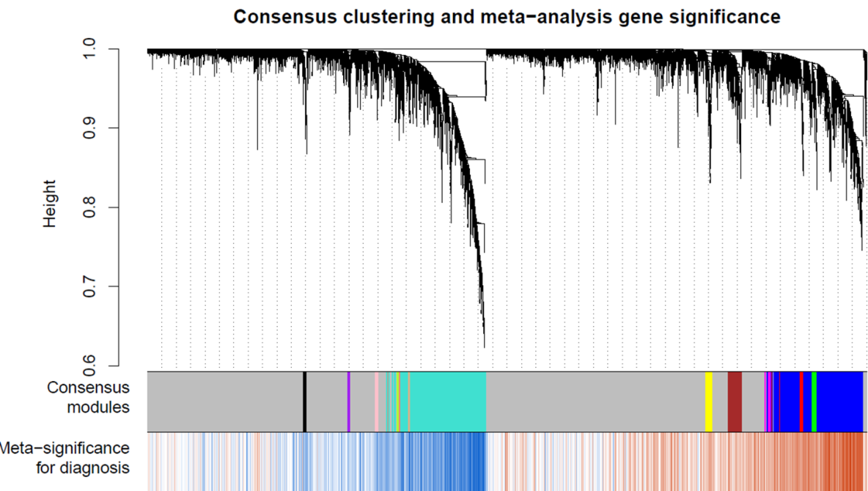
Defining modules based on a hierarchical cluster tree
Langfelder P, Zhang B et al (2007) Defining clusters from a hierarchical cluster tree: the Dynamic Tree Cut library for R. Bioinformatics 2008 24(5):719-720
Module=branch of a cluster tree
Dynamic hybrid branch cutting method combines
advantages of hierarchical clustering and pam clustering

Slide 29
Cor and MI to define network modules: gene ontology enrichment analysis
The same 8 empirical data sets are used.
Correlation or mutual information based adjacency is the only element that can vary in network construction: the same clustering algorithm and the same branch cutting method.
Enrichment is tested with respect to all GO terms and 5 most significant p-values are retained for each module.
R function GOenrichmentAnalysis in the WGCNA R package
P-values from all modules are averaged (details in Song et al 2012)
Modules
5 best p
5 best p
5 best p
5 best p

Slide 30
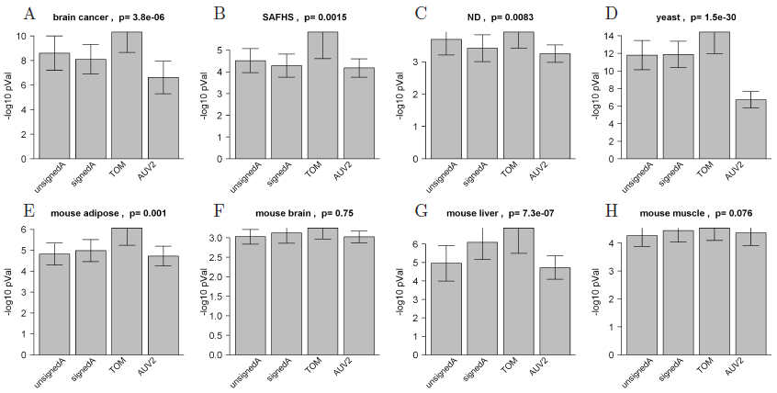
First, compare AUV2 with 3 bicor based ajacencies: unsigned adjacency, signed adjacency and signed adjacency coupled with Topological Overlap Matrix (TOM).
Message: Signed weighted network adjacency coupled with TOM leads to the most significant GO enrichment p-values in all 8 data sets.
Notes:
Difference is statistically significant in 6/8

Slide 31
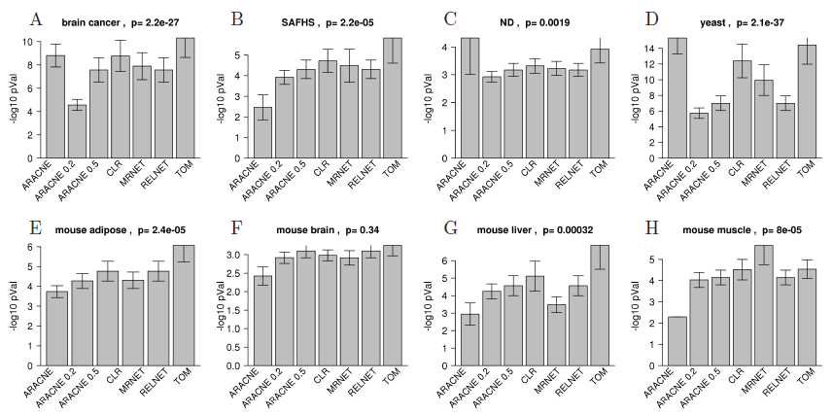
Second, compare TOM with 6 alternative MI based methods: ARACNE with different tolerance threshold values, CLR, MRNET and RELNET.
TOM gives the best p-values in 5 out of 8 data sets. ARACNE is the second best method.
Notes:
Difference is statistically significant in 4/5

Slide 32
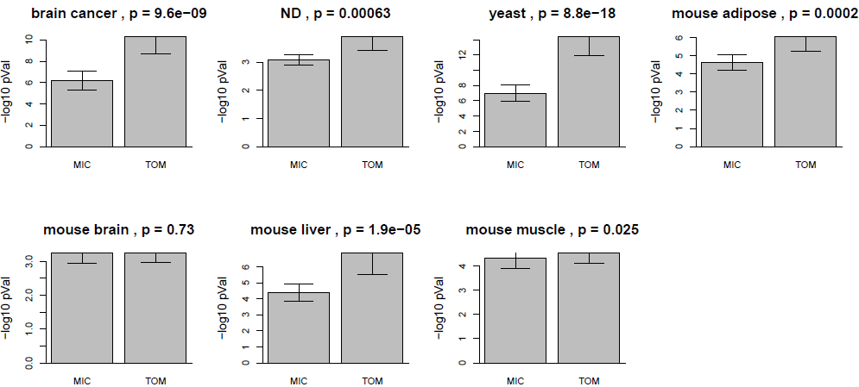
Third, compare TOM with MI based Maximal Information Coefficient (MIC), the maximal mutual information over many possible grids.
TOM outperforms MIC in 6 out of 7 data sets.
8th data set (SAFHS data) is not included due to computation issues of MIC.
Reshef DN, et al, Sabeti PC: Detecting Novel
Associations in Large Data Sets. Science 2011, 334(6062):1518–1524.
Notes:
Difference is statistically significant in 6/8

Slide 33
Polynomial and spline regression models as alternatives to mutual information

Slide 34

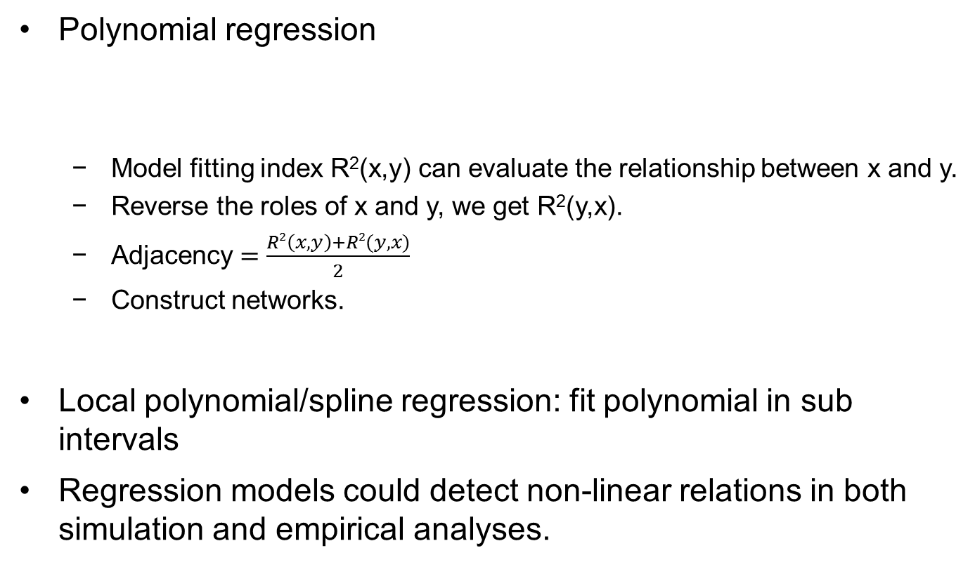
Regression models as alternative to MI to estimate non-linear relationships
Polynomial regression
Model fitting index R²(x,y) can evaluate the relationship between x and y.
Reverse the roles of x and y, we get R²(y,x).
Adjacency $=\frac{R2\left(x,y\right)+R2(y, x)}{2}$
Construct networks.
Local polynomial/spline regression: fit polynomial in sub intervals
Regression models could detect non-linear relations in both simulation and empirical analyses.
Notes:
M>100 use 5 knots, m<30 use 3 knots.

Slide 35
Compare regression models to MI
Pros
Computational simple and fast
Standard statistical tests available (F test, chi-square tests, Wald tests etc).
Model fitting indices are available
Easy to include covariates
Cons
Less general than mutual information when it comes to dependence patterns.

Slide 36
WGCNA R functions for calculating an adjacency matrix
adjacency
Calculate network adjacency based on cor or distance
Example: A=adjacency(datExpr,type="signed",power=12, corFnc = "bicor")
adjacency.fromSimilarity
Calculate network adjacency from a similarity matrix
adjacency.polyReg
Adjacency based on polynomial regression
adjacency.splineReg
Adjacency based on natural cubic spline regression

Slide 37
WGCNA R functions for mutual information
mutualInfoAdjacency
Calculate weighted adjacency matrices based on mutual information
Ex: A=mutualInfoAdjacency(datExpr, discretizeColumns = TRUE, entropyEstimationMethod = "MM", numberBins = NULL)
AFcorMI
Prediction of weighted mutual information adjacency matrix by correlation

Slide 38
Vast literature on mutual info. Some citations for mutual information
Horvath S (2011) Weighted Network Analysis. Springer Book, Chapter 14
Hausser J, Strimmer K (2008) Entropy inference and the James-Stein estimator, with application to nonlinear gene association networks. See http://arxiv.org/abs/0811.3579
Patrick E. Meyer, Frederic Lafitte, and Gianluca Bontempi. minet: A R/Bioconductor Package for Inferring Large Transcriptional Networks Using Mutual Information. BMC Bioinformatics, Vol 9, 2008
Kraskov A, Stoegbauer H, Andrzejak RG, Grassberger P (2003) Hierarchical Clustering Based on Mutual Information. ArXiv q-bio/0311039

Slide 39
WGCNA R functions for bicor
AFcorMI
Predict the weighted mutual information adjacency matrix based on a correlation coefficient (e.g. Pearson or bicor). Details are in book section 14.6 (Weighted Network Analysis)
bicor
Biweight Midcorrelation
bicorAndPvalue
Biweight Midcorrelation and the associated p-value

Slide 40
Conclusions
Biweight midcorrelation outperforms mutual information when it comes to
1) finding biologically meaningful co-expression patterns between pairs of genes
2) identifying co-expression modules that are enriched with GO categories
Polynomial and spline regression models are attractive alternatives to mutual information when it comes to detecting non-linear relationships (Song et al 2012)
Model based indices enjoy statistical advantages.
Mutual information can safely be replaced by linear regression based association measures in case of stationary gene expression data.

Slide 41
Content
Comparing Statistical Methods for Constructing Large Scale Gene Networks (2012)
Allen JD, Xie Y, Chen M, Girard L, Xiao G PLoS ONE 7(1): e29348. doi:10.1371

Slide 42
Comparing Statistical Methods for Constructing Large Scale Gene Networks (2012). Allen JD, Xie Y, Chen M, Girard L, Xiao G PLoS ONE 7(1): e29348. doi:10.1371/journal.pone.0029348
Comments:
Our group had no involvement in this comparison.
The study focused on methods for gene regulatory networks.

Slide 43
Abstract
The goal of this study was to provide a comprehensive evaluation and a practical guide to aid in choosing statistical methods for constructing large scale Gene Regulatory Networks (GRNs)
Using both simulation studies and a real application in E. coli data, the authors compare different methods
Results:
(1) GeneNet, WGCNA (Weighted Correlation Network Analysis), and ARACNE (Algorithm for the Reconstruction of Accurate Cellular Networks) performed well in constructing the global network structure;
(2) GeneNet and SPACE (Sparse PArtial Correlation Estimation) performed well in identifying a few connections with high specificity.

Slide 44
Methods
GeneNet (K. Strimmer)
Opgen-Rhein, R., and K. Strimmer. 2007. From correlation to causation networks: a simple approximate learning algorithm and its application to high-dimensional plant gene expression data. BMC Syst. Biol. 1: 37.
ARACNE
Margolin, A., Nemenman, I., Basso, K., Wiggins, C., Stolovitzky, G., Favera, R. and Califano, A. (2006). "ARACNE: an Algorithm for the Reconstruction of Gene Regulatory Networks in a Mammalian Cellular Context". BMC Bioinformatics 7 (Suppl 1): S7.
WGCNA (Zhang et al 2005, Langfelder et al 2008)

Slide 45
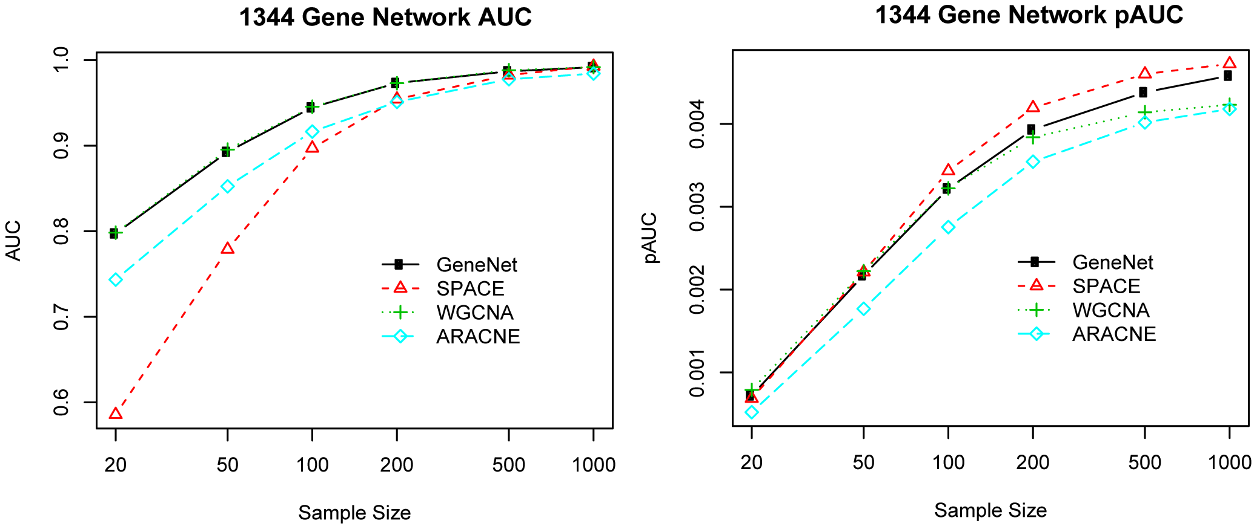
The AUCs for 1344-gene network in simulation 1.
WGCNA has consistently good performance across different sample sizes
Allen JD, et al. (2012)
PLoS ONE 7(1): e29348. doi:10.1371/journal.pone.0029348

Slide 46
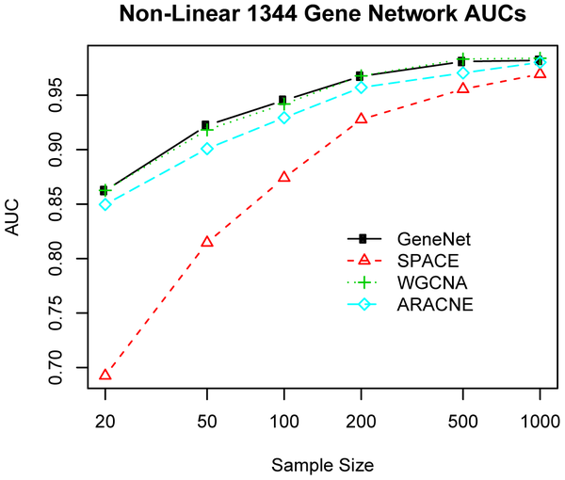
The AUCs for 1344-gene network in simulation 2 with non-normal distribution (Figure 4).
WGCNA consistently performs well in case of non-normal distributions
Allen JD, et al. (2012)
PLoS ONE 7(1): e29348. doi:10.1371/journal.pone.0029348

Slide 47
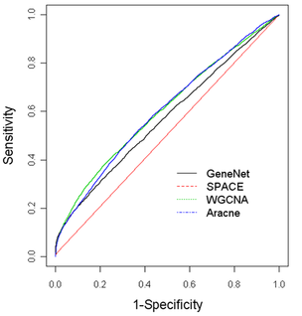
The performance in constructing gene regulatory network in E. coli. Figure 6.
WGCNA performs consistently well across different choices of the specificity
Allen JD, et al. (2012)
PLoS ONE 7(1): e29348. doi:10.1371/journal.pone.0029348

Slide 48
Content
Aging effects on DNA methylation modules in human brain and blood tissue. Genome Biol. 2012 Oct 3;13(10):R97. PMID: 23034122
When Is Hub Gene Selection Better than Standard Meta-Analysis?
Langfelder et al (2013) PLoS ONE 8(4): e61505.

Slide 49

Aging effects on DNA methylation modules in human brain and blood tissue.
Steve Horvath
Senior author: Roel A Ophoff UCLA

Slide 50
Weighted correlation network analysis (WGCNA) applied to multiple methylation data Goal: find age related consensus methylation modules in whole blood and brain tissue

Slide 51
Analysis steps of WGCNA
Construct a signed weighted correlation network
based on multiple, independent data sets
Purpose: keep track of relationships between genes
2. Identify consensus modules
Purpose: find robustly defined and reproducible modules
3. Relate modules to external information
Age
Gene Information: gene ontology, cell marker genes
Purpose: find biologically interesting age related modules

Slide 52
Additional public methylation data used for consensus module analysis
Inf 27k Illumina Array
1) Rakyan et al GSE20236
93 different healthy females (31 twin pairs and 31 singletons)
ranging from 49 to 75 years of age
Whole blood
2) Healthy individuals from UK ovarian cancer data
Teschendorff et al 2010, Song et al 2009 GSE19711
267 healthy women
3) Type 1 Diabetics (Irish)
93 males, 95 females
4) Brain data: about 150 individuals, 4 brain regions

Slide 53
R code
blockwiseConsensusModules in the WGCNA R package, see the tutorials…

Slide 54
Message: green module contains probes positively correlated with age

Slide 55
Consensus module analysis (Figure)
based on multiple independent DNA methylation data sets.
Technical stuff: Average linkage hierarchical clustering tree uses the consensus topological overlap matrix based on calibrated versions of the signed correlation networks in each of the data sets.
By definition co-methylation modules are present in all of the underlying data sets.
The first color band underneath the tree visualizes the consensus module colors.
The other color bands indicate age correlations in multiple data sets
red visualizes a high positive correlation
The green module contains CpGs that tend to be positively correlated with age.

Slide 57
Age relations in brain regions
The green module eigengene is
highly correlated with age in
Frontal cortex (cor=.70)
Temporal cortex (cor=.79)
Pons (cor=.68)
But less so in cerebellum (cor=.50).

Slide 58
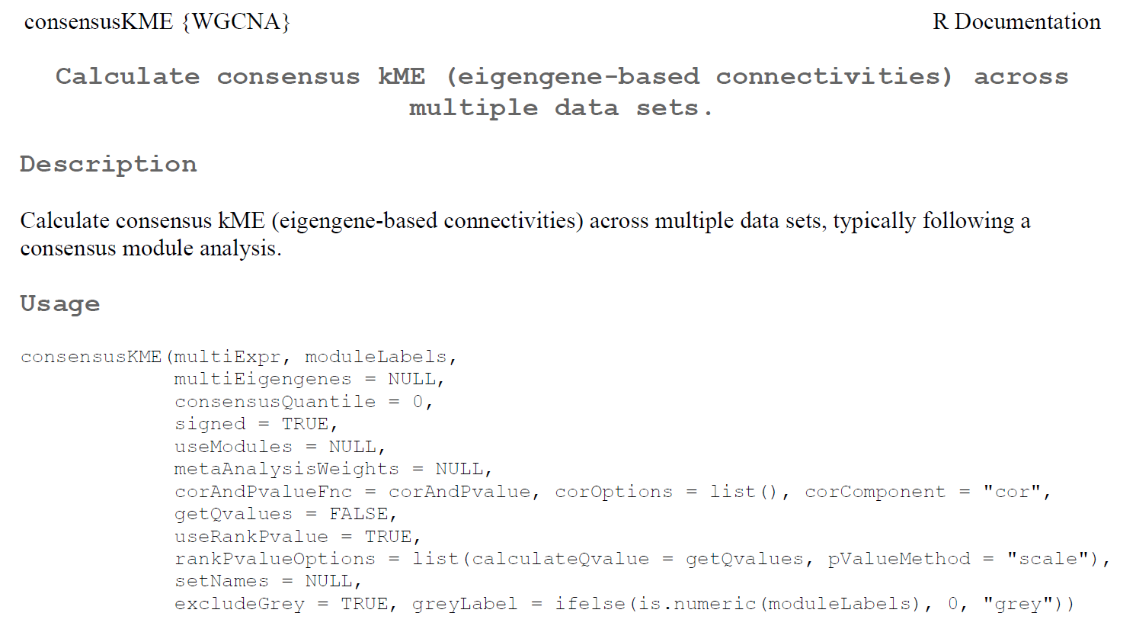
R code for finding hub genes consensusKME function

Slide 59
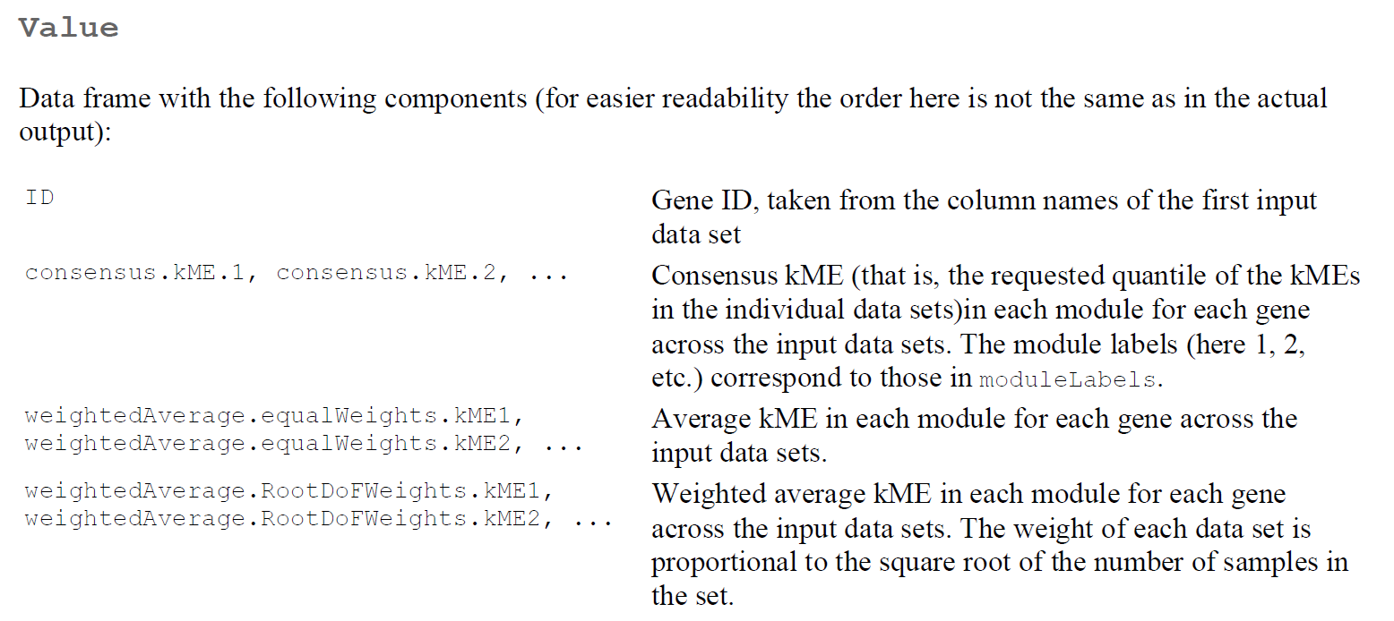
Output consensusKME

Slide 60
Gene ontology enrichment analysis of the green module
Highly significant enrichment in multiple terms related to cell differentiation, development and brain function
e.g. nervous system development (Bonferroni corrected p-value =2.1e-6),
neuron differentiation (p=7.6e-5),
anatomical structure development (p=0.00013),
cell development (p=0.00024),
generation of neurons (p=0.00038),
neurogenesis (p=0.00052), cell differentiation (p=0.00057).

Slide 61
Green module is enriched with neuronal cell type markers
Green module genes are enriched for genes that are
upregulated in neurons (based on Cahoy et al 2009) (Bonferroni corrected p-values p=5e-9)
Related to CA1 area related neurons (based on Newrzella et al 2007) (p=3e-7),
downregulated in hippocampus in early Alzheimer's disease (Parachikova et al 2007) (p=3e-6)
Recall that this module can also be found in blood tissue.

Slide 62
Polycomb-group proteins
Polycomb Group gene expression is important in many aspects of development.
Genes that are hypermethylated with age are significantly enriched with Polycomb group target genes (Teschendorff et al 2010)
This insight allows us to compare different gene selection strategies.
The higher the enrichment with respect to PCGT genes the more signal is in the data.

Slide 63
Comparison of standard screening vs. consensusKME screening with respect to enrichment for PCG target gene

Slide 64
Relating kME.green and cor.Age and sequence properties

Slide 65
Discussion
We confirm the findings of many others
age has a profound effects on thousands of methylation probes
Rough rule: positive/negative correlation for probes inside/outside of CpG islands
WGCNA reveals the presence of a methylation module that positively correlates with age
Enriched with neuronal markers
Contains cis regulated genes
Age related module genes are interesting for studying the age related decline of cognitive functioning

Slide 66
Content
When Is Hub Gene Selection Better than Standard Meta-Analysis?
Langfelder et al (2013) PLoS ONE 8(4): e61505.

Slide 67
When does hub gene selection lead to more meaningful gene lists than a standard statistical analysis based on significance testing?
Here we address this question for the special case when multiple data sets are available.
This is of great practical importance since for many research questions multiple gene expression or other -omics data sets are publicly available.
In this case, the data analyst can decide between a standard statistical approach (e.g., based on meta-analysis) and a co-expression network analysis approach that selects intramodular hubs in consensus modules.

Slide 68
Intramodular hub genes versus whole network hubs
Intramodular hubs have high intramodular connectivity kME with respect to a given module of interest
Whole network hubs have high values of whole network connectivity k
k= row sum of the adjacency matrix
k= number of direct neighbors in case of an unweighted network

Slide 69
Q & A
1. Are whole-network hub genes relevant or should one exclusively focus on intramodular hubs?
Answer: Focus exclusively on intramodular hubs in trait-related modules.
2. Do network-based gene selection strategies lead to gene lists that are biologically more informative than those based on a standard marginal approaches?
Answer: Yes, gene selection based on intramodular connectivity leads to biologically more informative gene lists than marginal approaches.
3. Do network-based gene selection strategies lead to gene lists that have more reproducible trait associations than those based on a standard marginal approaches? Answer: Overall no. But in case of a weak signal networks can help.

Slide 70
Criteria for judging gene selection methods
Criterion 1 evaluates the biological insights gained, i.e. it is relevant in basic research.
Criterion 2 evaluates the validation success in independent data sets, i.e. it is relevant when it comes to developing diagnostic or prognostic biomarkers.

Slide 71
Data sets used in the empirical evaluation
We compare standard meta-analysis with consensus network analysis in three comprehensive and unbiased empirical studies:
(1) Find genes predictive of lung cancer survival
Gold standard=cell proliferation related genes
(2) Find age related DNA methylation markers
Gold standard= Polycomb group target genes
(3) Find genes related to total cholesterol in mouse liver tissues
Gold standard= immune system related genes

Slide 72
R code in the WGCNA package
For standard screening, we used the metaAnalysis function
For finding hubs in consensus modules, we used the consensusKME function

Slide 73
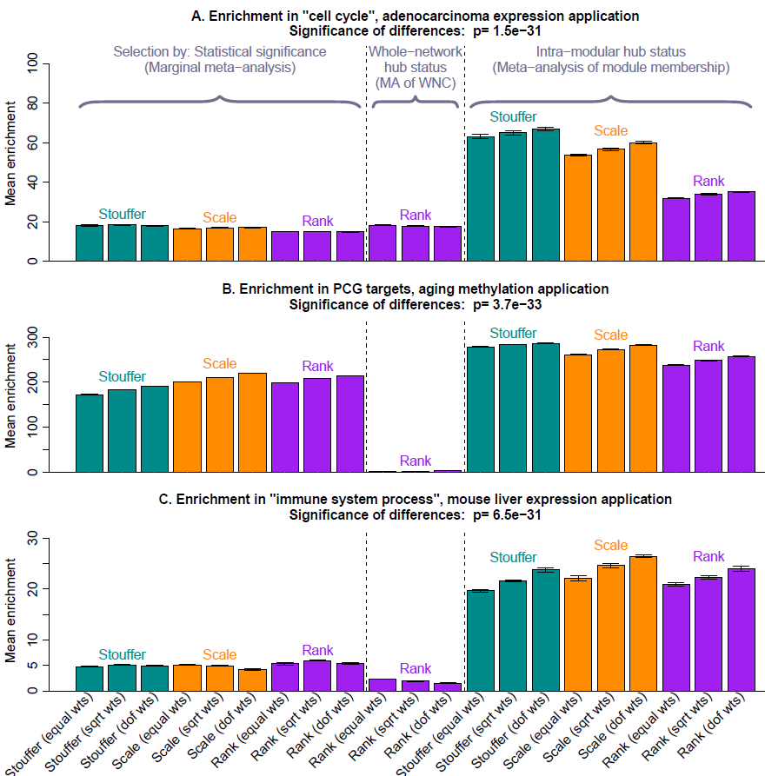

Slide 74
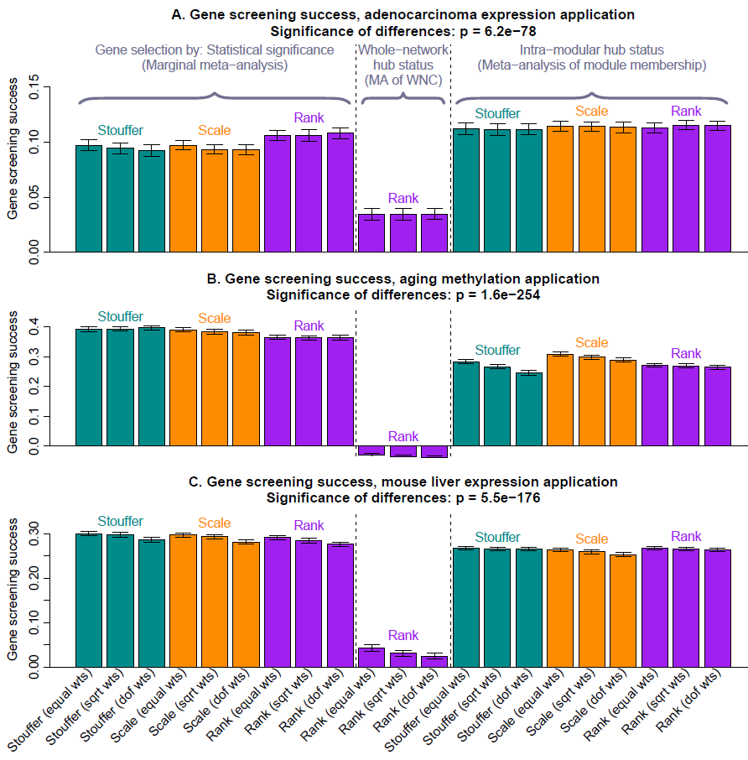

Slide 75
Results
The results demonstrate that intramodular hub gene status is more useful than a meta-analysis p-value when identifying biologically meaningful gene lists (reflecting criterion 1).
However, meta-analysis methods perform as good as (if not better) than a co-expression network approach in terms of validation success (criterion 2).

