Slide 1
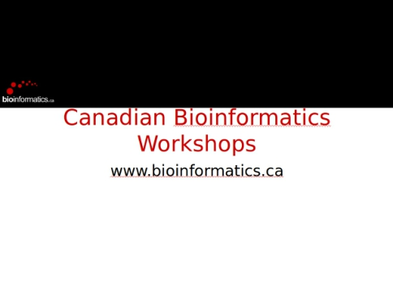
frame[plain]

Slide 2
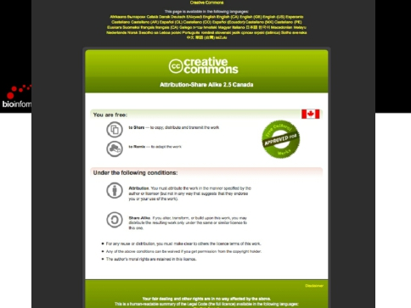
Module 5: 1D Autogating
bioinformatics.ca

Slide 3

Module 6 - Additional Tools
Ryan Brinkman
Senior Scientist, BC Cancer Agency
Associate Professor, Department of Medical Genetics, UBC
Vancouver, British Columbia, Canada
CBW: Flow Cytometry Data Analysis using R
June 17, 2013

Slide 4

Module Objectives
Data Annotation
(Perhaps the most painful / time consuming part of automated
analysis)
Future Directions in Automated Analysis
Module 6: Additional Tools
bioinformatics.ca

Slide 5
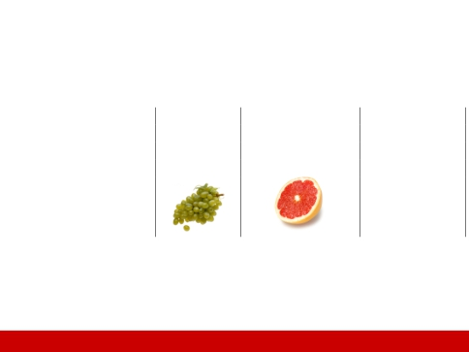
Future of Computational Analysis
Publicly Available High-Dimensional Datasets
Microarray
1995
879,722
Flow Cytometry
1965
58
∆
+30
-879,644
xkcd.com/388/
First publication :
Public datasets:
Fruit:
Schena et. al. Science (1995) Fulwyler Science (1965)
1 reason why this is important: Kodamaa et al. PNAS (2012)
Module 6: Additional Tools
bioinformatics.ca

Slide 6

Why Share ?
Promote open scientific inquiry and progress in the field
Allow for re-exploration of existing datasets to test new or
alternative hypotheses and methods of analysis
Allow for independent validation and refutation of
experimental findings
Required or encouraged by many funding agencies and
scientific journals
Your mom told you to
Module 6: Additional Tools
bioinformatics.ca

Slide 7

What to share?
A dump of FCS files is not enough
Data without context are not understandable to others
Minimum Information about a Flow Cytometry Experiment
Outlines the minimum information required to report about
flow cytometry experiments
Represents the community consensus
33 coauthors from 19 institutions
ISAC Recommendation
Required/recommended by Cytometry A and
Nature
Lee et al., MIFlowCyt: the Minimum Information about a Flow
Cytometry Experiment. Cytometry A. 2008; 73(10): 926-930
Module 6: Additional Tools
bioinformatics.ca

Slide 8
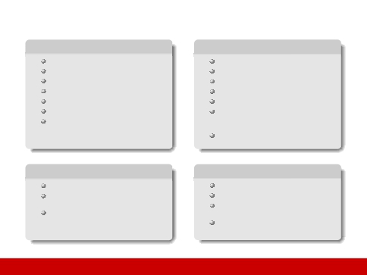
MIFlowCyt components
Sample description
Description
Sample material
Treatment
Fluorescent reagents
Source
Biological samples: Organism with
taxonomy, phenotype, genotype, age,
gender, ...
Location for environmental samples
Instrumentation details
Make
Model
User-adjustable components (e.g.,
Experiment overview
Purpose
Keywords
Experiment variables
Date(s)
Organization(s)
Primary contact
Quality control measures
Data analysis
FCS data files
Compensation and other
transformations
Gating details including gate
description, statistics and boundaries or
images or gate membership details
Module 6: Additional Tools
detector voltages)
Customized configurations
bioinformatics.ca

Slide 9
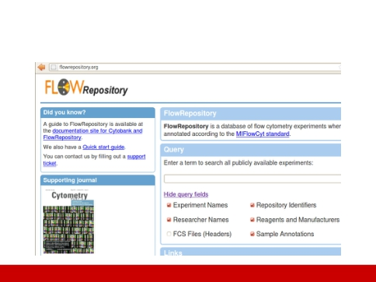
How to Share
Tri-Society supported FlowRepository.org
Module 6: Additional Tools
bioinformatics.ca

Slide 10
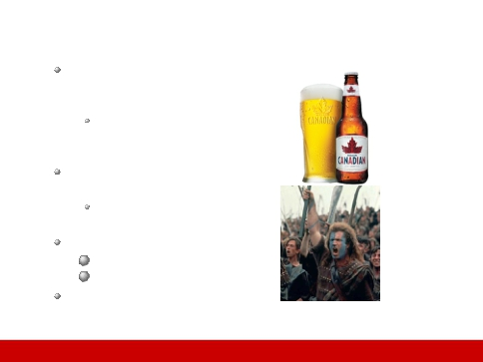
FlowRepository – What is it?
A public online resource of
annotated flow cytometry
datasets
Primarily those associated
with peer-reviewed
publications
Created by extending and
adapting Cytobank
Mainly to incorporate
MIFlowCyt
Its free, as in
1 Beer
2 “FREEEEEDOOOM!!!”
Supported by ISAC and hosted
by Carnegie Mellon University
Module 6: Additional Tools
bioinformatics.ca

Slide 11
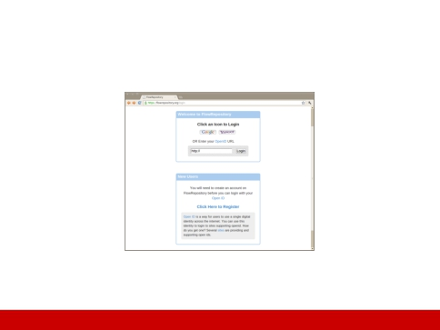
FlowRepository – How to use it?
Login for advanced options & uploading
Online help & 3 publications including free Current Protocols in Cytometry
Module 6: Additional Tools
bioinformatics.ca

Slide 12
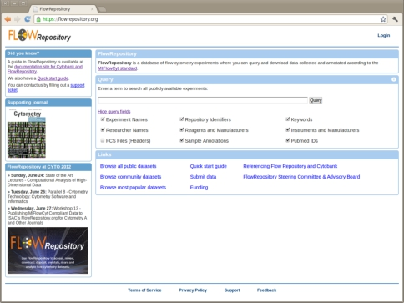

Slide 13

Upload and annotation of your own dataset
Typical steps
1 Create a new experiment
2 Upload data (FCS files)
3 Prepare annotation templates
Or prepare spreadsheets with annotations
4 Annotate the experiment
Describe samples and sample sources
Provide experimental variables
Describe instrumentation settings
5 Provide analysis details
Either analyze data online and create illustrations
Or upload third party analysis files (e.g., FlowJoTM workspaces,
FCS ExpressTM project files, FACS DivaTM files, etc.)
6 Review (and improve) your MIFlowCyt compliance
Module 6: Additional Tools
bioinformatics.ca

Slide 14
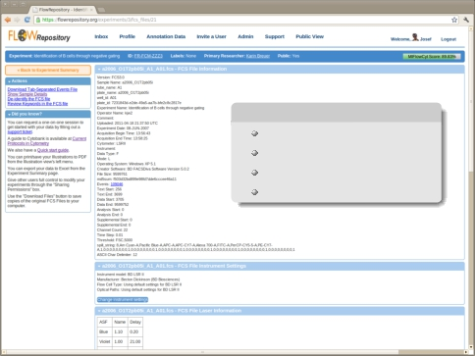
Information extracted from FCS
Keyword-value pairs
Channel details
Laser details
Compensation details

Slide 15
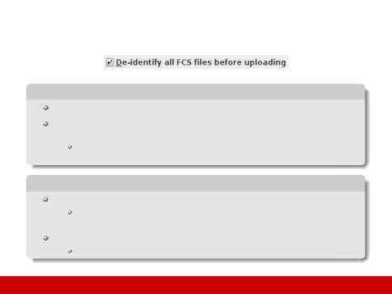
Data upload - de-identification
De-identification
Remove identifiers that could be used to identify an individual
Generally, privacy rules do not apply on de-identified data
Check with your regulatory authority as applicable, e.g., Health Insurance
Portability and Accountability Act (HIPAA)
Implementation in FlowRepository
Automated removal of all keyword values unless in our safe list
Safe list: Over 220 keywords identified from a few hundred FCS data files
produced by dozens of instruments from several vendors
Integrated in the upload process
Performed locally → no sensitive information leaves your computer
→ Allows for sharing
Module 6: Additional Tools
bioinformatics.ca

Slide 16
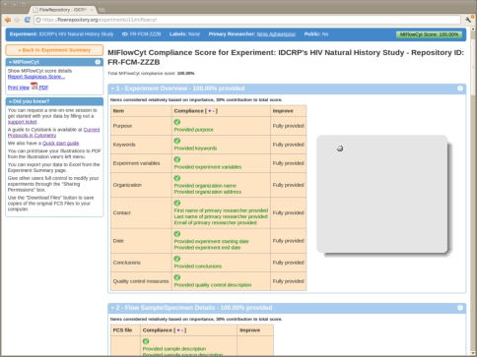
The “Improve”
column will
show direct links
to pages/forms
in case some
information is
still missing

Slide 17
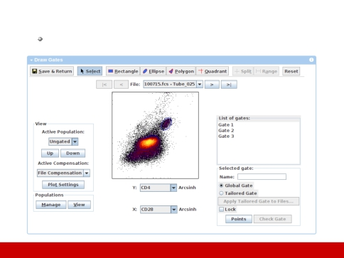
Analyze data online
Draw your gates
Module 6: Additional Tools
bioinformatics.ca

Slide 18
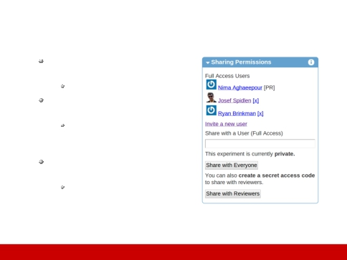
Data sharing
You can share with other
FlowRepository users
This will grant full access
You can make your
experiment public
This will grant read access
to everyone, including
anonymous visitors
You can share with reviewers
This will lock your
experiment and create a
secret access code
Module 6: Additional Tools
bioinformatics.ca

Slide 19
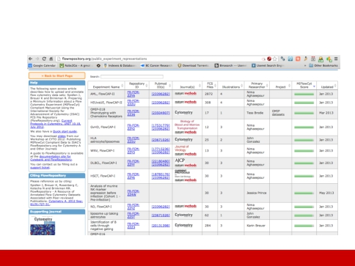
FlowRepository.org
Module 6: Additional Tools
bioinformatics.ca

Slide 20
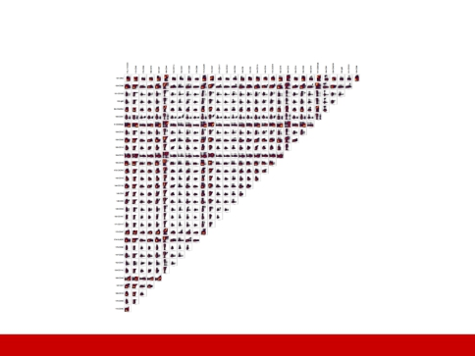
Future of Computational Analysis
Visualization
Bendall et al. Science (2011)
Module 6: Additional Tools
bioinformatics.ca

Slide 21
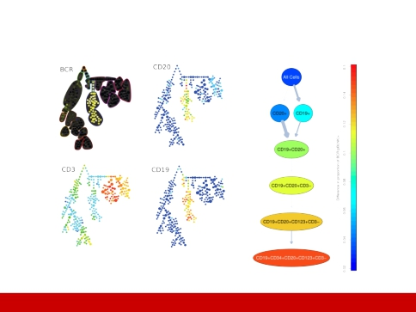
Future of Computational Analysis
Visualization
SPADE
Module 6: Additional Tools
RchyOptimyx
bioinformatics.ca

Slide 22

Visualization - Seeing is Believing
Analysis Example: MRD in T-ALL
1 Transform using Logicle (bi-exponential)
2 Find a threshold for each marker using consistent static gating
after normalization of data
Combine each MRD+ sample type (pre & post therapy) &
partition each channel to a positive/negative cell population
using 2D
3 Use the threshold to generate a set of multi-dimensional
phenotypes using flowType
4 Find the cell proportions and for RchyOptimyx
5 Use AUC to select phenotypes that are statistically significant
between MRD-, MRD+ patients.
Module 6: Additional Tools
bioinformatics.ca

Slide 23
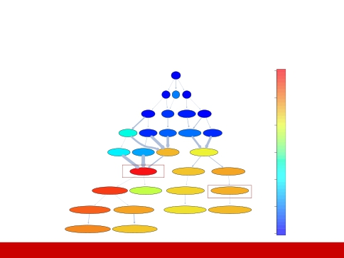
Future of Computational Analysis
FSC-SSC+CD44-CD3-CD8+ significantly correlated
All Cells
6
CD8+CD3− CD45−
CD8+> CD3−< CD45−>
CD3− CD8+ CD16+56+
5
CD44−
CD8+
CD44−CD8+<
CD3−CD8+<
CD16+56+CD45−<
CD8+CD45−>
SSC+
CD3−
SSC+
CD8+
CD16+56+
CD34−
4
SSC+CD44−CD8+<
CD44−CD3−CD8+<
SSC+CD3−CD8+<
CD16+56+CD8+CD45−<
CD34−CD8+CD45−<
FSC−
CD3−FSC−
SSC+
CD44−
CD34−
CD16+56+
FSC−SSC+CD44−CD8+<
FSC−CD44−CD3−CD8+<
SSC+CD44−CD3−CD8+<
CD34−CD16+56+CD8+CD45−<
AUROC
3
CD3−
SSC+
FSC−
CD3−
CD1a−
FSC−SSC+CD44−CD3−CD8+<
CD34−CD16+56+CD3−CD8+CD45−<
CD1a−CD34−CD16+56+CD8+CD45−<
CD16+56−
CD1a−
CD44−
CD3−
2
FSC−SSC+CD44−CD16+56−CD3−CD8+<
CD34−
CD4+
FSC−SSC+CD44−CD1a−CD3−CD8+<
CD44−CD34−CD16+56+CD3−CD8+CD45−<
CD4−
CD1a−CD34−CD16+56+CD3−CD8+CD45−<
CD44−
FSC−SSC+CD44−CD34−CD16+56−CD3−CD8+<
CD5−
FSC−SSC+CD44−CD34−CD16+56−CD3−CD5−CD8+<
FSC−SSC+CD44−CD16+56−CD3−CD4+CD8+<
CD5−
FSC−SSC+CD44−CD16+56−CD3−CD5−CD4+CD8+<
CD44−CD34−CD16+56+CD3−CD4−CD8+CD45−<
CD44−CD1a−CD34−CD16+56+CD3−CD8+CD45−<
1
0
Module 6: Additional Tools
bioinformatics.ca

Slide 24
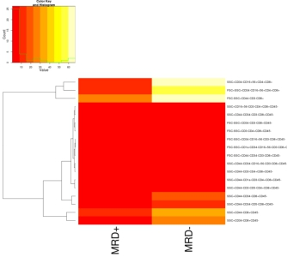
Future of Computational Analysis
Visualization

Slide 25
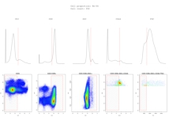
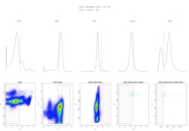
Future of Computational Analysis
Visualization (MRD+ vs. MRD- for same population)

Slide 26
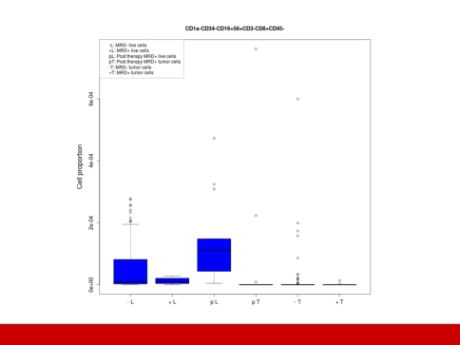
Module 6: Additional Tools
bioinformatics.ca

Slide 27

Visualization - Seeing is Believing
SPADE
1 Analyze each sample individually using SPADE
2 Build two FCM one from MRD+ and one from MRD− (via
3 Compare the minimum spanning tree of two sampled data for
each marker as a representative of MRD+ and MRD−
sampling)
samples.
Module 6: Additional Tools
bioinformatics.ca

Slide 28
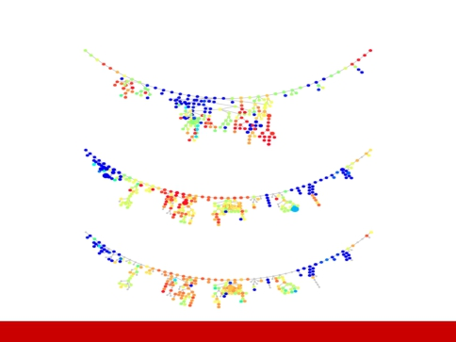
SPADE provides broad overview of populations
Normal Tissue (Sampled) CD8
Normal Tissue (MRD-) CD8
Normal Tissue (MRD+) CD8
Module 6: Additional Tools
bioinformatics.ca

Slide 29
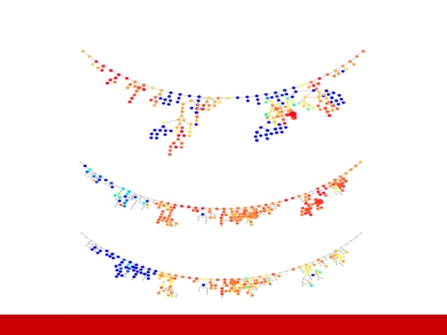
SPADE provides broad overview of populations
Tumor Tissue (Sampled) CD8
TumourTissue(MRD-)CD8
TumourTissue(MRD+)CD8
Module 6: Additional Tools
bioinformatics.ca

Slide 30
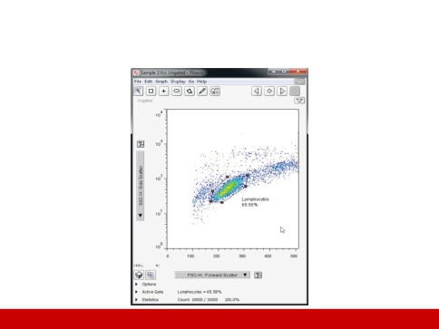
Future of Computational Analysis
Ease of use
Module 6: Additional Tools
bioinformatics.ca

Slide 31

All the Fish Without the Mess: GenePattern
Web-based genomic analysis platform
Developed at Broad Institute of MIT & Harvard (since 2003)
Over 120 tools (modules) for analysis of gene expression,
proteomics, and other data
Over 10,000 users world wide
Allows the creation of automated analysis pipelines
Facilitates reproducible data analysis
Module 6: Additional Tools
bioinformatics.ca

Slide 32
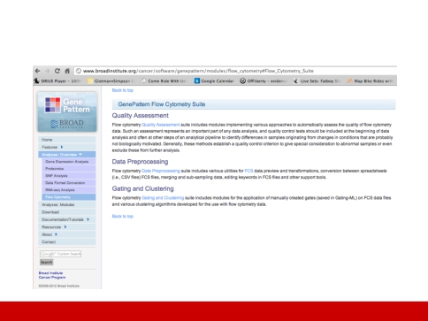
GenePattern
On-line biologist-accessible high throughput analysis platform
Module 6: Additional Tools
bioinformatics.ca

Slide 33
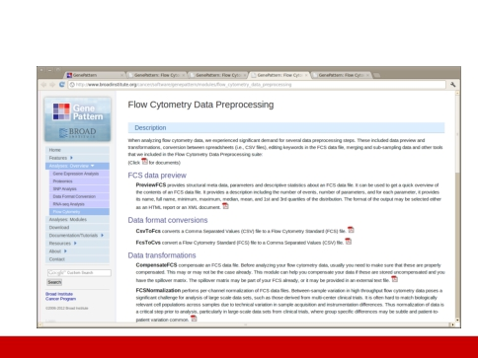
GenePattern: Flow Data Preprocessing
Module 6: Additional Tools
bioinformatics.ca

Slide 34
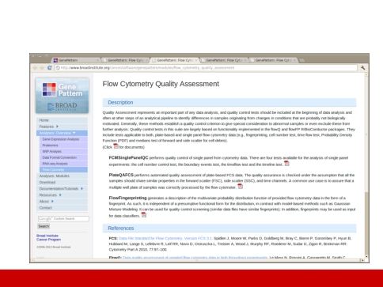
GenePattern: Quality Assessment
Module 6: Additional Tools
bioinformatics.ca

Slide 35
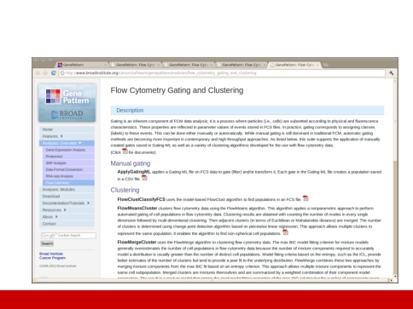
GenePattern: Automated Gating
Module 6: Additional Tools
bioinformatics.ca

Slide 36
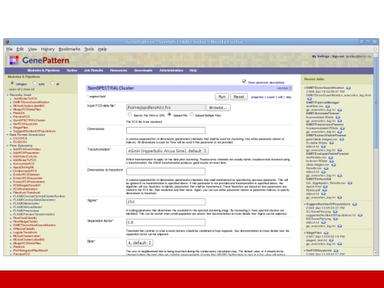
Genepattern - Example
Module 6: Additional Tools
bioinformatics.ca

Slide 37

Improving ease of use: openCyto
Goal: Make the best algorithms available for use.
http://www.github.com/RGLab/openCyto
Integrates R flow infrastructure with automated gating algorithms:
(Bayesian flowClust, flowCore, flowDensity, DENSE)
Modular architecture: plug-in any gating algorithms.
High-level description of gating schemes
User defines hierarchy of cell populations and relevant markers
Higher-dimensional gating (e.g. >2D) is available.
Framework abstracts away most of the R-coding.
Module 6: Additional Tools
bioinformatics.ca

Slide 38
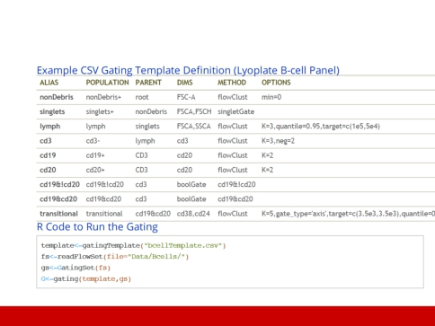
openCyto
Module 6: Additional Tools
bioinformatics.ca

Slide 39
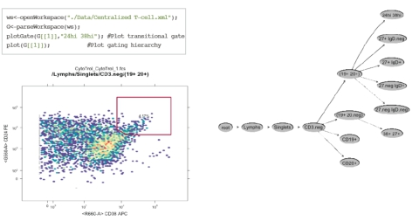
FlowWorkSpace

Slide 40
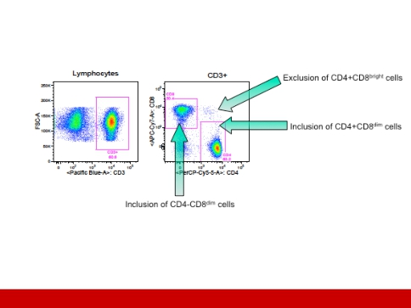
Labelling: Algorithms don’t know what a T cell is
...yet
Slide courtesy Holden Maecker
Module 6: Additional Tools
bioinformatics.ca

Slide 41
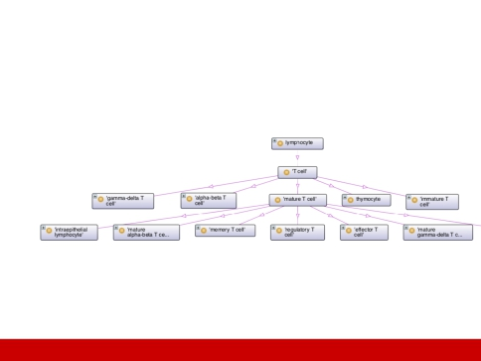
Semantic Labelling
Cell Ontology (CL)
Use R-based SPARQL queries to RDF implementation of CL to
label immunophenotypes
Module 6: Additional Tools
bioinformatics.ca

Slide 42
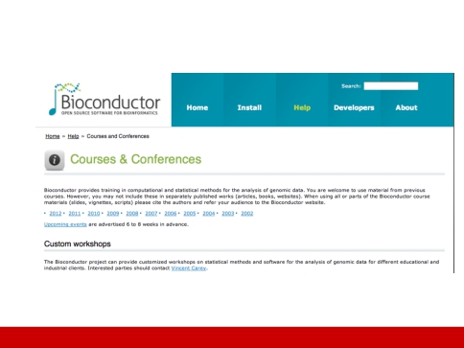
What next? BioC Courses
Module 6: Additional Tools
bioinformatics.ca

Slide 43
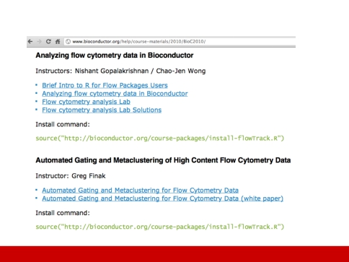
What next? BioC Courses
Module 6: Additional Tools
bioinformatics.ca

Slide 44
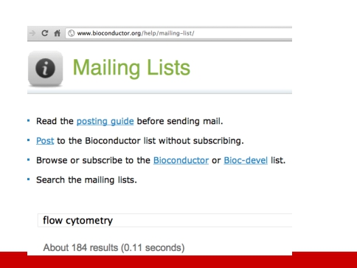
What next? Mailing List
Module 6: Additional Tools
bioinformatics.ca

Slide 45

Computation Analysis of High-D Flow Cytometry Data
Data in, discovery out
Complete
Thoroughly and objectively mines high dimensional data
Finds correlations missed by manual analysis
Informative, descriptive, interoperable results
Fast
Analysis takes hours (CPU time; works well with HPC)
Frees time for interpretation & snowboarding
Founded on robust statistics
Reproducible, exact, accurate
Statistically based & within the variability of manual gating
But..
Doesn’t handle poor compensation
Continuously variable expression / antigen intensity tricky
Difficult for biologists to use (requires collaboration)
Module 6: Additional Tools
bioinformatics.ca

Slide 46
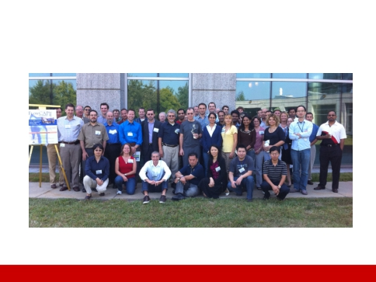
What next? Collaborate
Module 6: Additional Tools
bioinformatics.ca

