Slide 1
Jupyter

Slide 2
Intro to Jupyter Ecosystem (Presentation; 30 min; 1 hr. prep)
Name is Julia, R, python
Python, R native support

Slide 3
Intro to Jupyter Ecosystem (Presentation; 30 min; 1 hr. prep)
Name is Julia, R, python
Python, R native support
A little history
Funding support

Slide 4
Intro to Jupyter Ecosystem (Presentation; 30 min; 1 hr. prep)
Name is Julia, R, python
Python, R native support
A little history
Funding support
Basic overview of components
Present as slides - extension - riser???

Slide 5
Intro to Jupyter Ecosystem (Presentation; 30 min; 1 hr. prep)
Name is Julia, R, python
Python, R native support
A little history
Funding support
Basic overview of components
Present as slides - extension - riser???
Kernels
Jupyter supports python, r, Julia, perl, bash, many others
Mention SoS - multi-language kernel (https://github.com/vatlab/SoS)
Overview (https://vatlab.github.io/blog/post/sos-notebook/)

Slide 6
Intro to Jupyter Ecosystem (Presentation; 30 min; 1 hr. prep)
Name is Julia, R, python
Python, R native support
A little history
Funding support
Basic overview of components
Present as slides - extension - riser???
Kernels
Jupyter supports python, r, Julia, perl, bash, many others
Mention SoS - multi-language kernel (https://github.com/vatlab/SoS)
Overview (https://vatlab.github.io/blog/post/sos-notebook/)
Gallery of notebooks
Find notebook to get you started
GitHub

Slide 7
Intro to Jupyter Ecosystem (Presentation; 30 min; 1 hr. prep)
Name is Julia, R, python
Python, R native support
A little history
Funding support
Basic overview of components
Present as slides - extension - riser???
Kernels
Jupyter supports python, r, Julia, perl, bash, many others
Mention SoS - multi-language kernel (https://github.com/vatlab/SoS)
Overview (https://vatlab.github.io/blog/post/sos-notebook/)
Gallery of notebooks
Find notebook to get you started
GitHub
Interactive widgets
Kbase demo

Slide 8
Intro to Jupyter Ecosystem (Presentation; 30 min; 1 hr. prep)
Name is Julia, R, python
Python, R native support
A little history
Funding support
Basic overview of components
Present as slides - extension - riser???
Kernels
Jupyter supports python, r, Julia, perl, bash, many others
Mention SoS - multi-language kernel (https://github.com/vatlab/SoS)
Overview (https://vatlab.github.io/blog/post/sos-notebook/)
Gallery of notebooks
Find notebook to get you started
GitHub
Interactive widgets
Kbase demo
Other
iOS app – juno

Slide 9
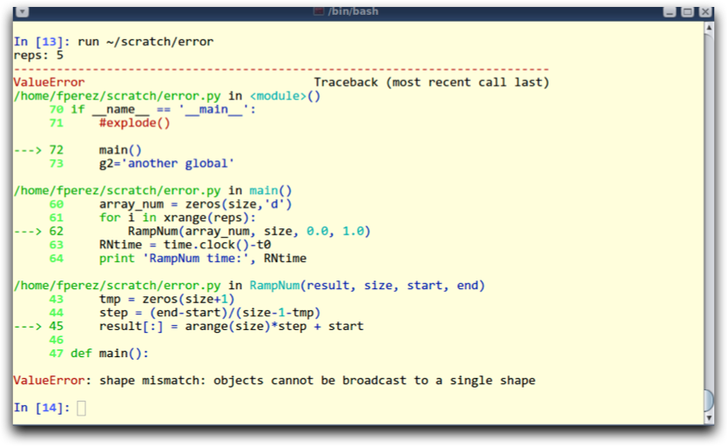
2001 – IPython
259 Line Python script
Plotting, numerics, interactive workflow
Fernando Perez
“how to best procrastinate on a Physics dissertation”
Fernando Perez

Slide 10
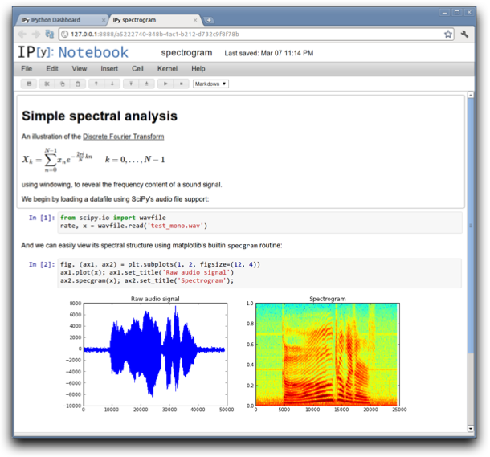
2011 – The IPython Notebook
Rich web client
Text & math
Code
Results
Share, reproduce.
Fernando Perez

Slide 11
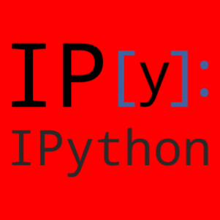
From IPython to Jupyter

Slide 12
IPython…Jupyter
IPython
Jupyter
Interactive Python shell at the terminal
Kernel for this protocol in Python
Tools for Interactive Parallel computing
Network protocol for interactive computing
Clients for protocol
Console
Qt Console
Notebook
Notebook file format & tools (nbconvert...)
Nbviewer
Language Agnostic
Fernando Perez

Slide 13
https://github.com/jbarratt

