Slide 1


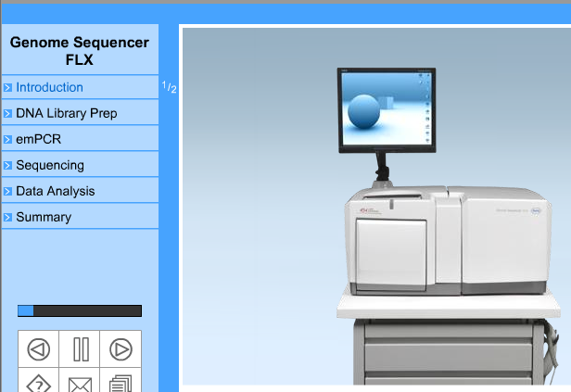
SOLiD, Illumina and Roche Sequencing Technologies

Slide 2
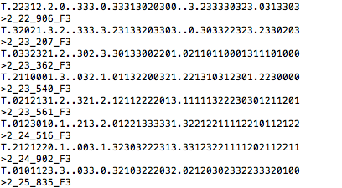
NGS Sequence Files

Slide 3
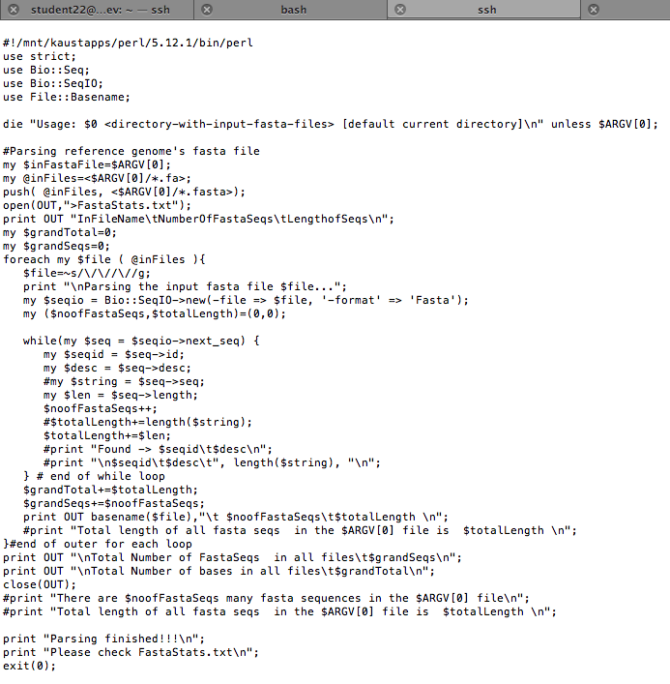
Current Method for Read Statistics

Slide 4
Magic of Unix Command
find /labs/bioscience_customer/Arnab_Pain/Solid/solid0397_20110808_PE_BC_LF46 -name '*csfasta'| xargs grep -c "^>"
/labs/bioscience_customer/Arnab_Pain/Solid/solid0397_20110808_PE_BC_LF46/c_velia1/solid0397_20110808_PE_BC_LF46_bcSample1_F3_c_velia1.csfasta:24648458 /labs/bioscience_customer/Arnab_Pain/Solid/solid0397_20110808_PE_BC_LF46/c_velia2/solid0397_20110808_PE_BC_LF46_bcSample1_F3_c_velia2.csfasta:5201106 /labs/bioscience_customer/Arnab_Pain/Solid/solid0397_20110808_PE_BC_LF46/m_bovis/solid0397_20110808_PE_BC_LF46_bcSample1_F3_m_bovis.csfasta:6700023 /labs/bioscience_customer/Arnab_Pain/Solid/solid0397_20110808_PE_BC_LF46/m_marinum/solid0397_20110808_PE_BC_LF46_bcSample1_F3_m_marinum.csfasta:3629682 /labs/bioscience_customer/Arnab_Pain/Solid/solid0397_20110808_PE_BC_LF46/m_tuberculosis1/solid0397_20110808_PE_BC_LF46_bcSample1_F3_m_tuberculosis1.csfasta:16370665 /labs/bioscience_customer/Arnab_Pain/Solid/solid0397_20110808_PE_BC_LF46/m_tuberculosis2/solid0397_20110808_PE_BC_LF46_bcSample1_F3_m_tuberculosis2.csfasta:6368279 /labs/bioscience_customer/Arnab_Pain/Solid/solid0397_20110808_PE_BC_LF46/p_falciparum1/solid0397_20110808_PE_BC_LF46_bcSample1_F3_p_falciparum1.csfasta:9044872 /labs/bioscience_customer/Arnab_Pain/Solid/solid0397_20110808_PE_BC_LF46/p_falciparum2/solid0397_20110808_PE_BC_LF46_bcSample1_F3_p_falciparum2.csfasta:16931047 /labs/bioscience_customer/Arnab_Pain/Solid/solid0397_20110808_PE_BC_LF46/p_falciparum3/solid0397_20110808_PE_BC_LF46_bcSample1_F3_p_falciparum3.csfasta:9244234 /labs/bioscience_customer/Arnab_Pain/Solid/solid0397_20110808_PE_BC_LF46/p_falciparum4/solid0397_20110808_PE_BC_LF46_bcSample1_F3_p_falciparum4.csfasta:3407158 /labs/bioscience_customer/Arnab_Pain/Solid/solid0397_20110808_PE_BC_LF46/p_yoelii/solid0397_20110808_PE_BC_LF46_bcSample1_F3_p_yoelii.csfasta:4778936 /labs/bioscience_customer/Arnab_Pain/Solid/solid0397_20110808_PE_BC_LF46/p_yoelii2/solid0397_20110808_PE_BC_LF46_bcSample1_F3_p_yoelii2.csfasta:17481517 -bash-3.2$ find /labs/bioscience_customer/Christian_Voolstra/Solid/ -name '*csfasta'| xargs grep -c "^>"
/labs/bioscience_customer/Christian_Voolstra/Solid/Pool1/Chris_Voolstra_RNASeq_20111010_FRAG_BC_Chris_Voolstra_Pool1_F3_Pool1.csfasta:1938 /labs/bioscience_customer/Christian_Voolstra/Solid/Pool2/Chris_Voolstra_RNASeq_20111010_FRAG_BC_Chris_Voolstra_Poo2_F3_Pool2.csfasta:2221 /labs/bioscience_customer/Christian_Voolstra/Solid/Pool3/Chris_Voolstra_RNASeq_20111010_FRAG_BC_Chris_Voolstra_Poo3_F3_Pool3.csfasta:760 /labs/bioscience_customer/Christian_Voolstra/Solid/Pool4/Chris_Voolstra_RNASeq_20111010_FRAG_BC_Chris_Voolstra_Poo4_F3_Pool4.csfasta:2232

Slide 5
Take Home Message
Multiple lines of a particular programming language script can be replaced with short and crisp unix command like this,
-bash-3.2$ find /labs/bioscience_customer/Christian_Voolstra/Solid/ -name '*csfasta'| xargs grep -c "^>"

