Slide 1
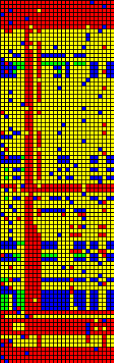
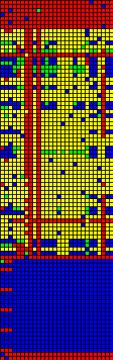
Lethal
Detrimental
Neutral
Beneficial
A
One-point mutations
B
Genome

Slide 2


Task Not Performed
No Effect
Task Performed
A
Knock-out Effect
B
Genome

Slide 3
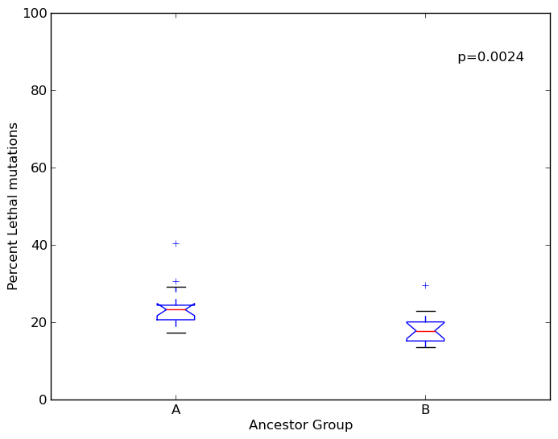
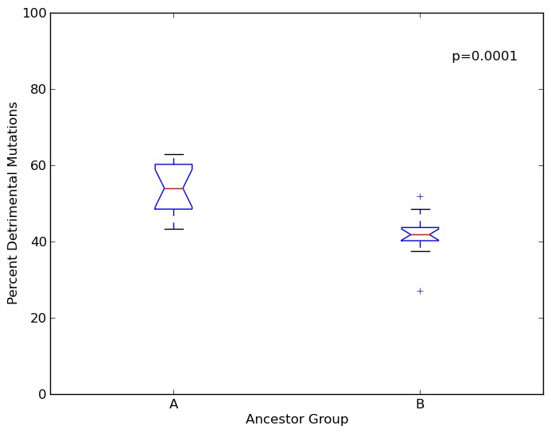
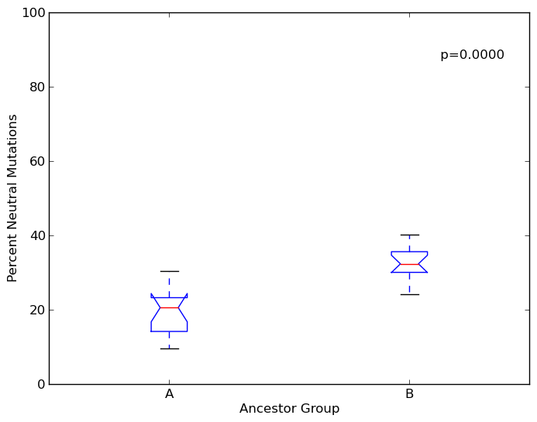
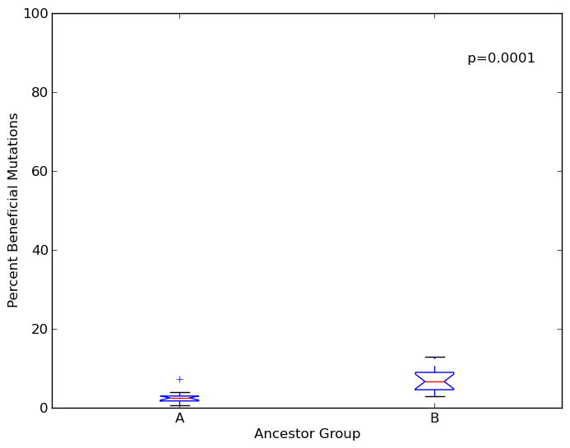
(a)
(b)
(c)
(d)

