Slide 1



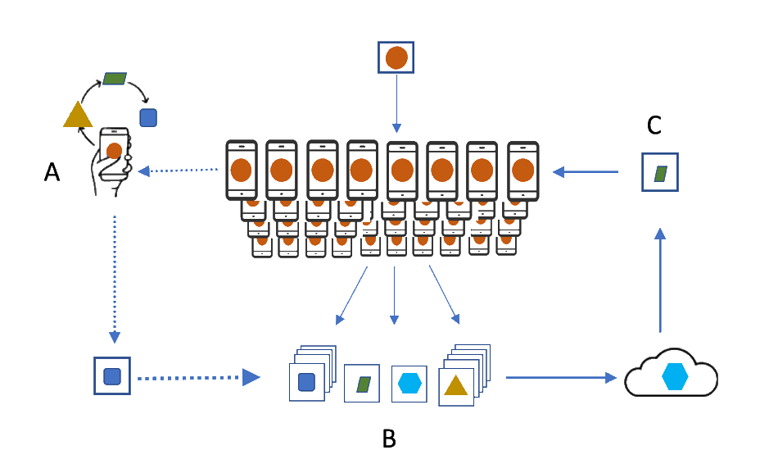
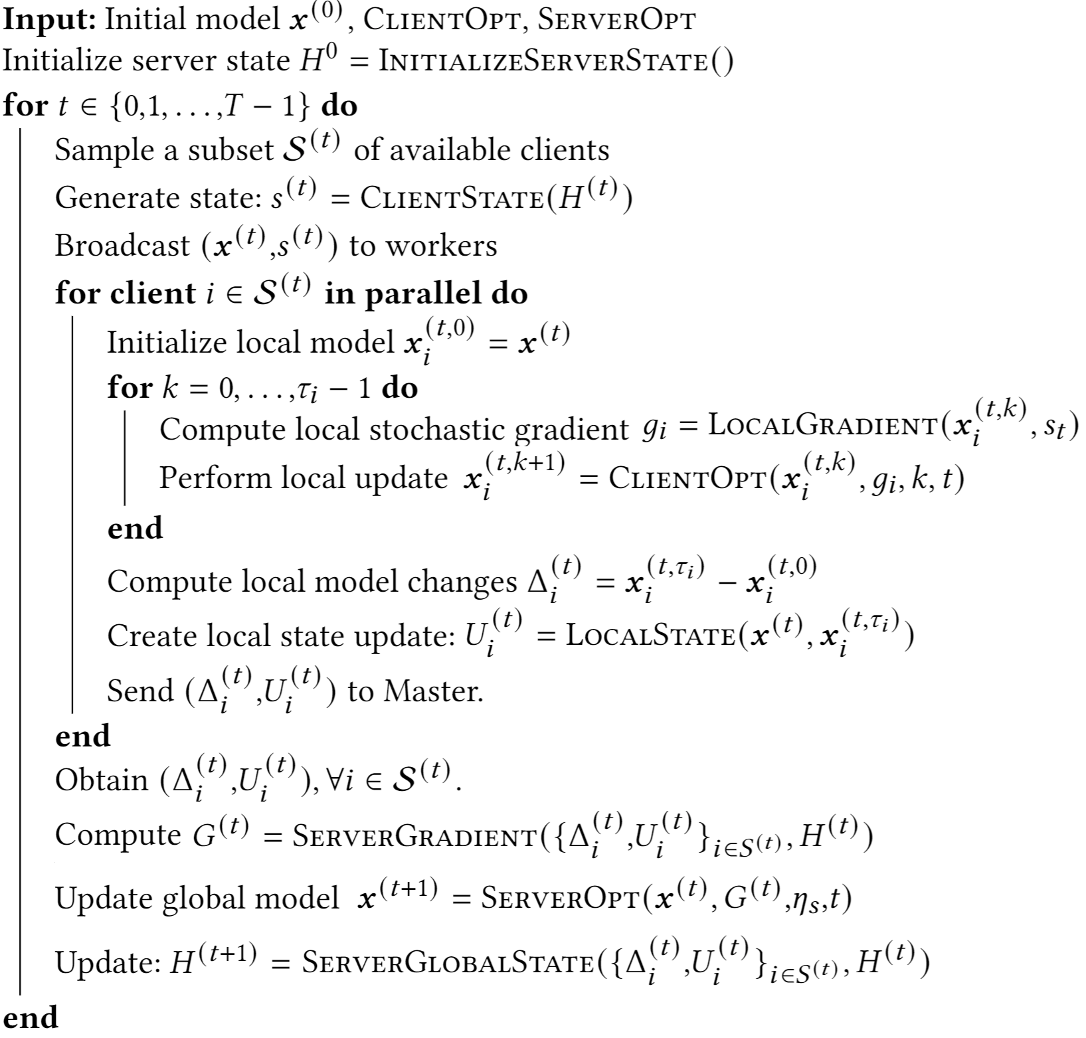
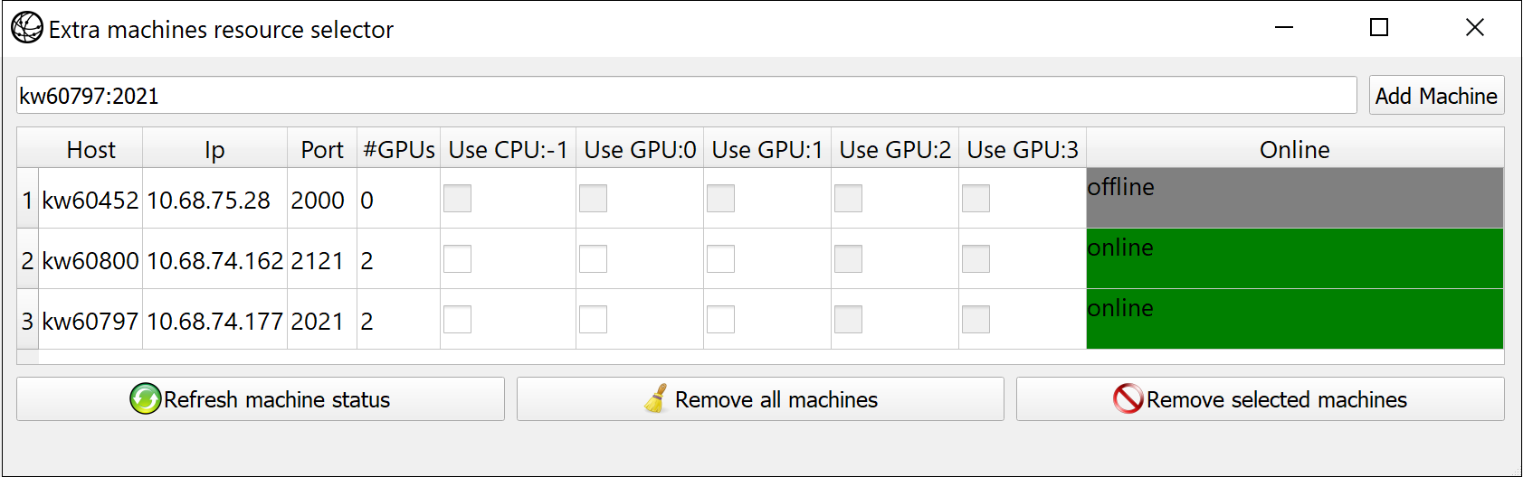
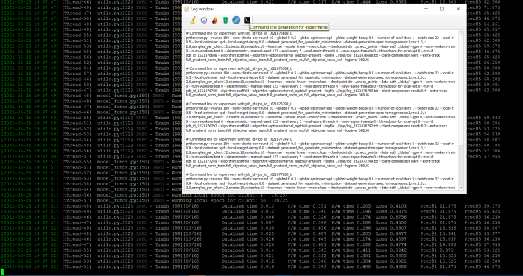
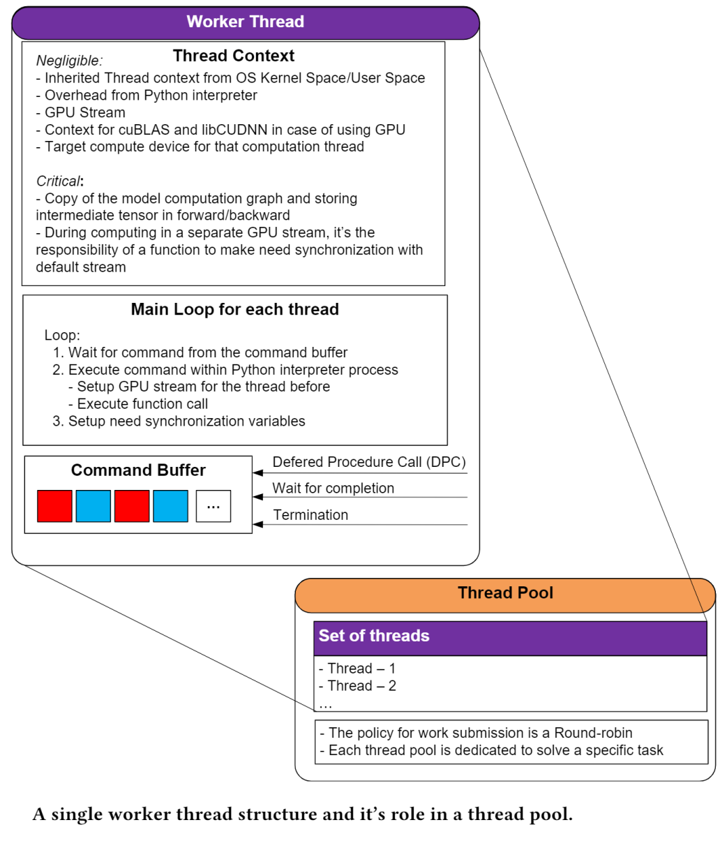
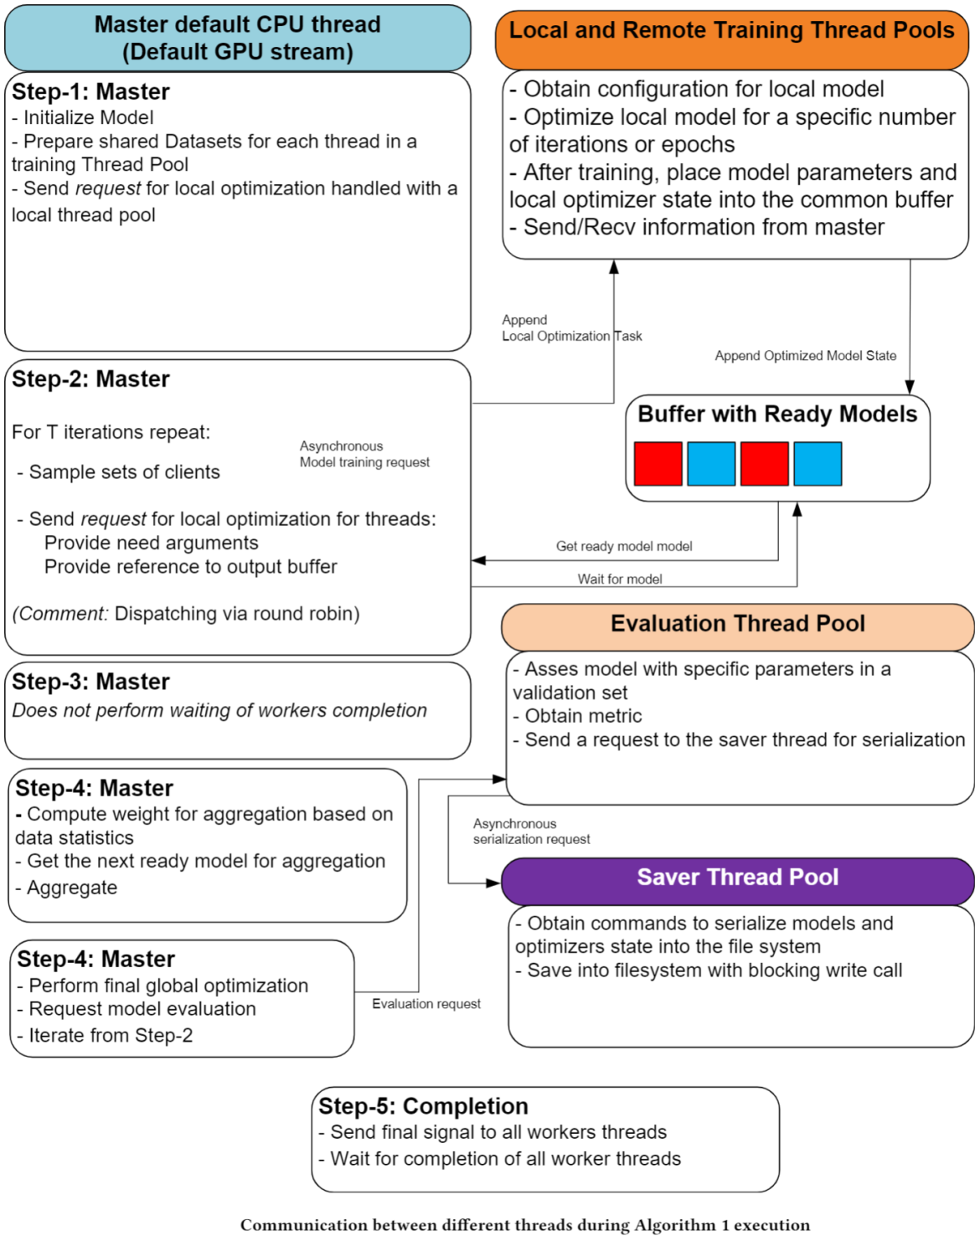
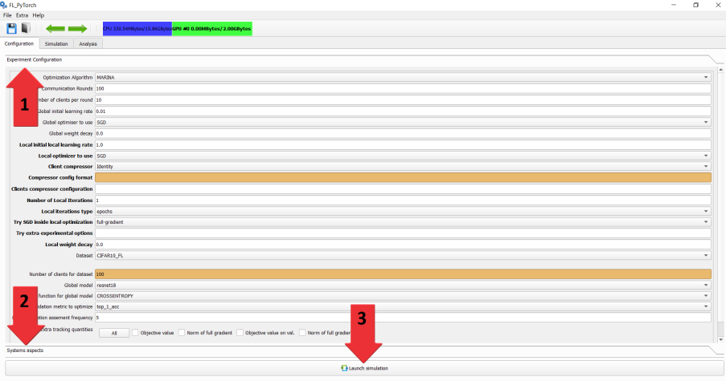
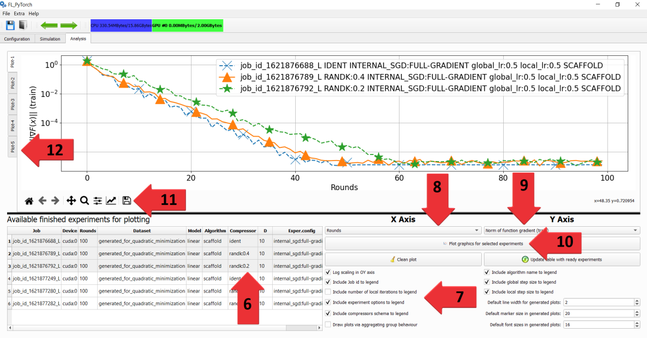
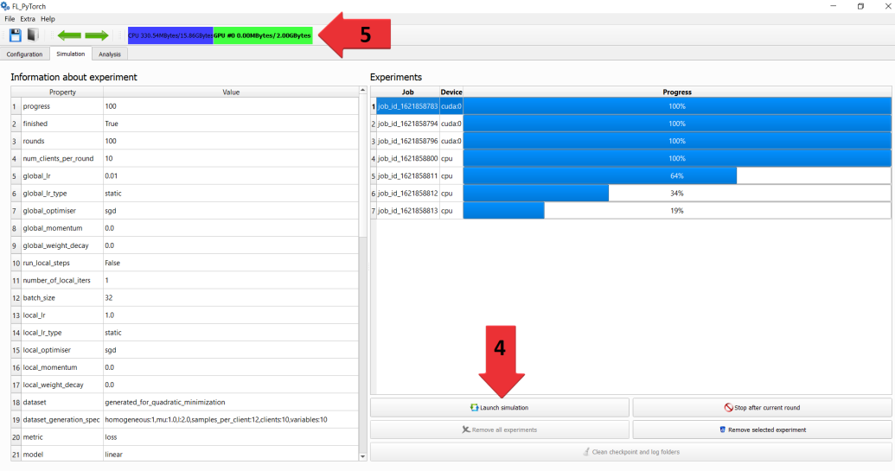
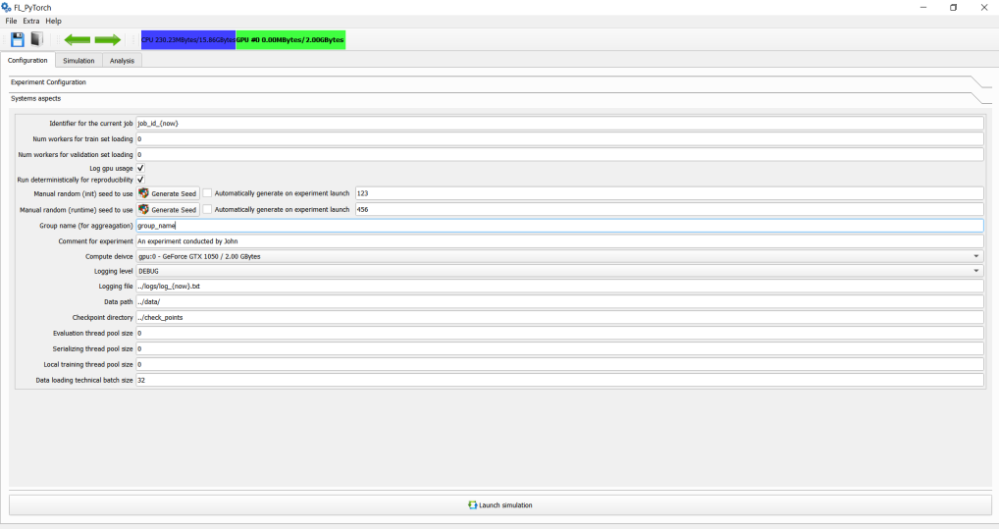
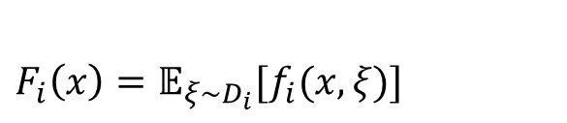



FL_PyTorch:
Optimization Research Simulator for Federated Learning
Konstantin Burlachenko, Samuel Horváth, Peter Richtárik
ACM Conference: Distributed Machine Learning DistributedML 2021, December 7, 2021.
Abstract: Federated Learning (FL) has emerged as a promising technique for edge devices to collaboratively learn a shared machine learning model while keeping training data locally on the device. FL is difficult to implement, test and deploy in practice considering heterogeneity in common edge device settings, making it fundamentally hard for researchers to efficiently prototype their optimization algorithms. Our aim is to alleviate this problem by introducing FL_PyTorch: a suite of open-source software written in python that builds on top of one the most popular research Deep Learning (DL) framework PyTorch. We built FL_PyTorch as a research simulator for FL to enable fast development, prototyping and experimenting with new and existing FL optimization algorithms. We provide: State-of-the-arts Optimization Algorithms, standard Models and Datasets, Communication reduction mechanisms. Our goals were: (1) Low Entry Bar; (2) Extensibility; (3) Hardware Utilization; (4) Easy Debugging
Federated Learning (FL) setup
Some Federated Learning Application
The goal of FL is to find a model deployable on each client while protecting the clients’ data. Challenges: # devices; privacy; data heterogeneity; communication; partial participation.
Google use it in the Gboard mobile keyboard for applications including next word prediction
Android Messages
Apple in iOS 13 for QuickType keyboard.
Apple uses FL for applications like the QuickType keyboard.
Apple uses FL for the vocal classifier for “Hey Siri”. With FL Apple upgraded Siri to distinguish the person who owns the Phone from other people's voices.
$${min.}_{x}^{}F\left(x\right)≜ 𝔼_{i\sim 𝒫}\left[F_{i}\left(x\right)\right]$$
$F_{i}\left(x\right)=𝔼_{ξ\sim D_{i}}[f_{i}(x,ξ)]$
Supported algorithms
out of the box
Generalized Fed Averaging
Generalized Fed Averaging Methods
State-of-the-arts Opt.Algorithms
Distributed Compressed GD
FedAVG
SCAFFOLD
FedProx
DIANA
MARINA
InitializeServerState
This method returns a dictionary that initializes the server state. The method constructs and initializes the model.
ClientState
By our design client state is stateless. The client state is instantiated at the beginning of each round for each of the selected clients. If you need a client state you may initialize it from the server state.
Communication reduction mechanisms
Local updates
Limiting the participating clients
Compressors
Identical compressor
Lazy or Bernoulli compressor
Rand-K
Natural compressor
Standard dithering
Natural Dithering
LocalGradient
Obtain the algorithm specific local gradient estimator $g_{i}$.
ClientOpt
Local optimization step using the obtained direction $g_{i}$.
LocalState
Collect all the local states that are sent to the master jointly with the local update.
ServerGradient
The estimator of the global direction to be used for the global model update.
Models
ResNet(18,34,50,101,152),
VGG(11,13,16,19)
WideResNets (28_2, 28_4, 28_8)
Controllable quadratics problems
Datasets:
Standard FL datasets
Synthetically generated
ServerOpt
Server optimization step using the obtained direction $G^{t}$.
ServerGlobalState
The global server state update
User Interface
Inside Runtime

