Slide 1
Topic: “Story about decision trees based on lectures from one professor” (Part II/III) Konstantin Burlachenko -kburlachenko@nvidia.com -bruziuz@stanford.edu -burlachenkok@gmail.com

Slide 2
References
[1] First part of presentation
https://github.com/burlachenkok/presentations_bruziuz/tree/master/decision_trees/mpti
[2] Classification And Regression Trees, 1983 (Brieman, Friedman, Olshey, Stone) – CART
https://www.amazon.com/Classification-Regression-Wadsworth-Statistics-Probability/dp/0412048418
[3] Book: The Elements of Statistical Learning
(Friedman, Tibshirani, Hastie)
https://web.stanford.edu/~hastie/Papers/ESLII.pdf
[4] News: Bradley Efron has won the 80K USD Prize in Statistics for his 1970s work
https://www.nature.com/articles/d41586-018-07395-w?fbclid=IwAR3EbV3LbBQmls4KarxRzblvonn6HUxiC4IqRGaaXPY2XRsbOXtSPHqo3pk
[5] [cvxbook] Convex Optimization (S.Boyd, L.Vandenberghe)
http://stanford.edu/~boyd/cvxbook/bv_cvxbook.pdf
[6] My notes: What is cross-validation and some hints about it
https://sites.google.com/site/burlachenkok/articles/what-is-cross-validation-and-some-hints-about-it
[7] Example of Random Forest usage.
Real-Time Human Pose Recognition in Parts from a Single Depth Image, 2011
https://www.microsoft.com/en-us/research/publication/real-time-human-pose-recognition-in-parts-from-a-single-depth-image/?from=http%3A%2F%2Fresearch.microsoft.com%2Fpubs%2F145347%2Fbodypartrecognition.pdf
[8] Some way to interpretate black-box models
https://sites.google.com/site/burlachenkok/some-ways-to-intepretate-black-box-models

Slide 3
Plan
Reminder about Decision tree for Regression
Extremely short note about decision tree for classification
Problem with regression trees and what todo
Ensemble of trees. Why such thing matter.
Bagging
Random Forest
Bagging and Random Forest. Advantages
Slide about cross-validation (or x-validation)
Boosting
Motivation
……………………………………..
……………………………………..
……………………………………..
……………………………………..
……………………………………..
……………………………………..
……………………………………..

Slide 4
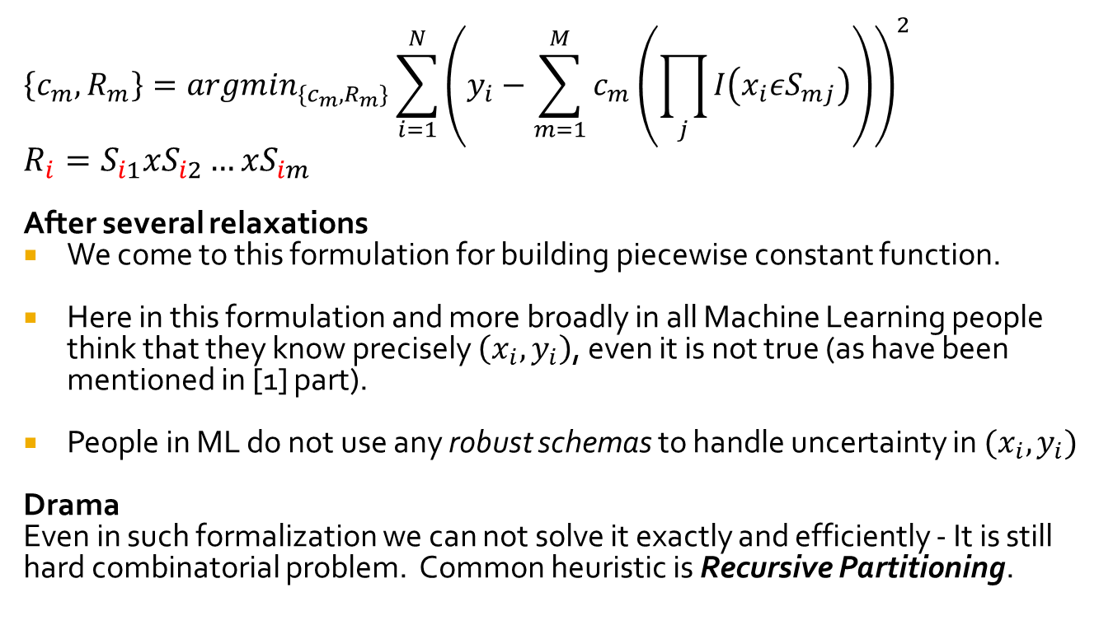
CART Decision Tree for regression. General
$$\left\{c_{m},R_{m}\right\}=argmin_{\{c_{m},R_{m}\}}\sum_{i=1}^{N}{{\left(y_{i}−\sum_{m=1}^{M}{c_{m}\left(\prod_{j}{I\left(x_{i}εS_{mj}\right)}\right)}\right)}^{2}}$$
$R_{i}=S_{i1}xS_{i2}…xS_{im}$
After several relaxations
We come to this formulation for building piecewise constant function.
Here in this formulation and more broadly in all Machine Learning people think that they know precisely $\left(x_{i},y_{i}\right)$, even it is not true (as have been mentioned in [1] part).
People in ML do not use any robust schemas to handle uncertainty in $(x_{i},y_{i})$
Drama
Even in such formalization we can not solve it exactly and efficiently - It is still hard combinatorial problem. Common heuristic is Recursive Partitioning.

Slide 5
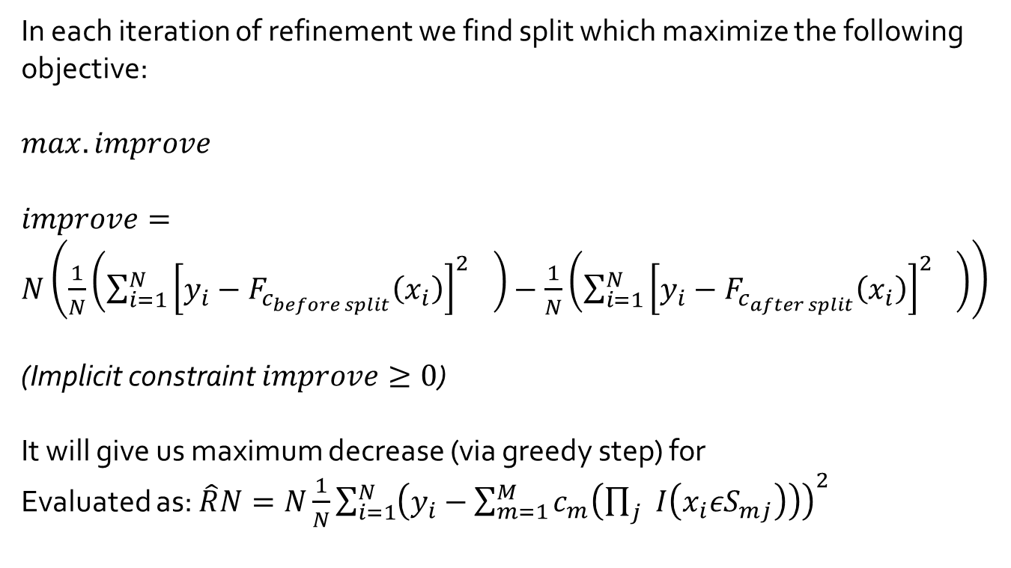
CART Decision Tree for regression. Split.
In each iteration of refinement we find split which maximize the following objective:
$max. improve$
$improve=N\left(\frac{1}{N}\left({\sum_{i=1}^{N}{{\left[y_{i}−F_{c_{before split}}\left(x_{i}\right)\right]}^{2}}}^{}\right)−\frac{1}{N}\left({\sum_{i=1}^{N}{{\left[y_{i}−F_{c_{after split}}\left(x_{i}\right)\right]}^{2}}}^{}\right)\right)$
(Implicit constraint $improve≥0$)
It will give us maximum decrease (via greedy step) for
Evaluated as: $\hat{R}N=N\frac{1}{N}\sum_{i=1}^{N}{{\left(y_{i}−\sum_{m=1}^{M}{c_{m}\left(\prod_{j}{I\left(x_{i}εS_{mj}\right)}\right)}\right)}^{2}}$
And if $improve=0$ it will just stops algorithm due to it’s limitations

Slide 6
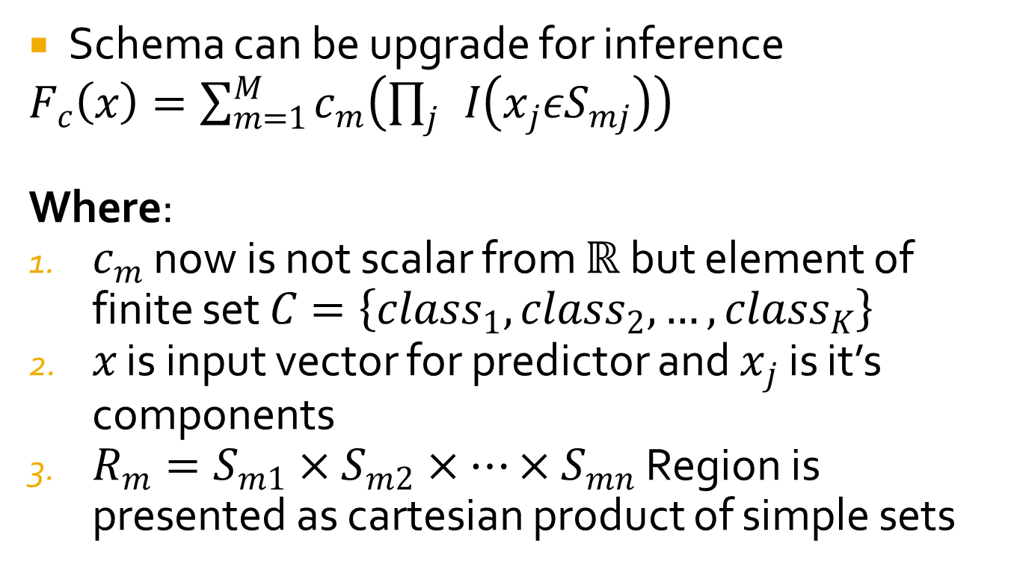
CART Decision Tree for classification (easy upgrade of model structure)
Schema can be upgrade for inference
$F_{c}\left(x\right)=\sum_{m=1}^{M}{c_{m}\left(\prod_{j}{I\left(x_{j}εS_{mj}\right)}\right)}$
Where:
$c_{m}$ now is not scalar from $ℝ$ but element of finite set $C=\left\{class_{1},class_{2},…,class_{K}\right\}$
$x$ is input vector for predictor and $x_{j}$ is it’s components
$R_{m}=S_{m1}×S_{m2}×…×S_{mn}$ Region is presented as cartesian product of simple sets

Slide 7
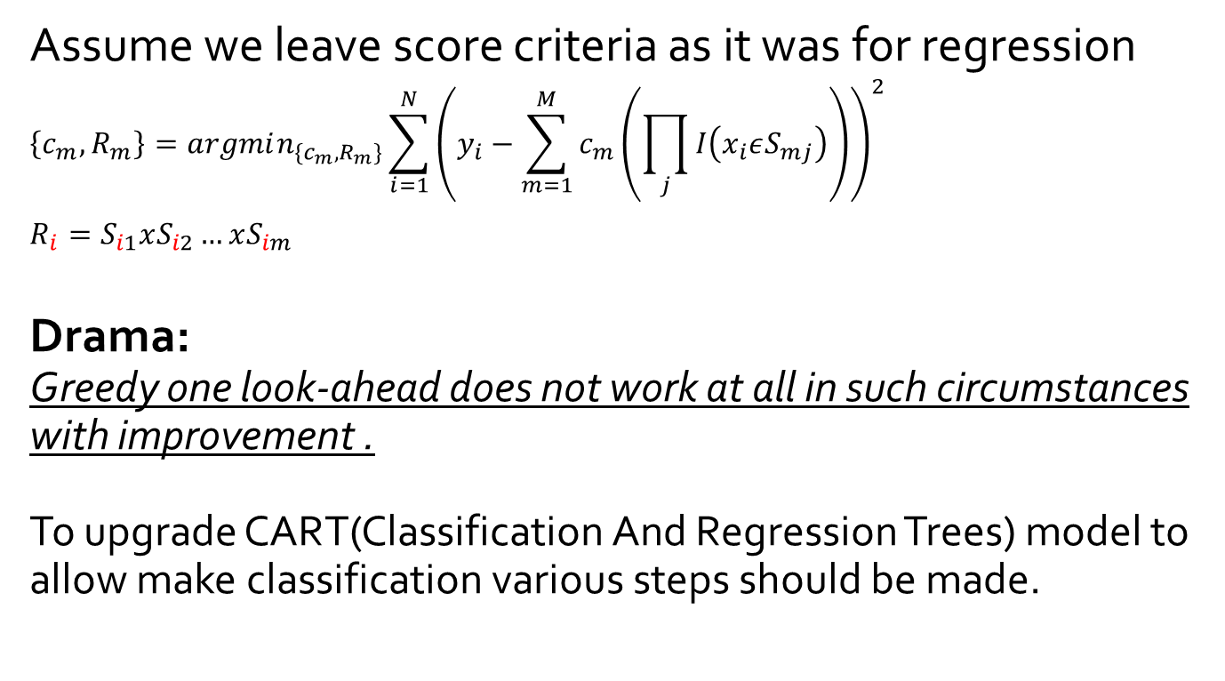
CART Decision Tree for classification (various problems in search strategy)
Assume we leave score criteria as it was for regression
$$\left\{c_{m},R_{m}\right\}=argmin_{\{c_{m},R_{m}\}}\sum_{i=1}^{N}{{\left(y_{i}−\sum_{m=1}^{M}{c_{m}\left(\prod_{j}{I\left(x_{i}εS_{mj}\right)}\right)}\right)}^{2}}$$
$R_{i}=S_{i1}xS_{i2}…xS_{im}$
Drama:
Greedy one look-ahead does not work at all in such circumstances with improvement .
To upgrade CART(Classification And Regression Trees) model to allow make classification various steps should be made.

Slide 8
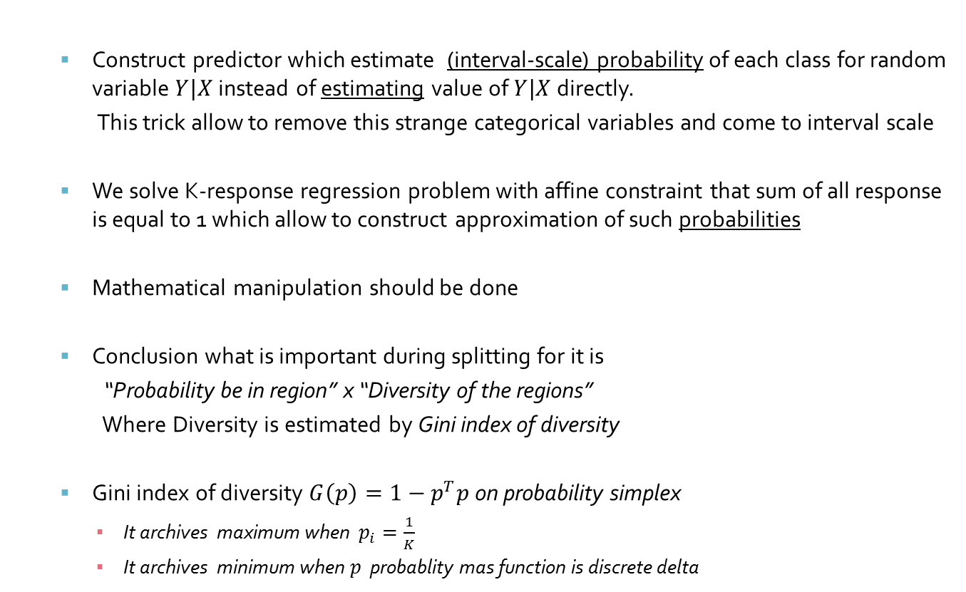
CART Decision Tree for classification. (Only general picture how this model handle classification)
Construct predictor which estimate (interval-scale) probability of each class for random variable $Y|X$ instead of estimating value of $Y|X$ directly.
This trick allow to remove this strange categorical variables and come to interval scale
We solve K-response regression problem with affine constraint that sum of all response is equal to 1 which allow to construct approximation of such probabilities
Mathematical manipulation should be done
Conclusion what is important during splitting for it is
“Probability be in region” x “Diversity of the regions”
Where Diversity is estimated by Gini index of diversity
Gini index of diversity $G\left(p\right)=1−p^{T}p$ on probability simplex
It archives maximum when $p_{i}=\frac{1}{K}$
It archives minimum when $p$ probablity mas function is discrete delta

Slide 9
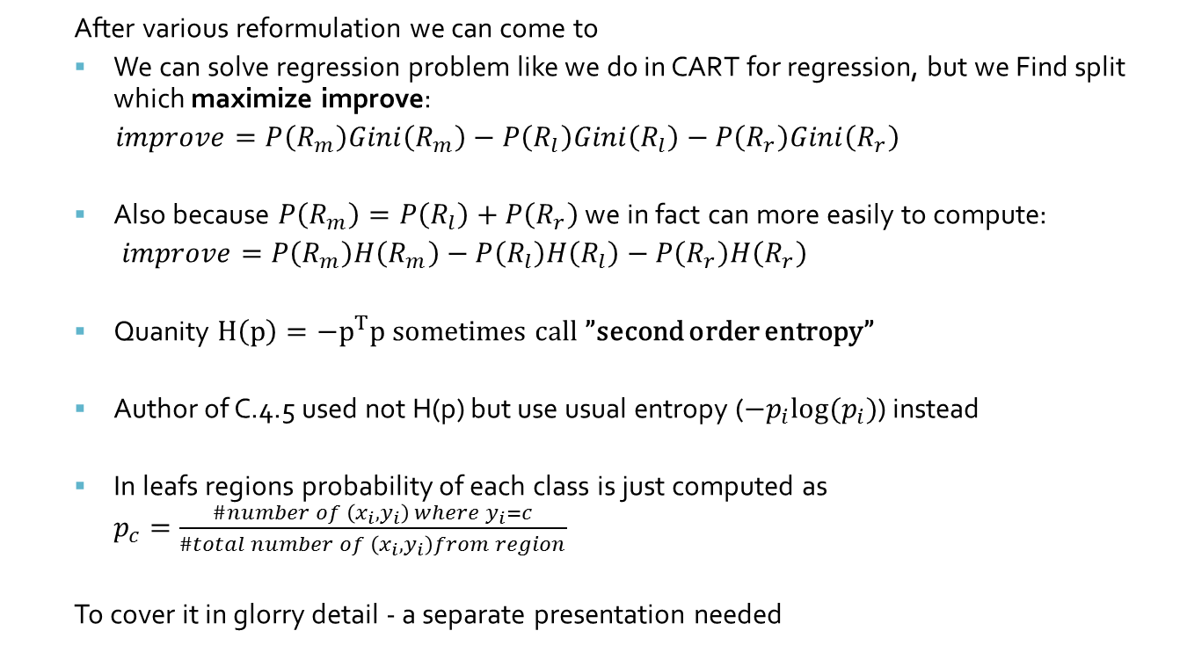
CART Decision Tree for classification. (Only general picture how it is doing)
After various reformulation we can come to
We can solve regression problem like we do in CART for regression, but we Find split which maximize improve:
$improve=P\left(R_{m}\right)Gini\left(R_{m}\right)−P\left(R_{l}\right)Gini\left(R_{l}\right)−P\left(R_{r}\right)Gini\left(R_{r}\right)$
Also because $P\left(R_{m}\right)=P\left(R_{l}\right)+P\left(R_{r}\right)$ we in fact can more easily to compute:
$improve=P\left(R_{m}\right)H\left(R_{m}\right)−P\left(R_{l}\right)H\left(R_{l}\right)−P\left(R_{r}\right)H\left(R_{r}\right)$
Quanity $H\left(p\right)=−p^{T}p$ sometimes call ”second order entropy”
Author of C.4.5 used not H(p) but use usual entropy ($−p_{i}log⁡(p_{i})$) instead
In leafs regions probability of each class is just computed as $p_{c}=\frac{\#number of \left(x_{i},y_{i}\right) where y_{i}=c}{\#total number of \left(x_{i},y_{i}\right)from region}$
To cover it in glorry detail - a separate presentation needed

Slide 10
Problem with decision trees for regression
Problem is that trees have big variance because:
Very rapid data fragmentation. During split’s there are less and less data in daughter regions.
The possible error in upper part of decision tree propagates down to the terminal nodes.
The errors are not accumulated (or averaged), but in fact errors is cascaded/multiplied
Even minor change split in the root will dramatically change tree structure
What todo if we do not leave room of nice advantages of the decision trees?
Live with the problem
Fix up trees. Recent research is:
Bagging ,1996
Boosting, 1996
MARS (Multiple Adaptive Regression Splines) 1989. (not so popular then 1,2 right now )

Slide 11
Ensemble of trees. Why such thing matter
First view of ensemble of trees
Ensemble of tree can be viewed as linear combination of tees
Trees is piecewise constant function with special form of regions
Linear combination of piecewise constant function is piecewise constant function
But why does it matter
In ensemble of trees there are more pieces then in single tree
Pieces can overlap
Any function can be approximated by piecewise constant functions if there are:
A lot of regions to split domain
A lot of data to fit each constant value in each region

Slide 12
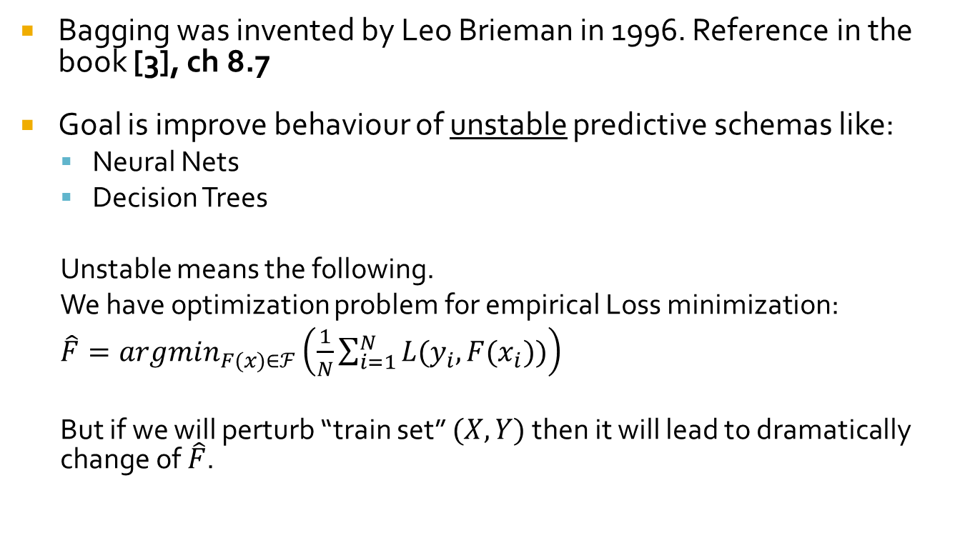
Bagging. History and goal
Bagging was invented by Leo Brieman in 1996. Reference in the book [3], ch 8.7
Goal is improve behaviour of unstable predictive schemas like:
Neural Nets
Decision Trees
Unstable means the following.
We have optimization problem for empirical Loss minimization:
$\hat{F}=argmin_{F(x)∈ℱ}\left(\frac{1}{N}\sum_{i=1}^{N}{L(y_{i},F(x_{i}))}\right)$
But if we will perturb “train set” $(X,Y)$ then it will lead to dramatically change of $\hat{F}$.

Slide 13



Bagging. Illustration of unstable procedure behaviour when function class is big.
Distributions of solutions is
“very wild as changing rapidly” as we draw different “train set” from population
$$F^{∗}$$
$$ℱ_{1}$$
$$ℱ_{3}⊇ℱ_{1}$$

Slide 14
Bagging. Illustration of stable procedure behaviour when function class is big.
$$F^{∗}$$
$$ℱ_{1}$$
$$ℱ_{3}⊇ℱ_{1}$$
14

Slide 15
Bagging. Several quotes.
“The simplicity how Leo figure out how to fix it is awesome by it’s simplicity” – J.H. Friedman
“Leo called it’s bagging because it means bootstrap aggregation” – J.H.Friedman

Slide 16
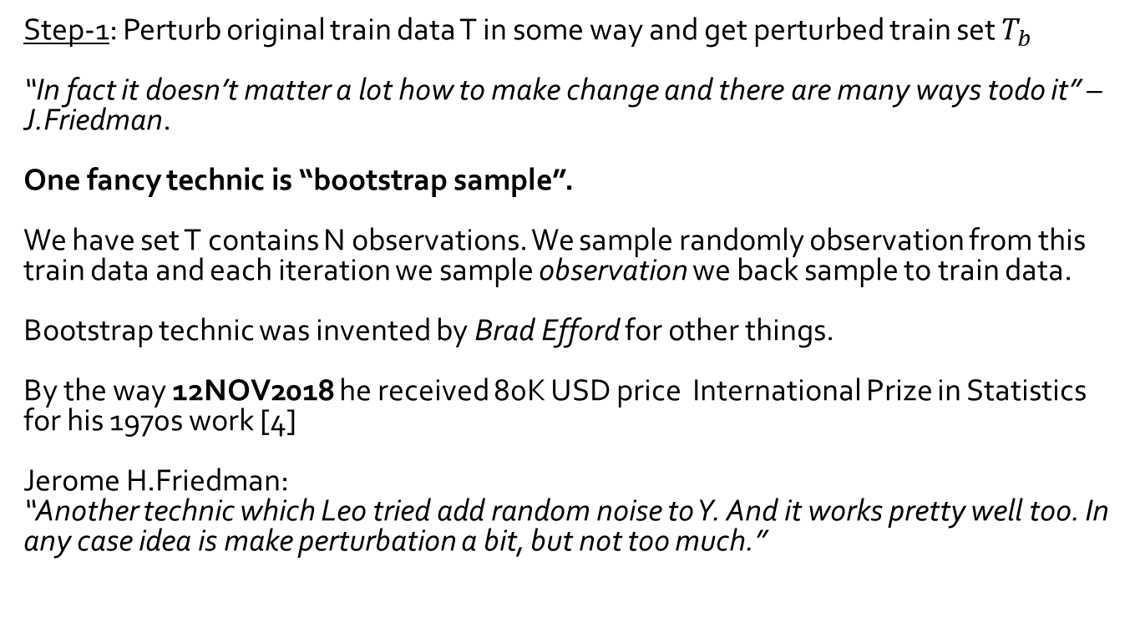
Bagging algorithm Step 1/3
Step-1: Perturb original train data T in some way and get perturbed train set $T_{b}$
“In fact it doesn’t matter a lot how to make change and there are many ways todo it” – J.Friedman.
One fancy technic is “bootstrap sample”.
We have set T contains N observations. We sample randomly observation from this train data and each iteration we sample observation we back sample to train data.
Bootstrap technic was invented by Brad Efford for other things.
By the way 12NOV2018 he received 80K USD price International Prize in Statistics for his 1970s work [4]
Jerome H.Friedman:
“Another technic which Leo tried add random noise to Y. And it works pretty well too. In any case idea is make perturbation a bit, but not too much.”

Slide 17
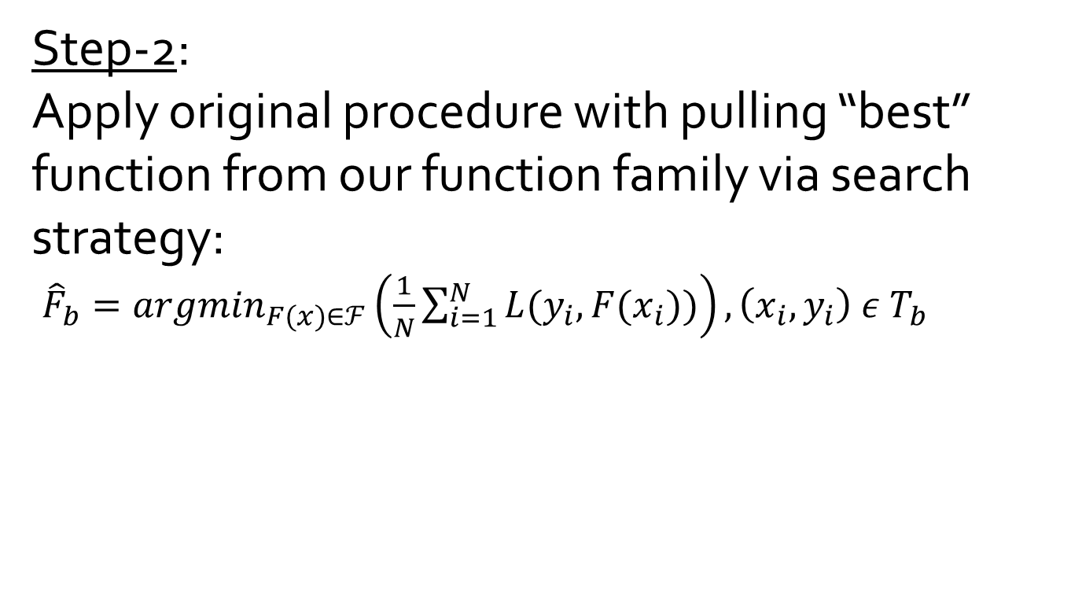
Bagging algorithm Step 2/3
Step-2:
Apply original procedure with pulling “best” function from our function family via search strategy:
${\hat{F}}_{b}=argmin_{F(x)∈ℱ}\left(\frac{1}{N}\sum_{i=1}^{N}{L(y_{i},F(x_{i}))}\right), \left(x_{i},y_{i}\right) ε T_{b}$

Slide 18
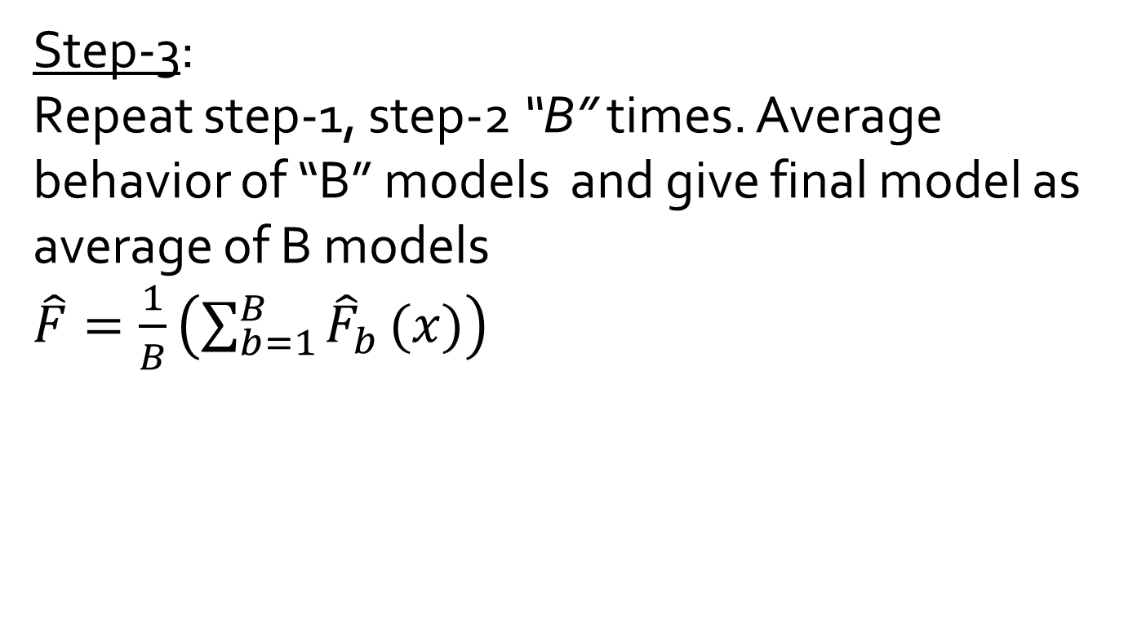
Bagging algorithm Step 3/3
Step-3:
Repeat step-1, step-2 “B” times. Average behavior of “B” models and give final model as average of B models
$\hat{F}=\frac{1}{B}\left(\sum_{b=1}^{B}{{\hat{F}}_{b}}(x)\right)$

Slide 19
Bagging. Some observations
Bagging doesn’t do nothing with bias (almost always). If we consider function space which is closed at least to “sum/scaling”.
So particularly for tree’s “this silly thing” do nothing with bias error.
Also what is averaging is ouput and it’s not the structure of the trees.
“But why this thing can do something? How even it’s possible! “ – J.Friedman

Slide 20
Bagging . Why this thing is working?
Deep answer lie in area of math optimization and one aspect of difference between
convex and non-convex math optimization.

Slide 21
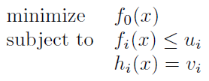
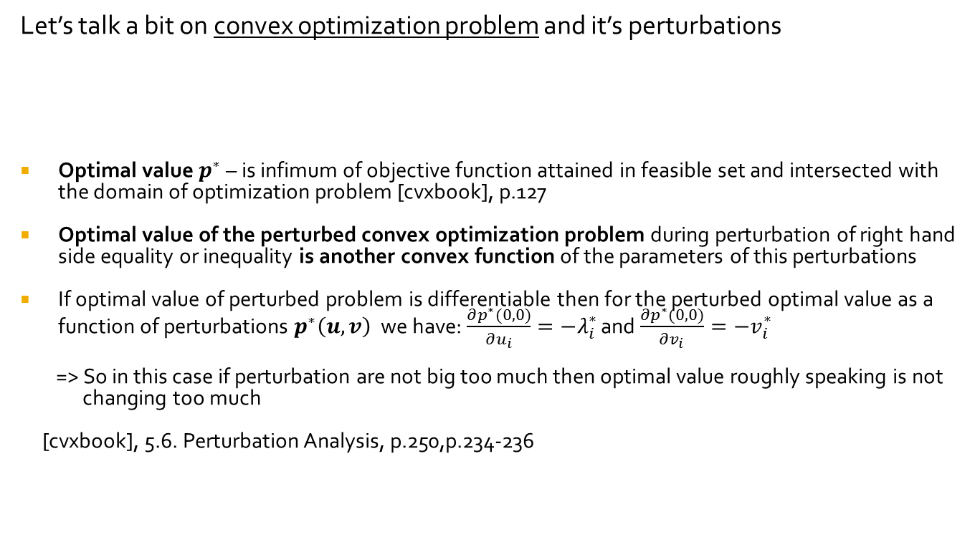
Bagging . About perturbed convex optimization problem
Let’s talk a bit on convex optimization problem and it’s perturbations
Optimal value $p^{∗}$ – is infimum of objective function attained in feasible set and intersected with the domain of optimization problem [cvxbook], p.127
Optimal value of the perturbed convex optimization problem during perturbation of right hand side equality or inequality is another convex function of the parameters of this perturbations
If optimal value of perturbed problem is differentiable then for the perturbed optimal value as a function of perturbations $p^{∗}\left(u,v\right)$ we have: $\frac{∂p^{∗}(0,0)}{∂u_{i}}=−λ_{i}^{∗}$ and $\frac{∂p^{∗}(0,0)}{∂v_{i}}=−v_{i}^{∗}$
=> So in this case if perturbation are not big too much then optimal value roughly speaking is not
changing too much
[cvxbook], 5.6. Perturbation Analysis, p.250,p.234-236

Slide 22
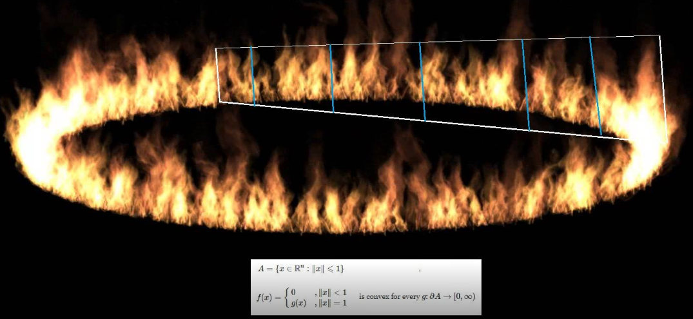
Bagging . About convex functions.
Convex function are continuous in relative interior of it’s domain. So mostly they are continuous even some strange situations can happend on boundary:
https://www.facebook.com/photo.php?fbid=664179037304832&set=a.164584463930961&type=3&theater

Slide 23
Bagging. Will bagging work for problem which are reduced to convex optimization?
No
“Bagging does not help for procedures which are themselves are convex optimization problem” – Jerome H. Friedman.
“Whole point of ensemble you combine different decision trees… ensemble methods in context of convex optimization are boring…” – S.Boyd,
58:40,
https://www.youtube.com/watch?v=wqy-og_7SLs
23

Slide 24
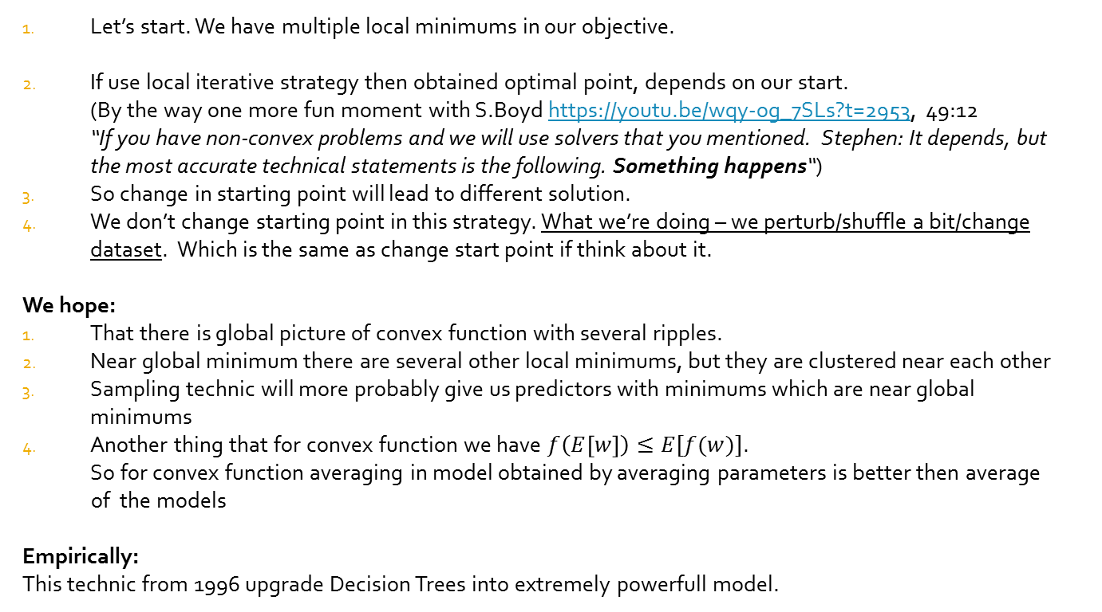
Bagging. Ideas why bagging helps for approximation schemas reduced to non-convex optimization
Let’s start. We have multiple local minimums in our objective.
If use local iterative strategy then obtained optimal point, depends on our start. (By the way one more fun moment with S.Boyd https://youtu.be/wqy-og_7SLs?t=2953, 49:12 “If you have non-convex problems and we will use solvers that you mentioned. Stephen: It depends, but the most accurate technical statements is the following. Something happens“)
So change in starting point will lead to different solution.
We don’t change starting point in this strategy. What we’re doing – we perturb/shuffle a bit/change dataset. Which is the same as change start point if think about it.
We hope:
That there is global picture of convex function with several ripples.
Near global minimum there are several other local minimums, but they are clustered near each other
Sampling technic will more probably give us predictors with minimums which are near global minimums
Another thing that for convex function we have $f\left(E\left[w\right]\right)≤E[f(w)]$.
So for convex function averaging in model obtained by averaging parameters is better then average
of the models
Empirically:
This technic from 1996 upgrade Decision Trees into extremely powerfull model.

Slide 25
Bagging. Nice decoupling.
Via deep of decision trees – we control bias.
Via bagging technic – we control variance .
If to be completely honest we can bag anything
When bagging works
Trees are not highly correlated
Each tree should be enough strong to predict something
But Bagging as “average technic” works with improve quality in average, no for particular tree.
“It still can be a case then a single tree works better” – J.Friedman

Slide 26
Random Forest as extreme case of Bagging
Random Forest is most popular form of bagging
We create deepest Decision Trees without any pruning (cp=0)
The height of decision tree is only limited by the size of train samples
Wrap-around this procedure via bagging
Nice thing about Random Forest – each tree can be compute completely in parallel.
Each Decision Tree is building completely independent
Example of usage. Kinect in human pose recognition use Random Forest [7]
26

Slide 27
Random Forest. Conclusion.
In Random forest it’s possible append extra variation of the trees via build tree based on random subset of variables.
J.Friedman said that Leo didn’t give any recommendation of the number of variables, but via consideration of J.Friedman selecting of variable is just a strange thing.
For random forest it should be 2 meta-parameters:
Size of the sample for bootstap.
Smaller boostrap sample – more randomness in the tree.
Bigger boostrap sample – less randomness in the tree.
Fraction of selected variables.
Unfortunately in standard implementations there is no necessary such thing have been implemented both.

Slide 28
Bagging and Random Forest. Advantages
They share all nice properties of Decision Trees from [1] exclude 1 interpretability
Even If you have 1000 or 10 or even 5 trees it’s very hard to understand what is going on under the hood
(or at least not so easy)
But main competitor which is Neural Nets – is not interpretable too (or at least it’s not so easy)
(If you’re interesting in interpretability here a short note about several schemas to interpret black-box models in AI/ML [8])

Slide 29
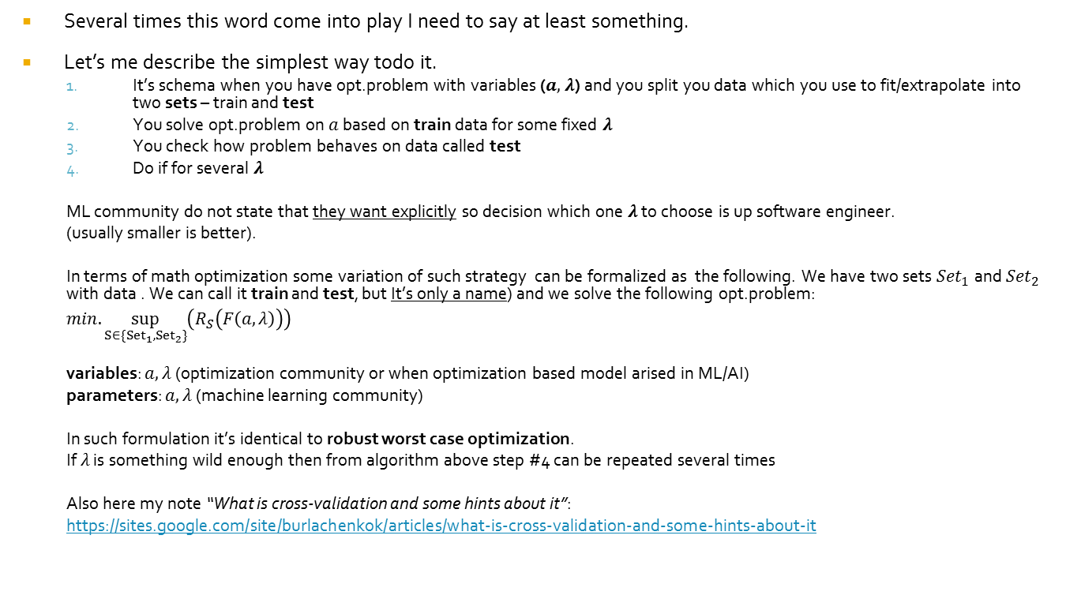
Model selection: slide about cross-validation
Several times this word come into play I need to say at least something.
Let’s me describe the simplest way todo it.
It’s schema when you have opt.problem with variables ($a,$ $λ$) and you split you data which you use to fit/extrapolate into two sets – train and test
You solve opt.problem on $a$ based on train data for some fixed $λ$
You check how problem behaves on data called test
Do if for several $λ$
ML community do not state that they want explicitly so decision which one $λ$ to choose is up software engineer.
(usually smaller is better).
In terms of math optimization some variation of such strategy can be formalized as the following. We have two sets ${Set}_{1}$ and ${Set}_{2}$ with data . We can call it train and test, but It’s only a name) and we solve the following opt.problem:
$min.\sup_{S∈\{{Set}_{1},{Set}_{2}\}}\left(R_{S}\left(F\left(a,λ\right)\right)\right)$
variables: $a,λ$ (optimization community or when optimization based model arised in ML/AI)
parameters: $a,λ$ (machine learning community)
In such formulation it’s identical to robust worst case optimization.
If $λ$ is something wild enough then from algorithm above step #4 can be repeated several times
Also here my note “What is cross-validation and some hints about it”:
https://sites.google.com/site/burlachenkok/articles/what-is-cross-validation-and-some-hints-about-it

Slide 30
Boosting. Only motivation
“Motivation as I see it’s right now is completely different how it was historically developed. It’s not in our book [3], but I think it’s just better way to understand from Optimization perspective” - J.H.Friedman, May2018.
Motivation: build something like random forest
But now similarity stops…
To be continue in the middle of February,2018…

Slide 31

Merry Christmas and a happy new year!

