Slide 1
Electron Energy Levels
Bohr vs Schrödinger

Slide 2
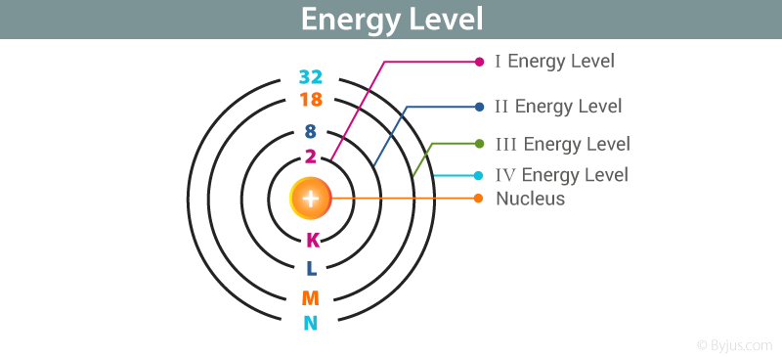
Bohr’s model
Proposed that electrons exist in discrete energy levels/ shells
Each electron has a fixed amount of energy
Electrons in lower energy levels contain less energy than those in higher shells
Each shell can hold a certain maximum no. of electrons
The max. no. is found using 2n² where n is the shell no.

Slide 3
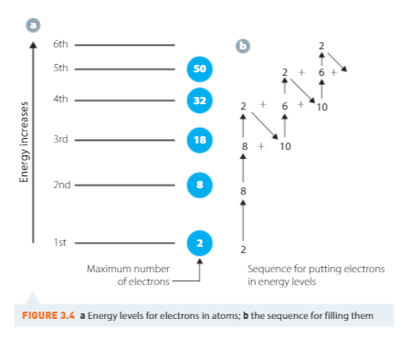
Electron configuration
Basic electron configuration is simply stating the no. of electrons in each shell.

Slide 4
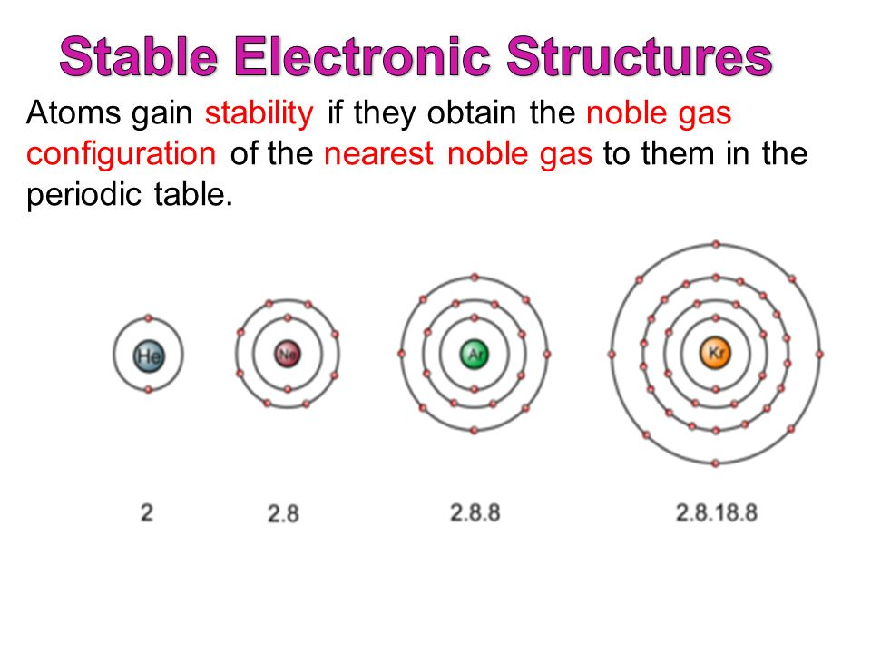
Stable electron configuration
Noble gases have stable electron arrangements (or valence/ outer shell energy levels filled to 8)
Other atoms undergo chemical reactions to gain stable electron arrangements
Atoms gain, lose or share electrons to gain stable (noble gas) electron configurations
Elements in the same group have the same number of
valence electrons

Slide 5
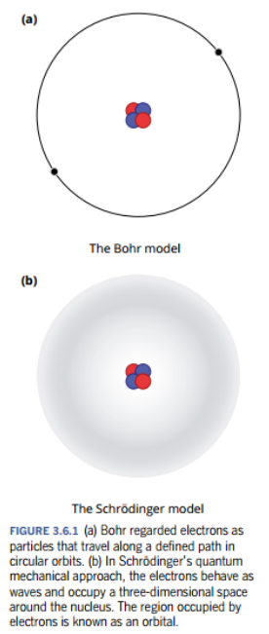
Schrödinger’s Model
This model is called quantum mechanics.
It assumes that electrons behave as waves around
the nucleus.
This model assumes:
There are major energy levels in an atom called shells
Each shell contains a separate energy level of similar
energy, called subshells (s, p, d, f)
Each subshell can only hold a certain number of electrons

Slide 6
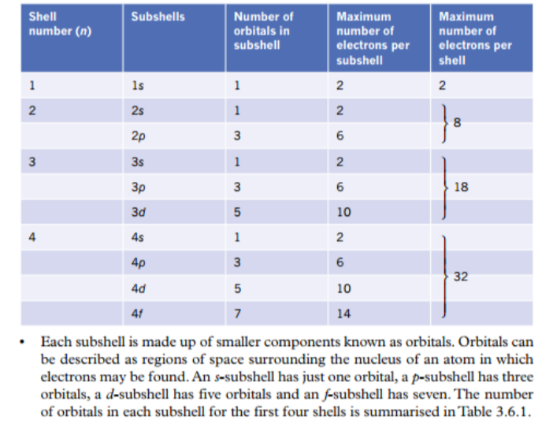
Energy levels within an atom

Slide 7
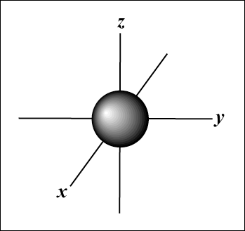
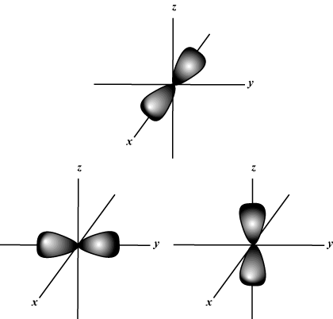
Atomic Orbitals
An atomic orbital is a volume of space around the nucleus of an atom through which 1-2 electrons can randomly move
Are assigned letters s, p, d or f (smart people do fine)
Energy sublevels correspond to a shape where the electron is likely to be found
s orbital (1) (spherical) p orbitals (3) (dumb-bell shaped)

Slide 8
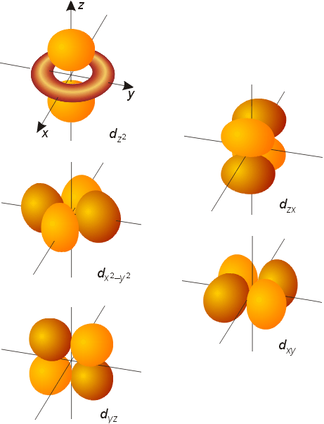
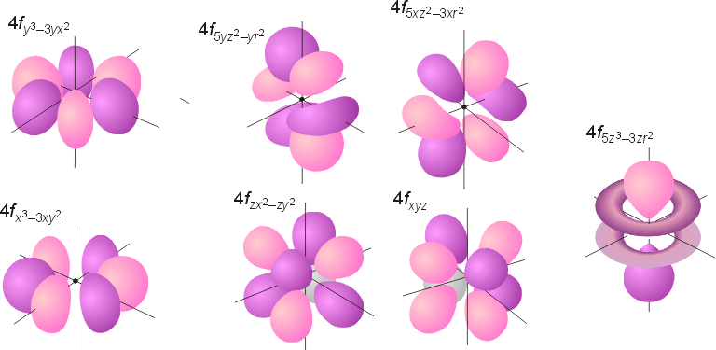
Orbitals Continued
d orbitals (5) f orbitals (7)

Slide 9
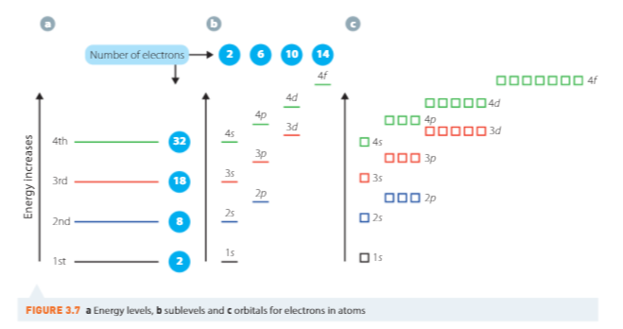
Filling energy shells

Slide 10
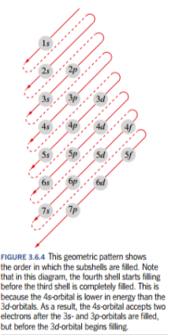
Filling energy shells
Here is another way to do it

Slide 11
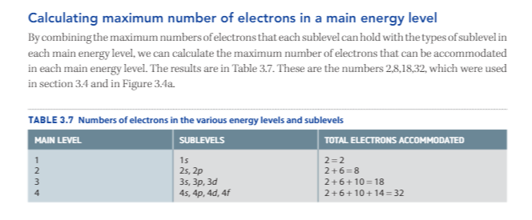
Calculating max. no. of electrons

Slide 12
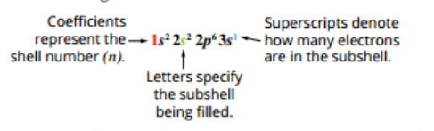
Orbital Notation
This method shows the numbers of electrons in each sublevel.
Neon… previously (2,8) becomes… 1s²2s²2p⁶
Scandium (2, 8, 9, 2) becomes… 1s²2s²2p⁶3s²3p⁶4s²3d¹

Slide 13
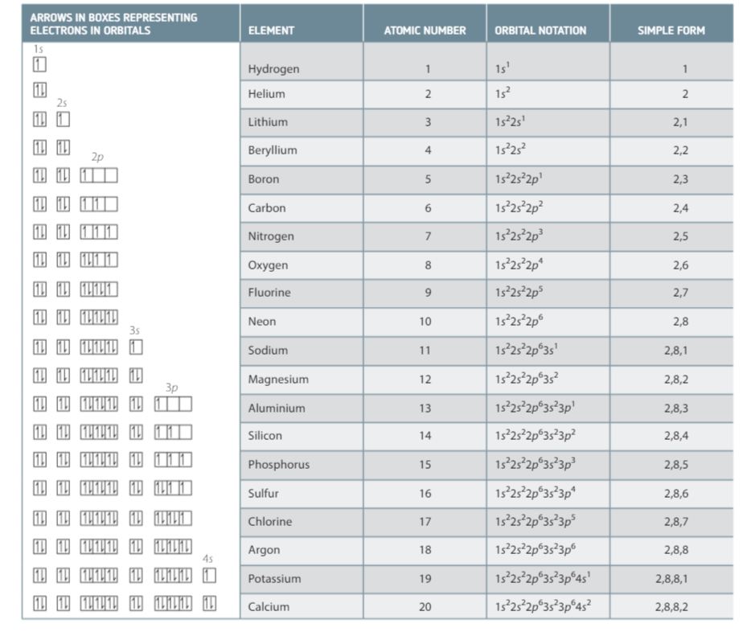
Different ways to represent electron configuration

Slide 14
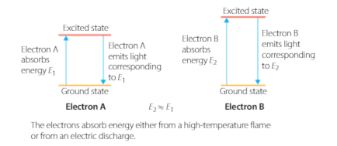
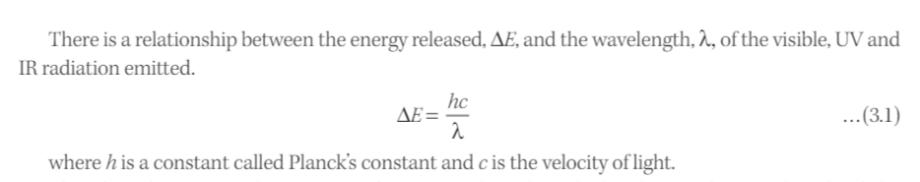
Atomic Emission Spectroscopy

Slide 15
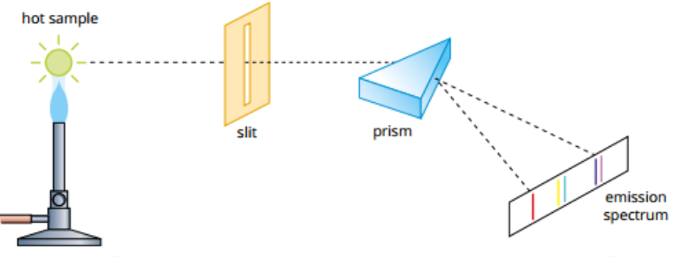
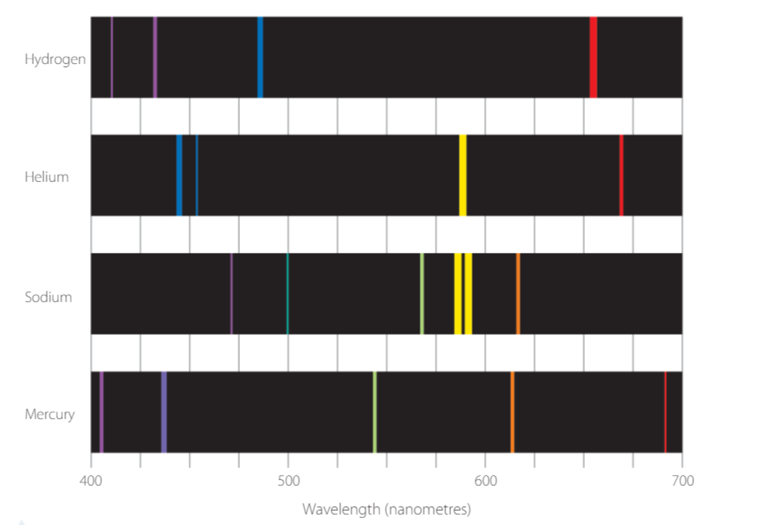
Emission Spectra

Slide 16
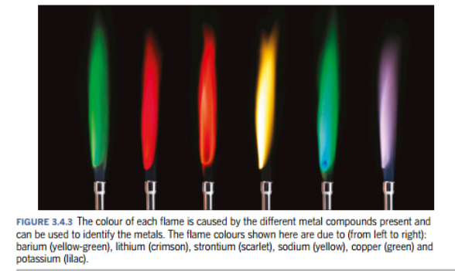
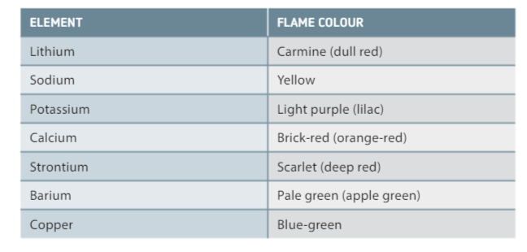
Flame Tests
In some metallic atoms… One electron transition occurs far more frequently than any others giving the flame a distinctive colour.

