Slide 1






Cherenkov detector for proton Flux Measurement (CpFM)
Leonid Burmistrov
on behalf of the UA9 Cherenkov detector team
¹ L. Burmistrov, ¹ D. Breton, ¹ V. Chaumat, ³ G. Cavoto, ¹ S. Conforti Di Lorenzo, ³ M. Garattini,
³ F. Iacoangeli, ¹ J. Jeglot, ² F. Loprete, ¹ J. Maalmi, ² S. Montesano,
¹ V. Puill, ² W. Scandale, ¹ A. Stocchi, ¹ J-F Vagnucci
¹ LAL, Univ Paris-Sud, CNRS/IN2P3, Orsay, France
² CERN - European Organization for Nuclear Research, CH-1211 Geneva 23, Switzerland
³ INFN - Roma La Sapienza, Italy

Slide 2

Outline
1. Introduction
Channeling effect of the charged particles in the bent crystal
UA9 experiment at SPS
2. CpFM detector
LUA9 project
CpFM detection chain components
Geant4 simulation of the CpFM
3. Beam test
Beam tests (at BTF Frascati) of simplified prototypes
Results of the beam test
4. Conclusion

Slide 3
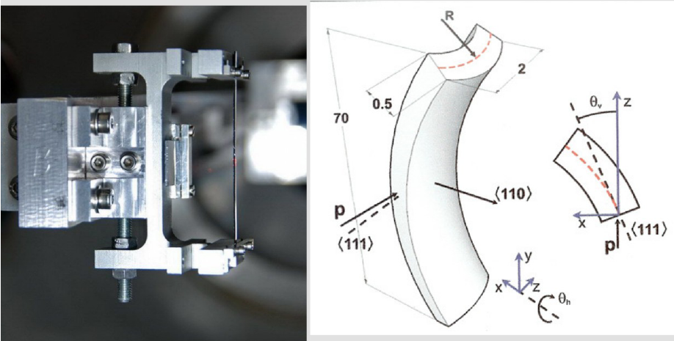
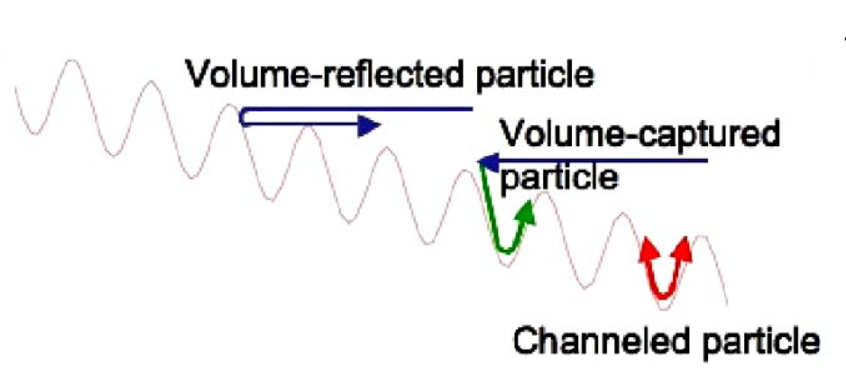
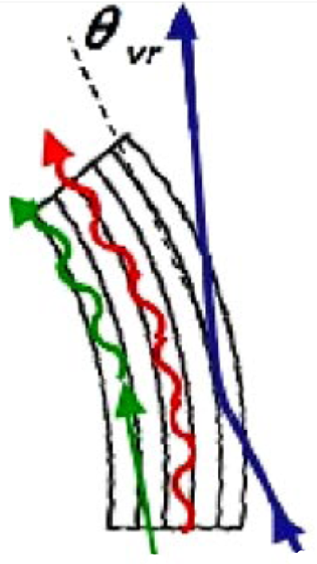
Channeling effect of the charged particles in the bent crystal
Mechanically bent crystal
Using of a secondary curvature of the crystal to guide the particles
If crystal planes are correctly oriented with respect to the incoming particle – particles can be trapped via potential parabolic barrier between the lattices (this effect is called channeling).
d
U₀
U₀ = 22.7 eV
d = 0.192 nm
High-Efficiency Volume Reflection of an Ultrarelativistic Proton Beam with a Bent Silicon Crystal
(W. Scandale et al. PRL 98, 154801, 2007)

Slide 4
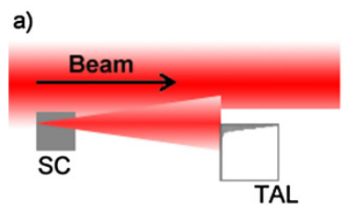
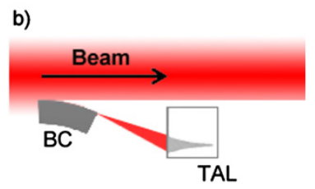
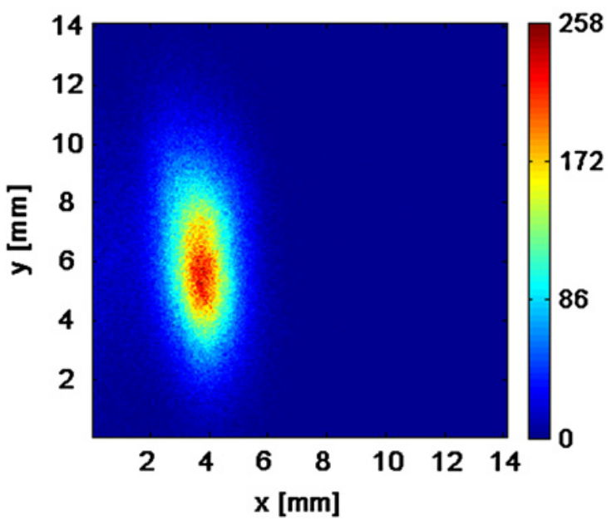
UA9 experiment at SPS
Solid state primary collimator
UA9 MISSION: Investigate bent crystals as primary collimators in hadron colliders
One of the possible applications is “smart” collimation system for particle accelerators.
Bent crystal primary collimator
Bent silicon crystals are expected to direct the beam halo promptly onto secondary collimator thus ideally reducing outscattering, beam losses and the radiation load in critical regions of the ring.
Tests of the bent crystal as a primary collimator in the circular accelerator (SPS) since 2009.
Target Aperture Limitation
Secondary beam after bent crystal is clearly seen
Observation of the secondary beam created by the bent crystal
Strong reduction of the counts from beam loss monitors has been observed at an optimal angle orientation of the crystal
First results on the SPS beam collimation with bent crystals
(W. Scandale et al. Physics Letters B 692 (2010) 78–82)

Slide 5
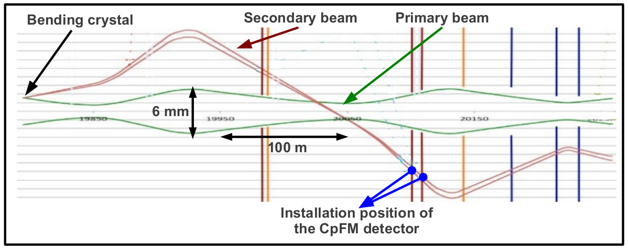
LUA9 project
Use bent crystal at LHC as a primary collimator.
LHC beam pipe (primary vacuum)
To monitor the secondary beam - Cherenkov detector based on quartz radiator can be used. Initial idea belongs to the PNPI group with a prototype tested in SPS.
Aim: count the number of protons with a precision of about 5% (in case of 100 incoming protons) in the LHC environment.
Main constrains for such device:
No degassing materials (inside the primary vacuum).
Radiation hardness of the detection chain (very hostile radioactive environment).
Compact radiator inside the beam pipe (small place available)
Readout electronics at 300 m
Cherenkov detector for proton Flux Measurements (CpFM)

Slide 6
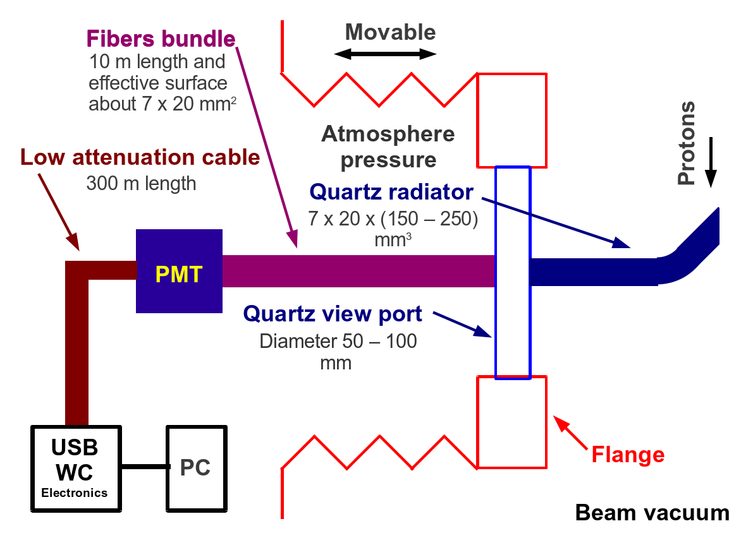
CpFM detection chain components
Radiation hard quartz radiator
The flange with view port attached to the movable bellow.
The light will propagate inside the radiator and will then be transmitted to the PMT via a bundle of optical fibers.
Quartz/quartz (core/cladding) radiation hard fibers.
300 m cable
USB-WC electronics. For more details see :
USING ULTRA FAST ANALOG MEMORIES FOR FAST PHOTO-DETECTOR READOUT,
(D. Breton et al. PhotoDet 2012, LAL Orsay)

Slide 7
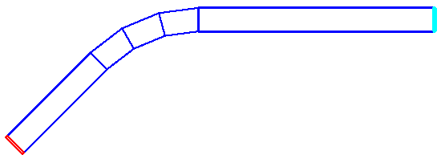
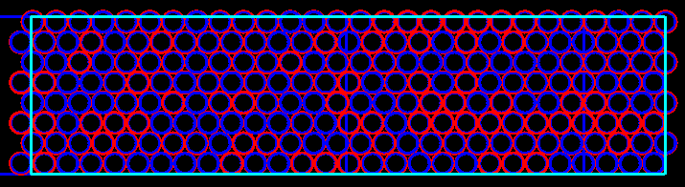
Geant4 simulation of the CpFM
A lot of shapes of the quartz radiator has been simulated. We present the most promising one.
pmt
Bundle of fibers
Quartz radiator (20 mm thick)
PMT:
Bialkali photocathod (24 % @ 400 nm)
Collection efficiency 80 %
Fiber:
Numerical aperture: 0.22
Corr diameter: 0.6 mm
Cladding diameter: 0.66 mm
Buffer diameter: 0.7 mm

Slide 8
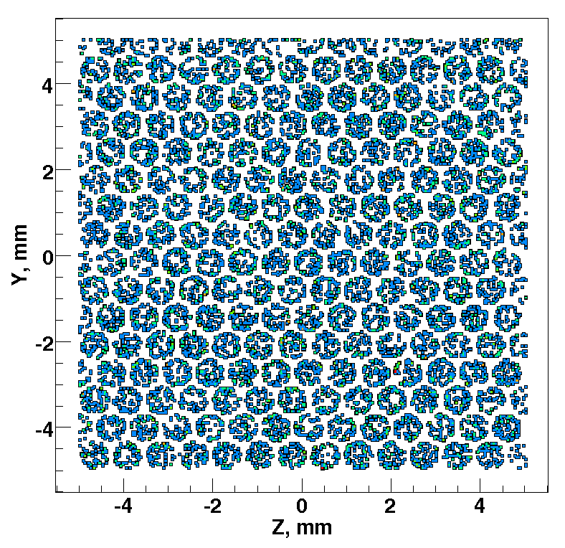
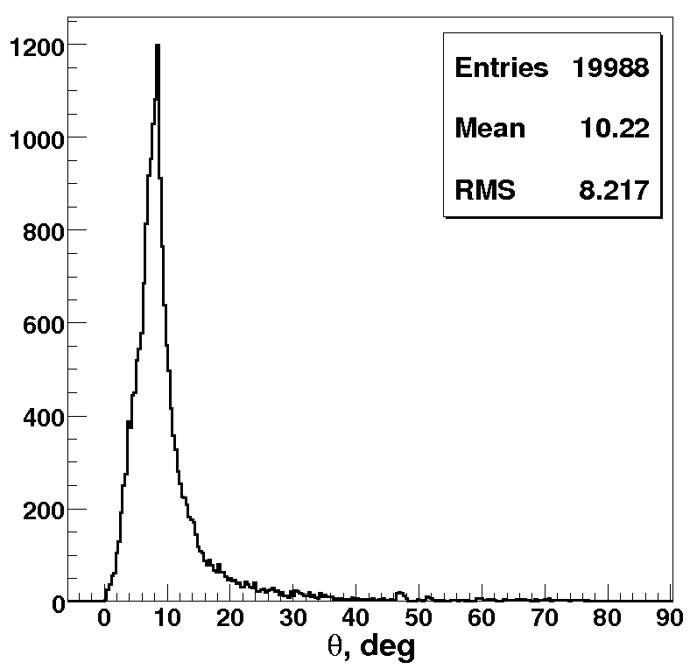
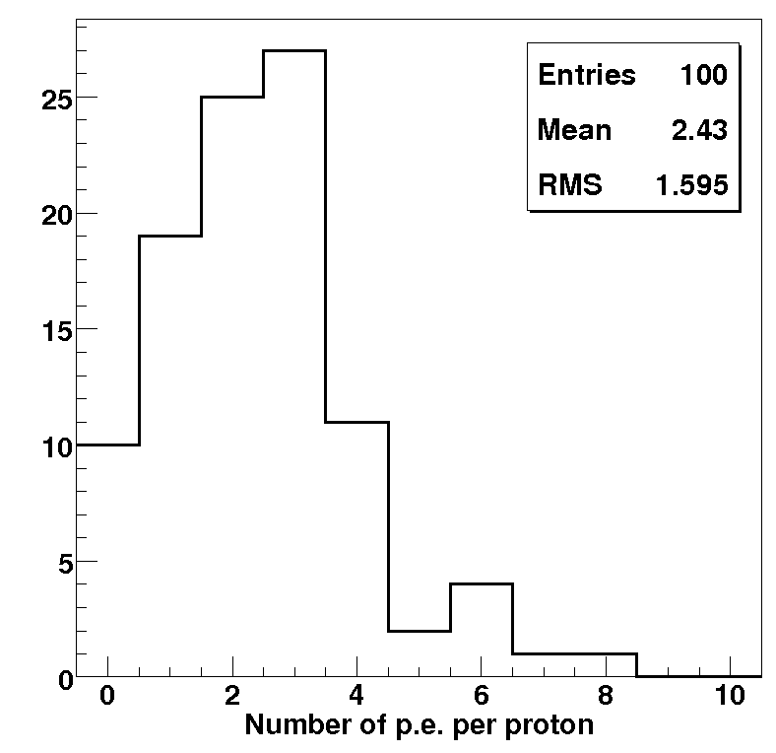
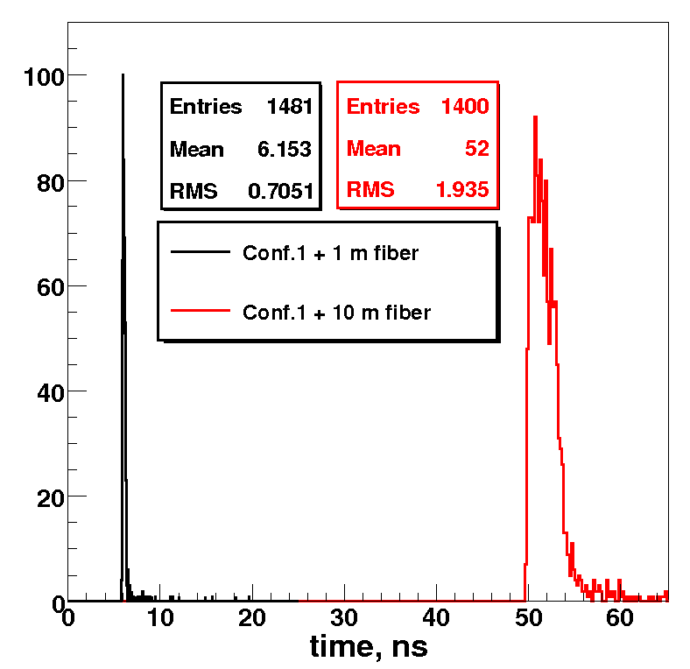
Results of the simulation
Position distribution of the photons on the PMT surface.
Theta distribution of the photons at the PMT entrance. Cut around 10º shows numerical aperture of the optical fiber.
Per proton we are going to detect 2.4 photo-electrons.
The timing length of the photon signal increases with length of the fiber (10 m).

Slide 9
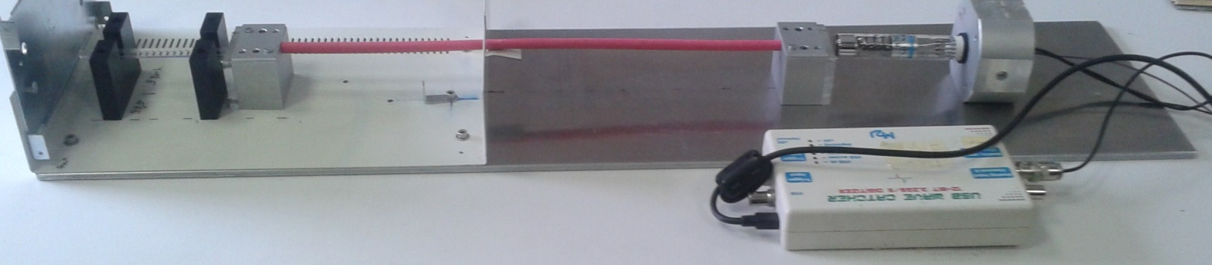
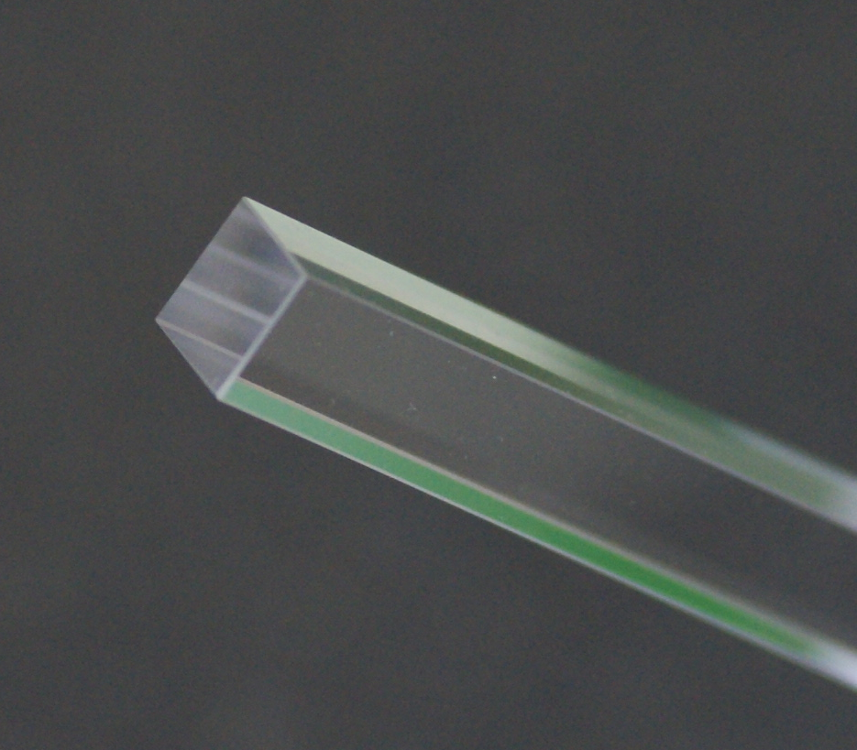
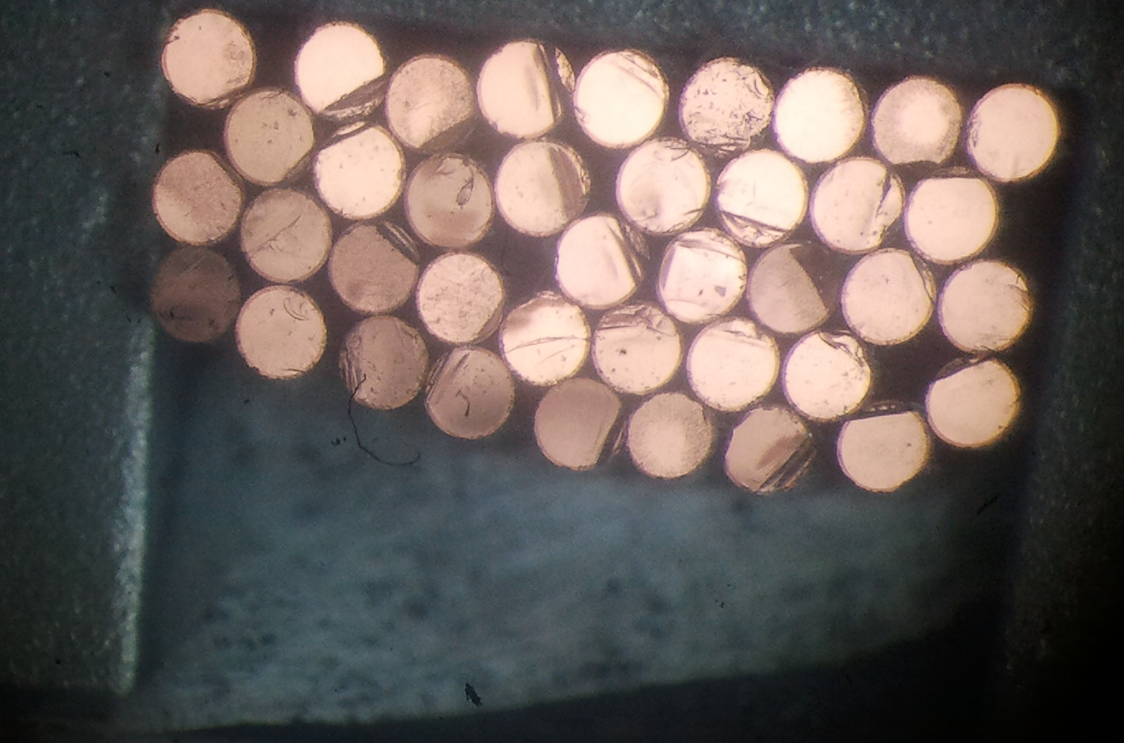
Simplified CpFM prototypes
Simplified prototype
Remotely driven PC
Quartz finger
100 x 10 x 10 mm³
Home made bundle Quartz/quartz (core/cladding) of fiber
400 x 2.8 x 5 mm³
PMT R762
(15 mm effective diameter)
(2 or 8) channels
USB - Wavecatcher
electronics
1)
2)
PMT
3)
PMT
PMT
Bundle
Bundle
e⁻
e⁻
Quartz
Calorimeter
Quartz
Calorimeter
e⁻
Calorimeter
Quartz

Slide 10
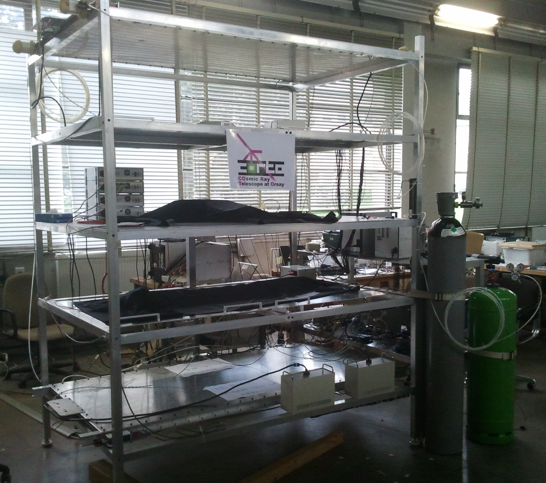
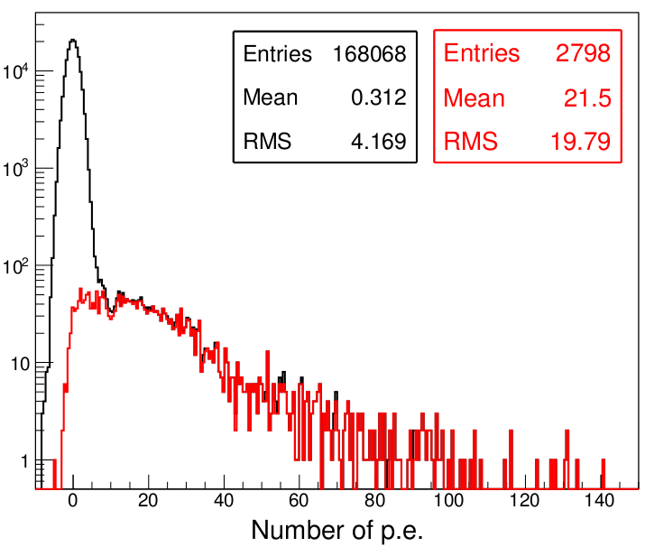
Test with cosmics
Before beam tests of the prototype we performed measurements with cosmic muons reconstructed with CORTO (Cosmic Ray Telescope at Orsay)
Results
MRPC
All events
Coincident with CORTO
MRPC
In average for all incoming muons we detected 21 p.e.

Slide 11
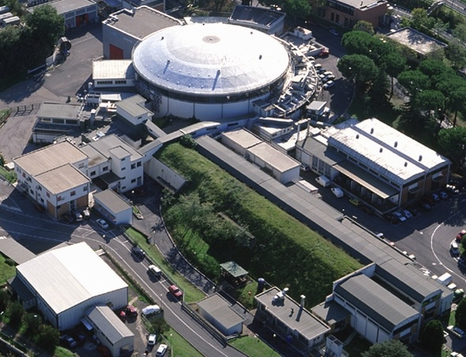
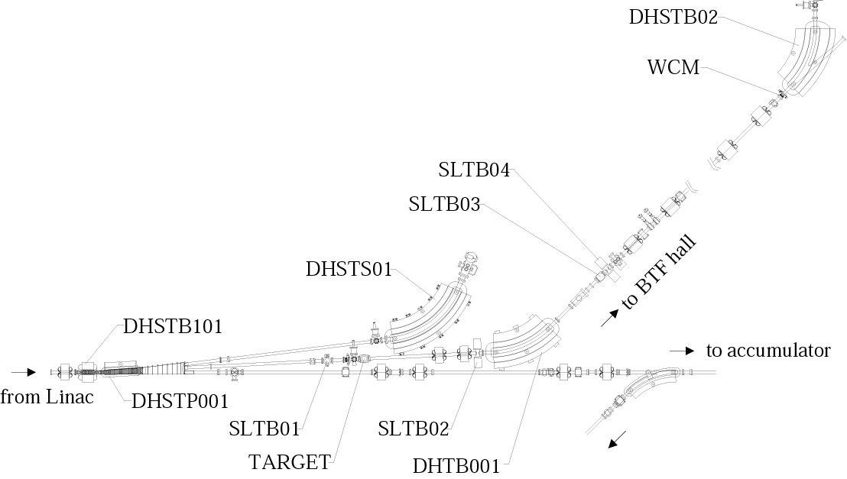
BTF – (Beam Test Facility) at Frascati
Synchrotron light
BTF hall
DAFNE Collider
Damping ring
BTF
Linac
Calorimeter
Tested device
Characteristics of the e⁻ beam @ BTF
Particles number: 1 - 10⁵ e⁻/pulse
Energy: 25 – 500 MeV
Frequency: 20 Hz
Pulse duration: 10 ns
e^{-/+}

Slide 12
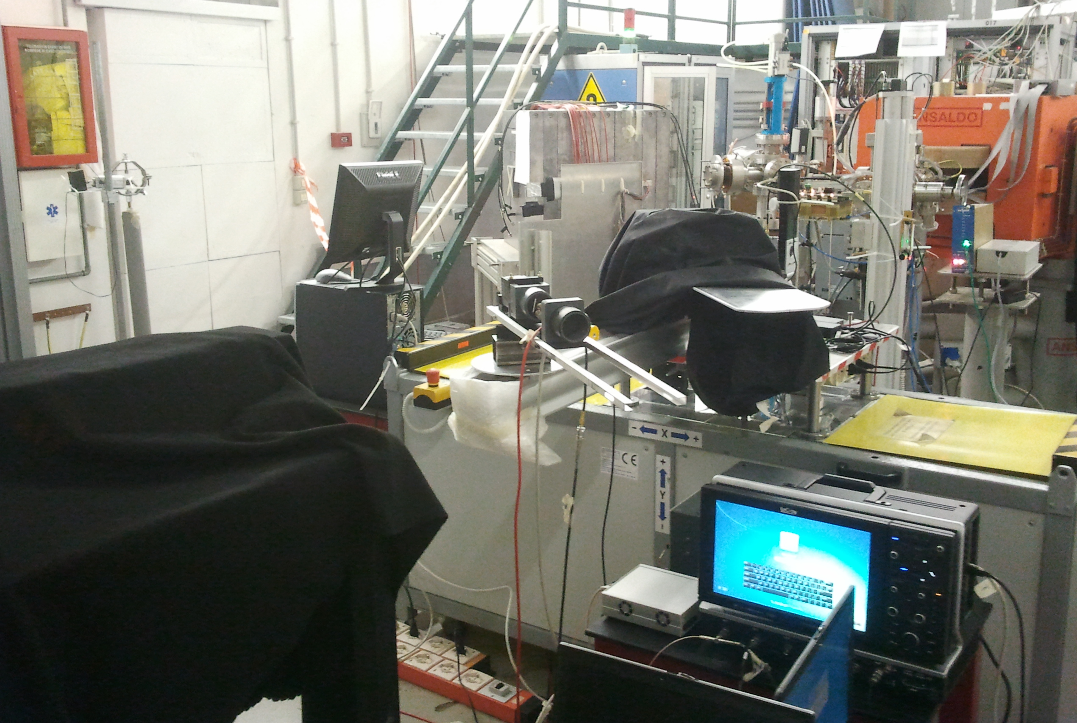
Beam tests at BTF (14-18 October 2013)
Electron beam with energy around 446 MeV
Translation stage
CpFM assembly
Calorimeter
8-channel USB-WaveCatcher

Slide 13
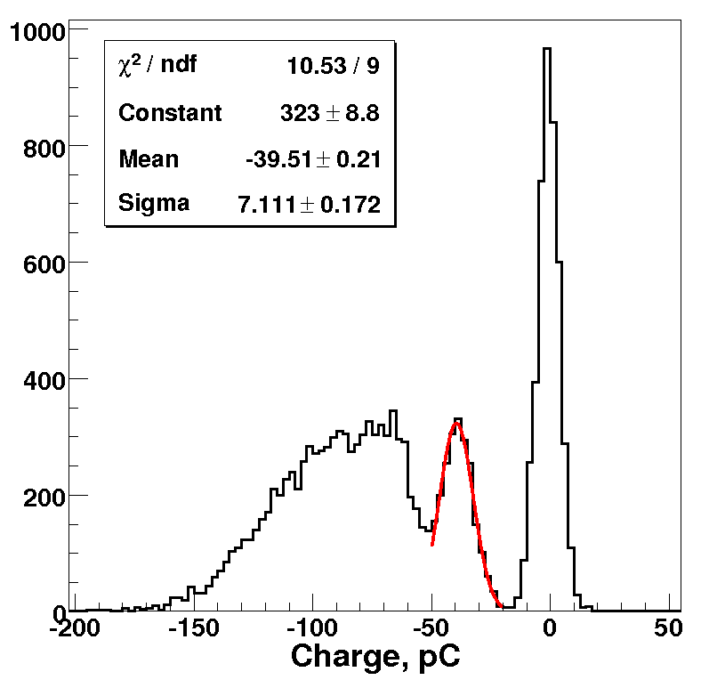
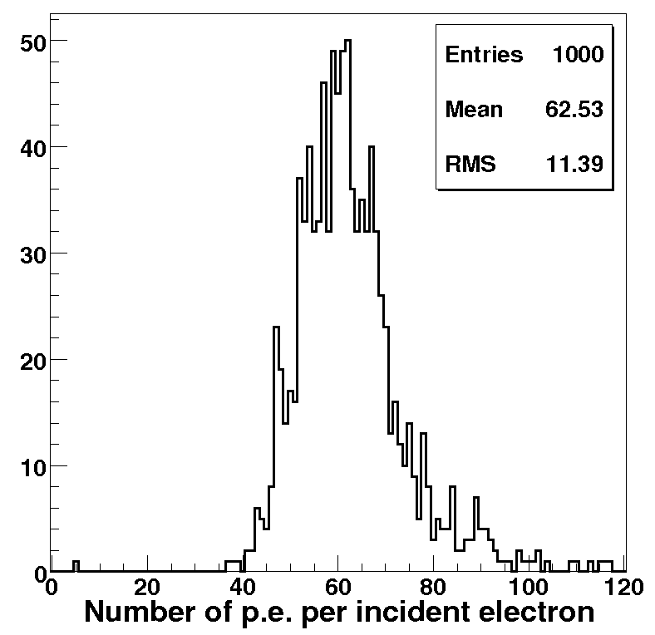
Quartz + PMT (comparison with simulation)
Simulation
Measurements
446 MeV e⁻ with 45º incident angle
Bialkali photocathode with 100% collection efficiency
1 e⁻
Measurements
Simulation
Gain of the PMT is ~ 4.3*10⁶ for H.V. = -1150 V
39.5 pC per incident electron
57.4 p.e. per incident electron
Good agreement !!!

Slide 14
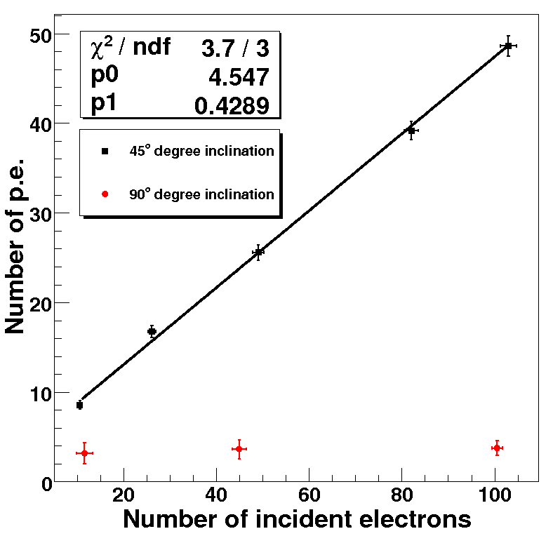
Quartz + bundle of fibers + PMT
45º degree inclination
PMT
PMT
90º degree inclination
Bundle
Bundle
e⁻
Calorimeter
e⁻
Quartz
We detect 0.43 p.e. per incident electron
Due to small angular acceptance of the fibers (numerical aperture 0.22) geometry with 90º degree inclination does not detect any light.
Measurements

Slide 15
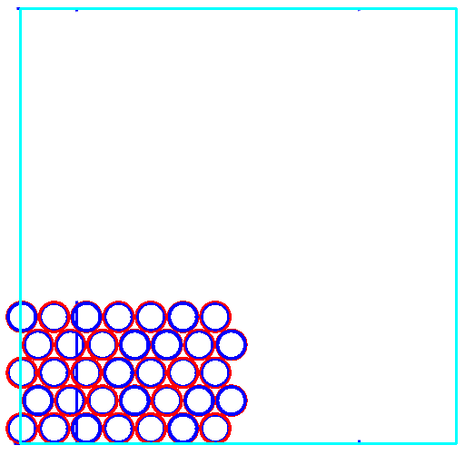
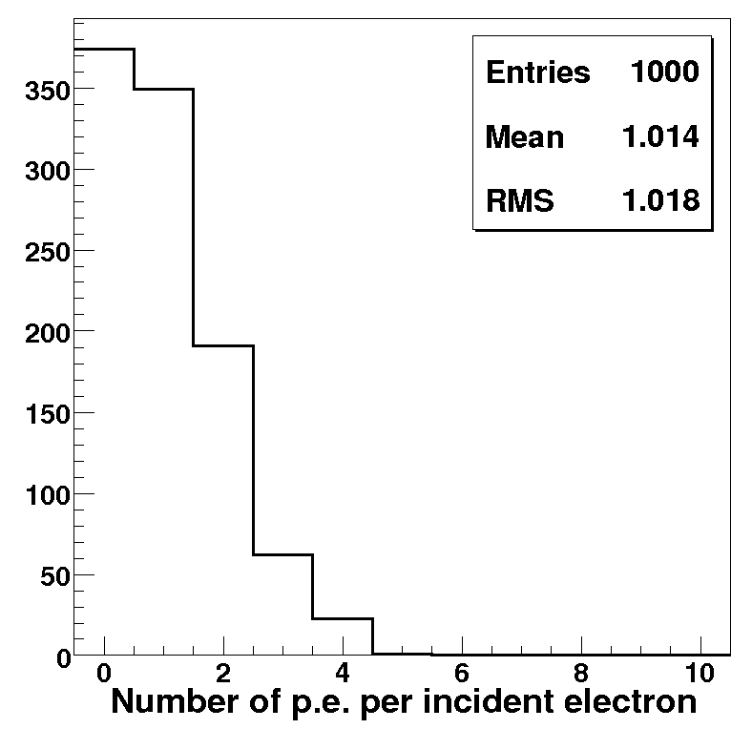
Quartz + bundle of fibers + PMT (comparison with simulation)
Fill factor is
only ~ 14%
The difference between measurements and simulation is roughly factor of two. It is probably coming from the poor quality of the home made bundle.
The interfaces efficiency:
quartz finger vs bundle
bundle vs finger
can be estimated: ~70 %
Simulation

Slide 16
Conclusions
BTF tests prove the feasibility of the CpFM detector. However additional tests are needed before construction and calibration of the final version of CpFM.
Quality of the optical fiber bundle need to be improved. It will be produced by a specialized company.
Mechanical support design on going at CERN.
The CpFM prototype will be tested under irradiation (protons and gammas).
The CpFM will be calibrated at BTF and then installed.
1. inside the SPS beam pipe in June 2014.
2. inside the LHC beam pipe at the beginning of 2015.

