Slide 1


Slide 2
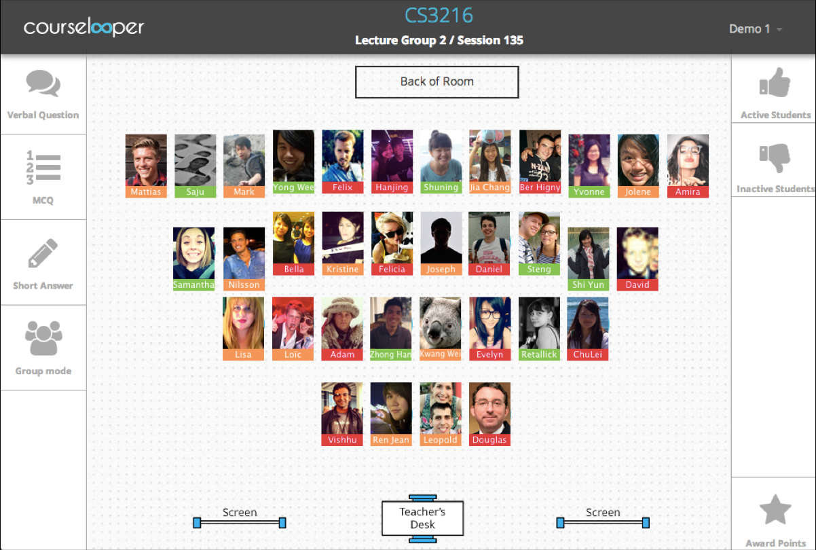
Notes:
1. enables real time participation tracking
2. data analytics verifying student grades, the extent of conceptual understanding by the students
3. extended to executive education; helps quantify success and concept retention for employees
4. Extended to online education by downloading the extension for your browser.

Slide 3
Pain Problems
Professors
Students
Corporations
Notes:
Redundant to take attendance
Tedious to track participation
Gauge participation throughout sem
Losing participation cuz they are shy
No existing method to keep track of participation

Slide 4


Slide 5

Notes:
Points reporting against each student - convert to grades
Class particiatopn
2-way interaction - ask question anonymously
targetting corporation

Slide 6

Notes:
Quantifying benefit on customers side
save time and money by no longer needing a TA to keep track of participation and saves profs time at the end of the year coming up with a number for each student for participation since it’s been accumulated all year
Subscription model: Increase revenue by charging per student/employee - charging less than our competitors to have a competitive advantage

Slide 7
How do we accomplish this?

