Slide 1
W
S
S
F
W
S
S
F
W
S
S
F
W
S
S
W
S
S
F
W
S
S
F
W
S
S
F
W
S
S
W
S
W
S
W
S
W
S

Slide 2




Ignition
Grow
Full development
W
S
W
S
W
S
W
S
2020
2021
2022
2023

Slide 3
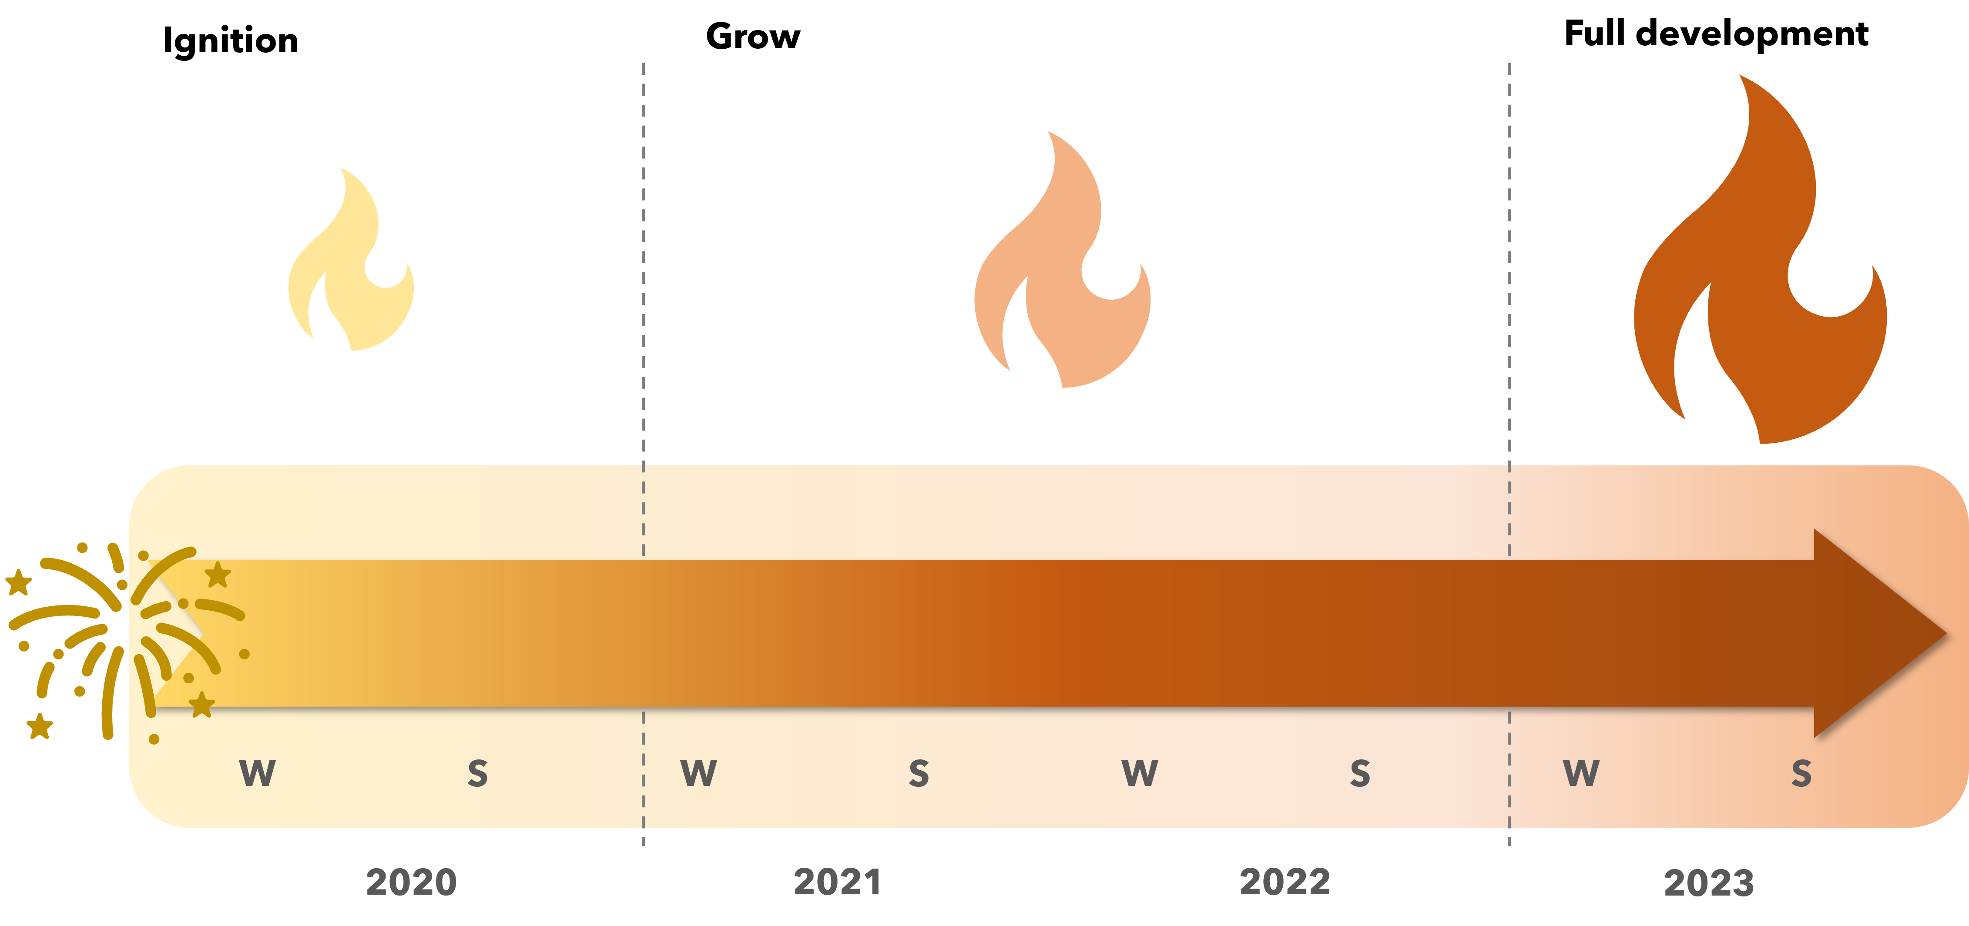
Full draft
ready for
submission
Initial concept
born with survey
planning committee
Brainstorming and development
of survey questions
Survey open &
responses
received
Conceptual synthesis (manual), email discussions, target journal

