Slide 1



https://aristanetworks.github.io/openmgmt/
https://github.com/burnyd/CTNUG-Openconfig
Dismantling Openconfig for network devices.
Presented By:

Slide 2




whoami
TME at Arista networks.
Works on network automation with customers.
10+ years in the network industry… lots of pain.
Real love / hate relationship with OC.
Dan Hertzberg @burneeed
Technical Marketing engineer.
Disclaimer on Openconfig
OC is complex, 90% of places can get away with most configuration management tools and a source of truth / opinionated data structure. OC is mainly for the robots. When it comes to configuration. Streaming can and should be used by everyone for metrics in 2022.
Anything I say referring to most places or ideas comes purely from opinions or experience working with customers at my current role.
The tooling is now in place where anyone can use OC in 2022.
Agenda
What is OC
What is YANG
OC transports
Streaming telemetry
Demos(I hope they all work!)
Presented By:

Slide 3
What are we accomplishing?
JSON API
XML API
JSON API
{
"jsonrpc": "2.0",
"id": "EapiExplorer-1",
"result": [
{
"vrfs": {
"default": {
"routerId": "10.0.1.102",
"peers": {
"10.1.102.1": {
<?xml version="1.0" encoding="UTF-8" ?>
<root>
<jsonrpc>2.0</jsonrpc>
<id>EapiExplorer-1</id>
<result>
<vrfs>
<default>
<routerId>10.0.1.102</routerId>
<peers>
<10.1.102.1>
{
"jsonrpc": "2.0",
"id": "API-NOS",
"result": [
{
"neighbors": {
"default": {
"routerId": "10.0.1.102",
"peer_neighbors": {
"vrf-default-unicast": {
“10.1.102.1”:{
Presented By:

Slide 4
Openconfig glance
Interface counters for Ethernet1
Network device 1
Network device 2
{
"openconfig-interfaces:in-octets": "2363",
"openconfig-interfaces:in-errors": "0",
"openconfig-interfaces:in-multicast-pkts": "15",
"openconfig-interfaces:out-octets": "15315",
"openconfig-interfaces:in-broadcast-pkts": "28",
"openconfig-interfaces:out-multicast-pkts": "115",
"openconfig-interfaces:in-unicast-pkts": "0",
"openconfig-interfaces:out-unicast-pkts": "0",
"openconfig-interfaces:out-broadcast-pkts": "5",
"openconfig-interfaces:out-discards": "0",
"openconfig-interfaces:out-errors": "0",
"openconfig-interfaces:in-discards": "0"
}
{
"openconfig-interfaces:in-octets": "2363",
"openconfig-interfaces:in-errors": "0",
"openconfig-interfaces:in-multicast-pkts": "15",
"openconfig-interfaces:out-octets": "15315",
"openconfig-interfaces:in-broadcast-pkts": "28",
"openconfig-interfaces:out-multicast-pkts": "115",
"openconfig-interfaces:in-unicast-pkts": "0",
"openconfig-interfaces:out-unicast-pkts": "0",
"openconfig-interfaces:out-broadcast-pkts": "5",
"openconfig-interfaces:out-discards": "0",
"openconfig-interfaces:out-errors": "0",
"openconfig-interfaces:in-discards": "0"
}
Presented By:
‹#›

Slide 5
Modeling devices.
Device 1 Vendor A
Device 2 Vendor B
Device 3 Vendor C
{
"bgp": {
"global": {
"config": {
"as": 1,
"router-id": "1.1.1.1"
}
},
"neighbors": {
"neighbor": {
"12.12.12.1": {
"config": {
"neighbor-address": "12.12.12.1",
"peer-as": 65001
},
"neighbor-address": "12.12.12.1"
}
}
}
}
}
{
"bgp": {
"global": {
"config": {
"as": 2,
"router-id": "2.2.2.2"
}
},
"neighbors": {
"neighbor": {
"12.12.12.2": {
"config": {
"neighbor-address": "12.12.12.2",
"peer-as": 65002
},
"neighbor-address": "12.12.12.2"
}
}
}
}
}
{
"bgp": {
"global": {
"config": {
"as": 3,
"router-id": "3.3.3.3"
}
},
"neighbors": {
"neighbor": {
"12.12.12.3": {
"config": {
"neighbor-address": "12.12.12.2",
"peer-as": 65003
},
"neighbor-address": "12.12.12.3"
}
}
}
}
}
Presented By:

Slide 6

Industry collaboration among network operators in the public.
data models for configuration, operational state, written in YANG Schema models.
Single Data structure!
Network operators
Presented By:

Slide 7



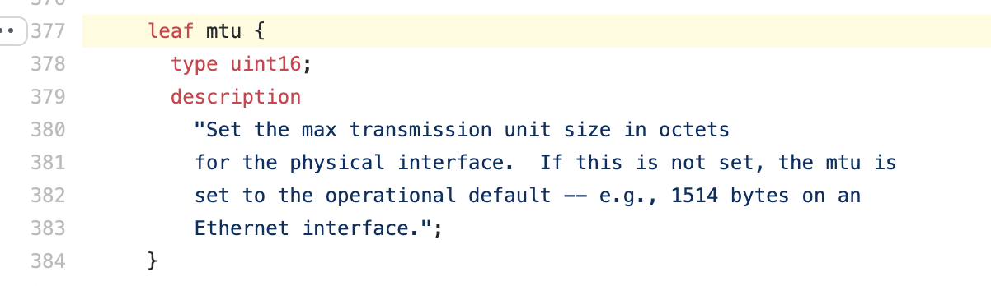
YANG
YANG != NETCONF
A YANG model is simply a SCHEMA that describes how parts of a data structure should look . For example a vlan has to be a integer and it has to have field like name and vlan id. A interface MTU needs to be a integer.
YANG is not a new modeling schema that has been around since the early 2000’s.
There are YANG models for BGP, Interfaces, system information even Wifi!
RFC 6020
.
https://github.com/openconfig/public/blob/master/release/models/interfaces/openconfig-interfaces.yang#L377
Presented By:
‹#›

Slide 8
Specific models.
ietf-interfaces
openconfig-interfaces
{
"format": "yang",
"identifier": "ietf-interfaces",
"location": [
"NETCONF"
],
"namespace": "urn:ietf:params:xml:ns:yang:ietf-interfaces",
"version": "2018-02-20"
},
{
"format": "yang",
"identifier": "openconfig-interfaces",
"location": [
"NETCONF"
],
"namespace": "http://openconfig.net/yang/interfaces",
"version": "2019-11-19"
},
arista-exp-eos-evpn
{
"format": "yang",
"identifier": "arista-exp-eos-evpn",
"location": [
"NETCONF"
],
"namespace": "http://arista.com/yang/experimental/eos/evpn",
"version": "2020-07-31"
},
Presented By:

Slide 9


Switch internal workings
Yang tree
/
/network-instances
/interfaces
/network-instance
/interfaces/interface/
/interfaces/interface/[name=eth1]
Yang mapper
Presented By:

Slide 10
Transports
Netconf client
The switch runs different servers for different transport. Netconf, Restconf, gRPC.
Restconf client
yang tree
gRPC client(gNMI)
Presented By:

Slide 11
Transports
Transport name | Transport protocol | Encoding / serialization | Security | Streaming | Strengths
Netconf | SSH | XML | SSH(secure) | No | RPC’s
Restconf | HTTPS | JSON | TLS | No | Restful
gNMI | gRPC/http2 | JSON/Protos | TLS | Yes | Streaming
Presented By:
‹#›

Slide 12
EOS Config
management api gnmi
transport grpc default
!
management api restconf
transport https test
ssl profile restconf
!
management api netconf
transport ssh test
port 22
!
management security
ssl profile restconf
certificate restconf.crt key restconf.key
!
security pki certificate generate self-signed restconf.crt key restconf.key generate rsa 2048 parameters common-name restconf
Presented By:

Slide 13

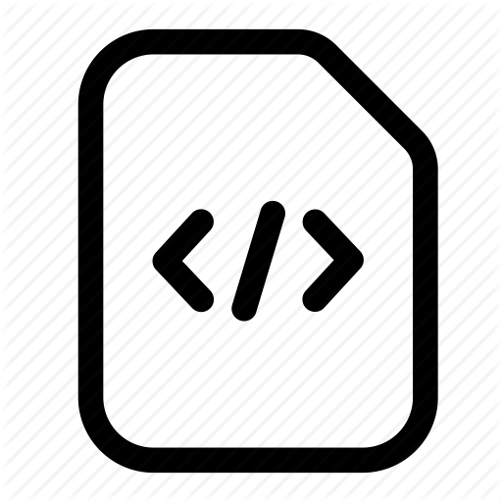

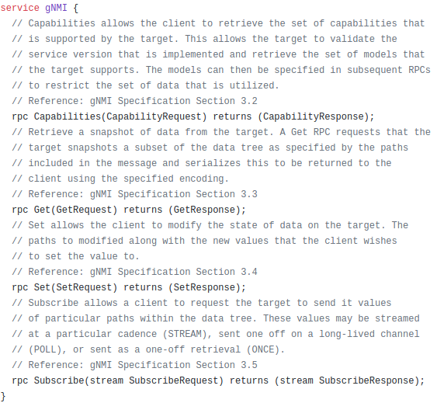
gNMI Place holder
GRPC
gRPC supports unidirectional gets.
gRPC supports bidirectional streaming.
gNMI is simply a gRPC service!
Protobuf/code
Protobuf/code
gNMI-Server
RPC/Function
Serialized data
gnmi protobuf
Embraces more of a programmatic way of talking to devices.
Uses a protobuf file to expose services.
Execution right from code. (Any code language)
NOT human readable :( over the wire.
Supports HTTP2 and streaming.
Presented By:

Slide 14





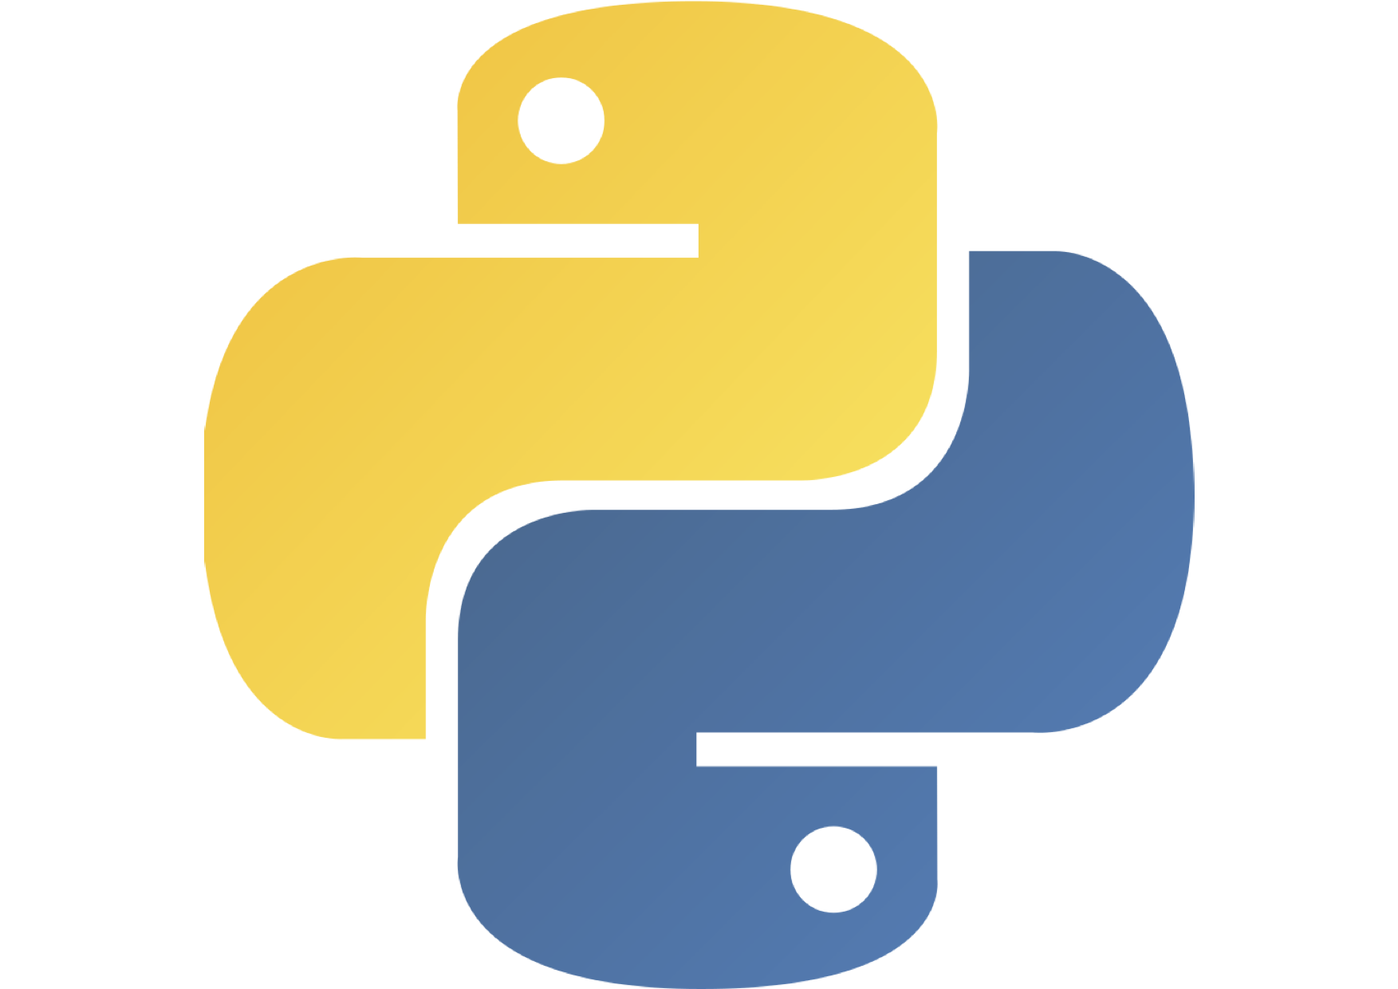
Clients and interacting
Protobuf/code
Protobuf/code
RPC/Function
Serialized data
gnmic
gnmi binary
telegraf
goarista
pygnmi
ansible gNMI collection
gnxi
Presented By:
‹#›

Slide 15

Lab setup
gNMI methods.
gNMI service
Get Method - > Gets a path 1 time and retrieves the data.
Capabilities - > Returns the capabilities of the switch(What yang models and versions are typically running on the devices)
Subscribe - > Subscribe to a path. So a client will subscribe to a path for instance /interfaces the switch will stream back the client as quickly as it can.
AS65001
AS65002
eBGP 10.0.0.0/30
Most common use cases.
Simple Capabilties.
Simple Get of all paths.
Interface stats (unicast, broadcast, etc)
Route table Streaming(AFTs).
eos_native paths
Cli paths
Presented By:

Slide 16


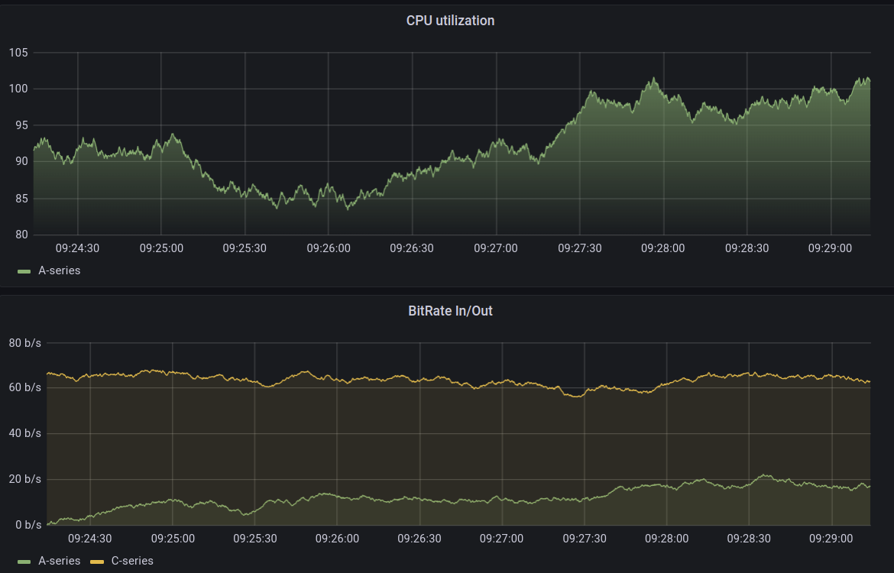
TIG Stack(Telegraf Influx Grafana)
Tig Stack
Multi vendor opensource telemetry with openconfig
InfluxDB
Telegraf agent
gNMI Subscribe request
gNMI service
telegraf.conf file
gNMI Subscribe response
Presented By:

Slide 17
Links
Openmgt
Github.com/openconfig
openconfig.net
https://github.com/arista-netdevops-community
gNMIC
Presented By:

