Slide 1
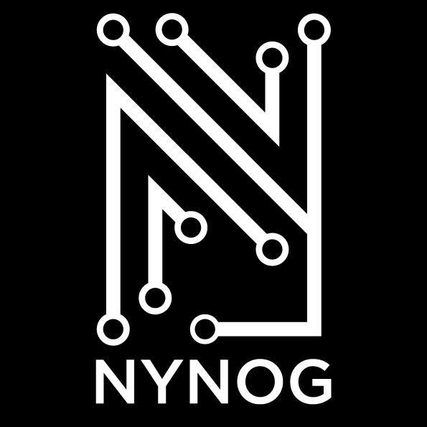
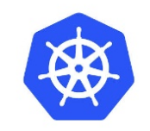


Kubernetes Networking 101
https://github.com/burnyd/nynog-k8s-networking-101
Agenda
Kubernetes 1000ft view
CNI (Most of our time will be spent here)
Network Design considerations
Load balancing
Security
@burneeed
whoami
TME at Arista networks.
Works on network automation with customers.
10+ years in the network industry.
I like Kubernetes more than most :D

Slide 2
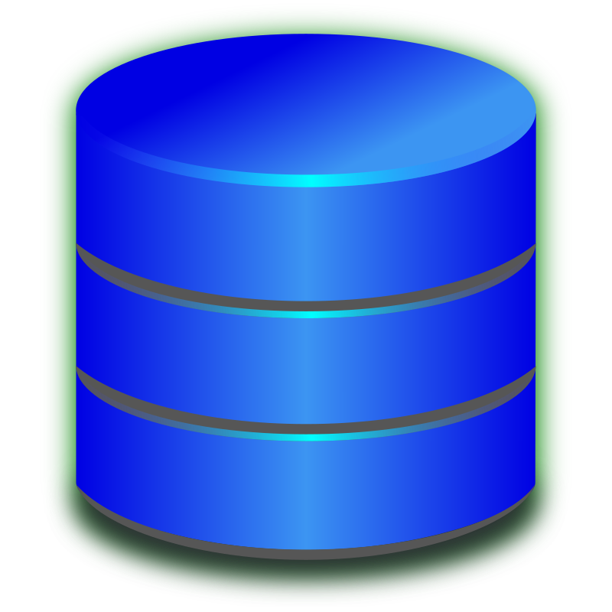

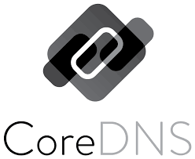

What is Kubernetes?
Master 1
Master 2
Master 3
Control Plane
ETCD
ETCD
ETCD
Controller
Controller
Controller
Kubelet
Scheduler
Kubelet
Scheduler
Kubelet
Scheduler
Kube proxy
API server
Kube proxy
API server
Kube proxy
API server
Data Plane
Kubelet Process on the node responsible for communication between the node and the api server / master
Kube Proxy container that runs on each node that constantly talks to the api server to get information so it can map kubernetes constructs to IPtables.
Kubectl Binary that external users leverage to talk to the Kubernetes control plane.
Node
Node
Node
Node
Kubelet
Kube proxy
Kubelet
Kube proxy
Kubelet
Kube proxy
Kubelet
Kube proxy

Slide 3

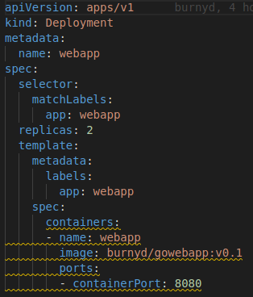
Kubernetes API and scheduling….
K8s Master
I need a 3 tiered APP with a load balancer HALP!
ETCD
Controller
API server
API Request for application scheduling
Scheduler
kubectl apply -f deployment.yaml
Node 1
Node 2
Node 3
Kubelet
Kube proxy
Kubelet
Kube proxy
Kubelet
Kube proxy
DB
LB
Web
APP
Web

Slide 4
Kubernetes Promise model
“Planes can breakdown, cars can breakdown, but no one at the post office ever calls you when any of those things happen! They make a promise to you — They promise that this letter will get there in 2 days. How they do it is not a concern!”
Kelsey Hightower
Node 1
Node 2
Node 3
Kubelet
Kube proxy
Kubelet
Kube proxy
Kubelet
Kube proxy
DB
LB
Web
APP
Web

Slide 5
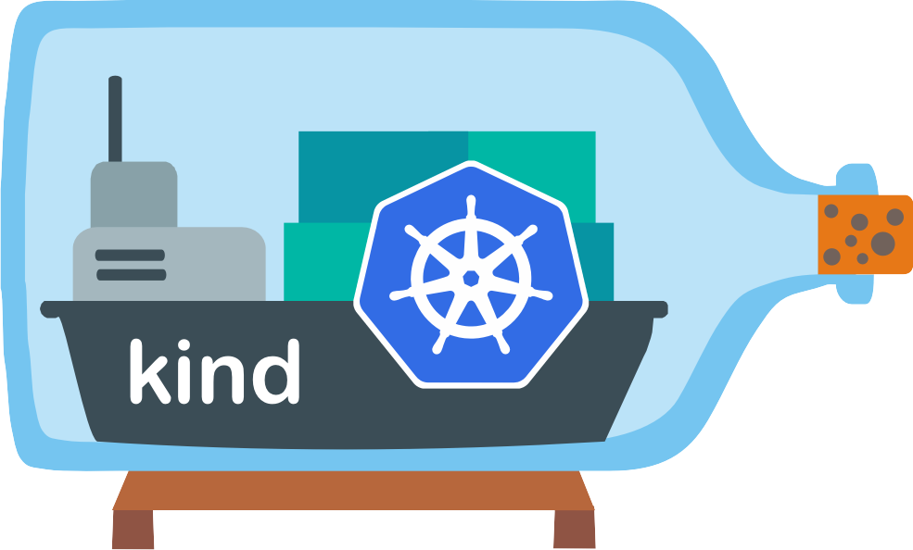
Demo Environment
https://github.com/burnyd/nynog-k8s-networking-101
192.168.16.0/24
Eth0
Worker2
Eth0
Worker
Eth0
control-plane
etcd
Core-dns
Core-dns
api-server
controller-manager
scheduler
Kubelet
Kube proxy
Kubelet
Kube proxy
Kubelet
Kube proxy

Slide 6
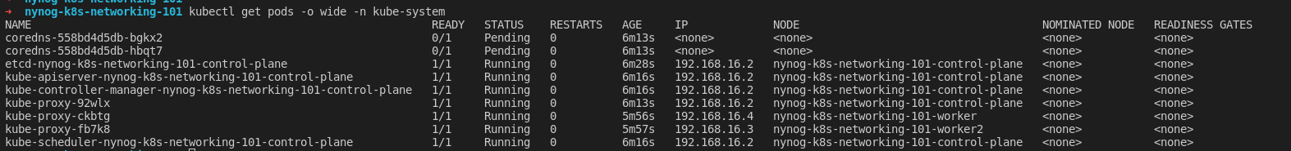
Demo Environment
PS.. There is no networking by default! Nothing works!
So we need networking!
Coredns pods are stuck in Pending status and do not have IP addresses.
All the control plane components work because they are operating in what is called “Host networking mode” As they are using the same IP address that the system is using.
This is why the CNI exists!

Slide 7





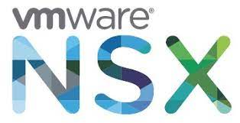

CNI Rules
cni spec
Supplement ip addresses to pods.
Pod to Pod communication.
Pod to Service communication.
Pod to Egress(Outside world)
Connectivity WITHOUT NAT!
Popular Kubernetes CNIs

Slide 8
Kubernetes PodCIDR
PodCIDR is a general ipv4/ipv6 range in which a pod can use for IP space. This is entirely adjustable upon creation of a cluster. This is the range in which a Kubernetes pod will use for its ip address.
PodCIDR: 10.0.0.0/24
PodCIDR: 10.0.1.0/24
PodCIDR: 10.0.2.0/24
PodCIDR: 10.0.99.0/24
Node 1
Node 2
Node 3
Node 100
Kubelet
Kube proxy
Kubelet
Kube proxy
Kubelet
Kube proxy
Kubelet
Kube proxy
…………………………….

Slide 9
CNI How does it work?
Outside world
CNI Json example /etc/cni/net.d/00-cni.json
{
"cniVersion": "1.0.0",
"name": "dbnet",
"type": "bridge",
"bridge": "cni0",
"ipam": {
"type": "host-local",
"subnet": "10.0.0.0/24",
"gateway": "100.0.1"
},
"dns": {
"nameservers": [ "10.0.0.1" ]
}
}
—----------------------------------------------------------------------------------------
/opt/cni/bin folder
root@nynog-k8s-networking-101-worker:/opt/cni/bin# ls -l
total 28900
-rwxr-xr-x 1 root root 14057472 May 31 15:28 cilium-cni
-rwxr-xr-x 1 root root 3565330 Feb 5 2021 host-local
-rwxr-xr-x 1 root root 3530531 Feb 5 2021 loopback
-rwxr-xr-x 1 root root 3966455 Feb 5 2021 portmap
-rwxr-xr-x 1 root root 4467317 Feb 5 2021 ptp
-rwxr-xr-x 1 root root 4235123 Feb 5 2021 bridge
Eth0
Kubernetes node
Kubelet
Kube proxy
Pod
Container run time
10.0.0.2/24
Eth0
CNI JSON
/etc/cni/net.d/00-cni.json
CNI Binary
/opt/cni/bin

Slide 10
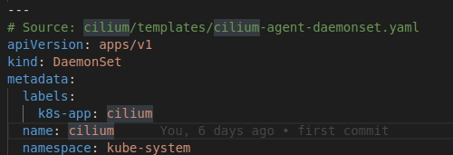
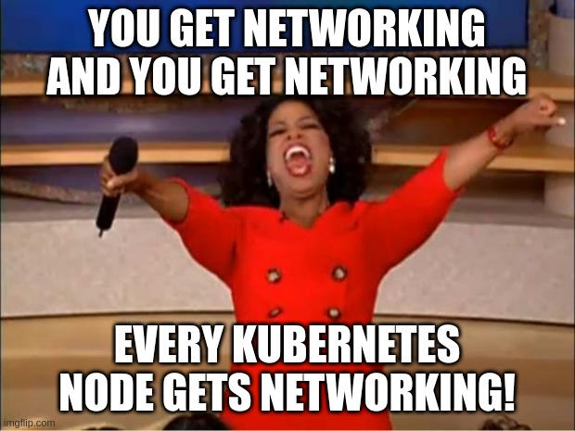

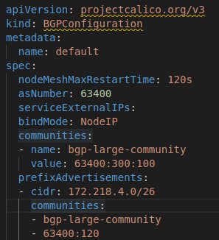
CNI Install to a cluster
Third party install links
cilium-cni.yaml(Our example uses VXLAN)
…….
Calico example
Using BGP
Kubectl apply -f cilium-cni.yaml

Slide 11
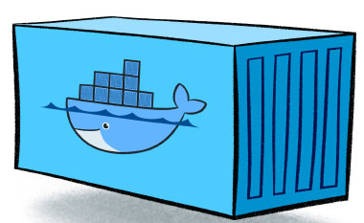
Kubernetes Networking under the hood
Every Kubernetes Node has routes to get to other nodes via CNI
root@nynog-k8s-networking-101-worker:/# ip r
default via 192.168.16.1 dev eth0
10.0.0.0/24 via 10.0.0.125 dev vxlan src 10.0.0.1
10.0.1.0/24 via 10.0.0.125 dev vxlan src 10.0.0.1 mtu 1450 // Route traffic to Node2 through VXLAN
10.0.2.0/24 via 10.0.0.125 dev vxlan src 10.0.0.1 mtu 1450 // Route traffic to Node3 through VXLAN
192.168.16.0/20 dev eth0 proto kernel scope link src 192.168.16.4
Eth0
K8s node
Linux Kernel routing
PodCIDR: 10.0.0.0/24
PodCIDR: 10.0.1.0/24
PodCIDR: 10.0.2.0/24
Node 1
Node 2
Node 3
Kubelet
Kube proxy
Kubelet
Kube proxy
Kubelet
Kube proxy
Kubelet
Kube proxy
VXLAN
VXLAN
VXLAN

Slide 12

Topology routed
Spine1
Spine2
Spine3
Spine4
The internets
Leaf
Leaf
Leaf
Leaf
Border
Border
Advertise BGP - Pod CIDR Network to ToRs
Advertise BGP - Pod CIDR Network to ToRs
Advertise BGP - Pod CIDR Network to ToRs
K8s node
AS 65001
K8s node
AS 65002
K8s node
AS 65003
Pod CIDR - 10.0.0.0/24
Pod CIDR - 10.0.1.0/24
Pod CIDR - 10.0.2.0/24

Slide 13
Overlay model
Spine1
Spine2
Spine3
Spine4
Leaf1
Leaf2
Leaf3
Leaf4
VXLAN
VXLAN
Eth1
Eth2
K8s node
K8s node
Eth1
Eth2
Kubelet
Kubelet
.1
Kube proxy
.1
Kube proxy
10.0.0.0/24
10.0.1.0/24
Routing table
10.0.1.0/24 - > VXLAN1
Routing table
10.0.0.0/24 - > VXLAN1
10.0.0.2/24
10.0.0.3/24
10.0.1.2/24
10.0.1.3/24
.
.
Pod CIDR - 10.0.0.0/24
Pod CIDR - 10.0.1.0/24

Slide 14
Hybrid Model
Spine1
Spine2
Spine3
Spine4
Leaf
Leaf
Leaf
Leaf
Border
Border
Advertise all BGP Pod CIDR example 10.0.0.0/8
VXLAN
VXLAN
VXLAN
K8s node
K8s node
K8s node
AS 65003
Pod CIDR - 10.0.0.0/24
Pod CIDR - 10.0.1.0/24
Pod CIDR - 10.0.2.0/24
Node Routing table
10.0.1.0/24 - > VXLAN1
10.0.3.0/24 - > VXLAN1
Node Routing table
10.0.0.0/24 - > VXLAN1
10.0.3.0/24 - > VXLAN1
Node Routing table
10.0.1.0/24 - > VXLAN1
10.0.0.0/24 - > VXLAN1

Slide 15
Kubernetes services
Pods are constantly coming up and down. They are ephemeral.
We need a general way to either load balance or go to a service that represents multiple pods.
K8s node1
K8s node2
K8s node3
K8s node4
Inter: I need to talk the back end
web-service
web-service
10.96.1.2/32
10.96.1.2/32
Intra: I need to talk to a k8s service?
10.0.0.1
10.0.1.1
10.0.2.1
10.0.3.1
DB
10.0.2.2
web-pod
web-pod
10.0.2.2
web-pod
10.0.1.2
10.0.3.2
Kubelet
Kube proxy
Kubelet
Kube proxy
Kubelet
Kube proxy
Kubelet
Kube proxy

Slide 16
Exposing services (Load balancing)
ClusterIP: Exposes the Service on a cluster-internal IP. Choosing this value makes the Service only reachable from within the cluster. This is the default ServiceType.
NodePort: Exposes the Service on each Node's IP at a static port (the NodePort). A ClusterIP Service, to which the NodePort Service routes, is automatically created. You'll be able to contact the NodePort Service, from outside the cluster, by requesting <NodeIP>:<NodePort>.
LoadBalancer: Exposes the Service externally using a cloud provider's load balancer. NodePort and ClusterIP Services, to which the external load balancer routes, are automatically created.
IntraCluster(external)
Nodeport
192.168.16.2:30001 - > 10.96.0.5:8080
IntraCluster(External)
Loadbalancer(metallb)
BGP Advertisement 10.96.0.6
InterCluster(Internal)
Clusterip: app1.svc.cluster.local
10.96.0.7
service
service
service
10.96.0.5
10.96.0.6
10.96.0.7
10.0.0.1
10.0.1.1
10.0.2.1
app1
10.0.0.1
10.0.1.2
10.02.2
app1
app1
Kubelet
Kube proxy
Kubelet
Kube proxy
Kubelet
Kube proxy

Slide 17
Kubernetes Services under the hood
Default IP Tables
Eth0
K8s node
root@nynog-k8s-networking-101-worker:/# iptables -t nat -L KUBE-SERVICES -n
Chain KUBE-SERVICES (2 references)
target prot opt source destination
KUBE-MARK-MASQ tcp -- !10.0.0.0/16 10.96.0.1 /* default/kubernetes:https cluster IP */ tcp dpt:443
KUBE-SVC-NPX46M4PTMTKRN6Y tcp -- 0.0.0.0/0 10.96.0.1 /* default/kubernetes:https cluster IP */ tcp dpt:443
KUBE-MARK-MASQ udp -- !10.0.0.0/16 10.96.0.10 /* kube-system/kube-dns:dns cluster IP */ udp dpt:53
KUBE-SVC-TCOU7JCQXEZGVUNU udp -- 0.0.0.0/0 10.96.0.10 /* kube-system/kube-dns:dns cluster IP */ udp dpt:53
KUBE-MARK-MASQ tcp -- !10.0.0.0/16 10.96.0.10 /* kube-system/kube-dns:dns-tcp cluster IP */ tcp dpt:53
KUBE-SVC-ERIFXISQEP7F7OF4 tcp -- 0.0.0.0/0 10.96.0.10 /* kube-system/kube-dns:dns-tcp cluster IP */ tcp dpt:53
KUBE-MARK-MASQ tcp -- !10.0.0.0/16 10.96.0.10 /* kube-system/kube-dns:metrics cluster IP */ tcp dpt:9153
KUBE-SVC-JD5MR3NA4I4DYOP tcp -- 0.0.0.0/0 10.96.0.10 /* kube-system/kube-dns:metrics cluster IP */ tcp dpt:9153
KUBE-NODEPORTS all -- 0.0.0.0/0 0.0.0.0/0 /* kubernetes service nodeports; NOTE: this must be the last rule in this chain */ ADDRTYPE match dst-type LOCAL
IPtables
Kubelet
Kube proxy
This could also be done in IPVS or eBPF

Slide 18
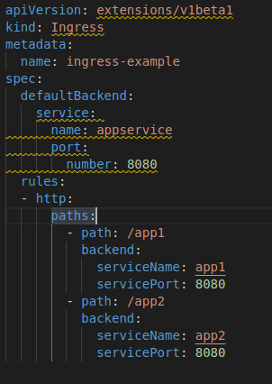
Ingress(Layer 7)
Ingress exposes HTTP and HTTPS routes from outside the cluster to services within the cluster. Traffic routing is controlled by rules defined on the Ingress resource.
Ingress will create a routing rule for http/https to send to the correct service.
Needs third party support like ngninx or haproxy.
App1-service
App2-service
App1-service
App2-service
app1
app1
app2
app2
Kubelet
Kube proxy
Kubelet
Kube proxy
Kube proxy

Slide 19

Kubernetes Network Policies
Network policy in K8s is a specification of how Kubernetes constructs are able to communicate. Generally speaking pod to pod communication.
All the policies consist on the Kubernetes nodes not on a firewall. Some CNI’s will make use of netfilter and iptables some use ebpf.
Not built into K8s. It needs third party integration. Like Calico or Cilium.
Most policies are based off of labels.
You have to specify ingress / egress within the policy.
Node 1
Node 2
Node 3
Traffic from APP to DB should be blocked on all ports except 3306
Kubelet
Kube proxy
Kubelet
Kube proxy
Kubelet
Kube proxy
IPtables filters
IPtables filters
IPtables filters
APP: Label=APP
DB: Label=DB
Web: Label=Web

Slide 20
Thank you!
Links:
https://github.com/burnyd/nynog-k8s-networking-101
https://kubernetes.io/docs/concepts/cluster-administration/networking/
https://kubernetes.io/docs/concepts/services-networking
https://github.com/containernetworking/cni/blob/main/SPEC.md
https://k8s.networkop.co.uk/
https://github.com/kubernetes/community/blob/master/sig-network/README.md

