Slide 1
MLDP Project
By Sena Nathaniel Luis Villaflor 2010297F

Slide 2
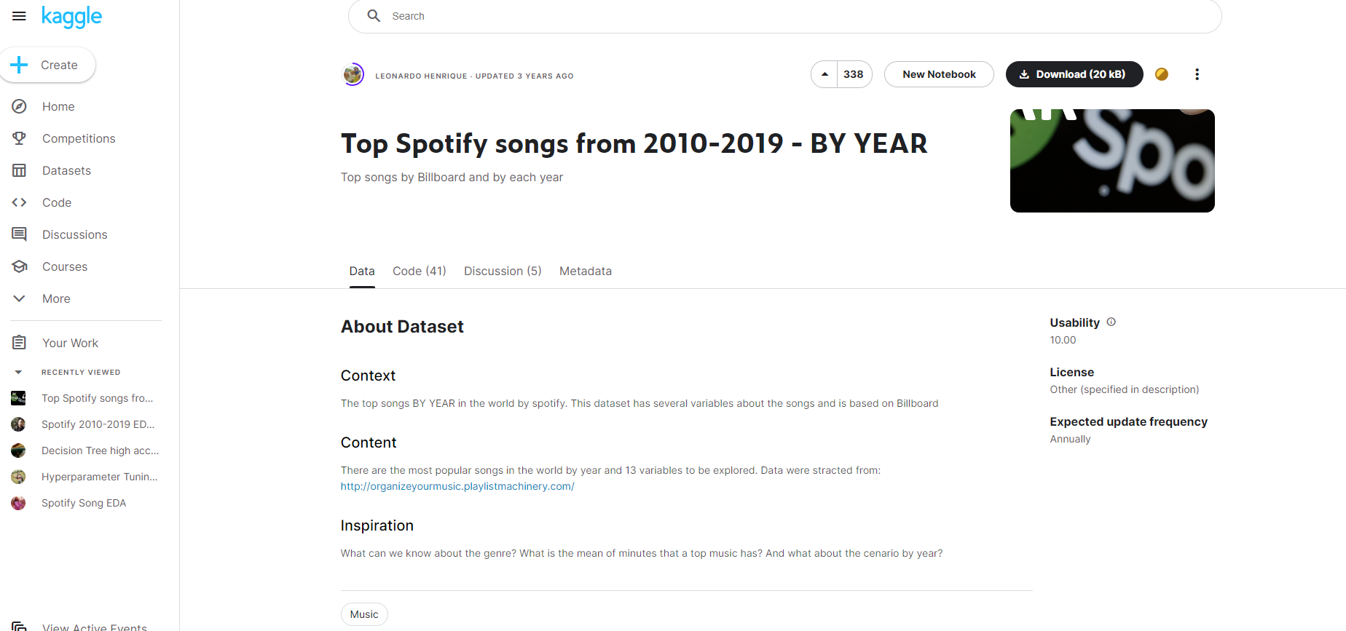
The Dataset
The dataset that I have chosen is called top10s.csv and it is a dataset that shows the top songs per year between 2010 and 2019.
Chosen to explore and understand how the popularity of songs change based on their musical characteristics.
To have a better understanding of how and why songs become popular and what role do such musical characteristics play into contributing to their popularity

Slide 3
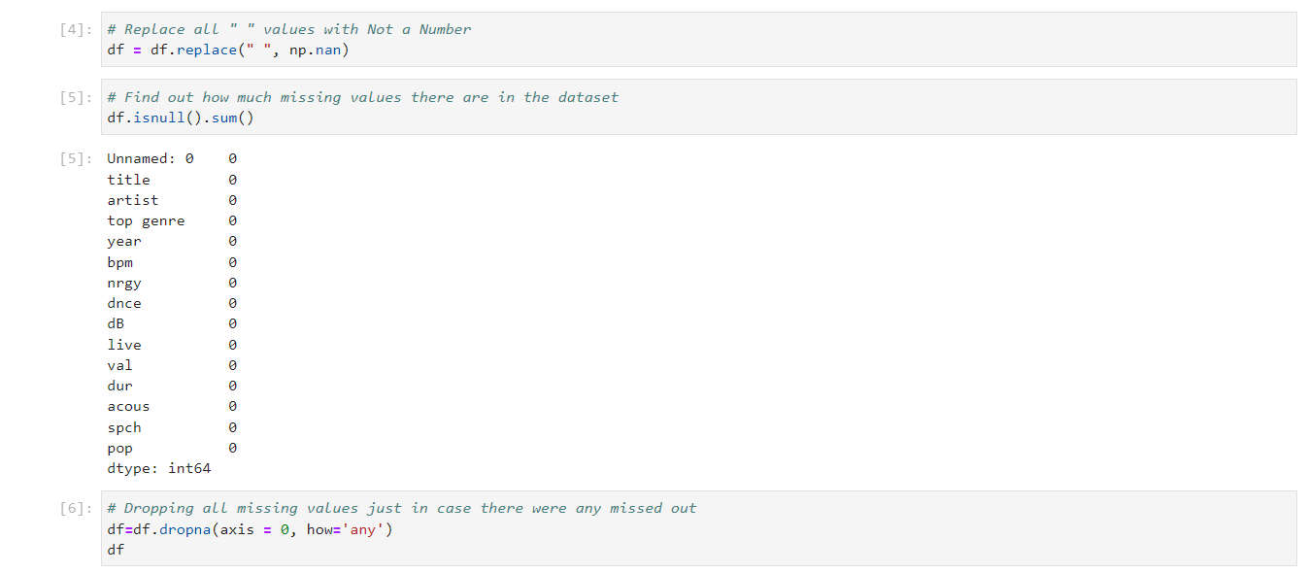
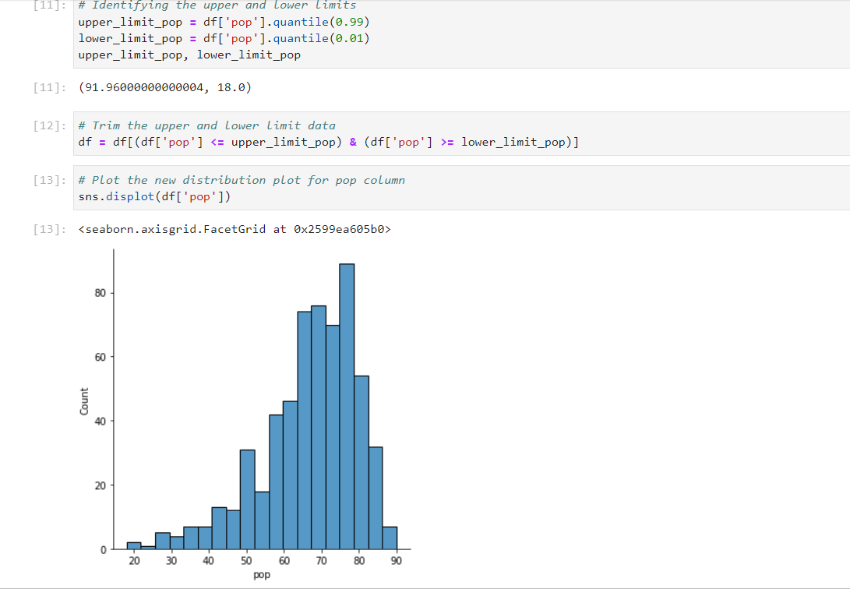

Data Cleaning
1.
3.
2.

Slide 4
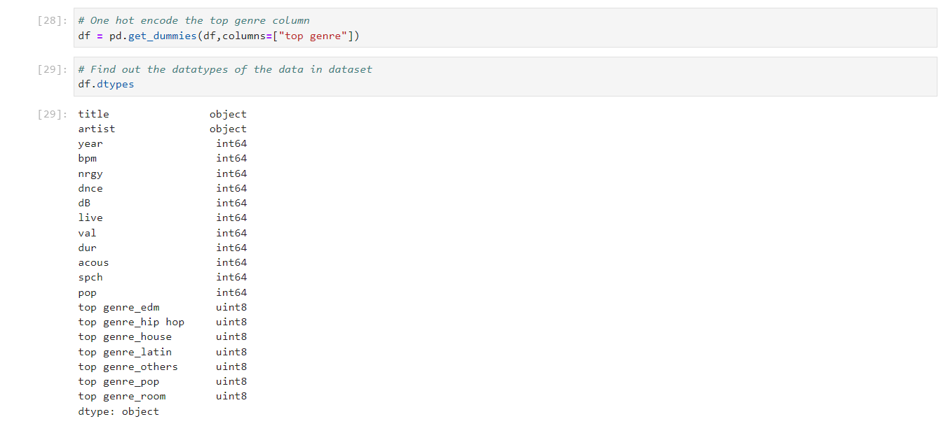
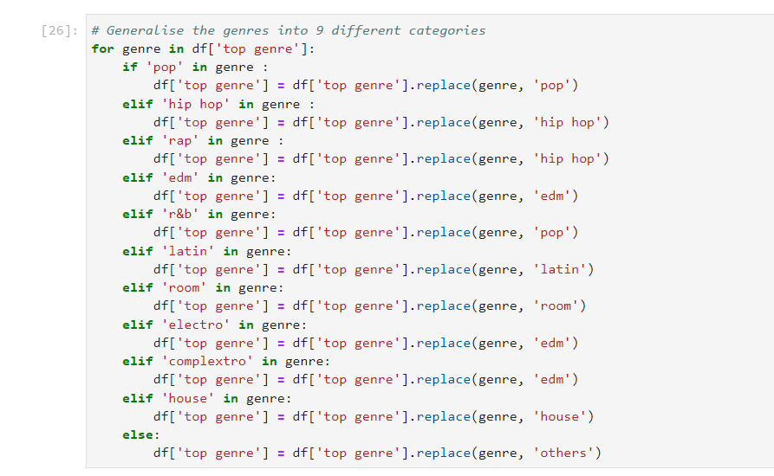
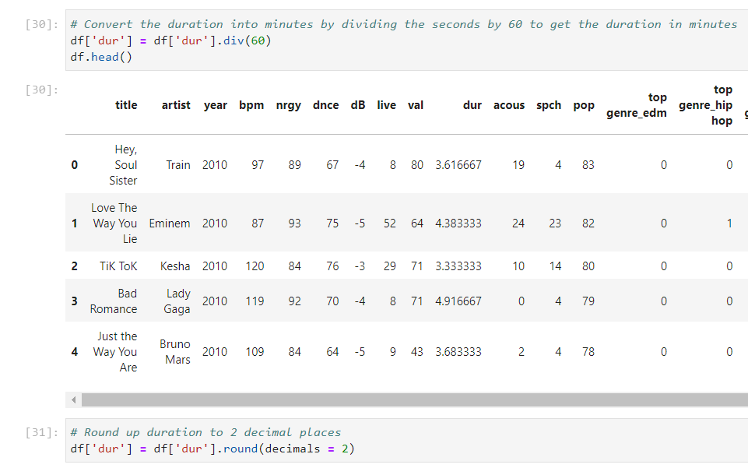
Data Transformation
2.
1.
3.

Slide 5

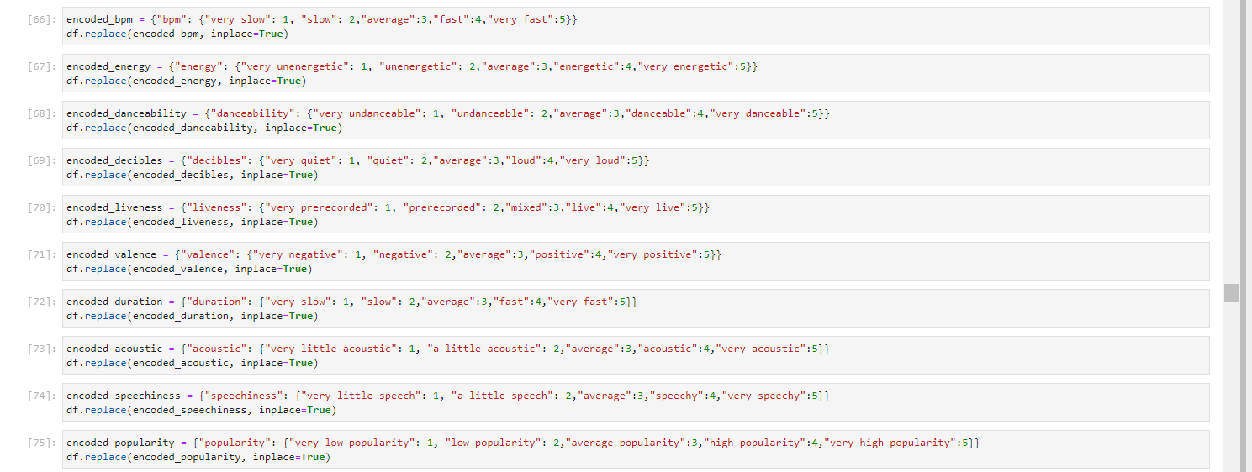
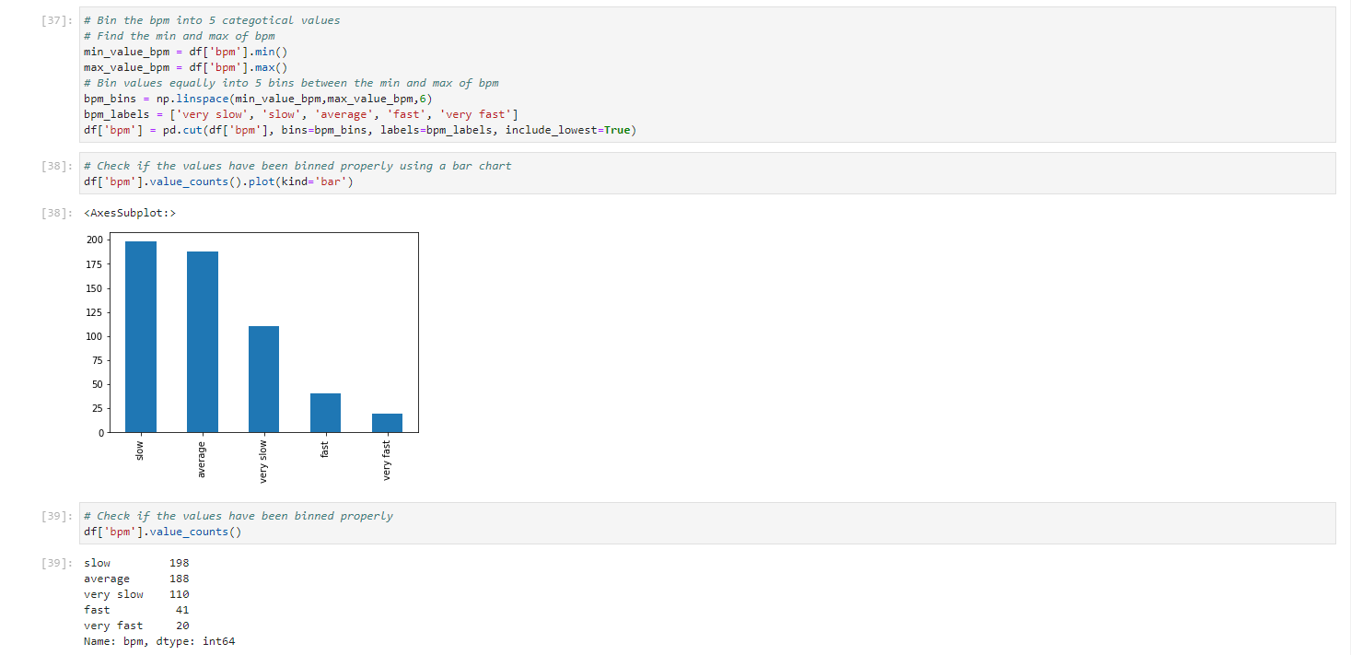

Data Transformation
6.
4.
5.
7.

Slide 6


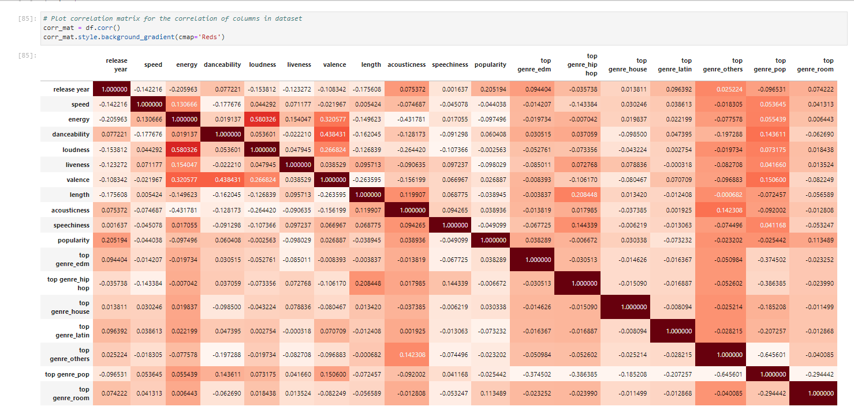
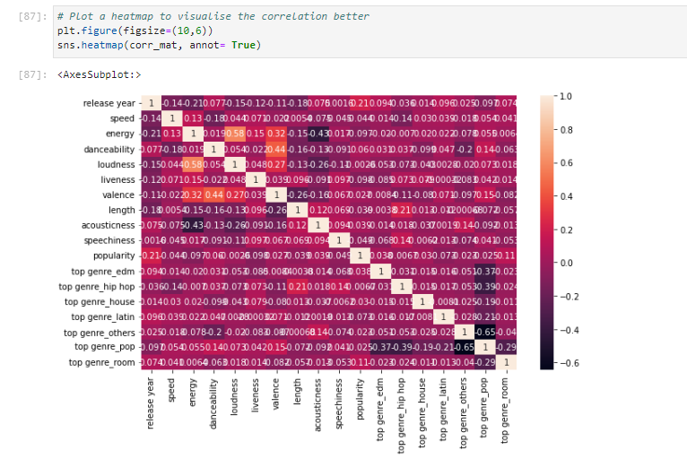
Correlation & Feature Selection
1.
3.
2.
4.

Slide 7
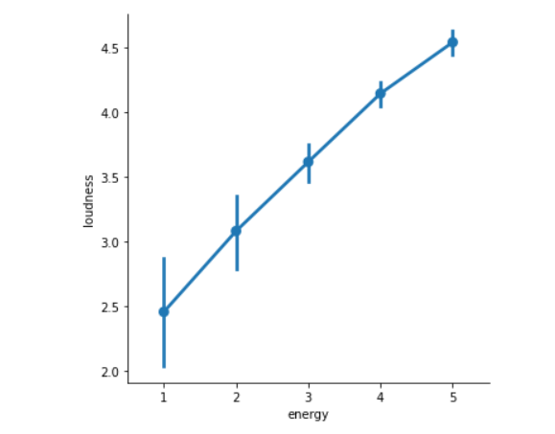
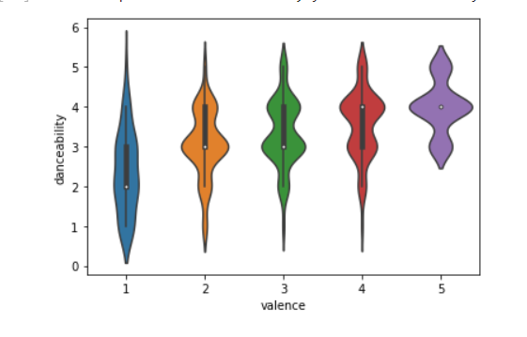
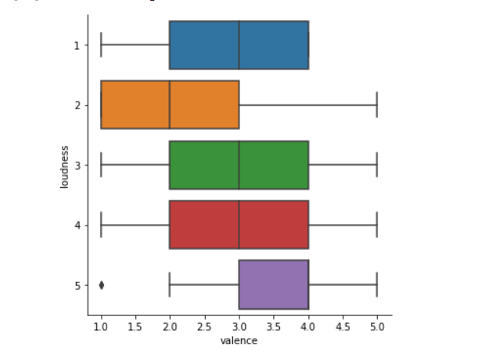
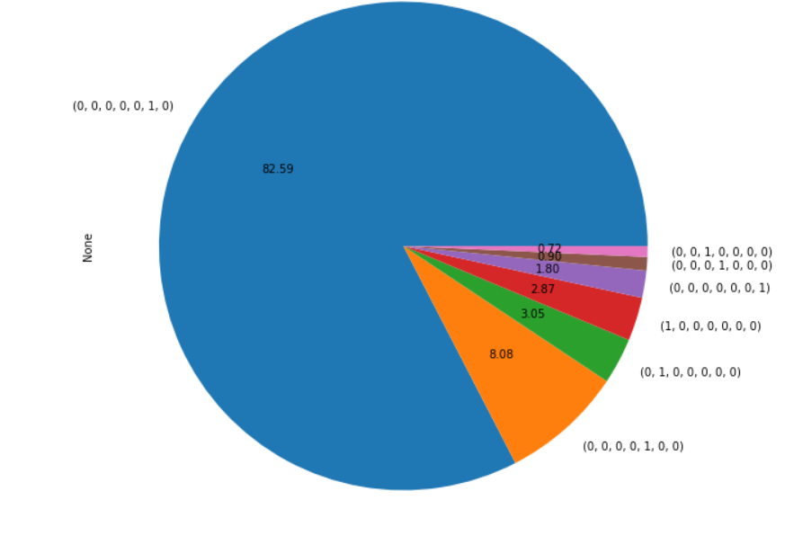
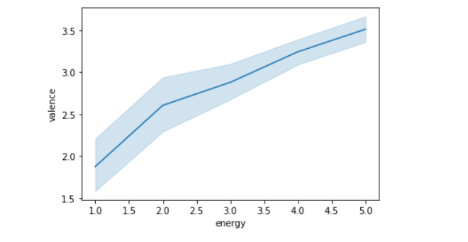
Data Visualisation

Slide 8
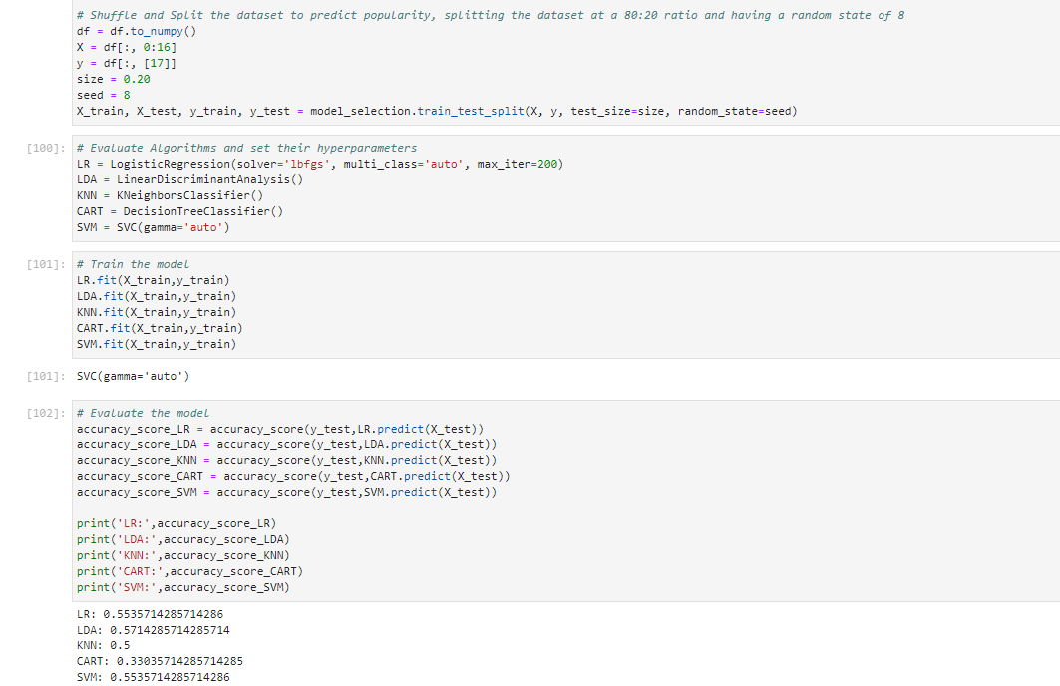
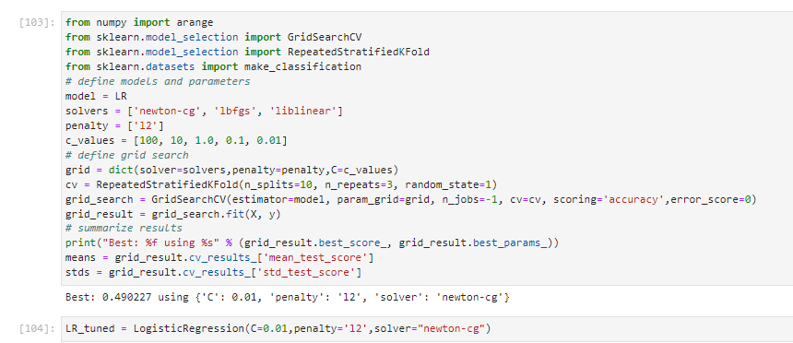
Methods & Improvements (and Modelling)
1.
2.

Slide 9
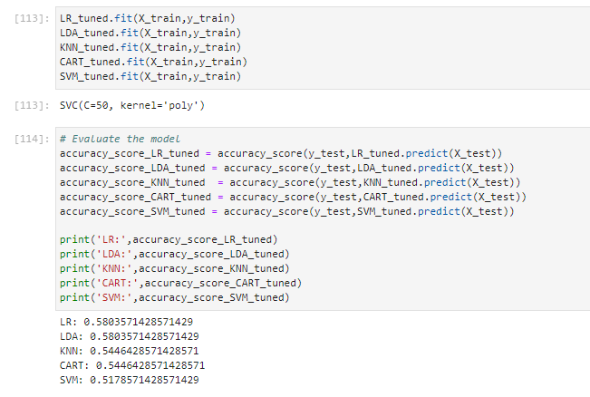
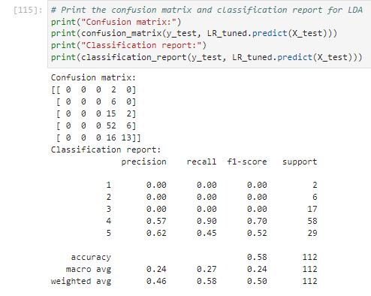
Methods & Improvements (and Modelling)
4.
3.

Slide 10
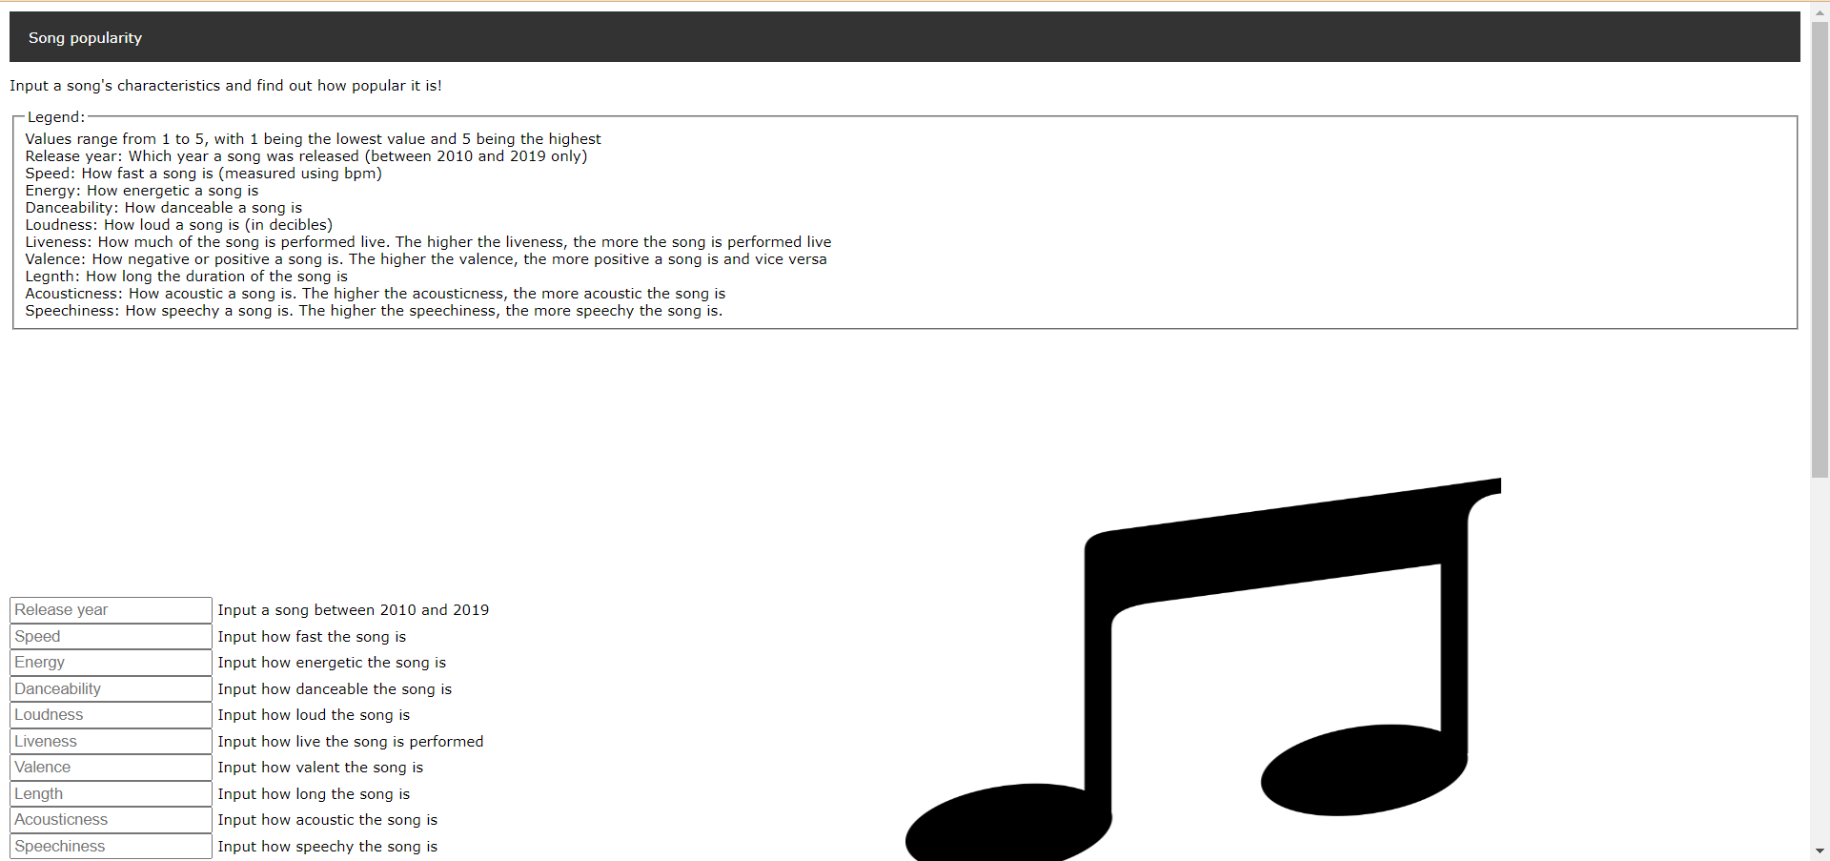
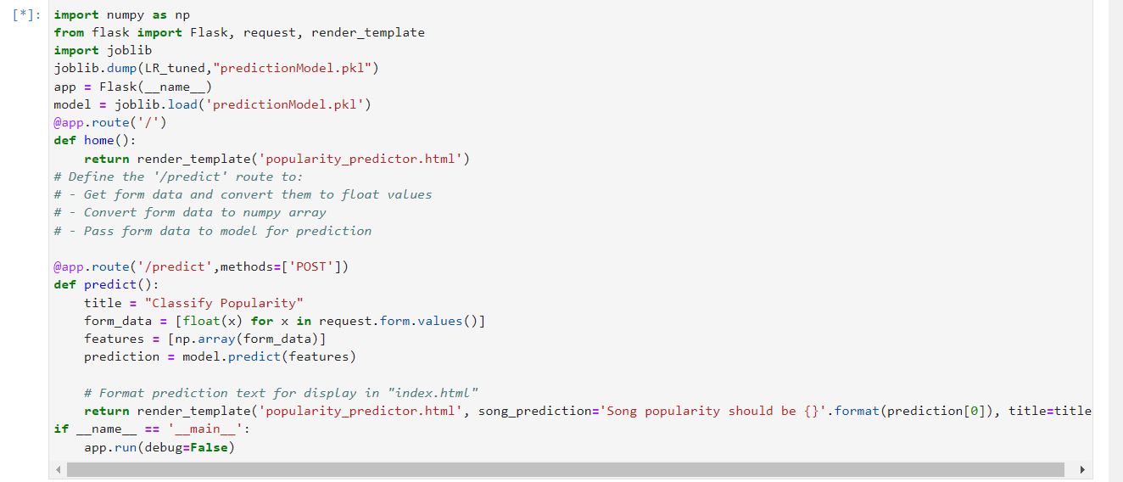
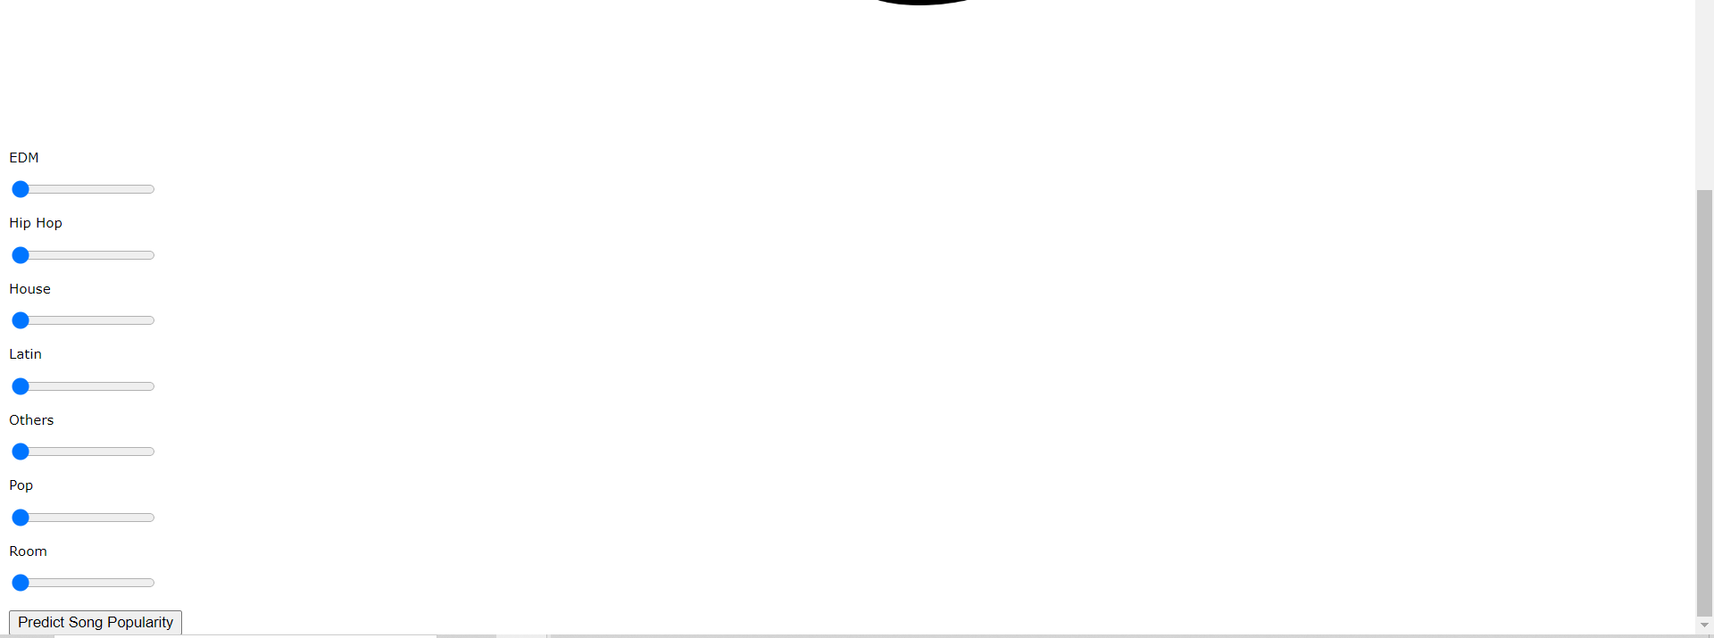
Flask Website Implementation

