Slide 1
Artificial Neural and Adaptive Systems FINAL PROJECT FINGER PRINT SPOOF DETECTION
BURRA VENKATA KRISHNA KARTHIK
16230698

Slide 2
TO FIND THE BEST CONFIGURATION
TOOK BGP FEATURE COMBINED TRAIN DATA FOR DIGITAL & SAGEM SENSOR TO FIND THE BEST CONFIGURATION,
HIDDEN LAYER 1=400 ,HIDDEN LAYER 2=150 ,L2WR=0.004,0.004, SR=2,1 ,SP=0.4,0.4, AUC=0.91995 fits the best configuration.
SENSOR | FEATURE | HL1 | HL2 | No of Autoencoders | L2WR | SR | SP | AUC
SAGEM+DIGITAL | BGP | 100 | 100 | 2 | 0.004,0.004 | 1,1 | 0.25,0.25 | 0.85654
SAGEM+DIGITAL | BGP | 200 | 100 | 2 | 0.004,0.004 | 1,1 | 0.25,0.25 | 0.86597
SAGEM+DIGITAL | BGP | 400 | 150 | 2 | 0.004,0.004 | 2,1 | 0.4,0.4 | 0.91995
SAGEM+DIGITAL | BGP | 300 | 100 | 2 | 0.004,0.004 | 2,1 | 0.4,0.25 | 0.91069
SAGEM+DIGITAL | BGP | 500 | 100 | 2 | 0.016,0.016 | 4,2 | 0.4,0.4 | 0.90236

Slide 3
TO FIND THE BEST CONFIGURATION
TOOK BSIF FEATURE COMBINED TRAIN DATA FOR DIGITAL & SAGEM SENSOR TO FIND THE BEST CONFIGURATION,
HIDDEN LAYER 1=400 ,HIDDEN LAYER 2=150 ,L2WR=0.004,0.004, SR=2,1 ,SP=0.4,0.4, AUC=0.92344
SENSOR | FEATURE | HL1 | HL2 | No of Autoencoders | L2WR | SR | SP | AUC
SAGEM+DIGITAL | BSIF | 100 | 100 | 2 | 0.004,0.004 | 1,1 | 0.25,0.25 | 0.78346
SAGEM+DIGITAL | BSIF | 200 | 100 | 2 | 0.004,0.004 | 1,1 | 0.25,0.25 | 0.82456
SAGEM+DIGITAL | BSIF | 400 | 150 | 2 | 0.004,0.004 | 2,1 | 0.4,0.4 | 0.92344
SAGEM+DIGITAL | BSIF | 300 | 100 | 2 | 0.004,0.004 | 2,1 | 0.4,0.25 | 0.90115
SAGEM+DIGITAL | BSIF | 500 | 100 | 2 | 0.016,0.016 | 4,2 | 0.4,0.4 | 0.87113

Slide 4
TO FIND THE BEST CONFIGURATION
TOOK LBP FEATURE COMBINED TRAIN DATA FOR DIGITAL & SAGEM SENSOR TO FIND THE BEST CONFIGURATION,
HIDDEN LAYER 1=400 ,HIDDEN LAYER 2=150 ,L2WR=0.004,0.004, SR=2,1 ,SP=0.4,0.4, AUC=0.9 0225
SENSOR | FEATURE | HL1 | HL2 | No of Autoencoders | L2WR | SR | SP | AUC
SAGEM+DIGITAL | LBP | 100 | 100 | 2 | 0.004,0.004 | 1,1 | 0.25,0.25 | 0.81226
SAGEM+DIGITAL | LBP | 200 | 100 | 2 | 0.004,0.004 | 1,1 | 0.25,0.25 | 0.87656
SAGEM+DIGITAL | LBP | 400 | 150 | 2 | 0.004,0.004 | 2,1 | 0.4,0.4 | 0.90225
SAGEM+DIGITAL | LBP | 300 | 100 | 2 | 0.004,0.004 | 2,1 | 0.4,0.25 | 0.85696
SAGEM+DIGITAL | LBP | 500 | 100 | 2 | 0.016,0.016 | 4,2 | 0.4,0.4 | 0.89123

Slide 5
TASK1
L2 Weight Regularization=0.004
Sparsity Regularization=2
Sparsity Proportion=0.4
Max Epoch =200
Sensor | Features | Hidden Layer1 | Hidden Layer2 | No of Auto-encoders | AUC Train | AUC Test
Digital | LBP | 400 | 150 | 2 | 0.93913 | 0.79821
Digital | BSIF | 400 | 150 | 2 | 0.92595 | 0.83685
Digital | BGP | 400 | 150 | 2 | 0.94565 | 0.78421
Sagem | LBP | 400 | 150 | 2 | 0.95484 | 0.85794
Sagem | BSIF | 400 | 150 | 2 | 0.93019 | 0.81046
Sagem | BGP | 400 | 150 | 2 | 0.91258 | 0.85794

Slide 6
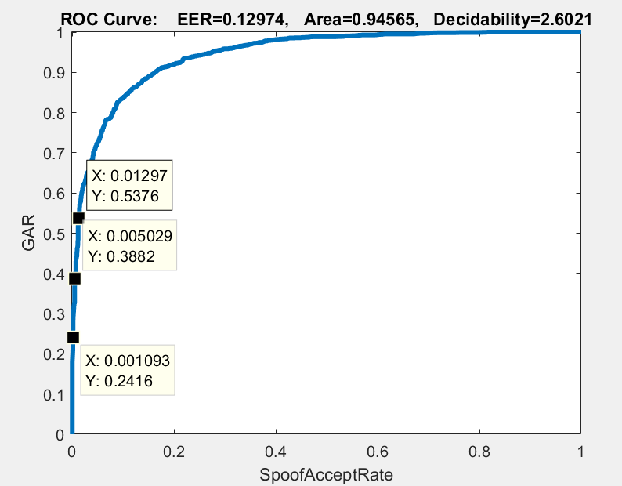
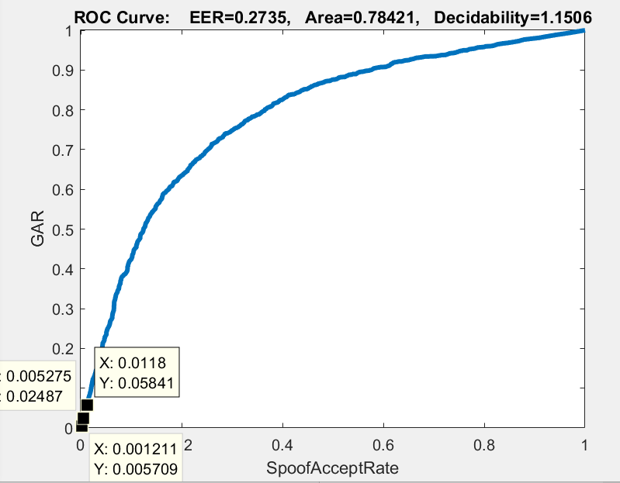
TASK 1- INDIVIDUAL TRAINING AND TESTING ROC CURVES BGP FEATURE DIGITAL SENSOR
GRR(Live Reject Rate)=1-GAR
TRAIN CURVE
SAR(Spoof Accept Rate) at 0.1%=1-0.2416=0.7584
SAR (Spoof Accept Rate) at 0.5% = 1-0.3882=0.6118
SAR (Spoof Accept Rate) at 1%=1-0.5376=0.4624
TEST CURVE
SAR (Spoof Accept Rate) at 0.1%=1-0.005709=0.994291
SAR (Spoof Accept Rate) at 0.5% = 1-0.02487=0.97513
SAR (Spoof Accept Rate) at 1%=1-0.05841=0.94159

Slide 7
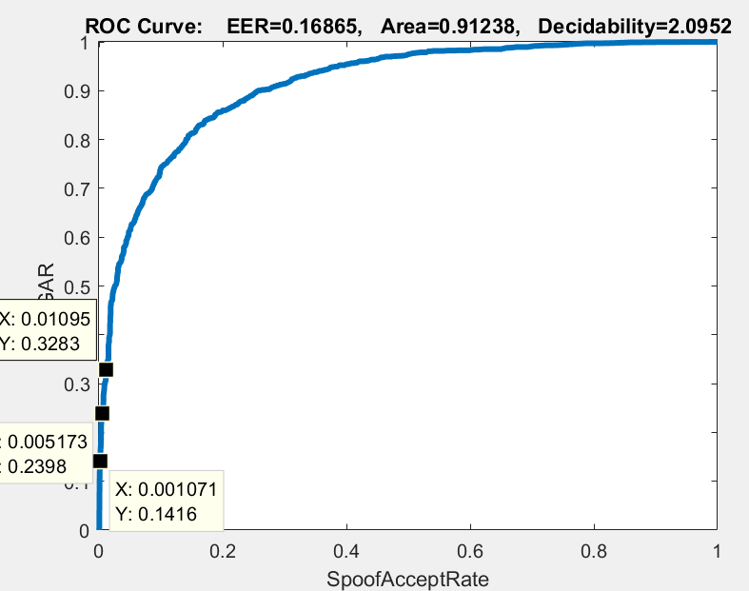
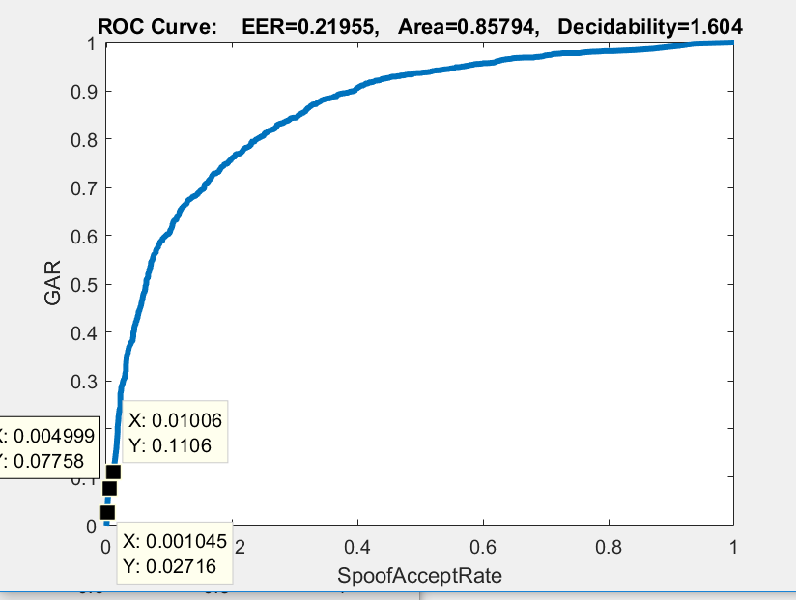
TASK 1- INDIVIDUAL TRAINING AND TESTING ROC CURVES BGP FEATURE SAGEM SENSOR
GRR(Live Reject Rate)=1-GAR
TRAIN CURVE
SAR (Spoof Accept Rate) at 0.1%=1-0.1416=0.8584
SAR (Spoof Accept Rate) at 0.5% = 1-0.2398=0.7602
SAR at 1%=1-0.3283=0.6717
TEST CURVE
SAR (Spoof Accept Rate) at 0.1%=1-0.02716=0.97284
SAR (Spoof Accept Rate) at 0.5% = 1-0.07758=0.92242
SAR (Spoof Accept Rate) at 1%=1-0.1106=0.8894

Slide 8
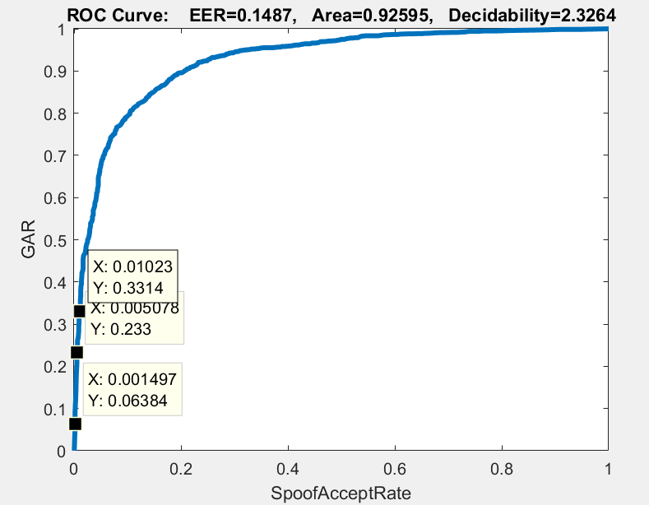
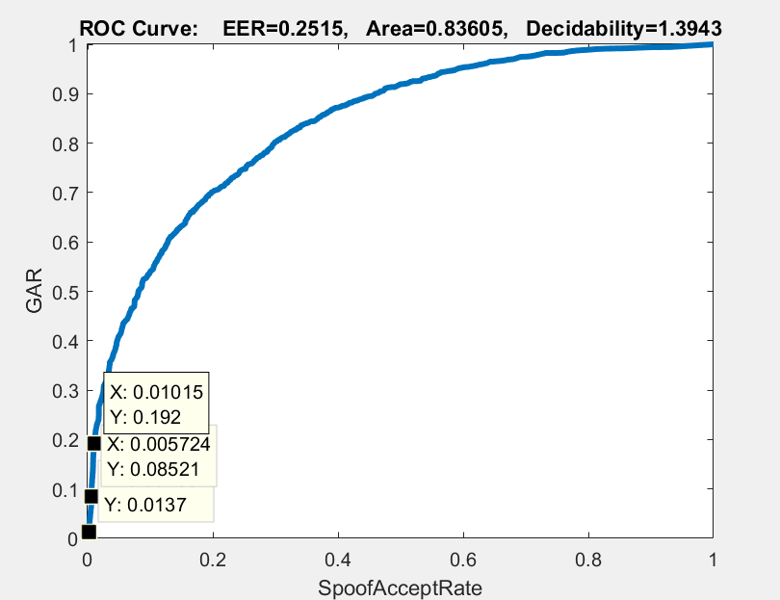
TASK1 –INDIVIDUAL TRAINING AND TESTING ROC CURVES BSIF FEATURE DIGITAL SENSOR
GRR(Live Reject Rate)=1-GAR
TRAIN CURVE
SAR (Spoof Accept Rate) at 0.1%=1-0.06384=0.93616
SAR (Spoof Accept Rate) at 0.5% = 1-0.2333=0.7667
SAR (Spoof Accept Rate) at 1%=1-0.3314=0.6686
TEST CURVE
SAR (Spoof Accept Rate) at 0.1%=1-0.0137=0.9863
SAR (Spoof Accept Rate) at 0.5% = 1-0.08521=0.9149
SAR (Spoof Accept Rate) at 1%=1-0.192=0.8089

Slide 9
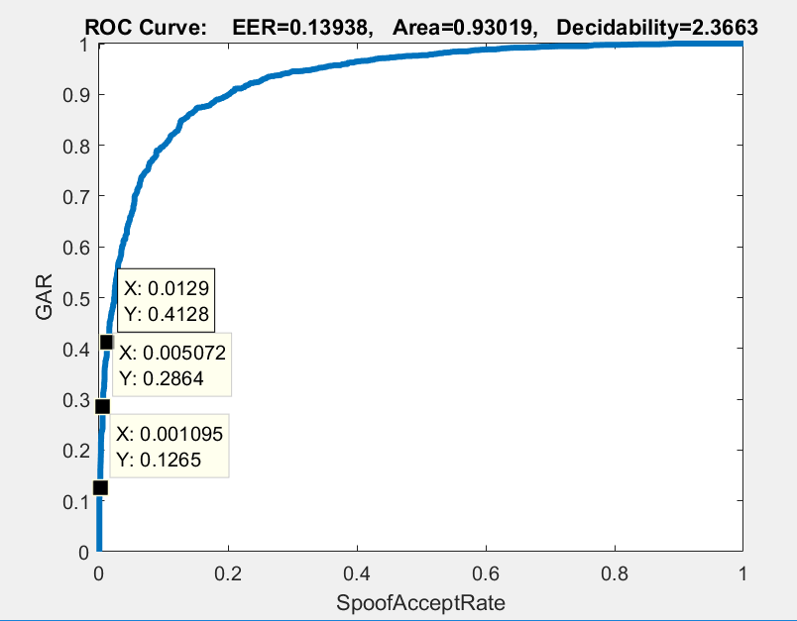
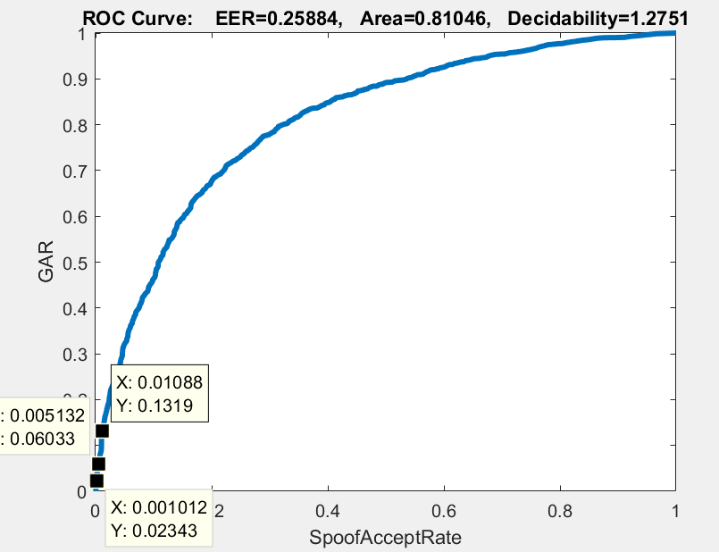
TASK1 INDIVIDUAL TRAINING AND TESTING ROC CURVES BSIF FEATURE SAGEM SENSOR
GRR(Live Reject Rate)=1-GAR
TRAIN CURVE
SAR (Spoof Accept Rate) at 0.1%=1-0.1265=0.8735
SAR (Spoof Accept Rate) at 0.5% = 1-0.2864=0.7136
SAR (Spoof Accept Rate) at 1%=1-0.4128=0.5872
TEST CURVE
SAR (Spoof Accept Rate) at 0.1%=1-0.02343=0.97657
SAR (Spoof Accept Rate) at 0.5% = 1-0.06033=0.93967
SAR (Spoof Accept Rate) at 1%=1-0.1319=0.8681

Slide 10
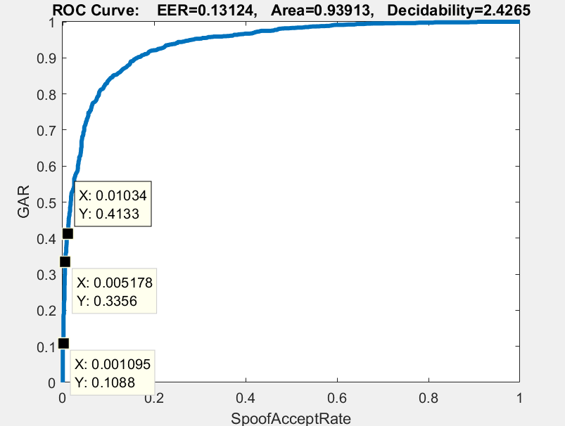
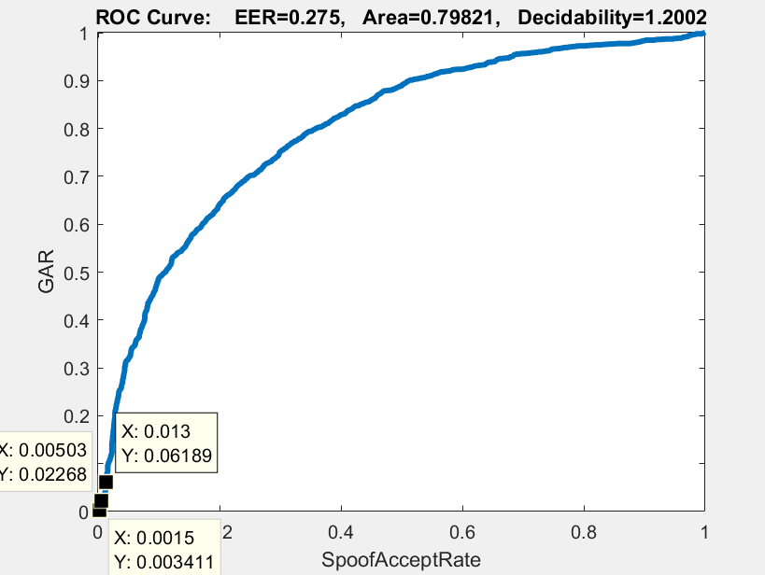
TASK1 –INDIVIDUAL TRAINING AND TESTING ROC CURVES FOR LBP FEATURE DIGITAL SENSOR
GRR(Live Reject Rate)=1-GAR
TRAIN CURVE
SAR (Spoof Accept Rate) at 0.1%=1-0.1088=0.8912
SAR (Spoof Accept Rate) at 0.5% = 1-0.3356=0.6644
SAR (Spoof Accept Rate) at 1%=1-0.4133=0.5867
TEST CURVE
SAR (Spoof Accept Rate) at 0.1%=1-0.003411=0.996589
SAR (Spoof Accept Rate) at 0.5% = 1-0.02268=0.97732
SAR (Spoof Accept Rate) at 1%=1-0.06189=0.93811

Slide 11
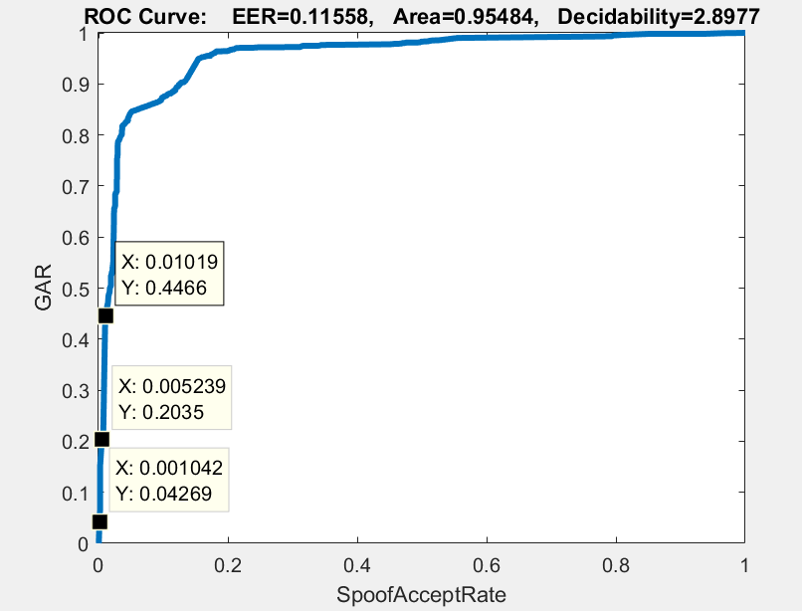
TASK1 –INDIVIDUAL TRAINING AND TESTING ROC CURVES FOR LBP FEATURE SAGEM SENSOR
GRR(Live Reject Rate)=1-GAR
TRAIN CURVE
SAR (Spoof Accept Rate) at 0.1%=1-0.04269=0.95731
SAR (Spoof Accept Rate) at 0.5% = 1-0.2035=0.7965
SAR (Spoof Accept Rate) at 1%=1-0.4466=0.5534
TEST CURVE
SAR (Spoof Accept Rate) at 0.1%=1-0.02716=0.97284
SAR (Spoof Accept Rate) at 0.5% = 1-0.07758=0.92242
SAR (Spoof Accept Rate) at 1%=1-0.1106=0.8894

Slide 12
TASK2
SENSOR | FEATURE | HL1 | HL2 | No of Autoencoders | L2WR | SR | SP | AUC Train | AUC Validate | AUC Test
Train-Digi, Test-Sage | LBP | 400 | 150 | 2 | 0.004,0.004 | 2,1 | 0.4,0.4 | 0.94787 | 0.91079 | 0.5461
Train-Digi, Test-Sage | BSIF | 400 | 150 | 2 | 0.004,0.004 | 2,1 | 0.4,0.4 | 0.98982 | 0.81411 | 0.7534
Train-Digi, Test-Sage | BGP | 400 | 150 | 2 | 0.004,0.004 | 2,1 | 0.4,0.4 | 0.93807 | 0.89016 | 0.57721
Train-Sage, Test-Digi | LBP | 400 | 150 | 2 | 0.004,0.004 | 2,1 | 0.4,0.4 | 0.96856 | 0.98628 | 0.52169
Train-Sage, Test-Digi | BSIF | 400 | 150 | 2 | 0.004,0.004 | 2,1 | 0.4,0.4 | 0.929 | 0.9266 | 0.56195
Train-Sage, Test-Digi | BGP | 400 | 150 | 2 | 0.004,0.004 | 2,1 | 0.4,0.4 | 0.98417 | 0.97731 | 0.43771

Slide 13
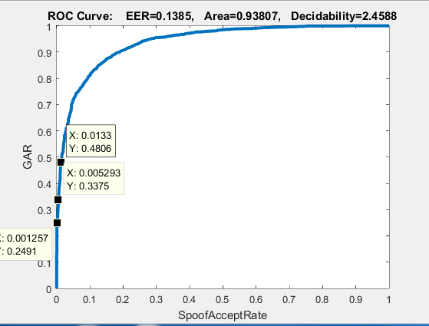
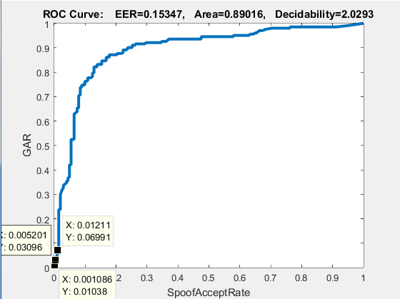
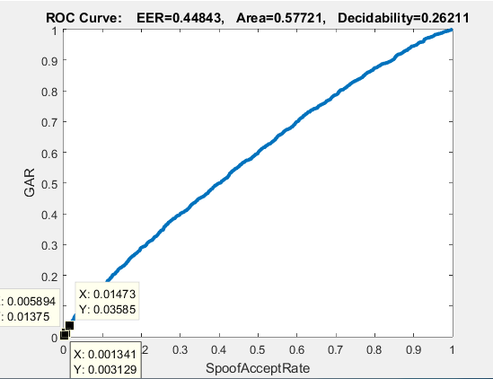
TASK2- BGP -TRAIN DIGITAL ,TEST SAGEM Validating on train data
GRR(Live Reject Rate)=1-GAR
TRAIN CURVE
SAR (Spoof Accept Rate) at 0.1%=1-0.2491=0.7581
SAR (Spoof Accept Rate) at 0.5% = 1-0.3375=0.6625
SAR (Spoof Accept Rate) at 1%=1-0.4806=0.5194
VALIDATE CURVE
SAR (Spoof Accept Rate) at 0.1%=1-0.01038=0.98962
SAR (Spoof Accept Rate) at 0.5% = 1-0.03096=0.96904
SAR (Spoof Accept Rate) at 1%=1-0.06991=0.93009
TEST CURVE
SAR (Spoof Accept Rate) at 0.1%=1-0.003129=0.996871
SAR (Spoof Accept Rate) at 0.5% = 1-0.01375=0.98625
SAR (Spoof Accept Rate) at 1%=1-0.003585=0.996415

Slide 14
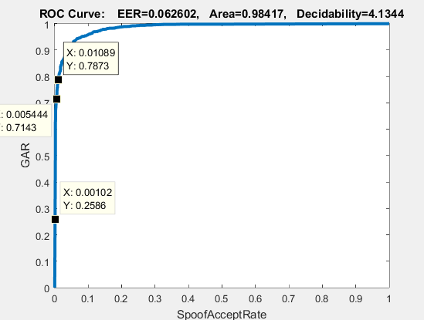
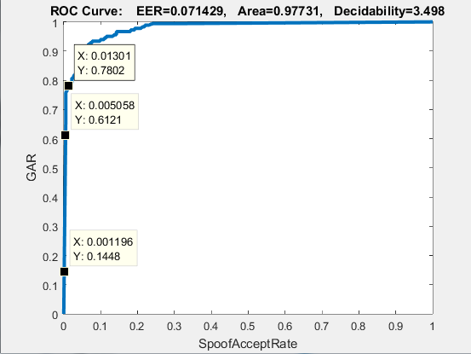
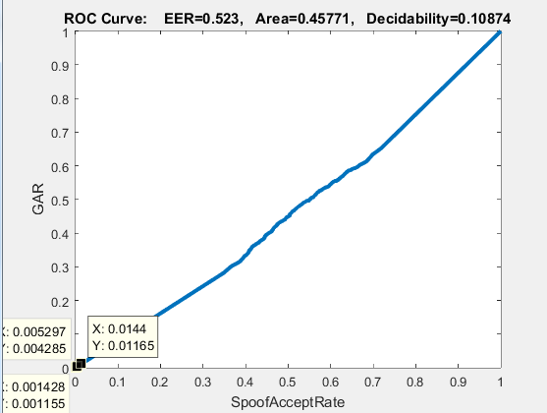
TASK2- BGP – TRAIN SAGEM, TEST DIGITAL Validating on train data
GRR(Live Reject Rate)=1-GAR
TRAIN CURVE
SAR (Spoof Accept Rate) at 0.1%=1-0.2586=0.7414
SAR (Spoof Accept Rate) at 0.5% = 1-0.7143=0.2857
SAR (Spoof Accept Rate) at 1%=1-0.7873=0.2127
VALIDATE CURVE
SAR (Spoof Accept Rate) at 0.1%=1-0.1448=0.8552
SAR (Spoof Accept Rate) at 0.5% = 1-0.6121=0.3879
SAR (Spoof Accept Rate) at 1%=1-0.7802=0.2198
TEST CURVE
SAR (Spoof Accept Rate) at 0.1%=1-0.001155=0.998845
SAR (Spoof Accept Rate) at 0.5% = 1-0.004285=0.9957175
SAR (Spoof Accept Rate) at 1%=1-0.01165=0.98835

Slide 15
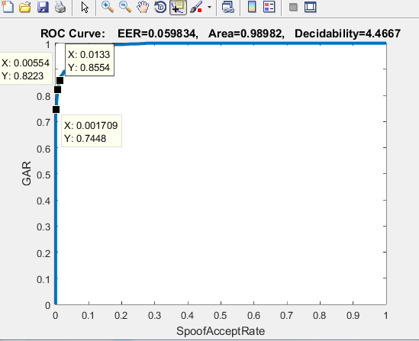
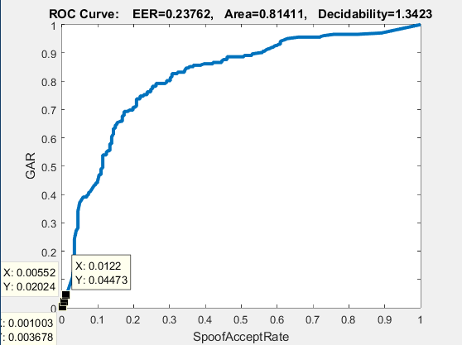
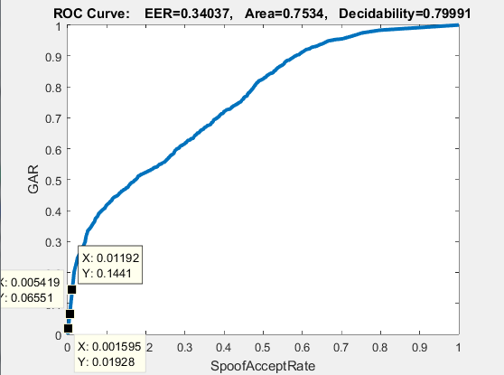
TASK2- BSIF – TRAIN DIGITAL, TEST SAGEM Validating on train data
GRR(Live Reject Rate)=1-GAR
TRAIN CURVE
SAR (Spoof Accept Rate) at 0.1%=1-0.7448=0.2552
SAR (Spoof Accept Rate) at 0.5% = 1-0.8223=0.1777
SAR (Spoof Accept Rate) at 1%=1-0.8554=0.1446
VALIDATE CURVE
SAR (Spoof Accept Rate) at 0.1%=1-0.003678=0.996322
SAR (Spoof Accept Rate) at 0.5% = 1-0.02024=0.97976
SAR (Spoof Accept Rate) at 1%=1-0.04473=0.95527
TEST CURVE
SAR (Spoof Accept Rate) at 0.1%=1-0.01928=0.98072
SAR (Spoof Accept Rate) at 0.5% = 1-0.06551=0.93449
SAR (Spoof Accept Rate) at 1%=1-0.1441=0.559

Slide 16
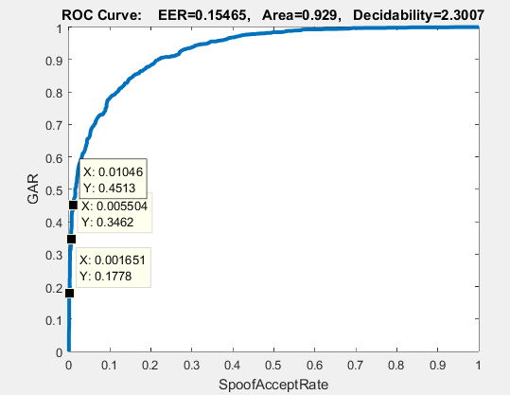
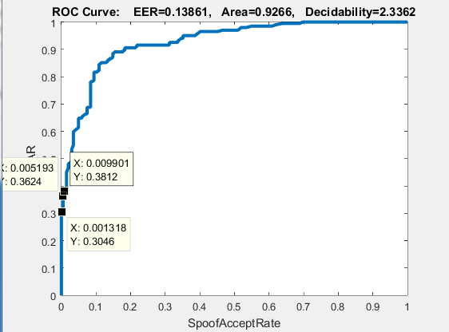
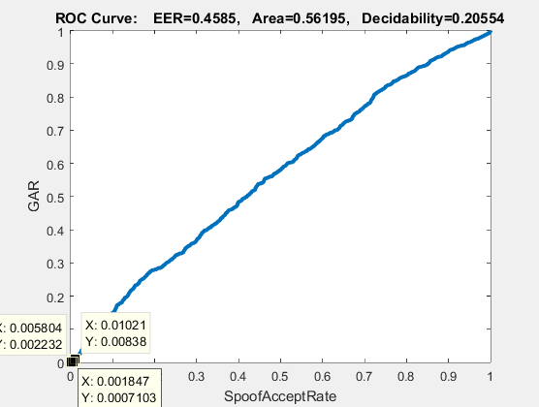
TASK2- BSIF – TRAIN SAGEM, TEST DIGITAL Validating on train data
GRR(Live Reject Rate)=1-GAR
TRAIN CURVE
SAR (Spoof Accept Rate) at 0.1%=1-0.1778=0.8222
SAR (Spoof Accept Rate) at 0.5% = 1-0.3462=0.6538
SAR (Spoof Accept Rate) at 1%=1-0.4513=0.5487
VALIDATE CURVE
SAR (Spoof Accept Rate) at 0.1%=1-0.3046=0.0.6954
SAR (Spoof Accept Rate) at 0.5% = 1-0.3624=0.6376
SAR (Spoof Accept Rate) at 1%=1-0.3812=0.6188
TEST CURVE
SAR (Spoof Accept Rate) at 0.1%=1-0.0007103=0.9992897
SAR (Spoof Accept Rate) at 0.5% = 1-0.002232=0.997768
SAR (Spoof Accept Rate) at 1%=1-0.00838=0.99162

Slide 17
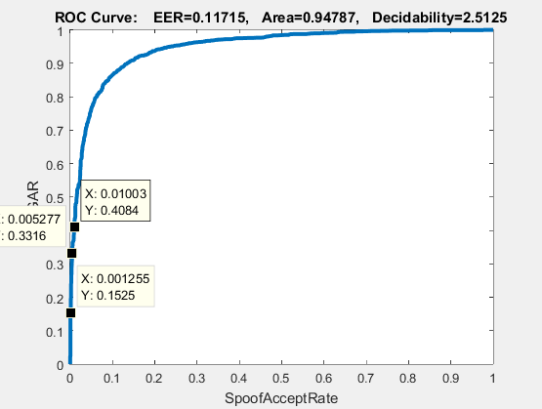
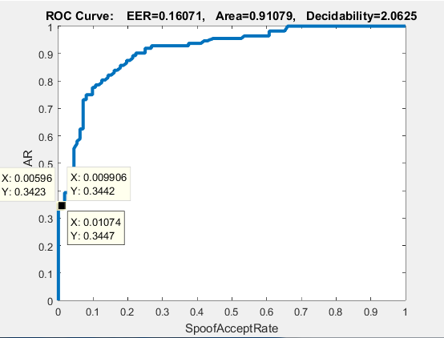
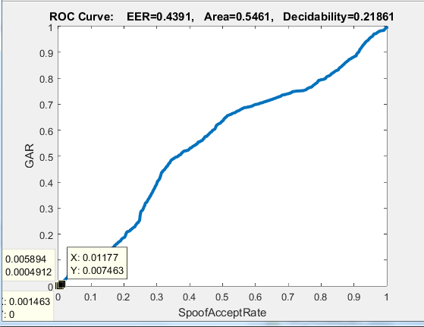
TASK2- LBP – TRAIN DIGITAL, TEST SAGEM Validating on train data
GRR(Live Reject Rate)=1-GAR
TRAIN CURVE
SAR (Spoof Accept Rate) at 0.1%=1-0.525=0.475
SAR (Spoof Accept Rate) at 0.5% = 1-0.3316=0.6684
SAR (Spoof Accept Rate) at 1%=1-0.4084=0.5916
VALIDATE CURVE
SAR (Spoof Accept Rate) at 0.1%=1-0.3447=0.6553
SAR (Spoof Accept Rate) at 0.5% = 1-0.3423=0.6577
SAR (Spoof Accept Rate) at 1%=1-0.3442=0.6558
TEST CURVE
SAR (Spoof Accept Rate) at 0.1%=1-0=0
SAR (Spoof Accept Rate) at 0.5% = 1-0.0004912=0.9995088
SAR (Spoof Accept Rate) at 1%=1-0.007463=0.992537

Slide 18
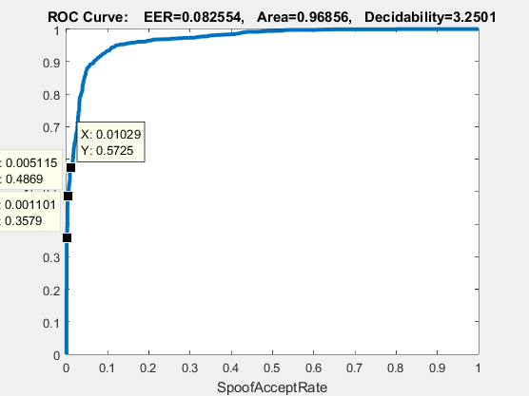
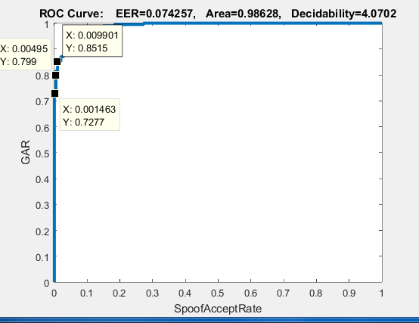
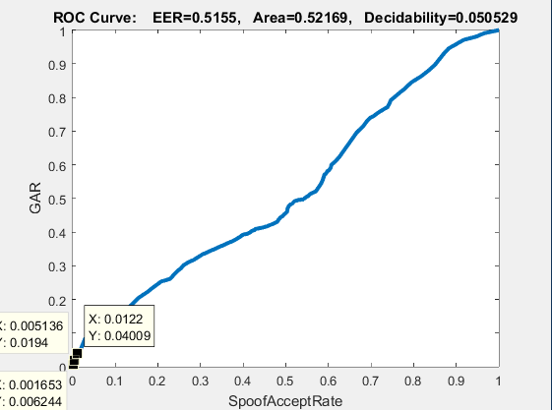
TASK2- LBP – TRAIN SAGEM, TEST DIGITAL Validating on train data
GRR(Live Reject Rate)=1-GAR
TRAIN CURVE
SAR (Spoof Accept Rate) at 0.1%=1-0.3579=0.6421
SAR (Spoof Accept Rate) at 0.5% = 1-0.4869=0.5131
SAR (Spoof Accept Rate) at 1%=1-0.5725=0.4275
VALIDATE CURVE
SAR (Spoof Accept Rate) at 0.1%=1-0.7277=0.2723
SAR (Spoof Accept Rate) at 0.5% = 1-0.799=0.201
SAR (Spoof Accept Rate) at 1%=1-0.8515=0.1485
TEST CURVE
SAR (Spoof Accept Rate) at 0.1%=1-0.006244=0.993756
SAR (Spoof Accept Rate) at 0.5% = 1-0.0194=0.9806
SAR (Spoof Accept Rate) at 1%=1-0.04009=0.5991

Slide 19
BONUS
SENSOR | FEATURE | HL1 | HL2 | No of Autoencoders | L2WR | SR | SP | AUC Train | AUC Validate | AUC Test
Train-Digi, Test-Digi | LBP+BGP | 400 | 150 | 2 | 0.004,0.004 | 2,1 | 0.4,0.4 | 1 | 0.94189 | 0.5772
Train-Digi, Test-Digi | BSIF+LBP | 400 | 150 | 2 | 0.004,0.004 | 2,1 | 0.4,0.4 | 1 | 0.94118 | 0.50013

Slide 20
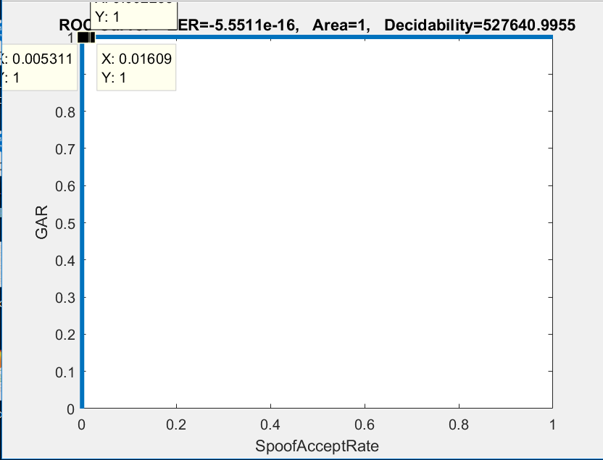
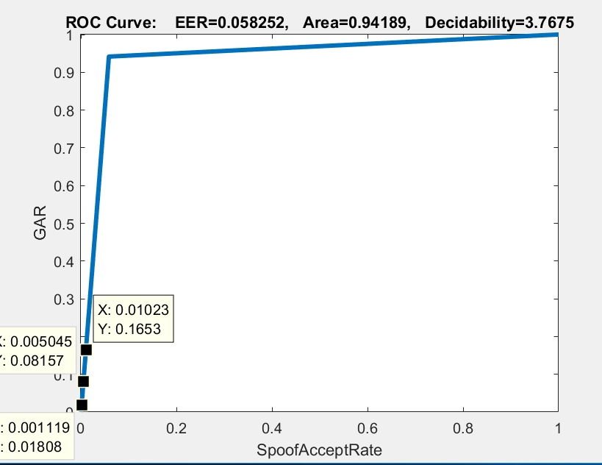
BONUS fusion of BGP and LBP features
GRR(Live Reject Rate)=1-GAR
TRAIN CURVE
SAR (Spoof Accept Rate) at 0.1%=1-1=0
SAR (Spoof Accept Rate) at 0.5% = 1-1=0
SAR (Spoof Accept Rate) at 1%=1-1=0
VALIDATE CURVE
SAR (Spoof Accept Rate) at 0.1%=1-0.018157=0.981843
SAR (Spoof Accept Rate) at 0.5% = 1-0.08157=0.91843
SAR (Spoof Accept Rate) at 1%=1-0.1653=0.8347
TEST CURVE
SAR (Spoof Accept Rate) at 0.1%=1-0.003129=0.996871
SAR (Spoof Accept Rate) at 0.5% = 1-0.01375=0.98625
SAR (Spoof Accept Rate) at 1%=1-0.03585=0.96415

Slide 21
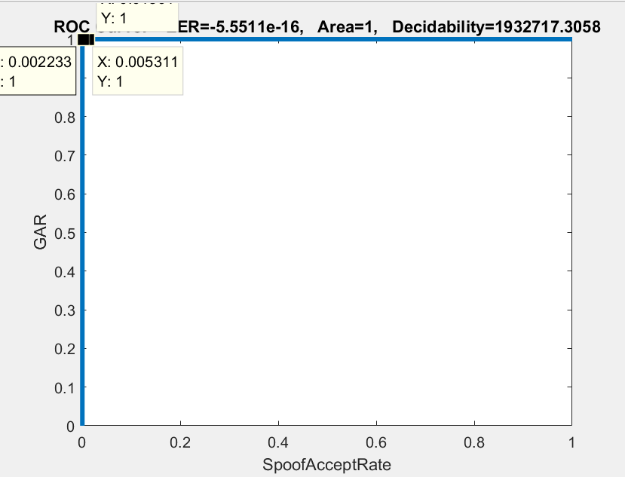
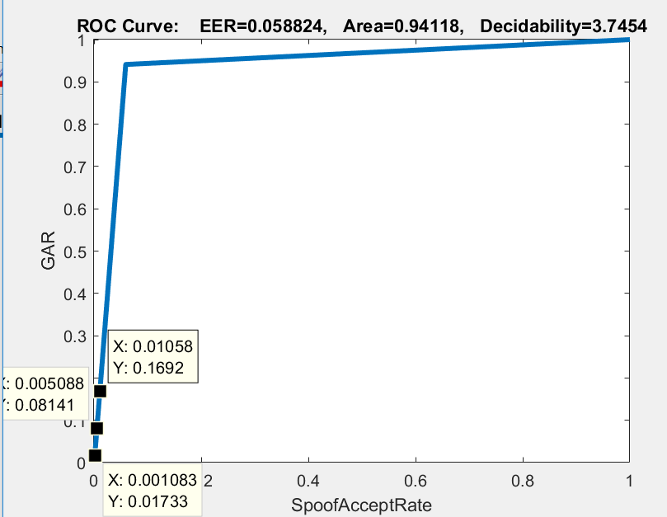
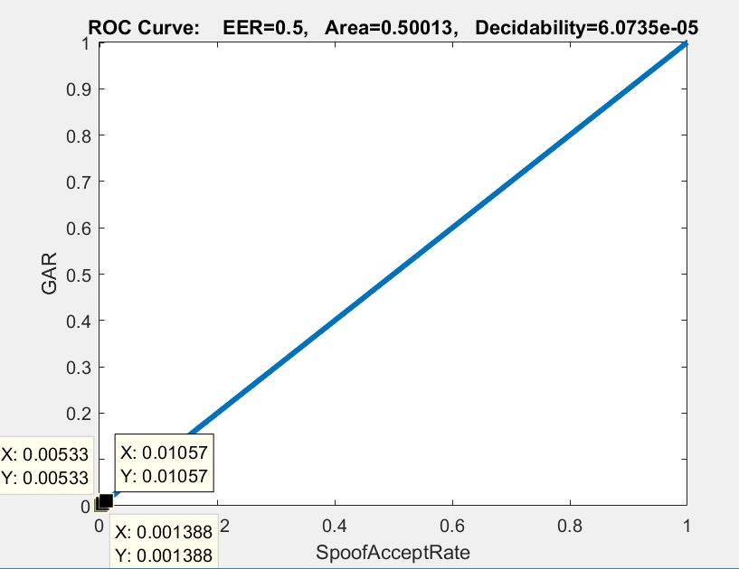
BONUS fusion of BSIF and LBP features
GRR(Live Reject Rate)=1-GAR
TRAIN CURVE
SAR (Spoof Accept Rate) at 0.1%=1-1=0
SAR (Spoof Accept Rate) at 0.5% = 1-1=0
SAR (Spoof Accept Rate) at 1%=1-1=0
VALIDATE CURVE
SAR (Spoof Accept Rate) at 0.1%=1-0.01733=0.98267
SAR (Spoof Accept Rate) at 0.5% = 1-0.08141=0.91859
SAR (Spoof Accept Rate) at 1%=1-0.1692=0.8308
TEST CURVE
SAR (Spoof Accept Rate) at 0.1%=1-0.=0.996871
SAR (Spoof Accept Rate) at 0.5% = 1-0.=0.98625
SAR (Spoof Accept Rate) at 1%=1-0.=0.9

Slide 22
CONCLUSIONS
LivDet2011 database is used which consists of LBP,BSIF and BGP features and are trained, validated and tested accordingly.
Two autoencoders are used so that the performance of ROC curve is increased. But, when one or three autoencoders are used, performance decreases. So, two autoencoders is optimal.
Hidden Layer sizes should be increased to get better Area Under Curve value. But it is not valid in all cases. When Hidden layer size is increased from 100 to 400 , performance of ROC curve is increased but when hidden layer size is 500, AUC decreases. So, in this case, H1=400 and H2=150 are found to be optimal.
Changing L2W Regularization or weight decay parameter, It’s generally low in the range of 0 to 1, it affects more for smaller weights than larger weights. So, ROC’s were plotted for different values of weights starting from 0.004 to 0.016. It is seen that as the weights are increased the AUC values were dropping.
Changing Sparsity Regularization parameter. It is observed that as the value of the Sparsity Regularization parameter increases, the AUC decreases. For Sparsity Regularization of 2 it was better than the Sparsity Regularization of 4.
Varying Sparsity Proportion parameter. When this parameter is increased, the number of active neurons increases. So, AUC increases. Higher the Sparsity Proportion, better AUC value .
In Task1, use the features LBP, BSIF and BGP individually to train and test the deep network. We can see that the test AUC is better for BSIF among LBP, BSIF and BGP considering digital sensor and we can see that the test AUC is better for BGP among LBP, BSIF and BGP considering Sagem sensor.
In Task2, Same features are taken, but trained and tested on different sensors accordingly. BGP is considered best feature among BGP, BSIF and LBP when trained on digital sensor and tested on sagem sensor and BSIF is considered best feature among BGP, BSIF and LBP when trained on sagem sensor and tested on digital sensor. We also see the performance degradation.
Considering the Bonus case, which is evaluating fusion of features (such as LBP and BSIF) considering only digital sensor for training, validating and testing the data. We see the performance degradation.

