Slide 1
QLIKVIEW & QLIKSENSE – UI/UX
BURRA VENKATA KRISHNA KARTHIK

Slide 2
Content
Introduction
Dataset
Qlik view – ETL, Data Modeling & Scripting
QlikSense

Slide 3

Introduction
Patients UI
Hospital UI
Quality Measures UI
Surgical Department UI
Vitals UI

Slide 4
Dataset
URL : https://community.qlik.com/docs/DOC-19245
This zip file contains the base CSV files that comprise the General Hospital data set. This forms the foundation of the fake health systems data and is in a normalized fashion.
The data was largely generated using a fake data generation site called Mockaroo then combined with other test sources of data.

Slide 5
Dataset
CSV files: Downloaded to C:\Users\bvkka\Desktop\Qlik_sql\New folder\Layer1 CSV
Accounts
Departments
Encounters
Hospitals : I took only 5 out of many because we have data from only 5 hospitals
Order Procedures
Patients
Physicians
Practices
Quality Measures
Results
Surgical Costs
Surgical Encounters
Latest Patient Vitals

Slide 6
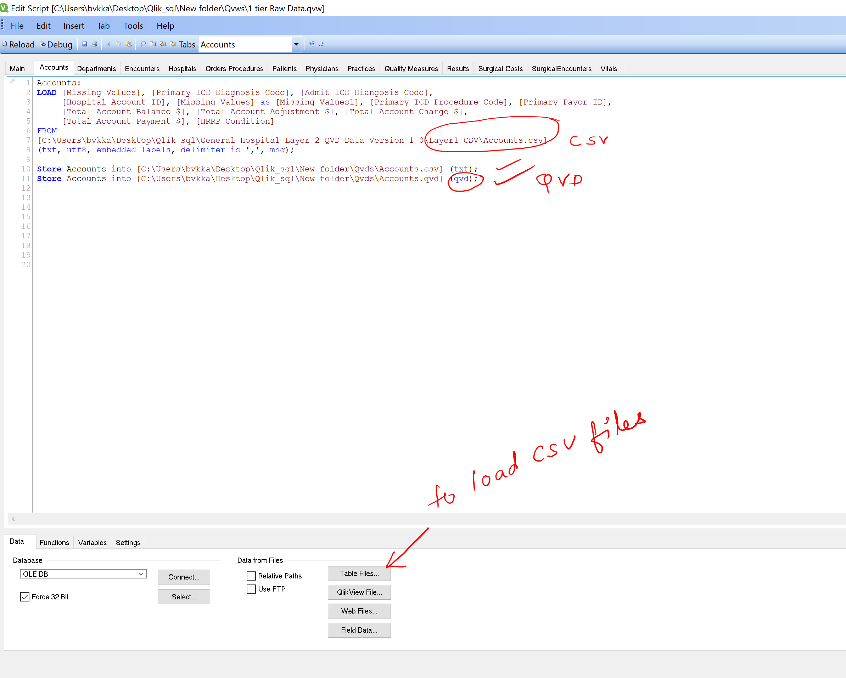
QlikView – ETL , Data Modeling & Scripting
Data Loading : (Layer1 or 1st tier)
Following a 3 tier architecture!
Loaded all CSV files into 1 tier Raw Data.qvw and then converted them into qvd files.

Slide 7
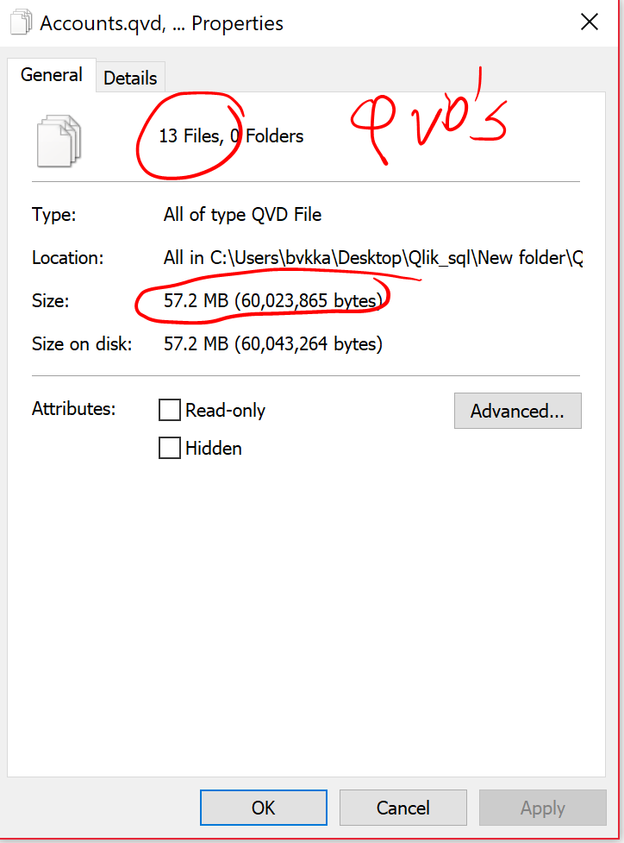
QlikView
Data Loading :
Compressed 227 MB CSV data to 52MB QVD (78% reduction of data size)
24 MB of 1 tier raw data.qvw file (90% compression)
Awesome right!

Slide 8
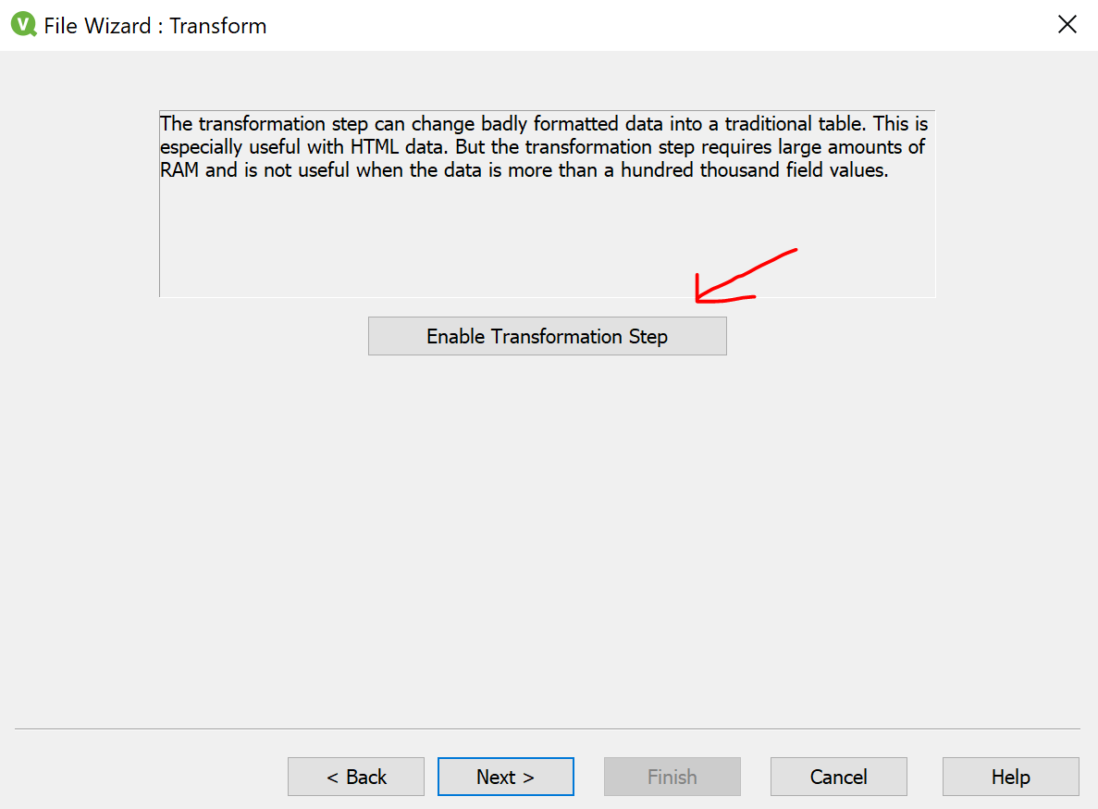
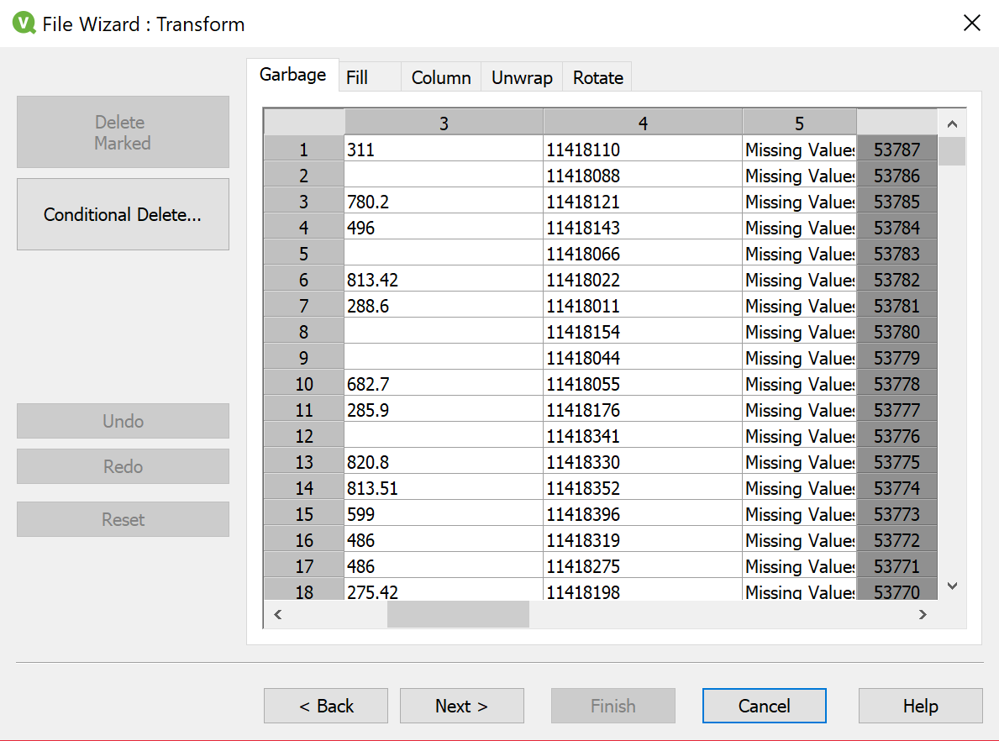
QlikView
Data Transformation (2nd Tier)
Different qvw file for 2 tier
Accounts and departments tab :
Okay what I'm doing here is data cleaning. I filled missing values in columns as 'Missing values' using 2 methods, 1 - created a new column 'Missing values' in excel and applied transformation step called 'fill' in the wizard when you load. 2- used if condition.

Slide 9
QlikView
Data Transformation (2nd Tier)
Encounters tab : Did some good transformations!
Applied Preceding load : converted date time to date, month, day, ym,yrqtr,monthqtr,hour formats
Applied Timestamp function : to convert the datetime format
Applied Dual function: to store the data into (text, number) format so that we can perform sorting & calculations on number while the string value can be used for display purposes.
Used Mapping table : to replace field values to field names
Used if condition for filling missing values

Slide 10
QlikView
Data Transformation (2nd Tier)
Patients tab :
Applied text ( right()) function on zip code : there are some zip codes with 4 numbers instead of 5. So, we embed ‘0’ at the start position.
Used Capitalize function to return the string with only first letter capital
Used Dual and Mapping functions
Used Inline load in Mapping tab and applied apply map() in patients tab to patient PCP type

Slide 11
QlikView
Data Transformation (2nd Tier)
Order Procedures, surgical encounters, Results and Quality Measures tab :
Similarly, applied different transformations like mapping, dual, filling missing values , preceding load etc.
Hospitals, Physicians, Practices, Surgical costs and Vitals tab:
No transformations applied : Just few columns and not required. It looks neat!
Avoided circular loops due to same column names. Commented which are not required
Used inner keep () function at multiple locations to get common intersection values but store both the tables without removing any table.
I used SQL Server Management Studio to do testing.
Final Tab: I named it as Final QVD’s – stored all the transformed tables into new folder. Achieved a little more compression (51.2 MB) of data files and 2 tier transformation. qvw file of 24MB (just 24 MB !! ☺)

Slide 12
QlikView
Data Visualization (3rd Tier)
Loading just the transformed qvds into this. That’s all!
Named the qvw as 3 tier data visualization. Qvw
Now, Instead of showing UI in QlikView, I transformed this file qvw file to qvf file and loaded using Qlik sense. I wanted to show more interesting UI using Qlik sense and how Qlik sense is more powerful in visualization than Qlik view.
Just dragged and dropped qvw file into Qlik sense and it will take care of itself very easily.

Slide 13
Qlik sense -UI
Used many extensions : Downloaded from Qlik branch website and GitHub links and then copied it to extensions in Qlik sense folder.
Used Google maps extension . It was crashing at first, then I followed a procedure I found online . Had to put a google maps API key into the java script. Downloaded the API key and added it to the .js file
Used many set analysis and variables variables in set analysis and expressions.
Used custom visualizations D3.js too.
Used various charts like bar chart, pie chart, gauge chart, KPI’s , buttons, drill down charts, bubble chart, word cloud, butterfly chart, Line chart, Area chart, straight table, pivot table, heat map, tree map, combo chart etc.
Made a beautiful application in Qlik sense! Cant wait to show you!
Also, made some nice stories in Qlik sense itself.
Always ensured values are correct. Used SQL Server Management Studio for testing

