Slide 1
Chapter 12 Analysis of Variance
Notes:
Sometimes, like in t-tests, we want to compare group means (interval level DV)… but where we have more than two groups in the IV (categorical/nominal or ordinal).
The bulk of our sociological questions deal with more than two groups:
we may want to see the influence of ethnic identity (white, black, asian, latino) on church attendance. Has to go beyond two-groups compared
we may want to look at educational attainment for blacks versus whites (including men versus women)… which is now 4 groups: BW,BM,WW,WM
This is why we move beyond the two-sample/independent samples t-test to the more complicated analysis of variance (ANOVA).
ANOVA follows the same steps for hypothesis testing that we used for t-tests (Z-tests)

Slide 2
Research Problem
Want to understand if/how groups differ/have variation on some outcome
Social Research
Often have more than two groups interested in
Want to see how racial categories (black, white, asian, other, etc) vary in incomes.

Slide 3

The t-test Way
Could calculate a series of t-ratios
Problem
Inflates our alpha, increases likelihood of making Type I error
Each t-ratio is compared to a critical t-value, using $α= .05$
More likely to find significance when it may not exist
We will reject null for each t, rather than do an omnibus test
Thus our significance will be more likely from sampling error than actual relationship
ANOVA solves the problem

Slide 4
ANOVA
Inferential technique to test for significant relationship between two variables
where independent variable is nominal/ordinal with more than two groups
Looks for differences in means
between all samples and within each individual sample
Notes:
Logic of anova is same, but examines variation/difference/variance in numerous means (X1, X2, X3, and X4are all compared), and the null hypothesis isthat all means are equal (mu1 = mu2 = mu3 = mu4).

Slide 5
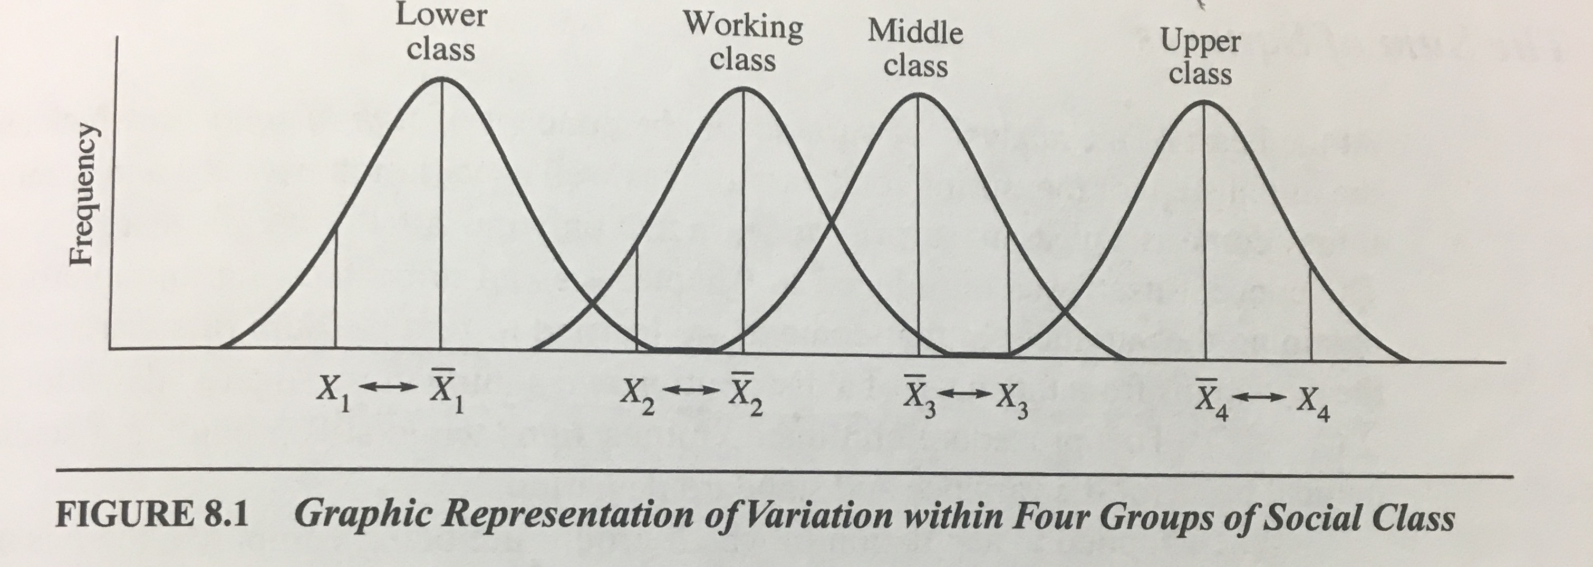
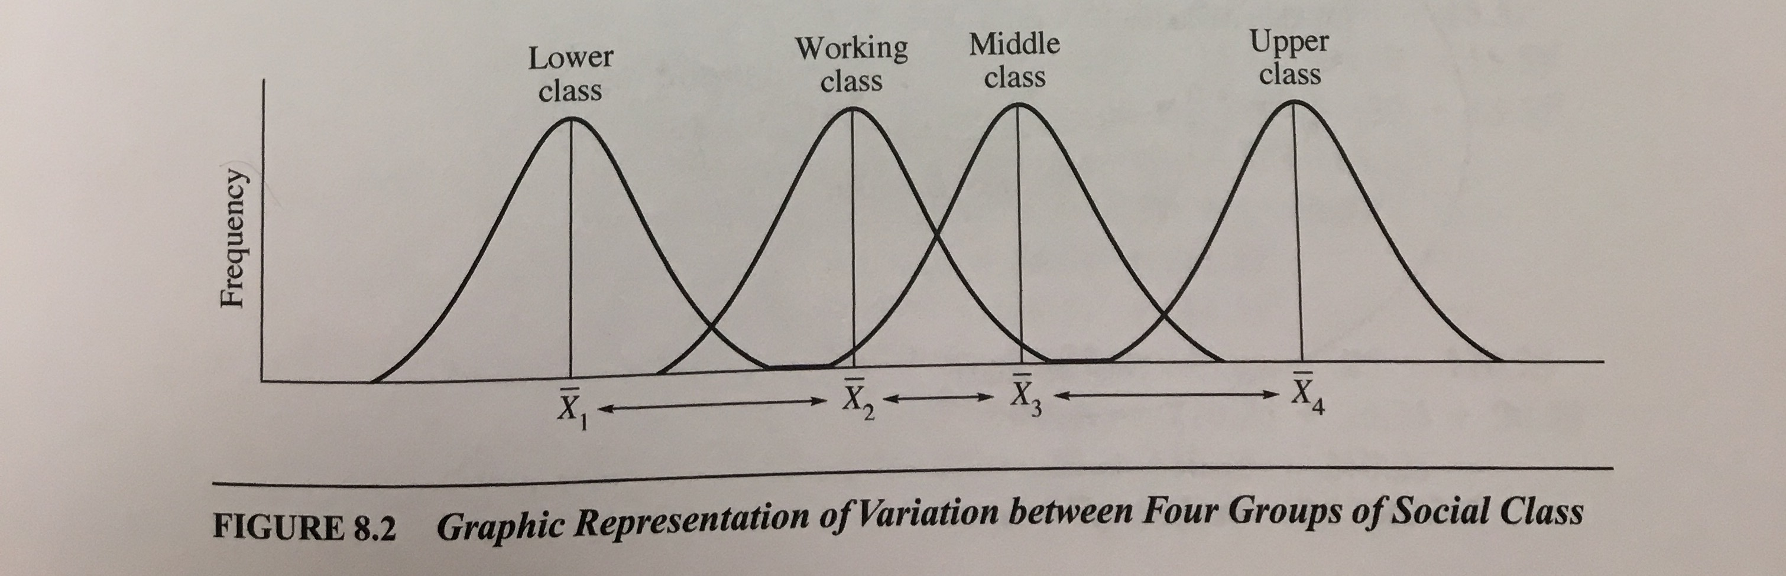
Logic of ANOVA
Total variation across all groups is divisible into two components
Variation within groups
Deviation of raw scores from their group mean
Variation between groups
Deviation of group means from one another

Slide 6
Logic of ANOVA
Much like t-ratio, we’re interested in variation between groups
ANOVA has an F-ratio, which includes
Numerator = variation between groups
Denominator = variation within groups
If there were no group differences, no relationship between the groups of the independent variable and outcome, the values should be the same
Variation between groups = Variation within groups
Thus, F = 1.00
But, larger F ratios mean that there’s greater variation between groups, and increase the likelihood of rejecting the null hypothesis

Slide 7
Logic of ANOVA (more)
To determine if differences are significant, ANOVA examines variances between the groups, as well as variances within each group.
If overall (summed) variance between groups is larger than the overall (summed) variance within groups, we know that the dependent variable varies significantly across the different groups in our independent variable
The groups have significantly different means

Slide 8
ANOVA Hypotheses
H₀: All group means are equal
μ₁ = μ₂ = μ₃ = μ₄ …
H₁: group means are not equal
μ₁ ≠ μ₂ ≠ μ₃ ≠ μ₄ …
Rejecting null means:
there is significant variation in group means
At least one group mean is significantly different than the others
Notes:
Logic of anova is same, but examines variation/difference/variance in numerous means (Y1, Y2, Y3, Y4 are all compared), and the null hypothesis isthat all means are equal (mu1 = mu2 = mu3 = mu4).

Slide 9
Hypothesis Testing with ANOVA
Assumptions
Independent random samples are used
The dependent variable is measured at the interval-ratio level
The independent variable has more than two groups/categories
The population is normally distributed
Notes:
Lax assumption: The population variances are equal
Some researchers apply ANOVA to ordinal level measurements

Slide 10
ANOVA
One-way ANOVA
ANOVA with one dependent and one independent variable

Slide 11
Computing the F-ratio
To compute variation between and variation within, we need to first calculate a “Sum of Squares”
Measure of deviation from the mean
Notes:
Sum of squared deviations from the mean…
Do this for both between group means, and within group means, but also total deviation of raw scores from overall mean

Slide 12

Hypothesis Testing with ANOVA
Total Sum of Squares
$$SStotal= \sum{{(X −{\overline{X}}_{total})}^{2}}$$
Notes:
X_ total also known as the grand mean: mean of all group means

Slide 13

Hypothesis Testing with ANOVA
Total Sum of Squares
Sum of the within and between sum of squares
Total variation in scores
$$SStotal= \sum{{(X −{\overline{X}}_{total})}^{2}}$$
$SStotal= SSbetween$ $+ SSwithin$

Slide 14

Hypothesis Testing with ANOVA
Between-Group Sum of Squares
The mean difference between all groups
$$SSbetween= \sum{Ngroup{(\overline{X}group −{\overline{X}}_{total})}^{2}}$$
Notes:
SSB

Slide 15

Hypothesis Testing with ANOVA
Within-Group Sum of Squares
The mean difference in scores within a single sample, then sums them up
Amount of unexplained variance
$$SSwithin= \sum{{(X −{\overline{X}}_{group})}^{2}}$$
$SSwithin=$ $SStotal− SSbetween$
Notes:
SSW is the sum of squares within, calculated between each individual score and the sample mean.

Slide 16
Mean Square
A more “pure” measure of variation
Sum of Squares value tends to become larger as variation increases, and with large sample sizes
Cannot trust the value of SS unless we control for the number of scores included
We do this with degrees of freedom
Divide sum of squares value by the degrees of freedom

Slide 17

Mean Square Calculations
${MS}_{between}= \frac{{SS}_{between}}{{df}_{between}}$
${MS}_{within}= \frac{{SS}_{within}}{{df}_{within}}$
${df}_{between}=k −1$ where k is number of groups
${df}_{within}=N_{total} −k$

Slide 18

Hypothesis Testing with ANOVA
ANOVA statistic (F) is based on a ratio of mean square between divided by mean square within
F = $\frac{{MS}_{between}}{{MS}_{within}}$

Slide 19
Definitions
F ratio (F statistic) | Used in an analysis of variance Represents the ratio of between-group variance to within-group variance
F obtained | Computed by the ratio for between-group to within-group variance
F critical | The F score associated with a particular alpha level and degrees of freedom Marks the beginning of the region of rejection for our null hypothesis

Slide 20
Example: Education Levels by Sex and Race
N = 21
k = 4
SS_{B} = 31.83
SS_{W} = 45.33
df_{b} = k - 1 = 4 – 1 = 3
df_{w} = N - k = 21 – 4 = 17
Notes:
White males, white females, black males, black females

Slide 21
Example: Education Levels by Sex and Race
MS_{b} = SSB / df_{b} = 31.83 / 3 = 10.61
MS_{w} = SSW / df_{w} = 45.33 / 17 = 2.67
F = MS_{b} / MS_{w} = 10.67 / 2.67 = 3.97

Slide 22
Example: Education Levels by Sex and Race
Using our two df values and our obtained F, we can determine the significance whether our F is significant
df_{b} = 3
df_{w} = 17
F = 3.97

Slide 23
Example: Education Levels by Sex and Race
Next, we choose a table to use in Appendix A.3 (p 894) based on our alpha level (α = .05 or α = .01)
Table will help us determine whether or not our obtained F is significant at either the .05 or .01 level
Select the column associated with our df_{b} value and the row associated with our df_{w} value, we find the value that intersects both.
Go to the p = .05 row
This is our critical F.
If our obtained F is larger than the critical F, we know our obtained F is significant (at least at the p=.05 level)

Slide 24
Example: Education Levels by Sex and Race
In our example, we have the following:
df_{b} = 3
df_{w} = 17
F = 3.97
In our Appendix A.3 (α = .05 ), we follow the df = 3 column and df = 17 row, we get a critical F = 3.20
Because our obtained F is larger than the critical F, we know that our F is significant, meaning that (at least) one of our group means is significantly different than others.
Next, we can use the α = .05 table to see if our obtained F is ALSO greater than the critical F (at those degrees of freedom) for that table. But we do know that…
p < .05

Slide 25
Example: Education Levels by Sex and Race
Report
The test used
If you reject or fail to reject the null hypothesis
The variables used in the analysis
The degrees of freedom, calculated value of the test, and p-value
F(dfb,dfw) = F value, p-value
“Using a one-way ANOVA, I reject the null hypothesis that there is no mean difference in years of education across groups (by gender and race), F(3,17) = 3.97, p < .05”

Slide 26
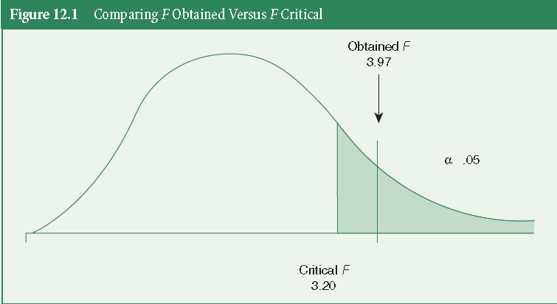

Slide 27
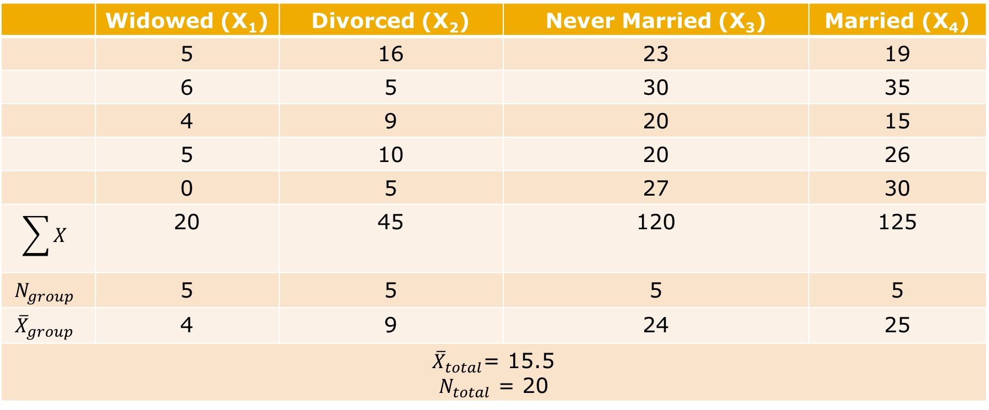
ICE #5: Computing SS, MS, and F
 | Widowed (X₁) | Divorced (X₂) | Never Married (X₃) | Married (X₄)
 | 5 | 16 | 23 | 19
 | 6 | 5 | 30 | 35
 | 4 | 9 | 20 | 15
 | 5 | 10 | 20 | 26
 | 0 | 5 | 27 | 30
$$\sum{X}$$ | 20 | 45 | 120 | 125
$$N_{group}$$ | 5 | 5 | 5 | 5
$${\overline{X}}_{group}$$ | 4 | 9 | 24 | 25
${\overline{X}}_{total}$= 15.5 $N_{total}$ = 20

