Slide 1
Correlation

Slide 2
Why Correlation?
We’ve said nothing about the degree of the relationship between variables
To do this, we need to know about the strength or direction of the association between two variables
“Co-relation”:
The relationship between two interval-ratio variables
Correlation:
Describes strength and direction of relationships in a linear fashion

Slide 3
Example: Weight and Height
We know that both are associated because the taller a person is, the more they tend to weigh
Notes:
And this correlation is not PERFECT, because we know that some tall people weigh very little, and some short people weigh a lot.

Slide 4
Example: Education and Income
We know that both are associated because the more educated a person is, the more they tend to make in income
Notes:
And this correlation is not PERFECT, because we know that some tall people weigh very little, and some short people weigh a lot.

Slide 5
Correlation: Two Parts
Strength of relationship
Direction of relationship

Slide 6
Strength of Correlation
Correlations vary in strength
Can visualize strength using scatterplot
IV on X axis, DV on Y axis
Easier to call one variable X (IV) and the other Y (DV)
Strength increases as the points on the scatterplot more closely form an imaginary line

Slide 7
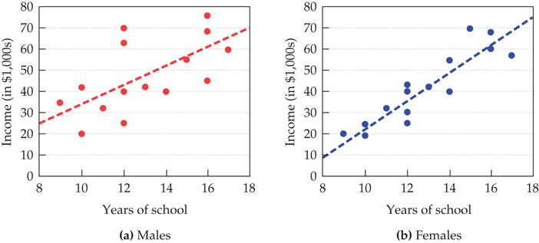
Strength of Correlation
Notes:
One plot for males, one for females
Each point depicts education and income
Correlation stronger when points closely form line
Female correlation between education and income is much stronger since points closer to line
Because this is based on (variation from) the straight line, this is a linear relationship

Slide 8
Strength of Correlation
Perfect correlation means that the every x and y value fall directly on the line (no variation)
Perfect correlation rarely seen in the real world

Slide 9
Direction of Correlation
Positive correlation
Relationships in the SAME direction
As one variable increases, the other variable increases
As one variable decreases, the other variable decreases
Negative correlation
inverse relationship; relationships in the OPPOSITE direction
as the score for one variable increases, the other decreases (vice versa)

Slide 10
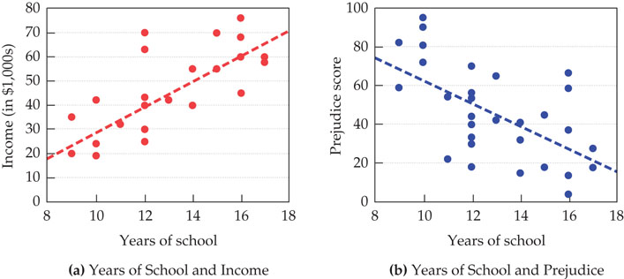
Direction of Correlation
Notes:
Figure (a): relationship between education and income has positive correlation
Figure (b): relationship between education and prejudice has negative correlation
Another linear relationship

Slide 11
Extra: Nonlinear Relationships
Not all relationships between X and Y form a straight line
Curvilinear correlation
one variable increases as the other increases until a point, then the relationship reverses itself

Slide 12
Correlation Strength Cutoffs (Cohen 1988)
Weak/Small Correlation
r less than/equal to |.29| (r ≤ |.29|)
Moderate Correlation
r between |.30| and |.49| (|.30| ≤ r ≤ |.49|)
Strong Correlation
r greater than/equal to |.50| (r ≥ |.50|)

Slide 13
Pearson’s Correlation Coefficient (r)
Strength:
The closer to ±1.0, the stronger the relationship
Direction:
Ranges from -1.0 to +1.0
Negative: negative correlation
Positive: positive correlation
-0.7 and +0.7 have the same strength, but different directions

Slide 14

Pearson’s Correlation Coefficient (r)
Uses the PRODUCT of the X and Y deviations from their means
Deviation of X ($X$-$\overline{X}$)
Example: tells us how much more or less education a person has from the mean education
Deviation of Y ($Y$-$\overline{Y}$)
Example: tells us how much more or less income a person makes than the mean income
Also uses the SUM OF SQUARES deviation from the mean
SSx = ($X$-$\overline{X}$)²
Ssy = ($Y$-$\overline{Y}$)²

Slide 15

Pearson’s r
Notes:
Interacting relationship of deviations from expectation/mean – how much variation found in relationship between two
Divided by
Overall expected deviations from mean (squared to get a measure of total variation) – how much total variation expected from relationship
Doing so constrains value to 1…

Slide 16

Pearson’s r

Slide 17
Degrees of Freedom
df = N-2

Slide 18

Hypothesis Testing
H₀: No relationship between the variables (in the population)
$ρ=0$
H₁: There is a relationship between the variables
$ρ≠0$

Slide 19
Hypothesis Testing
The logic is the same as usual, compare our calculated r value to the table r value
If calculated r > table r, reject the null hypothesis
If calculated r < table r, fail to reject the null hypothesis

Slide 20
ICE #6: Calculate r for Child’s Height (X) and Weight (Y)
Child ID | X (height - in) | Y (weight - lbs)
1 | 49 | 81
2 | 50 | 88
3 | 53 | 87
4 | 55 | 99
5 | 60 | 91
6 | 55 | 89
7 | 60 | 95
8 | 50 | 90

Slide 21
ICE #6: Child’s Height (X) and Weight (Y)
Next, we use a critical r table based on our alpha level (α = .05 or α = .01)
Table will help us determine whether or not our obtained r is significant at either the .05 or .01 level
Begin with the α = .05 column
Select the column associated with our α value and the row associated with our df value, we find the value that intersects both. This is our critical r.
If our obtained r is larger than the critical r, we know our obtained r is significant (at least at the p=.05 level)

Slide 22
ICE #6: Child’s Height (X) and Weight (Y)
In our example, we have the following:
df = ?
r = ?
In our table (α = .05), we follow the df = ? row and get a critical r = ± ?
Because our obtained r is ? than the critical r, we know that our r is/is not significant, meaning that the relationship does/does not exist in the population.
p ? .05

Slide 23
Reporting r
Report
The test used
If you reject or fail to reject the null hypothesis
The variables used in the analysis
The degrees of freedom, calculated value of the test, and p-value
r(df) = r value, p-value
“Using the Pearson correlation, I reject/fail to reject the null hypothesis that there is no relationship between a child’s height and weight, in the population, r(?) = ?, p ? .05”
(if significant, follow with…)
“We have a [strength] [direction] relationship between [X] and [Y]”

Slide 24
Pearson’s Correlation Coefficient (r) Assumptions
Interval variables
Random sampling
Normally distributed characteristics- in small samples especially (N < 30) a skewed distribution will throw off your results

Slide 25
Pearson’s r and r²
Pearson’s product moment correlation coefficient is the basis for regression analysis.
In correlation we find r, in regression we use r, but we square it to tell us “how much variation in Y is explained by variation in X”
So r² tells us how much percent of Y is explained by X
r² is a proportion, so convert it to percentage, and tell me
If r² = .159, that means that 15.9% of the variation in Y is explained by variation in X

Slide 26
ICE #6: Child’s Height (X) and Weight (Y)
Report r² and interpret it.

