Slide 1
ANOVA: Multiple Comparison Procedures
Notes:
Sometimes, like in t-tests, we want to compare group means (interval level DV)… but where we have more than two groups in the IV (categorical/nominal or ordinal).
The bulk of our sociological questions deal with more than two groups:
we may want to see the influence of ethnic identity (white, black, asian, latino) on church attendance. Has to go beyond two-groups compared
we may want to look at educational attainment for blacks versus whites (including men versus women)… which is now 4 groups: BW,BM,WW,WM
This is why we move beyond the two-sample/independent samples t-test to the more complicated analysis of variance (ANOVA).
ANOVA follows the same steps for hypothesis testing that we used for t-tests (Z-tests)

Slide 2
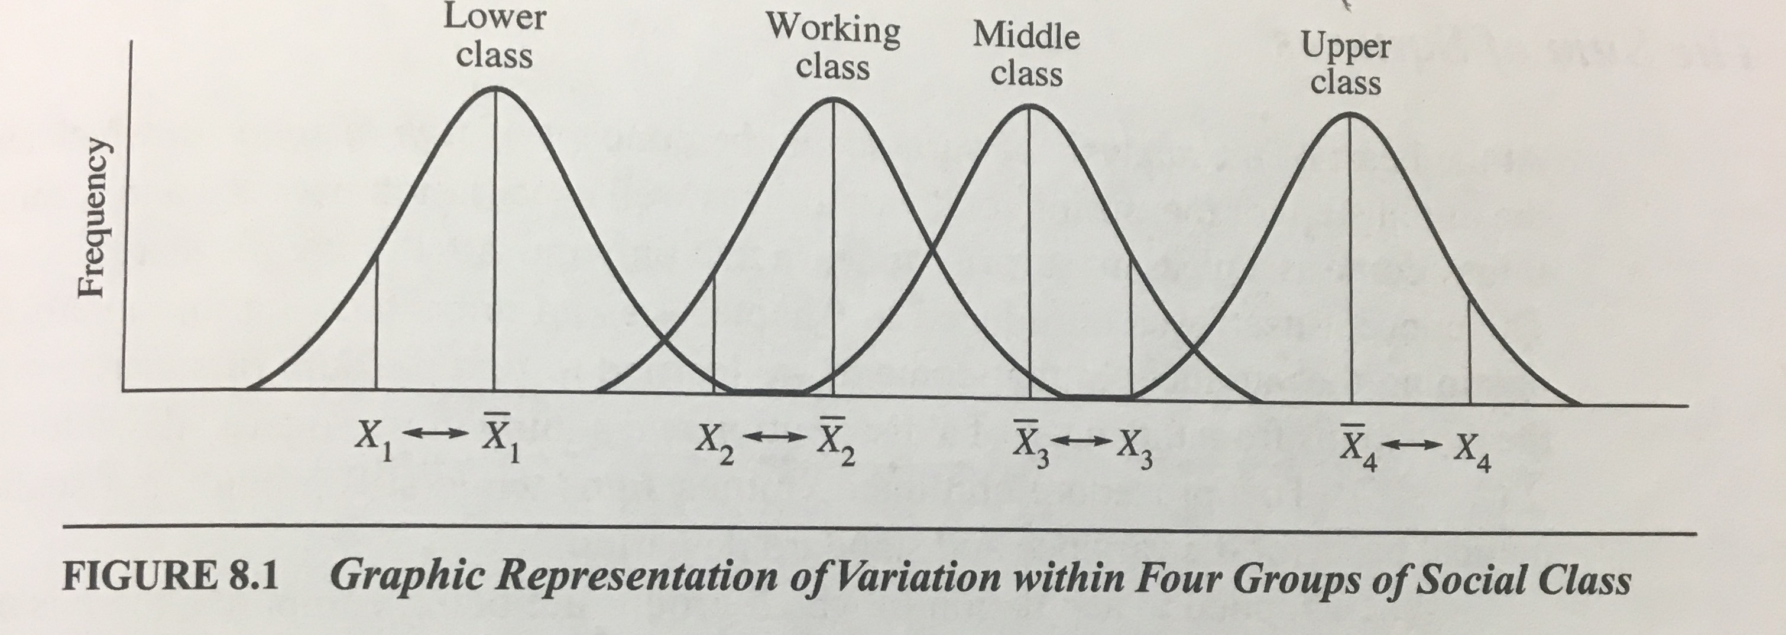
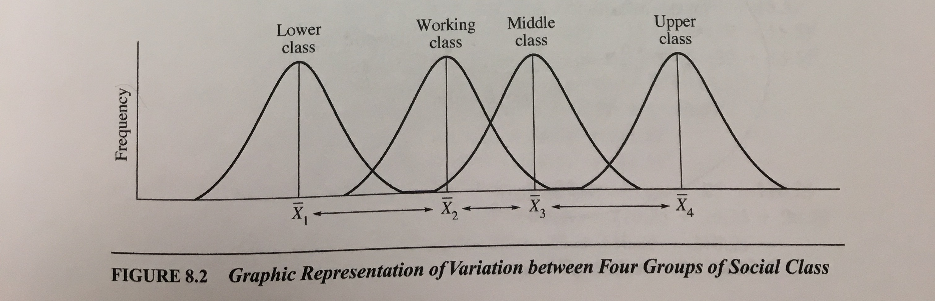
Logic of ANOVA
Total variation across all groups is divisible into two components
Variation within groups
Deviation of raw scores from their group mean
Variation between groups
Deviation of group means from one another

Slide 3
ANOVA Overview
H₀: All group means are equal
μ₁ = μ₂ = μ₃ = μ₄ …
H₁: group means are not equal
μ₁ ≠ μ₂ ≠ μ₃ ≠ μ₄ …
Rejecting null means:
there is significant variation in group means
At least one group mean is significantly different than the others
Notes:
Logic of anova is same, but examines variation/difference/variance in numerous means (Y1, Y2, Y3, Y4 are all compared), and the null hypothesis isthat all means are equal (mu1 = mu2 = mu3 = mu4).

Slide 4
Where is the Significant Difference?
a priori tests
a priori t-test
Planned contrasts
posteriori /Post-Hoc tests
Fisher’s LSD
Tukey’s HSD
Scheffé

Slide 5

Fisher’s Least Significant Difference (LSD)
Needs a significant omnibus/overall F from ANOVA
Then do t-tests between the group means that we think have significant differences
The most liberal post-hoc test, only works well for 3 maximum comparisons
Tukey’s calculation does not alter the $α$, keeping it at .05
Doing so multiplies $α$ by the number of comparisons done
3 comparisons, 3*.05 = .15, means we have a 15% chance of type I error (rejecting when shouldn’t)
To combat this, we can use a Bonferroni alpha adjustment where:
$α= \frac{α_{desired}}{\# comparisons}$

Slide 6
Tukey’s Honestly Significant Difference (HSD)
Doesn’t require significant omnibus/overall F from ANOVA
With too many groups, two may significantly differ but because overall variation is lacking, F will be non-significant
Holds alpha at .05 for a select number of pairwise contrasts
No Bonferroni alpha adjustment needed (already built into formula/package)
Notes:
In the case that you have too many groups… and most don’t vary but two do… the overall F will be non-sig, but you can check individual diffs using HSD.

Slide 7
Scheffé Test
No requirements on F
Best for complex comparisons (and interactions)
Most conservative
Holds Type I error rate constant (alpha = .05) for all possible linear contrasts

