Slide 1
CHI SQUARE TEST OF INDEPENDENCE/ASSOCIATION

Slide 2
The Chi-Square Test
Inferential statistical technique to test for significant relationships between two nominal or ordinal variables
Notes:
Talk more about why assumptions of population distribution are important later when we get to hypothesis testing
Requires no assumptions about the shape of the population distribution from which a sample is drawn

Slide 3
But First… The Cross-tabulation
Used to look at bivariate relationships
Compare the distribution in categories of one variable across categories of another variable
Differences in the independent variable groups (e.g. liberals and conservatives), in terms of the dependent variable, their childrearing method (e.g. permissive and not)

Slide 4
Political Orientation and Child-Rearing
Child-Rearing Method | Political Orientation |  | Total
 | Liberals | Conservatives
Permissive | 15 | 10 | 25
Not Permissive | 5 | 10 | 15
Total | 20 | 20 | 40

Slide 5
The Chi-Square Test
Takes into account the frequencies (in the cross-tab) across categories of two nominal or ordinal variables
Tests the independence of (absence of association between) two variables

Slide 6
Hypotheses
The null hypothesis (H0)
States that no association exists between the two cross-tabulated variables in the population, therefore the variables are statistically independent
The research hypothesis (H1)
Proposes that the two variables are related in the population
Notes:
H₀: 2 variables are unrelated, and X² is low
H₁: 2 variables are related, and X² is high
H0 is null hypothesis… which we are always trying to reject.. Null says no relationship… to reject is to show that there is a relationship…

Slide 7
Hypotheses for Political Orientation and Child-Rearing
The null hypothesis (H0)
No association between political orientation and child-rearing in the population
The variables are independent of (do not influence) one another, in the population
The frequency of liberals who are permissive does not differ (is the same as) the frequency of conservatives who are permissive, in the population
Frequencies of dependent variable are expected to be the same across groups of the independent variable
The research hypothesis (H1)
The frequency of liberals who are permissive differs (is different than) the frequency of conservatives who are permissive, in the population

Slide 8
Expected and Observed Frequencies
Expected frequencies (f_{e})
Cell frequencies if the two variables were statistically independent
What is expected, if the null hypothesis were true
Observed frequencies (f_{o})
Cell frequencies actually observed in a bivariate table (cross-tab)

Slide 9
The Chi-Square Test
If the overall difference between the expected and observed frequencies is large
We reject the null hypothesis
Decide that a population association, or difference between two groups on the dependent variable, exists

Slide 10

Calculating the Expected Frequencies
Notes:
We take the marginals to calculate the fe for each cell.

Slide 11
Calculating the Expected Frequencies
Row Marginal
Child-Rearing Method | Political Orientation |  | Total
 | Liberals | Conservatives
Permissive | 15 | 10 | 25
Not Permissive | 5 | 10 | 15
Total | 20 | 20 | 40
Column Marginal
N
Notes:
We take the marginals to calculate the fe for each cell.

Slide 12
Calculating the Expected Frequencies
Child-Rearing Method | Political Orientation |  | Total
 | Liberals | Conservatives
Permissive | 15 (12.5) | 10 (12.5) | 25
Not Permissive | 5 (7.5) | 10 (7.5) | 15
Total | 20 | 20 | 40
Notes:
We take the marginals to calculate the fe for each cell.

Slide 13
Calculating the Obtained Chi-Square
Chi-Square (obtained)
The test statistic that summarizes the differences between the observed and the expected frequencies
By calculating the difference for each cell

Slide 14
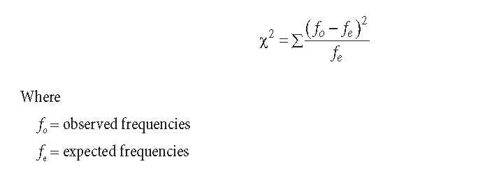
Calculating the Obtained Chi-Square

Slide 15
Calculating the Obtained Chi-Square
Child-Rearing Method | Political Orientation |  | Total
 | Liberals | Conservatives
Permissive | 15 (12.5) | 10 (12.5) | 25
Not Permissive | 5 (7.5) | 10 (7.5) | 15
Total | 20 | 20 | 40
Cell | f₀ | f_{e} | f₀ - f_{e} | (f₀ – f_{e})² | (f₀ – f_{e})² / f_{e}
Upper left | 15 | 12.5 | 2.5 | 6.25 | .50
Upper right | 10 | 12.5 | -2.5 | 6.25 | .50
Lower left | 5 | 7.5 | -2.5 | 6.25 | .83
Lower right | 10 | 7.5 | 2.5 | 6.25 | .83
∑ |  |  |  |  | X² = 2.66
Notes:
We take the marginals to calculate the fe for each cell.

Slide 16
Calculating the Obtained Chi-Square
To see if our obtained X² value is statistically significant, we have to compare it to a critical or table X² value
To do so, we need to know
degrees of freedom for our X²
Our alpha level (a = .05)

Slide 17
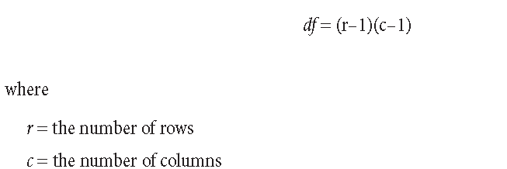
Degrees of Freedom
Notes:
The number of values that are free to vary (or in simple terms how much error or miscalculation we’re willing to have)

Slide 18
Calculating Chi-Square
We use our obtained Chi-Square (X²), and our degrees of freedom (df) to look up the significance level in Appendix A.4 (page 898).
Using our df, we follow the table down that row and stop when we reach a value greater than our obtained X². Then go back one column.
If there is no value greater than your obtained value, use the final column.
Go up to that column, and report that value as your p-value (significance level).

Slide 19
Calculating Chi-Square
In our example, we have the following:
X² = 2.66
df = (2-1)(2-1) = 1
In our Appendix A.4, we follow the df = 1 row, down to find see if our obtained X² is larger than the table X² at (at least) the p=.05 significance level.
Our value of 2.66 is less than the lowest table X² (at p=.05, the X² value is 3.84), which means that our p-value (our likelihood of being wrong) is greater than .05 (more than 5 percent – based on our selected .05 alpha value).
p > .05 (fail to reject the null)

Slide 20
Reporting Chi Square
Report
The test used
If you reject or fail to reject the null hypothesis
The variables used in the analysis
The degrees of freedom, calculated value of the test, and p-value
X²(df) = Chi-square value, p-value
“Using the Chi Square test of independence, I fail to reject the null hypothesis that there is no relationship between political orientation and child-rearing, X²(1) = 2.66, p > .05”

Slide 21
Chi-Square
The Sampling Distribution
The distributions are positively skewed
The research hypothesis is always a one-tailed test
Values are always positive
Minimum is zero with no maximum
As the number of degrees of freedom increases, the chi-square distribution becomes more symmetrical

Slide 22
ICE #3
Using the following cross-tab, hand calculate:
X²
degrees of freedom
determine it’s significance level
Fully and completely report your findings (and whether you reject/fail to reject the null hypothesis
Views of BLM | Political Orientation |  | Total
 | Liberals | Conservatives
Positive | 47 | 5 | 52
Negative | 3 | 35 | 38
Total | 50 | 40 | 90

Slide 23
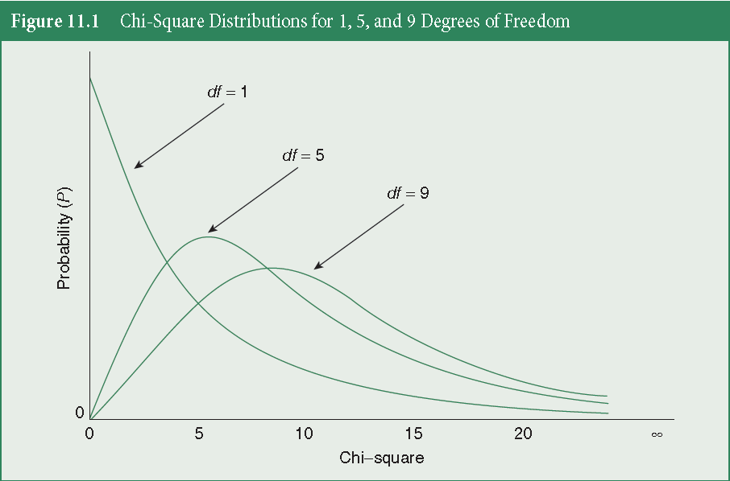
Chi-Square Distributions

Slide 24
Chi-Square Test Limitations
Does not offer much information about the strength of the relationship
Sensitive to sample size
Sensitive to small expected frequencies in one or more of the cells in the table

