Slide 1
Graphic Presentation
Notes:
Various types of graphs. Pie charts and bar graphs for nominal and ordinal variables. Histograms and line graphs for interval-ratio variables. Also, there are maps and time-series graphs.
Importantly, all tables include a descriptive title representing what kind of chart it is, and an explanation of the variables depicted.

Slide 2
The Pie Chart
A graph showing the differences in frequencies or percentages among categories of a nominal or an ordinal variable
Categories are displayed as segments of a circle whose pieces add up to 100% of the total
Notes:
No x or y axis needed. Each sliver of the pie must be labeled with a category of the variable and the actual frequency or percentage for that category. Each table must have a title representing (1) what kind of chart it is, and an explanation of the variables depicted.

Slide 3
The Pie Chart
Source: U.S. Census Bureau, American Fact Finder, 2011, Table S01013
Notes:
However, you may notice that there are a bunch of smaller slivers in the pie chart… indicating that that category represents only a small percentage of the total. To make the pie chart easier to read, you may want to combine/collapse a number of the smaller categories into a single “other” category.

Slide 4
The Bar Graph
A graph showing the differences in frequencies or percentages among categories of a nominal or an ordinal variable
Categories are displayed as rectangles of equal width with their height proportional to the frequency or percentage of the category
Notes:
Same definition for bar and pie charts. But slight difference.
Bars can be organized vertically, or horizontally.
If bars are vertical, categories of the variable are listed along the x axis, the y axis represents the frequency or percentage. Each bar must be labeled with the actual frequency or percentage. Each table must have a title representing (1) what kind of chart it is, and an explanation of the variables depicted.

Slide 5
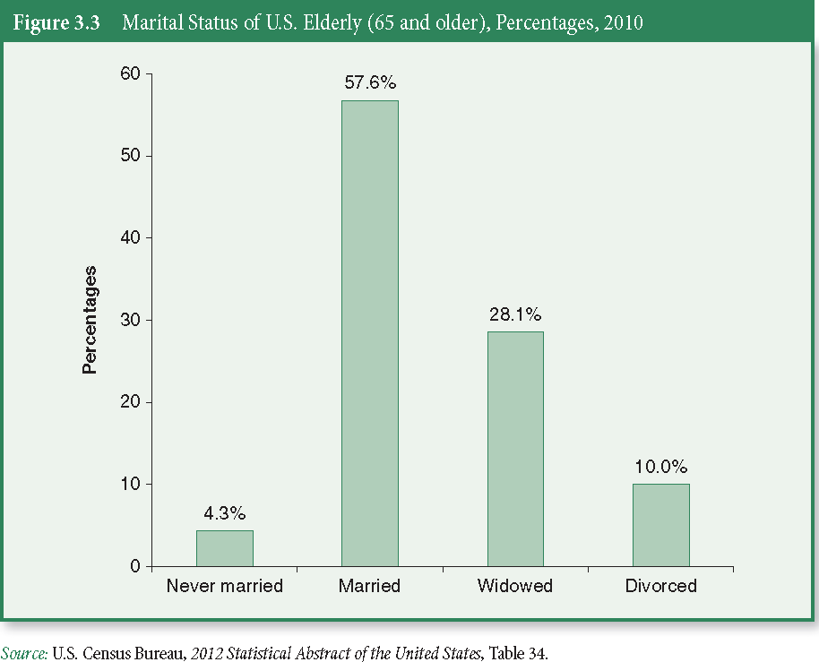
The Bar Graph

Slide 6
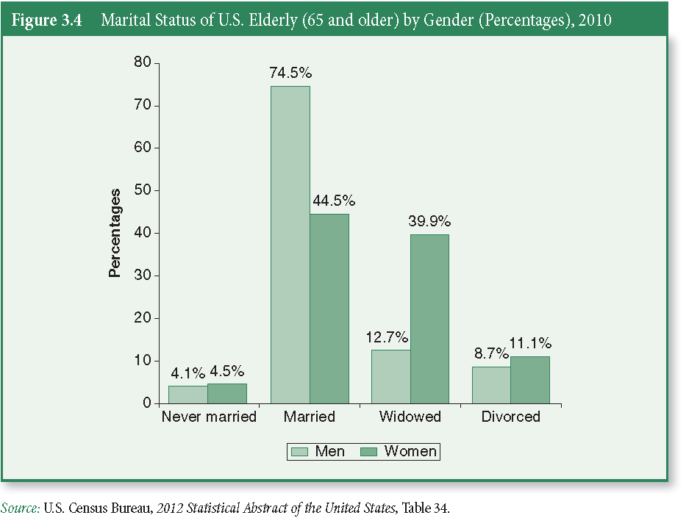
The Bar Graph
Notes:
You can also cluster the categories of one variable (marital status) by categories of another variable (sex).

Slide 7
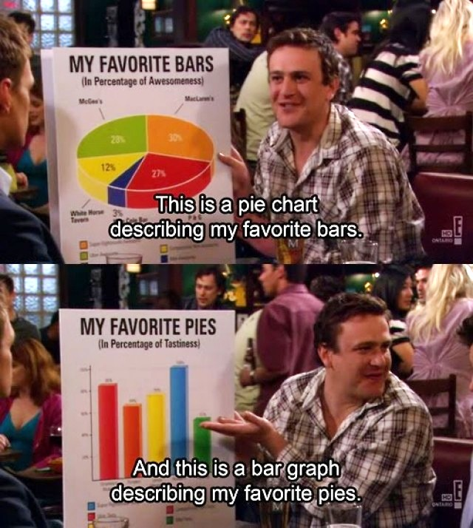
Exercise: Pie Chart and Bar Graph
Notes:
Top should say in percentage of attendance.

Slide 8
The Map
We can display geographic data using a map
Population distribution
Voting patterns
Crimes rates
Notes:
See page 71 for an example of a map. Can be broken down into a variety of levels (cities, counties, blocks, tracts, etc.)

Slide 9
The Histogram
A graph showing the differences in frequencies or percentages among categories of an interval-ratio variable
Categories displayed as contiguous bars, with width proportional to the width of the category and height proportional to the frequency or percentage of that category
Notes:
Histogram looks like bar chart… but because bar chart works with nominal or ordinal variables, the categories of those variables are not continuous, so must not touch. However, with a histogram for interval-ratio variables, like age, are all contiguous (each category is preceded by a category of lesser value), so they must be treated as such and connected.

Slide 10
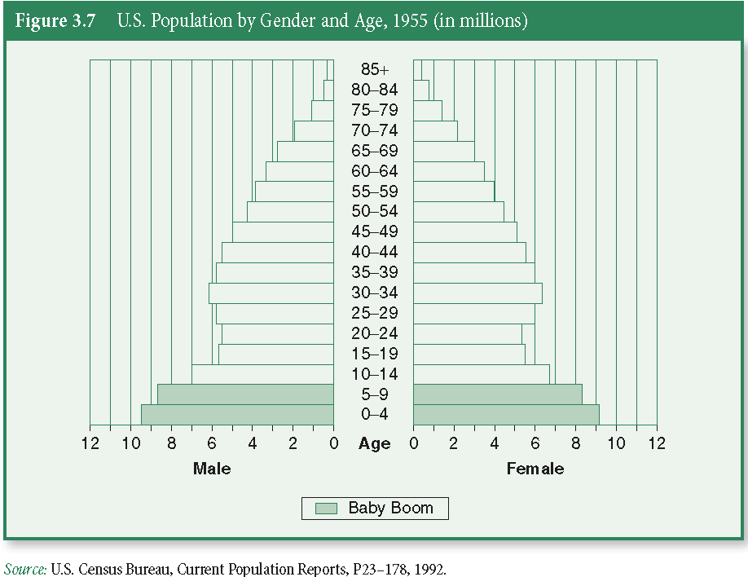
The Histogram
Notes:
Horizontal bars.. Usually used by statistical demographers.

Slide 11
Time Series Charts
A line graph displaying changes in a variables at different points in time
It shows time (measured in units such as years or months) on the horizontal axis and the frequencies (percentages or rates) of another variable on the vertical axis

Slide 12
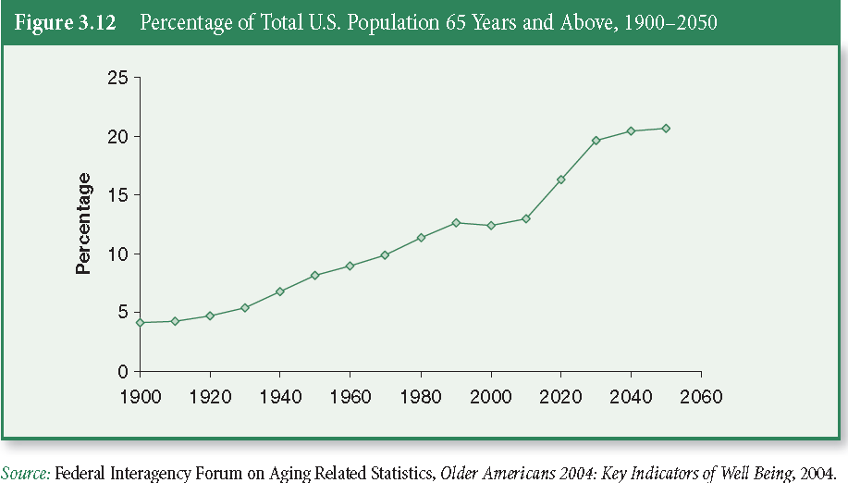
Time Series Charts

Slide 13
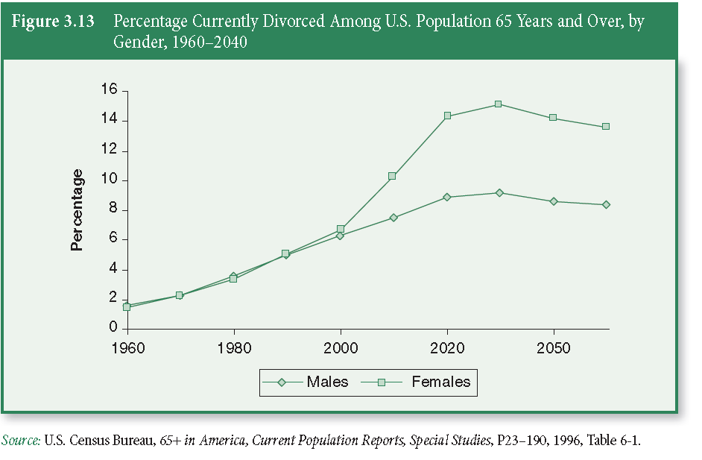
Time Series Charts

Slide 14
Distortions in Graphs
Graphs not only quickly inform us, they can quickly deceive us
Because we are interested in general impressions, we are more vulnerable to being swayed by distorted graphs

Slide 15
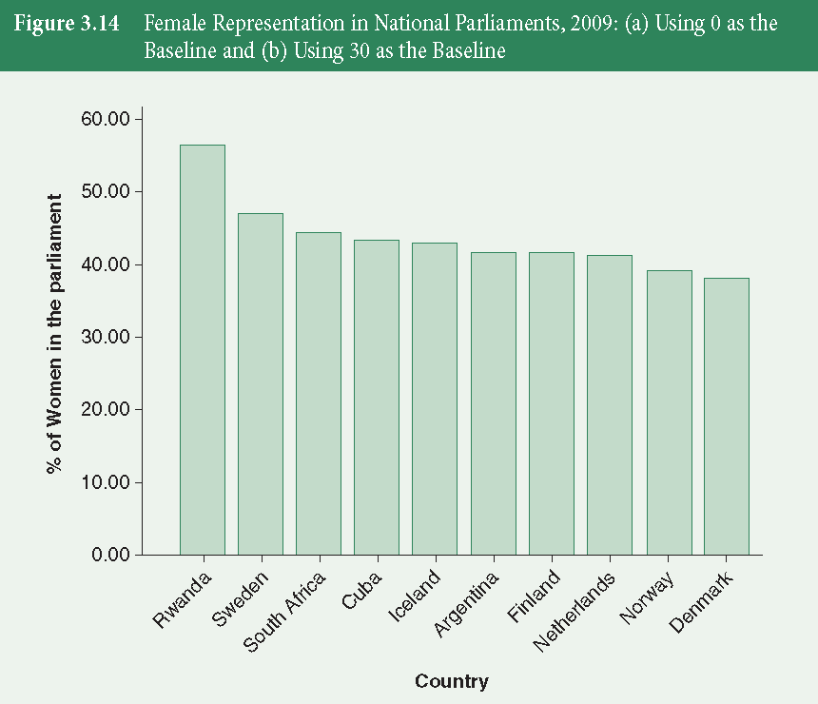
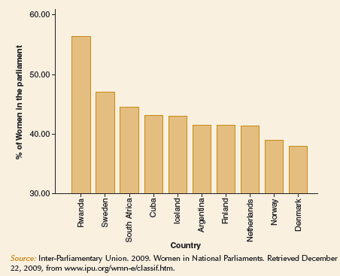
Graphical Distortions
Axes can be stretched or shrunk to create any desired result

Slide 16
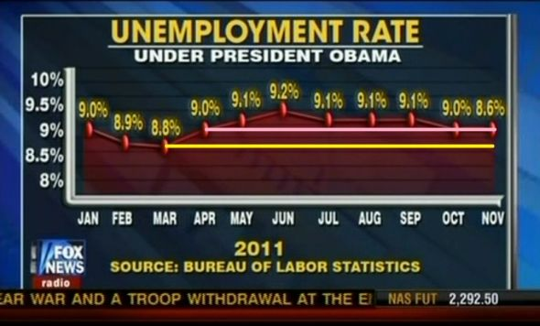
Graphical Distortions
Famous Fox News distortion

Slide 17
Statistics in Practice
The following graphs are particularly suitable for making comparisons among groups:
Bar chart
Line graph
Time series chart
Notes:
All are…

Slide 18
Why Use Charts and Graphs?
What do you lose?
Numeric detail offered by a table
Ability to see additional relationships within data
Our free time
We can get caught up in selecting colors and formatting charts when a simply formatted table is sufficient

Slide 19
Why Use Charts and Graphs?
What do you gain?
Can direct attention to one aspect of the evidence
Can reach readers who are intimidated by data in a table
Can focus on bigger picture rather than minor technical details

