Slide 1
The Normal Distribution
Notes:
Distributions have different shapes skewed ... and of course we have the normal distribution.
EMPIRICAL:
All the one’s we’ve talked about up to this point are empirical distributions… meaining theyre based on REAL data.
NORMAL == THEORETICAL
The normal distribution (the one we most commonly think of when we say a symmetrical distribution) is a THEORETICAL distribuiton... Meaning it’s based on theory... What we EXPECT in a distribution... Not data

Slide 2
Normal Distribution / Normal Curve
A bell-shaped and symmetrical theoretical distribution,
With mean, median, and mode all coinciding at its peak
With frequencies gradually decreasing at both ends of the curve
Notes:
The normal distribution has PERFECT symmetry…
This is why its theoretical... not empirical.. since no distribution based on real data will ever be PERFECT.

Slide 3
Normal Distribution / Normal Curve
A theoretical ideal distribution
Real-life empirical distributions never match this model perfectly
Many aspects of social life come close, and are said to be normally distributed
Notes:
Grades, height,

Slide 4
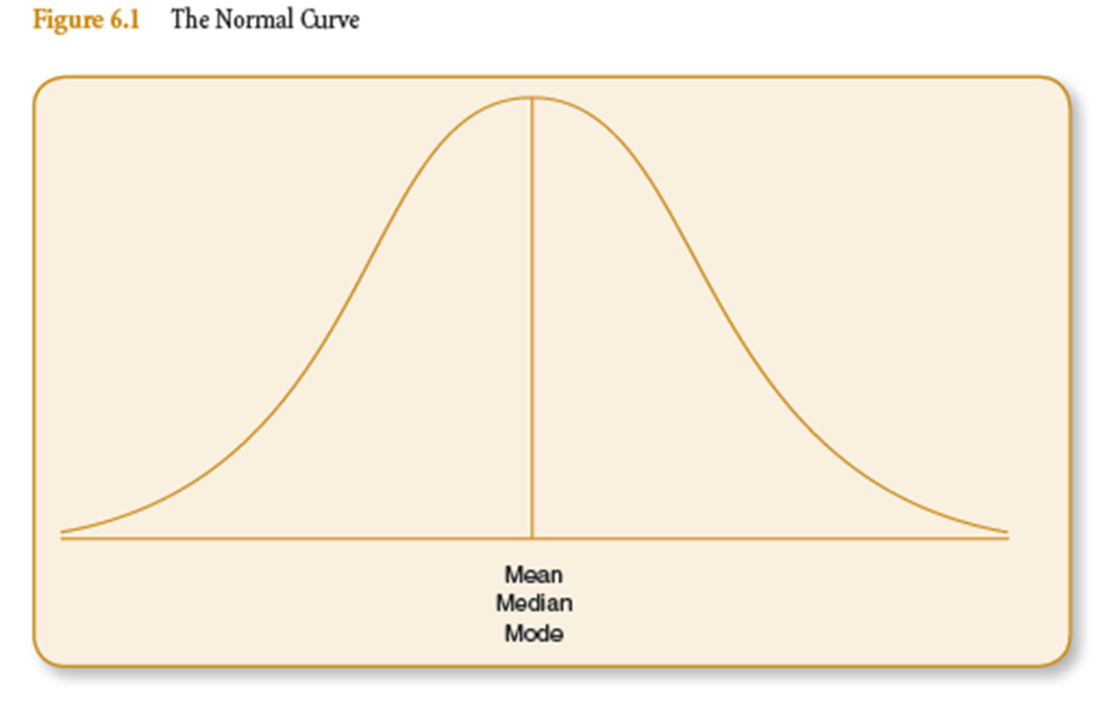
The Normal Curve

Slide 5
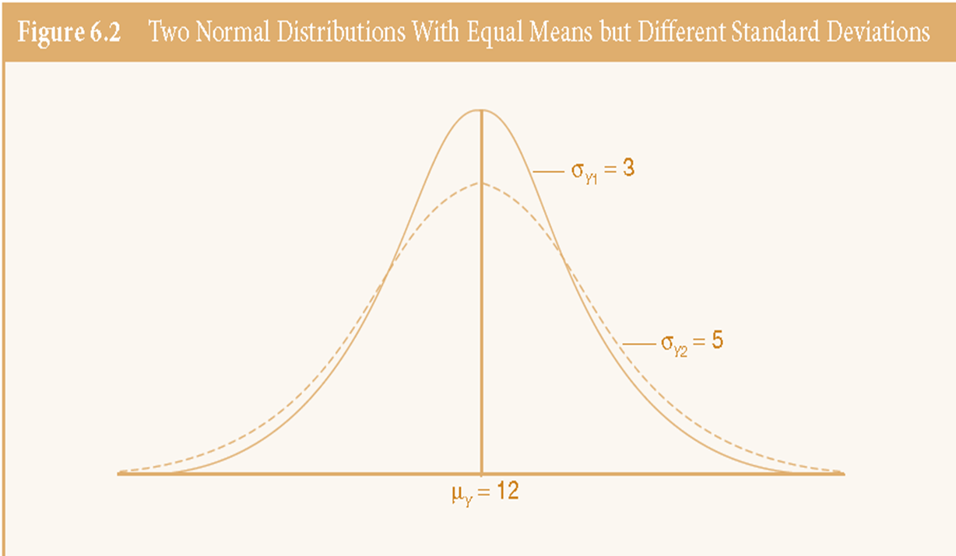
The Normal Curve

Slide 6
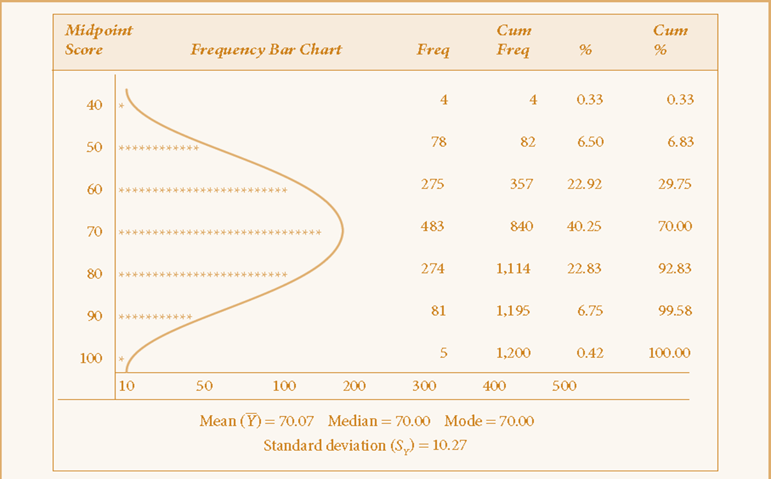
A Near Normal Distribution
Table 6.1 Final Grades in Social Statistics of 1,200 Students (1983-1993)
Notes:
Normal curve varies depending on the mean mu_y and standard deviation sigma_y of the distribution

Slide 7
Area Under the Normal Curve
Because the normal distribution is theoretical and never skewed, there is a constant percentage of area under the curve between any two points
Two points are measured in standard deviation units
The total area under the curve is 100%... Which represents 100% of the observations/cases (e.g. individuals, cities, states, counties, organizations)

Slide 8
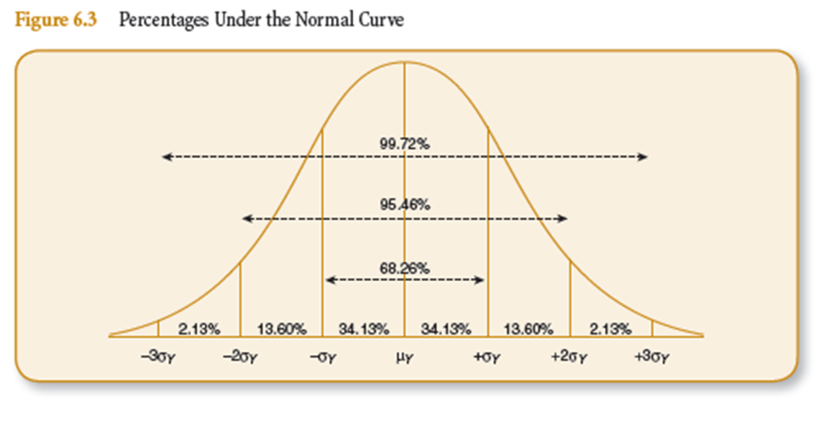
Area Under the Normal Curve
Notes:
Remember this! 68, 95, 99. Percent of cases that fall between –xSD (below the mean) and +xSD (above the mean)
Try mean of 10, and SD of 2… how many dollars in your pocket.

Slide 9
Exercise: Calculate Values for SAT Scores
Assume 1,000 students took the SAT and you know the following
Mean Score = 500
Standard Deviation = 100
Find the scores that coincide with:
68% of the cases (between -1SD and +1SD)
95% of the cases (between -2SD and +2SD)
99% of the cases (between -3SD and +3SD)
Notes:
Remember this! 68, 95, 99. Percent of cases that fall between –xSD (below the mean) and +xSD (above the mean)
Now phrase it like this: we can say X% of the people who take the SAT will have a value between X and X.
Or: we can say with X% confidence that the true population SAT score (provided we have a representative sample) will fall between X and X.

Slide 10
Area Under the Normal Curve
Our mean (and mode and median) is measured as 0 standard deviation units. It is the center of the distribution
50% of the area under the curve:
Lies above the mean
Lies below the mean

Slide 11
Area Under the Normal Curve
We can calculate the percentage of cases that fall between any two scores, as long as we know:
that the distribution in normal
the mean
the standard deviation

Slide 12
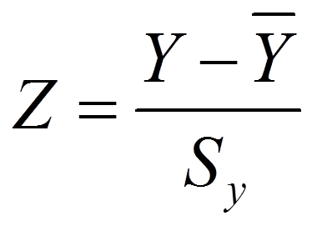
Standard (Z) Scores
The number of standard deviations that a raw score (an observation’s score) is equal to.
Can be positive (above the mean) or negative (below the mean)
We standardize to make our scores comparable
Where S_{y} = standard deviation
Notes:
Value, minus the mean, all over the standard deviation.
So, to calculate the Z score for the amount of money that Amelia has in his pocket… remember the class mean is 10, and the standard deviation is 2. And Amelia has $14.75. Lets calculate.

Slide 13
Exercise: Calculate Z Score for a Percent Grade on the Exam
Mean Score = 74%
Standard Deviation = 12%
Find the Z scores associated with:
50%
94%

Slide 14

Standard (Z) Scores
To convert a Z score back into a raw score, you need to do the following:
Where S_{y} = standard deviation

Slide 15
Transforming Z scores into Proportions or Percentages
We can calculate the percent of scores that fall between two specific scores using…
The Standard Normal Table (Appendix B) pg. 480
Small portion of table on pg. 186.

Slide 16
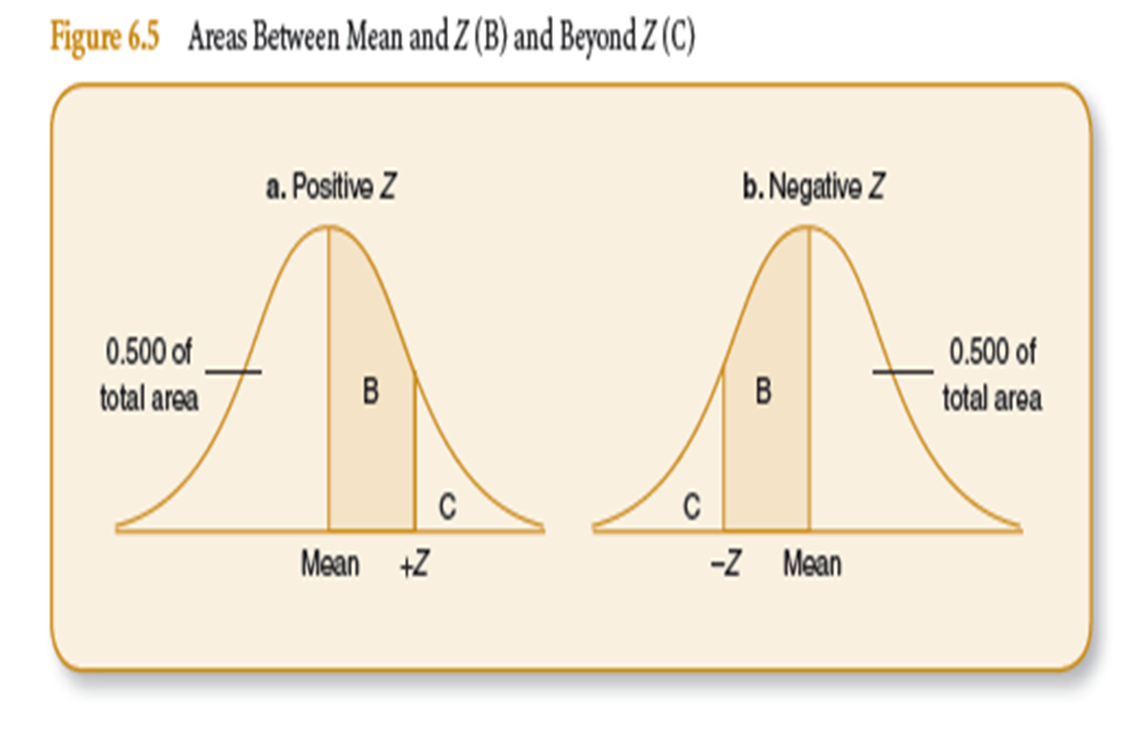
Transforming Z scores into Proportions or Percentages
Notes:
This is important because it tells you which column to follow on the standard normal table… either column B or C.

Slide 17
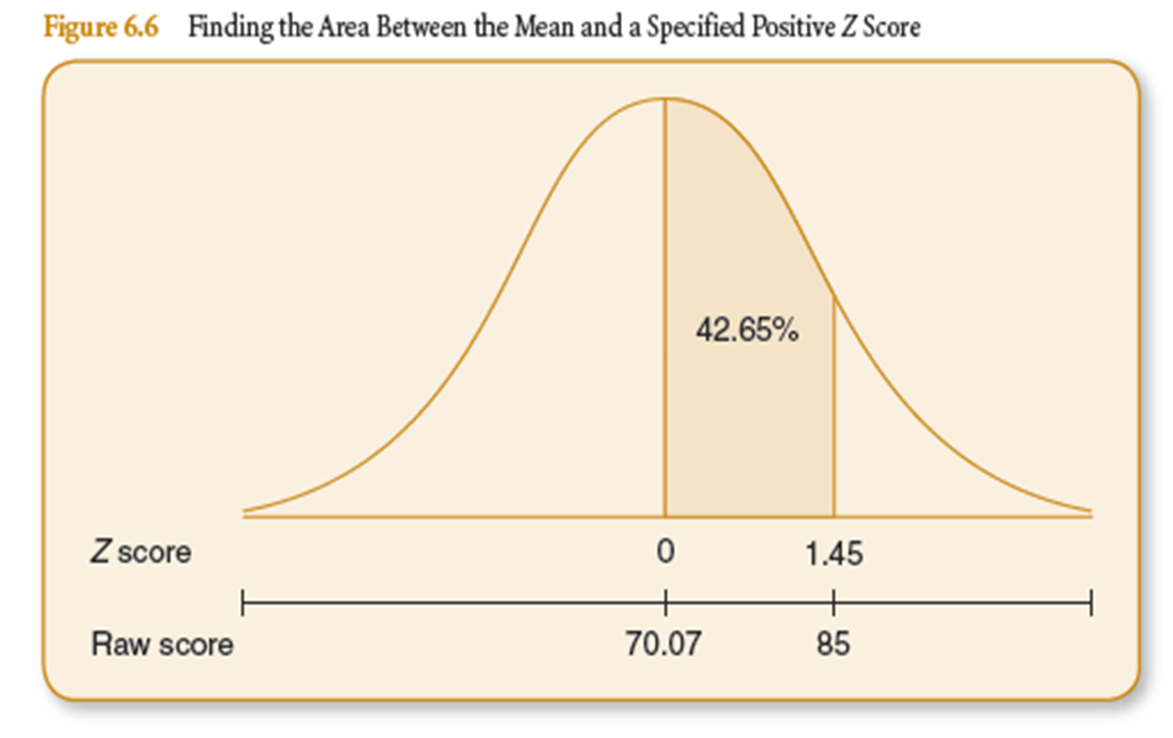
Z Scores

Slide 18
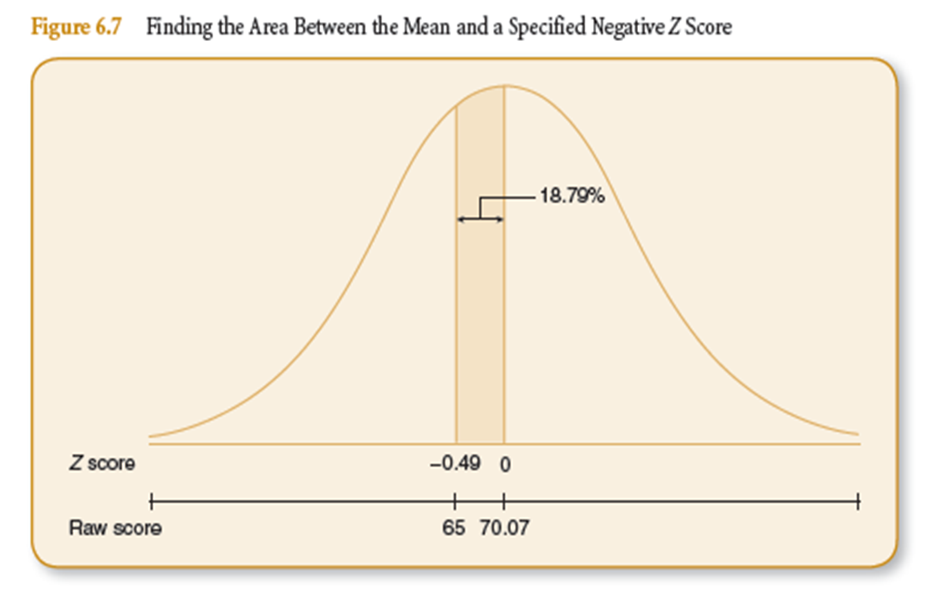
Z Scores

Slide 19
Z Scores

