Slide 1
Testing Hypotheses

Slide 2
Example: Average Gas Prices
Hypothesis
The average price of gas in California is higher than the average national price of gas
Notes:
We take a sample of N=100 gas stations in california and compare that to the national gas average.
We find that price in california sample is 3.90 and the average national is 3.53
Is this diff large enough to convince us that the sample from california is non-representative?
This diff can mean two things 1) that the average price in california is actually higher, or 2) the average price in california is about the same as national average, but the sample has a high mean

Slide 3
Hypothesis Testing
Allows us to evaluate hypotheses about population parameters based on sample statistics

Slide 4
Hypothesis Testing
Assumptions (that must be met)
The sample was randomly selected
The variable is measured at the interval-ratio level
The population is normally distributed (assumed if sample is N>50)

Slide 5
Hypothesis Testing
Testing the null hypothesis versus alternative hypotheses (various research hypotheses)
We are testing whether or not the null hypothesis is true.
We are trying to reject the null hypotheses in favor of our research hypothesis or hypotheses

Slide 6

The Null Hypothesis (H₀)
A statement that contradicts the research hypothesis
Is always expressed in terms of population parameters
Says there is “no mean difference” between the population mean and the sample mean or that there is “no relationship” between the two variables
Notes:
So using our example, the null is that there is no diff between mean price of gas in california and national mean of gas prices

Slide 7
The Research Hypothesis (H₁)
A statement reflecting the substantive hypothesis
It is always expressed in terms of population parameters, but its specific form varies from test to test

Slide 8

Example: The Research Hypothesis (H₁)
The average price of gas in California is higher than the average price of gas nationally

Slide 9
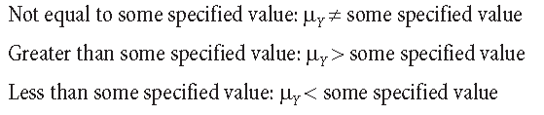
The Research Hypothesis (H₁)
The research hypothesis can be one of three things:
Two-tailed
One-tailed
One-tailed
Notes:
Two-tailed,

Slide 10

One-Tailed Tests
The research hypothesis is directional
That the population mean is less than or greater than some value

Slide 11
One-Tailed Tests
Right-Tailed Test
A one-tailed test in which the sample outcome is hypothesized to be at the right tail of the sampling distribution (greater than)
Left-Tailed Test
A one-tailed test in which the sample outcome is hypothesized to be at the left tail of the sampling distribution (less than)

Slide 12

Two-Tailed Tests
A hypothesis test in which the region of rejection falls equally within both tails of the sampling distribution

Slide 13
Probability Values
Z statistic
The test statistic computed by converting a sample statistic to a Z score
P value
The probability associated with the obtained value of Z

Slide 14

Probability Values
When we are comparing our statistic to a population parameter, we modify the Z-score formula

Slide 15

Example: Gas
National Average Price: $3.53
National Standard Deviation: $.21
California Average Price (sample): $3.90
California Sample Size (N): 100

Slide 16
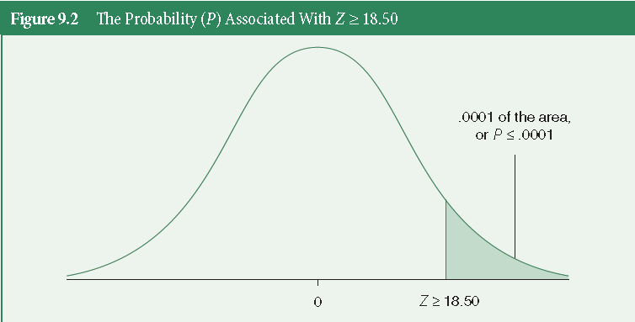
Probability Values
Notes:
Compare to back of book, appendix B, and see that the probability associated with getting a Z score (prob that falls beyond that z score) is below .0001. That means that our p-value (significance) for our z-score… is p < .0001. Means that our california data are significantly different from our national average. We’re looking for a p-value of less than .05... Meaning that we are willing to be wrong only 5% of the time.
This is the probability of obtaining our z score... That means that our z score is rare.
The smaller the p-value, the more evidence we have that the null hypothesis should be rejected.

Slide 17
Probability Values
Alpha (a)
The level of probability at which the null hypothesis is rejected
It is customary to set alpha at the .05, .01, or .001 level
If your obtained p-value is less that alpha (which is usually set at .05), then it’s safe to reject the null hypothesis.
Notes:
Our least strict level is .05, meaning that we are willing to be wrong 5% of the time… our most strict is .001, or .1% of the time.
If p is less than or equal to our alpha (.05), then we can say that our z score is statistically significant... It is unlikely to have occured by chance or sampling error.
IF we have a non-directional research hypothesis (h1 =/= value), This means that we mulitiply our p-value (associated with our z score, by 2. since we are looking in both tails of the distribution.

Slide 18
Hypothesis Testing Steps
Assumptions
Stating research and null hypotheses, selecting alpha
Selecting the sampling distribution and specifying the test statistic
Computing the test statistic
Making a decision and interpreting the results
Notes:
Assumptions: random sample, specify variable type (n,o,i), specify distribution of sample (normal if N>50)
Stating null and research hypotheses, and alpha: null: no relationship, research is specific, and alpha is always at least .05.
Selecting sampling distribution and test: sample is normal if over 50 cases, and the test statistic is based on the variable type you have. Chi, t-test, anova, and correlation.

Slide 19
Hypothesis Testing
Type I Error
You find relationship when there isn’t
Null is true, but you reject it
No relationship/no difference, but you say there is
Type II Error
You find no relationship when there is
Null is false, but you fail to reject
There is a relationship/difference, but you say there isn’t
Notes:
We can combat this by making our alpha more stringent (decreasing from .05, to .01, or .001)

