Slide 1
Frequencies, Central Tendency, Dispersion/Variability, Graphing Distributions

Slide 2
Frequency Distributions

Slide 3
Frequency Distributions
A table reporting the number of observations falling into each category of the variable

Slide 4
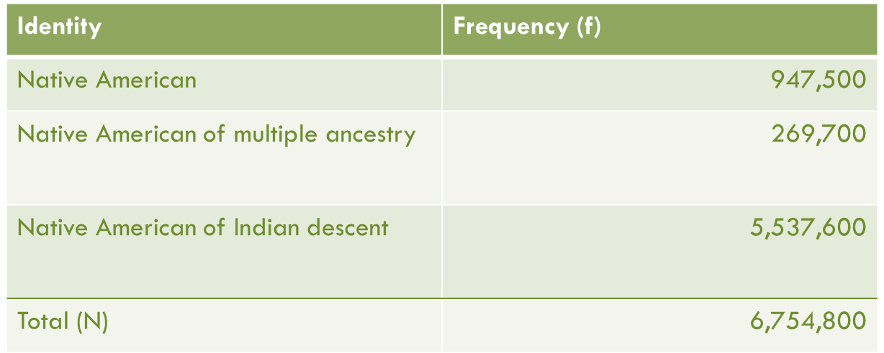
Frequency Distributions
Nominal Variables

Slide 5
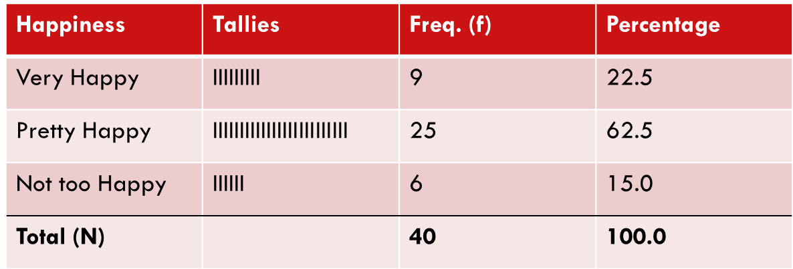
Frequency Distributions
Ordinal Variables

Slide 6
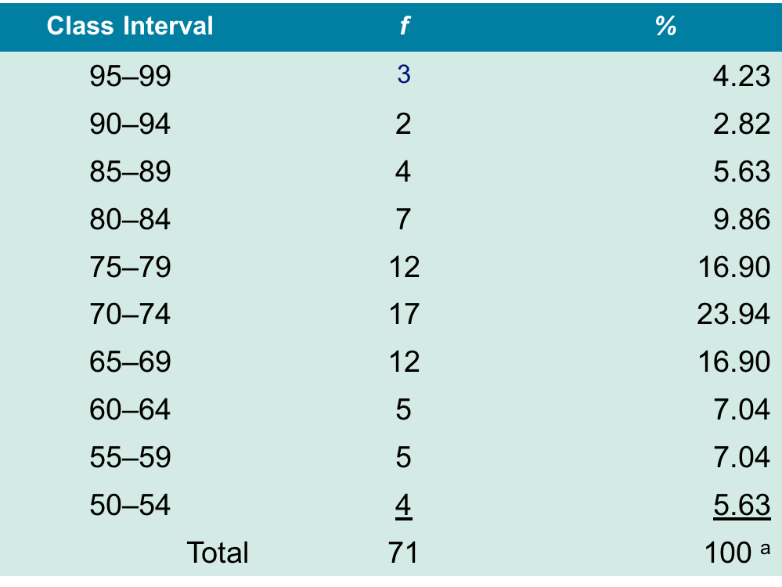
Frequency Distributions
Interval-Ratio Variables
Notes:
Too many numbers but need to make table interpretable
Collapse or group into smaller categories/values
Range of values in each category
Each category should have same number of values

Slide 7

Frequency Distributions: Percentages & Proportions
Race/Eth | Frequency (f) | Proportion (P) | Percentage (%)
Black | 1 | 1/27=.037 | 3.7%
Native Am. | 1 | .037 | 3.7%
Latinx | 9 | .333 | 33.3%
As. Am. | 4 | .148 | 14.8%
White | 12 | .444 | 44.4%
Total (N) | 27 | 1.0 | 100%
A relative frequency obtained by dividing the frequency in each category by the total number of cases and multiplying by 100
A proportion multiplied by 100
$$\%= \frac{f}{N}\left(100\right)=P(100)$$

Slide 8
Graphing Distributions

Slide 9
Graphic Presentation
Pie Charts
Bar Graphs
Histograms

Slide 10
Pie Chart
A graph showing the differences in percentages among categories of a nominal (or ordinal) variable
Categories are displayed as segments of a circle whose pieces add up to 100% of the total

Slide 11
Pie Chart
Source: U.S. Census Bureau, American Fact Finder, 2011, Table S01013

Slide 12
Bar Graph
A graph showing the differences in frequencies or percentages among categories of a nominal or ordinal variable
Categories are displayed as rectangles of equal width with their height proportional to the frequency or percentage of the category
The taller the bar, the greater the frequency or percentage

Slide 13
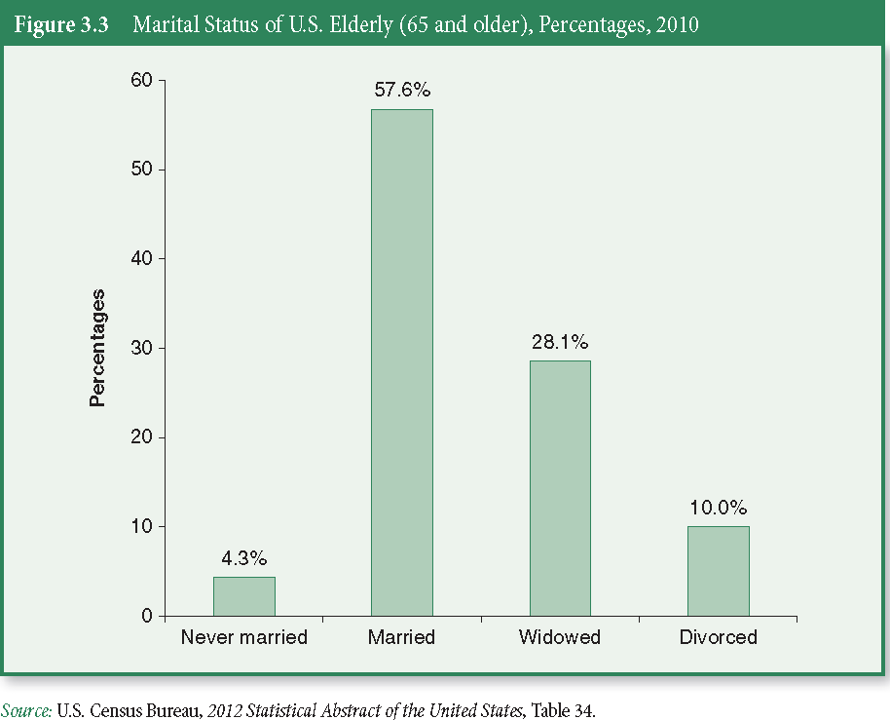
Bar Graph

Slide 14
Histogram (Special Bar Graph)
A bar graph showing the differences in frequencies or percentages among categories of an interval-ratio variable
Categories displayed as contiguous bars, with width proportional to the width of the category and height proportional to the frequency or percentage of that category

Slide 15
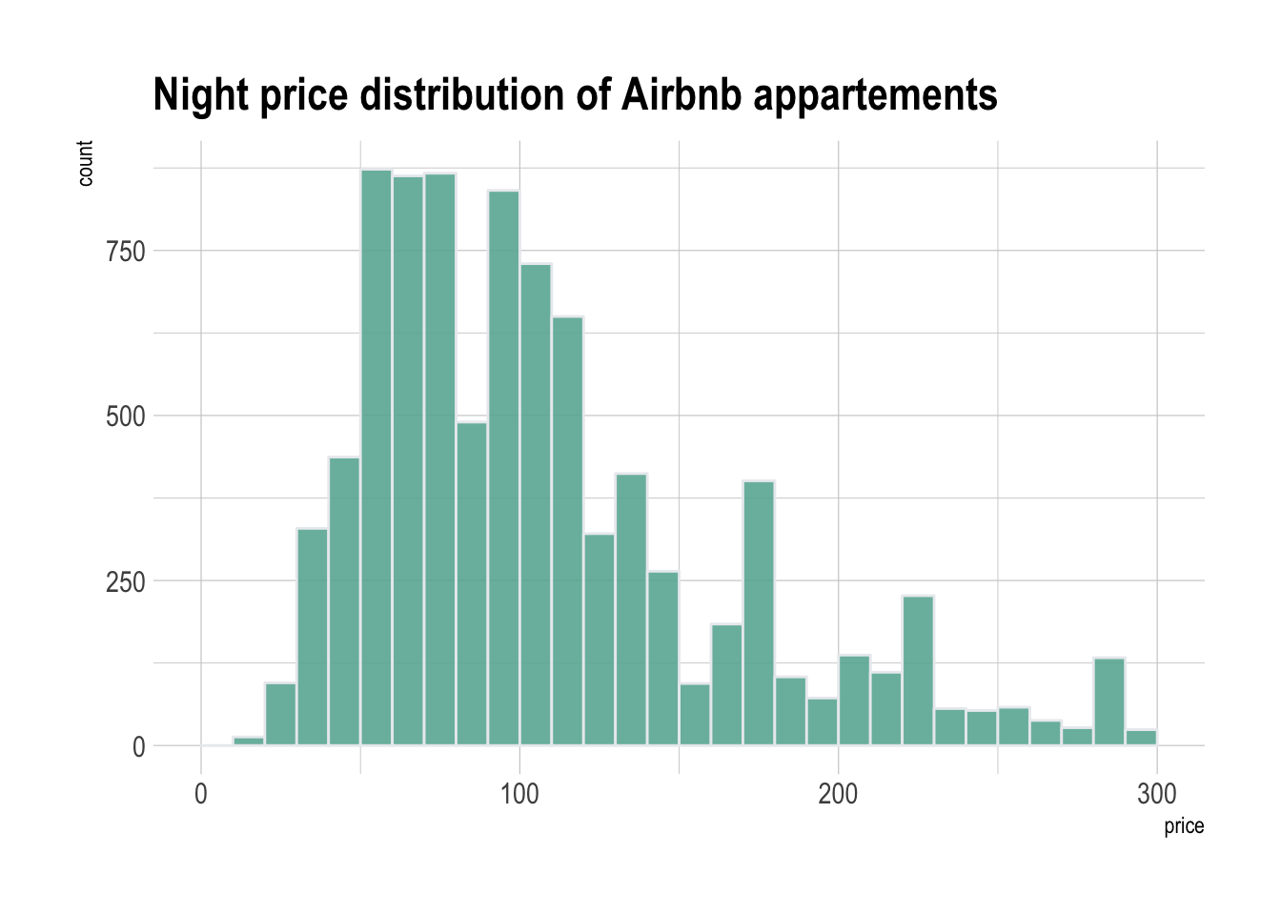
Histogram

Slide 16
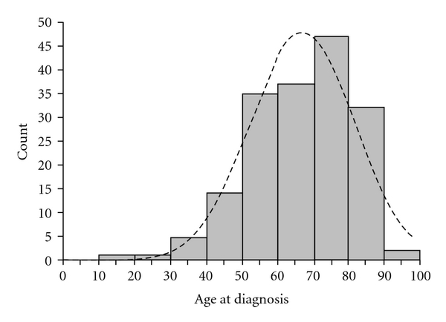
Histogram (w/ Normal Curve)

Slide 17
Measures of Central Tendency

Slide 18
Measures of Central Tendency
Measures that describe what is “average” or “typical” of the distribution of numbers

Slide 19
Measures of Central Tendency
Mode
Median
Mean

Slide 20
The Mode
The category with the largest frequency (percentage) in the distribution
Can be calculated for following variable levels:
Nominal
Ordinal
Interval-ratio
Notes:
Unimodal
One mode
Bimodal
Two distinct modes
Multi-modal
More than 2 distinct modes

Slide 21

The Median
The score that divides the distribution into two equal parts, so that half the cases are above it and half below it (the 50th percentile)
Can be calculated for following variable levels:
Ordinal
Interval-ratio
To do:
Put data in ascending or descending order
Position of median is : $\frac{N+1}{2}$

Slide 22
The Mean
Distribution’s average
Obtained by adding up all the scores and dividing by the total number of scores
Center of gravity for distribution
So, sensitive to extremes
Can be calculated for following variable levels:
Interval-ratio

Slide 23

The Mean
Calculating the mean
$$\overline{X}= \frac{\sum{X}}{N}$$
X = mean of X
X = the raw scores of the variable
ΣX = the sum of all the X (raw) scores
N = the number of observations or cases

Slide 24
Measures of Variability

Slide 25
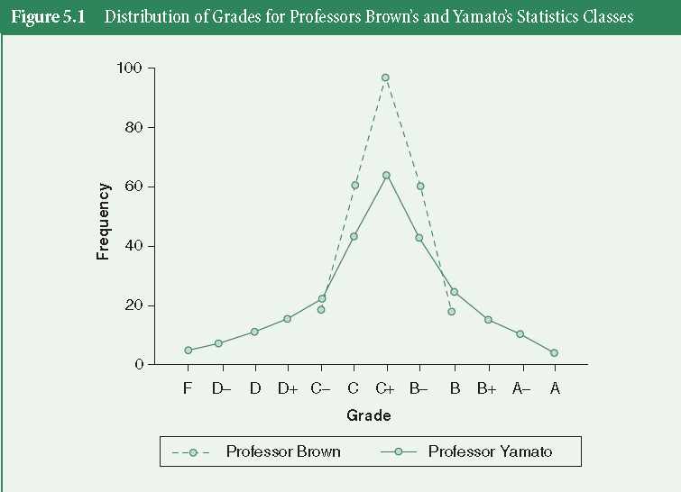
Why Not Just Central Tendency?
Notice that both distributions have the same mean, yet they are shaped differently

Slide 26
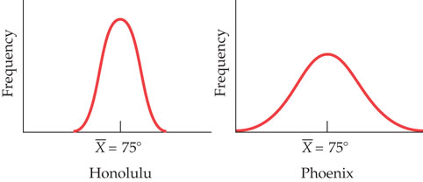
Why Not Just Central Tendency?

Slide 27
Why Not Just Central Tendency?
Measures of central tendency can be misleading
Need a measure of the spread/clustering of data

Slide 28
Measuring Variability
Once we have the mean (central tendency) we want to know how much variation is around the mean
Are scores closely clustered around the mean or spread out?
Numbers that describe diversity or variability in the distribution

Slide 29
Measures of Variability
Range
Variance
Standard Deviation

Slide 30
The Range
A measure of variation in interval-ratio variables.
It is the difference between the highest (maximum) and the lowest (minimum) scores in the distribution
Range = Highest score – Lowest score
Notes:
Sensitive to extremes

Slide 31
Problems and Fixes
Range sensitive to extremes… looks at
Instead, want measure of clustering around the mean

Slide 32

Raw Score Deviation
A value for how close or far a raw score is from the mean
Each raw score has an associated deviation
Because mean ($\overline{X}$) is the “center of gravity” of all raw scores (X), each raw score will be some distance from the mean

Slide 33
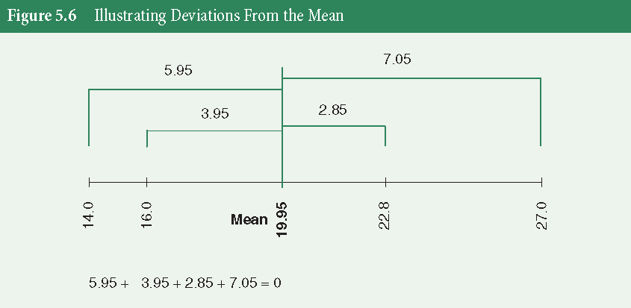
Raw Score Deviation

Slide 34
Raw Score Deviation
Subtract each raw score from the mean
Each raw score (observation) will have a deviation score
Raw score deviations can be negative or positive
Scores below mean have negative deviation and scores above mean have positive deviation
Shows how close or far they are from the mean (how much each score differs)

Slide 35


Raw Score Deviation
Calculating the raw score deviation
$Raw Dev= (X − \overline{X})$
$\overline{X}$ = mean of X
X = the raw scores of the variable

Slide 36
Raw Score Deviation
-
-

Slide 37
Raw Score Deviation
Instead of reporting deviation for every raw score, we want to come up with one overall summary score
We can do this by summing (adding up) every raw score deviation scores

Slide 38

Raw Score Deviation
Summary Score: How much all scores vary from the mean?
$$\sum{(X − \overline{X})}$$

Slide 39

Raw Score Deviation
Cannot sum all the raw score deviations...
Negative and positive cancel each other out and sum to zero
Because mean is ”center of gravity” …
$$\sum{(X − \overline{X})}=0$$

Slide 40
Raw Score Deviation
-
-
- -

Slide 41
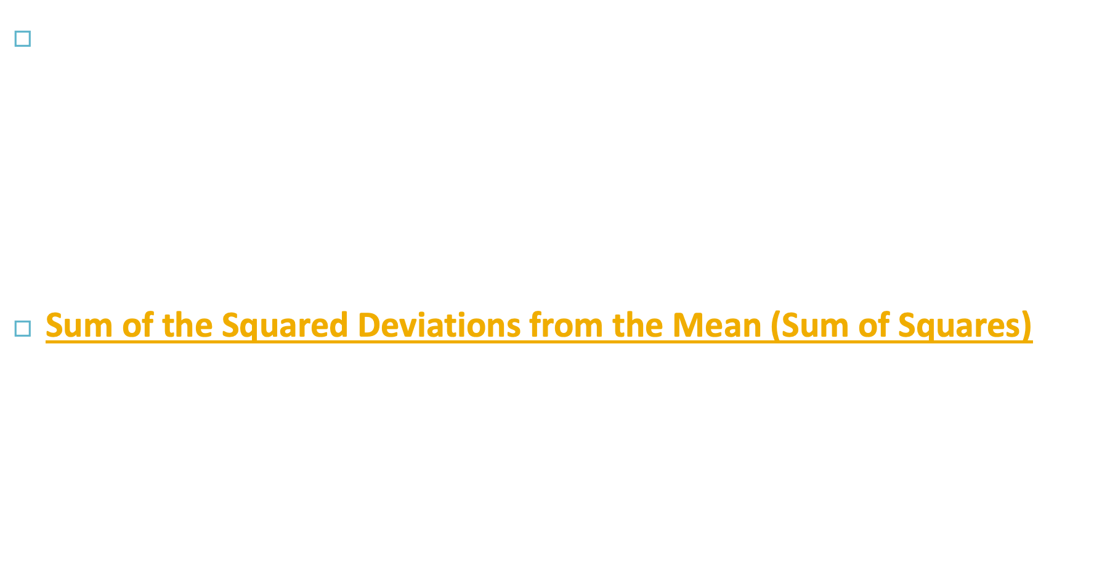
Fixing Raw Score Deviation
Instead, we can square the sum of the deviations to make them all positive
Sum of the Squared Deviations from the Mean (Sum of Squares)
$\sum{{(X −\overline{X})}^{2}}$

Slide 42

Fixing Raw Score Deviation
We create an average-summed-deviation by dividing by the number of cases involved
(number of cases minus 1, to correct for error)
Variance
$$var= \frac{\sum{{(X −\overline{X})}^{2}}}{(N−1)}$$

Slide 43
Variance
A measure of variation for interval-ratio variables
How much all scores vary from the mean, on average?
how closely the scores cluster around the mean, on average
Average of the squared-deviations from the mean

Slide 44
Fixing Variance
In “squared units”
We square the deviations because, when we add deviations, they sum to zero
When we square numbers, they become larger (in absolute value) and positive, so you won’t have zeros
However, squared numbers aren’t in the original units as the variable X

Slide 45

Fixing Variance
Must take the square root of variance to get it back to the original units (not squared units)
Standard Deviation
$$SD=\sqrt{var}= \sqrt{\frac{\sum{{(X −\overline{X})}^{2}}}{(N−1)}}$$

Slide 46
Standard Deviation
A measure of variation for interval-ratio variables
Average overall deviation from the mean
Equal to the square root of the variance

Slide 47
Variability and Distributions

Slide 48
Standard Deviation in Relation to Distributions
Real measure for average variability in a distribution
Larger scores indicate more variability/spread around the mean
Can be used to interpret position of a raw score, relative to all other scores within a distribution
Standardized (e.g. SD), so can be used to compare variability in one distribution to variability in other distributions

Slide 49
Standard Deviation in Relation to Distributions
Can be used to divide up a normal curve (AKA normal distribution)
About 99.9% of cases in a distribution fall between -3 SDs and +3 SDs of the mean
Just over 2/3 of cases in a distribution fall between -1 SDs and +1 SDs of the mean

Slide 50
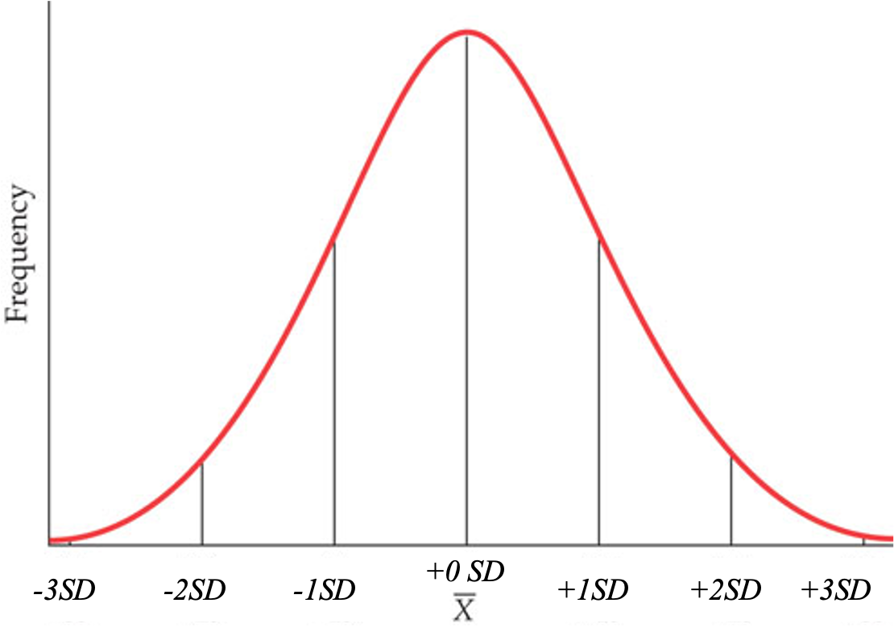
Standard Deviation in Relation to Distributions

Slide 51
A Note on the Shape of the Distribution
Skewness (symmetry)
measure of how close or far a distribution is from symmetry (the normal curve). It measures the clustering of scores along the X-axis, with regard to the position of the mode, median, and mean.
Kurtosis (peakedness)
measure of the peakedness of the distribution - how high or low the distribution is on the Y-axis, and how different it is from mesokurtic (e.g. middle kurtosis, or the normal curve).

Slide 52
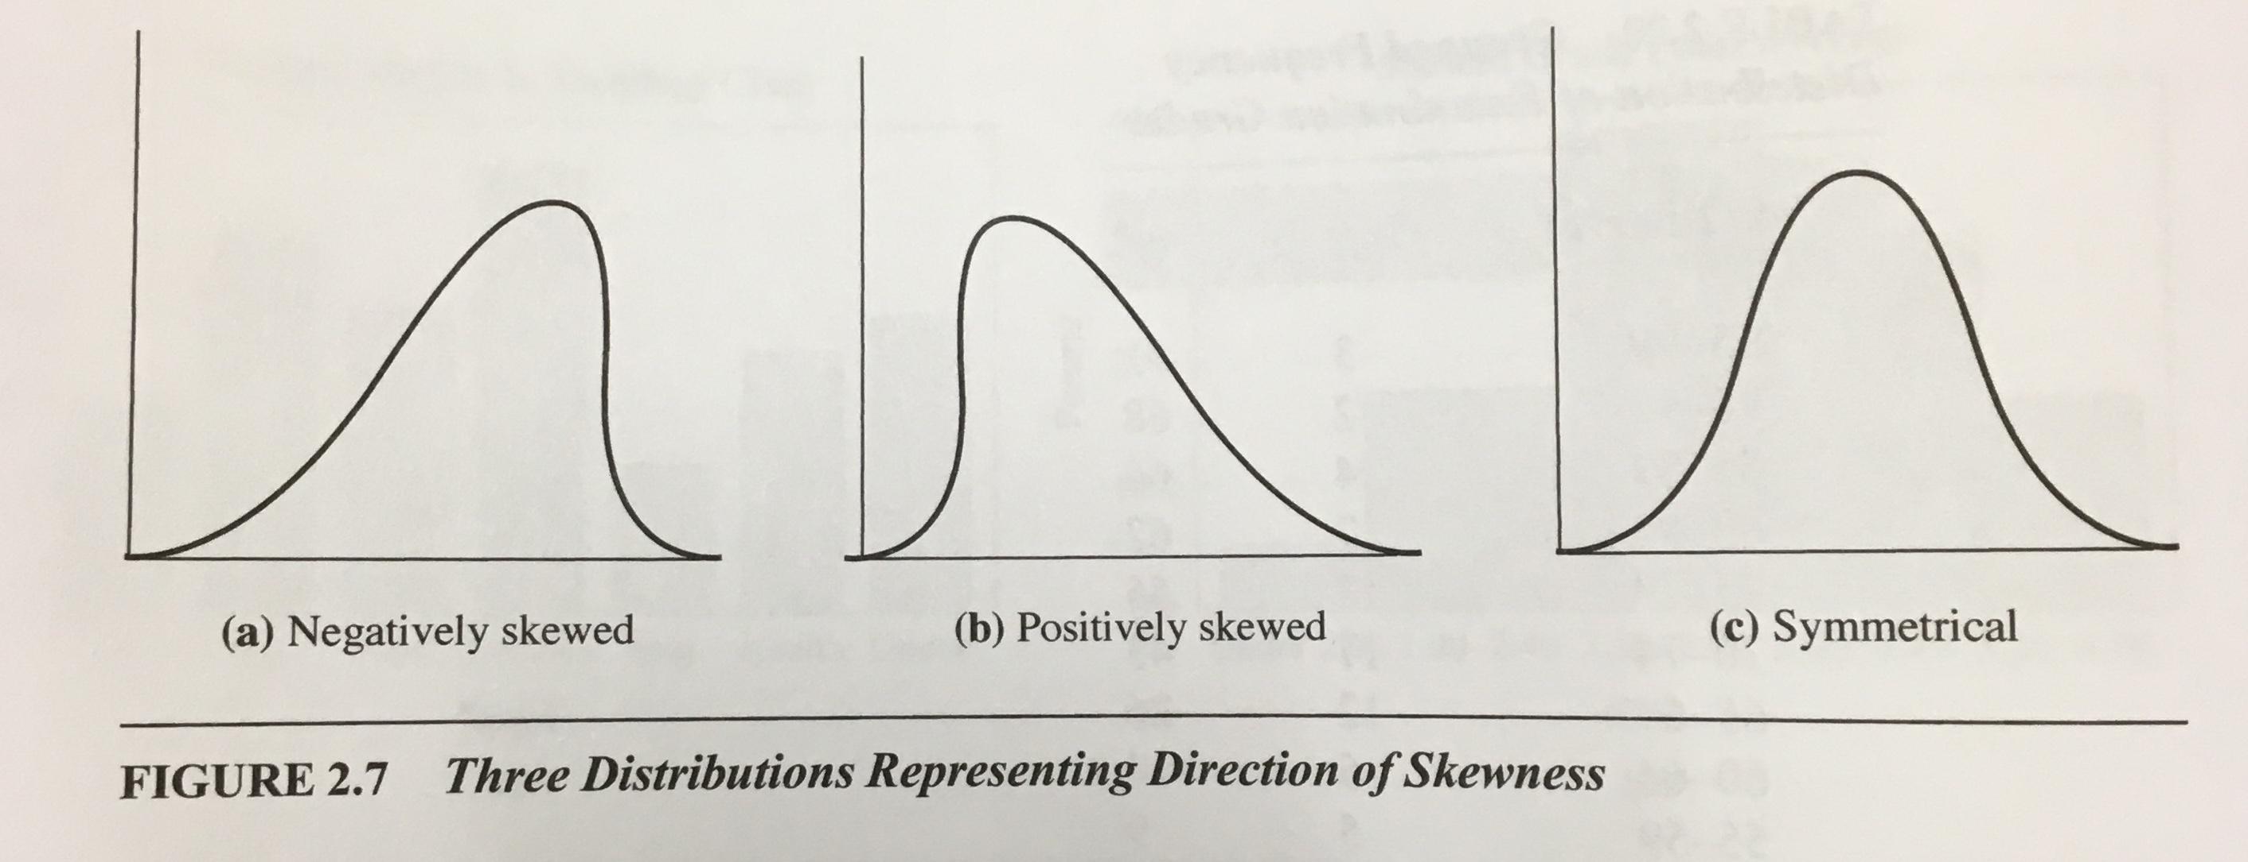
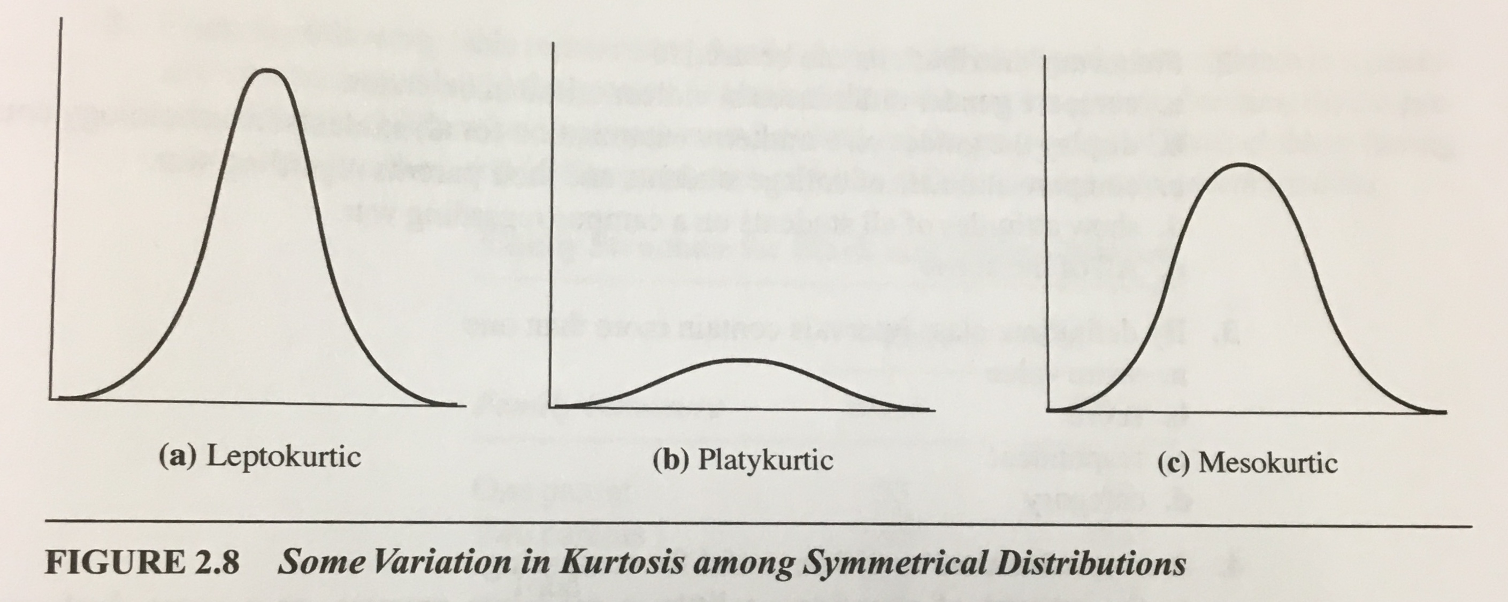
Skewness and Kurtosis
Skewness (symmetry)
Symmetrical (e.g. Normal Curve)
Mean, median, mode all at center
Negatively Skewed (e.g. Final Grades)
left skew, tail to the left
mean < median < mode
Positively Skewed (e.g. STIs)
right skew, tail to the right
mode < median < mean
Kurtosis (peakedness)
Mesokurtic
Normal Curve
Leptokurtic
Very peaked
Platykurtic
Very flat
Notes:
In unimodal distributions, when the mode, the median, and the mean coincide or are almost identical, the distribution is symmetrical
If mean is higher than the median, the distribution is positively skewed
If mean is lower than the median, the distribution is negatively skewed

Slide 53
Skewness and Kurtosis (Ranges and Cutoffs)
Skewness (symmetry)
Range: −∞ to ∞.
Signs: − is negative skewness, + is positive skewness, and 0 is no skew… (AKA symmetry, AKA the normal curve).
Cutoffs:
High Skewness: x ≥|1|
Moderate Skewness: |1| ≥ x ≥ |.5|
Low Skewness: |.5| ≥ x ≥ |0|
Kurtosis (peakedness)
Range: −2 to +∞.
Signs: − is platykurtic, + is leptokurtic (+ but close to 0 is mesokurtic)
Cutoffs:
Platykurtic: 0 ≥ x ≥ −2
Mesokurtic: 1 ≥ x ≥ 0
Leptokurtic: +∞ ≥ x ≥ 1

