Slide 1
CHI SQUARE TEST OF INDEPENDENCE/ASSOCIATION

Slide 2
A bit about social Research
Sometimes we want to know about whether or not a category (attribute) of one variable varies by categories of another variable
Are blacks more likely to be Democrats?
Relationship between race (2 or more groups) and political party affiliation (2 or more groups)
Are liberals or conservative more permissive in their childrearing?
Relationship between party affiliation (2 groups) and permissiveness (2 categories)
Relationship between two nominal/ordinal variables

Slide 3
The Chi-Square Test
Inferential statistical technique to test for significant relationships between two nominal or ordinal variables
Widely used in social sciences

Slide 4
Statistical Independence
Tests the independence of (absence of association between) two variables

Slide 5
Chi-Square test is based on the Crosstabulation (Crosstab)
Crosstab
Helps visualize bivariate relationships
Allows us to compare distribution in categories of one variable across categories of another variable
Differences in the independent variable groups (e.g. liberals and conservatives), in terms of the dependent variable, their childrearing method (e.g. permissive and not)

Slide 6
Crosstab of Political Orientation and Child-Rearing
Child-Rearing Method | Political Orientation |  | Total
 | Liberals | Conservatives
Permissive | 15 | 10 | 25
Not Permissive | 5 | 10 | 15
Total | 20 | 20 | 40

Slide 7
The Chi-Square Test
Takes into account the frequencies (in the crosstab) across categories of two nominal or ordinal variables
Tests the independence of (absence of association between) two variables

Slide 8
Stating the Hypotheses
Null hypothesis (H₀)
States that no association exists between the two cross-tabulated variables in the population, therefore the variables are statistically independent
Research hypothesis (H₁)
States that the two variables are related in the population
Notes:
H₀: 2 variables are unrelated, and X² is low
H₁: 2 variables are related, and X² is high
H0 is null hypothesis… which we are always trying to reject.. Null says no relationship… to reject is to show that there is a relationship…

Slide 9
Hypotheses for relationship b/w Political Orientation and Child-Rearing
Null hypothesis (H₀)
No association between political orientation and child-rearing in the population
The variables are independent of (do not influence) one another, in the population
The frequency of liberals who are permissive does not differ (is the same as) the frequency of conservatives who are permissive, in the population
Frequencies of dependent variable are expected to be the same across groups of the independent variable
Research hypothesis (H₁)
The frequency of liberals who are permissive differs (is different than) the frequency of conservatives who are permissive, in the population

Slide 10
The Concept of Expected Frequencies
Observed frequencies (f_{o})
Cell frequencies actually observed in a bivariate table (crosstab)
Expected frequencies (f_{e})
Expected cell frequencies in crosstab if…
the two variables were statistically independent
the null hypothesis were true

Slide 11
Observed Frequencies Example: Sex by First-gen Status
Frequencies of actual data
First Gen Status | Men | Women | Total
Firsts | 691 | 1245 | 1936
Nonfirsts | 1259 | 1425 | 2684
Total | 1950 | 2670 | 4620

Slide 12
Expected Frequencies
What would the data look like if H₀ were true?
No association between categories of the variables

Slide 13
Expected Frequencies Example: Sex by First-gen Status
What would the data look like if H₀ were true?
No association between categories of the variables
First Gen Status | Men | Women | Total
Firsts |  |  | 1936
Nonfirsts |  |  | 2684
Total | 1950 | 2670 | 4620

Slide 14

Expected Frequencies Example: Sex by First-gen Status
What would the data look like if H₀ were true?
No association between categories of the variables
Row Marginal
First Gen Status | Men | Women | Total
Firsts |  |  | 1936
Nonfirsts |  |  | 2684
Total | 1950 | 2670 | 4620
Column Marginal
N

Slide 15
Expected Frequencies Example: Sex by First-gen Status
What would the data look like if H₀ were true?
No association between categories of the variables
First Gen Status | Men | Women | Total
Firsts | 817.14 | 1118.86 | 1936
Nonfirsts | 1132.86 | 1551.14 | 2684
Total | 1950 | 2670 | 4620

Slide 16
Expected Frequencies
Actual data
Expected data from H₀: no association between categories of the variables
First Gen Status | Men | Women | Total
Firsts | 691 | 1245 | 1936
Nonfirsts | 1259 | 1425 | 2684
Total | 1950 | 2670 | 4620
First Gen Status | Men | Women | Total
Firsts | 817.14 | 1118.86 | 1936
Nonfirsts | 1132.86 | 1551.14 | 2684
Total | 1950 | 2670 | 4620

Slide 17
The Chi Square (X²) test

Slide 18
The Chi Square test
Examines whether or not two nominal/ordinal variables are independent of each other (not related to each other)
Examines how frequencies within categories of one variable are distributed along categories of another variable

Slide 19
The Chi-Square Test
Measures size of difference between observed and the expected frequencies
By calculating the difference for each cell

Slide 20
The Chi Square Test (Variable Types)
IV: nominal, ordinal (e.g. categorical/discrete)
Grouping variable
DV: nominal, ordinal (e.g. categorical/discrete)
Grouping variable

Slide 21
The Chi Square Test (Hypotheses)
H₀: There is no difference between the observed and expected frequencies for categories of the variables. The variables are independent of one another. There is no association between the variables.
H₀: f_{e} = f_{o}
H₁: There is a difference between the observed and expected frequencies for categories of the variables. The variables are dependent on one another. There is an association or relationship between the variables.
H₁: f_{e} ≠ f_{o}

Slide 22
The Chi Square test ASSUMPTIONS (cannot be violated)
Independence of Observations
Groups are not related or dependent upon each other. Case can’t be in more than one group. No ties between observations
Normality of Distribution
Distribution must be relatively normal
If 20% or more expected cell frequencies (f_{e}) are below n=5, you violate the assumption
Notes:
If one is violated should be okay. But should make adjustments if necessary.
Don’t have triple whammy (violating final 3 – equal sample sizes, homogeneity of variances, and normality of distribution). You can violate 2 of 3 and still be okay, though.

Slide 23
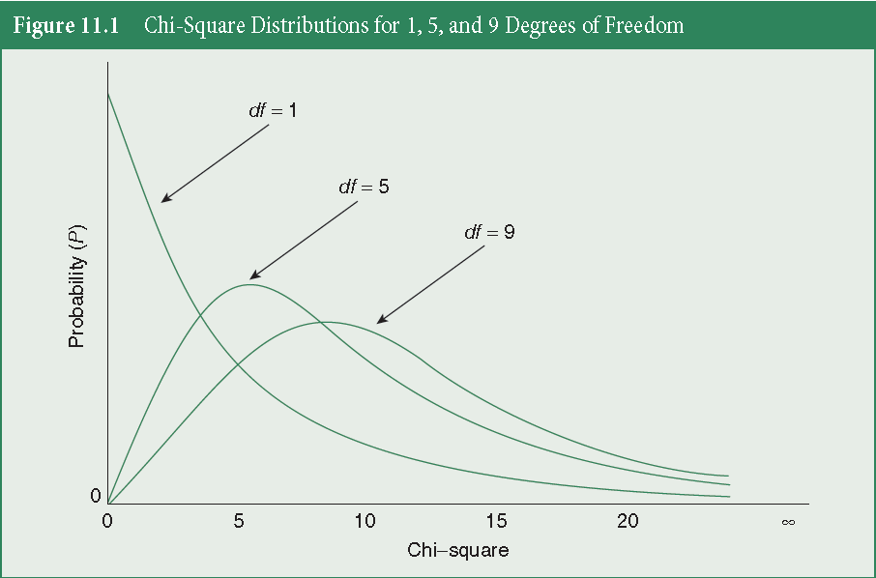

The Chi Square test (Distributions)
The X²-distribution has multiple curves
Each curve based on sample size or degrees of freedom
It also is one-sided (squaring gets us positive numbers), ranging from 0 to +$∞$

Slide 24
The Chi-Square Test
If the overall difference between the expected and observed frequencies is extreme enough
We reject the null hypothesis
We claim to have a statistically significant association between the two variables
Decide that an association, or difference between two groups on the dependent variable, exists in the population

Slide 25
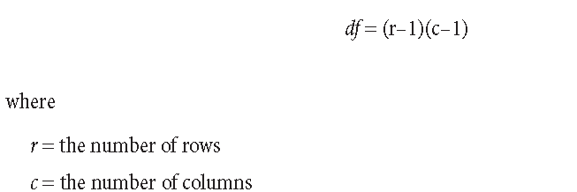
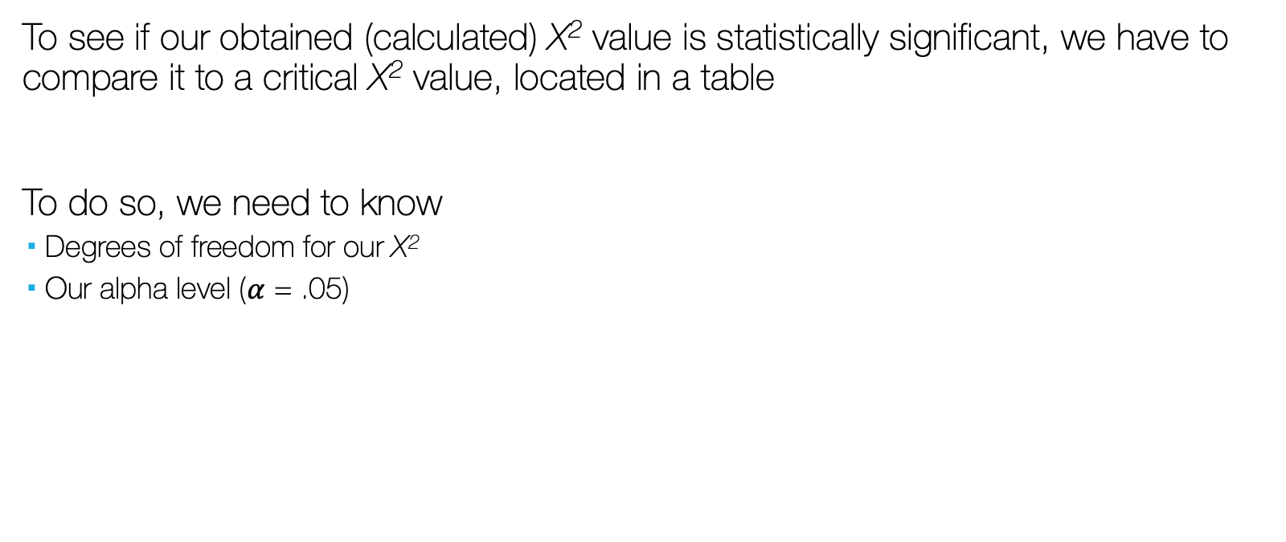
The Chi-Square Test
To see if our obtained (calculated) X² value is statistically significant, we have to compare it to a critical X² value, located in a table
To do so, we need to know
Degrees of freedom for our X²
Our alpha level ($α$ = .05)

Slide 26
The Chi-Square Test
Hypothesis Testing:
Compare our calculated X² value to the critical X² value (X² Table)
If X²_{obtained} > X²_{critical}, reject the null hypothesis
If X²_{obtained} < X²_{critical}, fail to reject the null hypothesis
Logic is same as other hypothesis tests (for t-test, ANOVA, correlation, Z-score, etc)

Slide 27
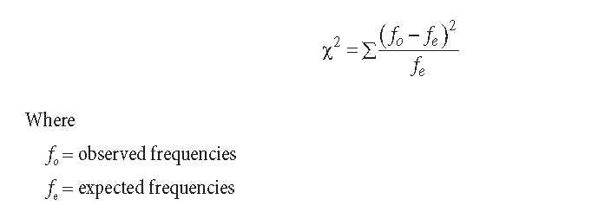
The Chi-Square Test

Slide 28
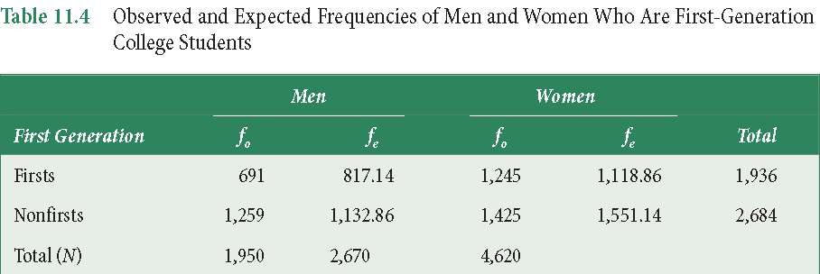
The Chi-Square Test for Sex by First-gen Status

Slide 29
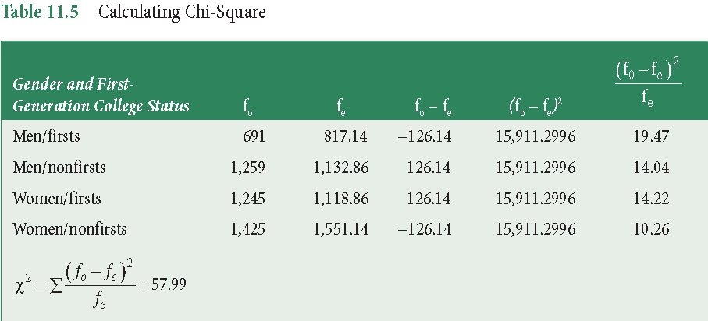
The Chi-Square Test for Sex by First-gen Status

Slide 30
Hypothesis Testing
The logic is the same as usual, compare our calculated X² value to the critical X² value (X² Table)
If X²_{obtained} > X²_{critical}, reject the null hypothesis
If X²_{obtained} < X²_{critical}, fail to reject the null hypothesis

Slide 31

Hypothesis Testing
To find critical X² in X² Table, we need alpha ($α$) and degrees of freedom df.
Select the column based on $α$ (usually $α$ = .05)
Select the row based on df
df = (r-1)(c-1)
Where they intersect is the critical X² value, X²_{critical}
If X²_{obtained} > X²_{critical}, reject H₀

Slide 32

Chi-Square
We compare our X²_{obtained} to our X²_{critical} in X² Table.
If X²_{obtained} $≥$ X²_{critical}, then…
X²_{obtained} is in rejection region
We reject H₀
p $≤$ $α$
Statistically significant association (diff from expected by H₀)

Slide 33
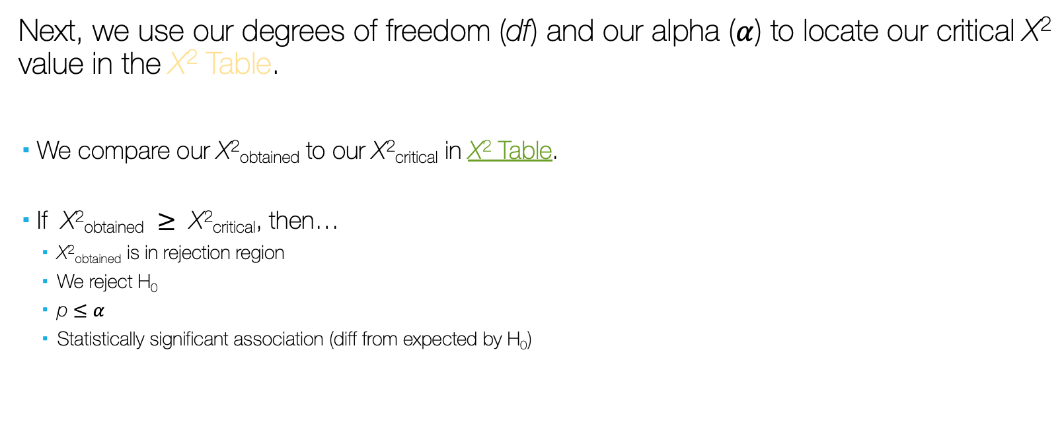
Chi-Square
Next, we use our degrees of freedom (df) and our alpha ($α$) to locate our critical X² value in the X² Table.
We compare our X²_{obtained} to our X²_{critical} in X² Table.
If X²_{obtained} $≥$ X²_{critical}, then…
X²_{obtained} is in rejection region
We reject H₀
p $≤$ $α$
Statistically significant association (diff from expected by H₀)

Slide 34

Calculating Chi-Square
In our example, we have the following:
X² = 57.99
df = (2-1)(2-1) = 1
In our X² Table, we follow the df = 1 row and the $α$ = .050 column, to see where they intersect.
X²_{critical} = 3.84
Because X²_{obtained} $≥$ X²_{critical} we reject the null

Slide 35
Reporting Chi Square
Report
The test used
If you reject or fail to reject the null hypothesis
The variables used in the analysis
The degrees of freedom, calculated value of the test, and p-value
X²(df) = Chi-square_{obtained}, p-value
“Using the Chi Square test of independence, I reject/fail to reject the null hypothesis that there is no relationship between one variable and the other variable, in the population, X²(?) = ?, p ? .05”

Slide 36
Reporting Chi Square
Report
The test used
If you reject or fail to reject the null hypothesis
The variables used in the analysis
The degrees of freedom, calculated value of the test, and p-value
X²(df) = Chi-square_{obtained}, p-value
“Using the Chi Square test of independence, I reject the null hypothesis that there is no relationship between gender and first-gen status, in the population, X²(1) = 57.99, p < .05”

Slide 37
Calculating the Expected Frequencies
Row Marginal
Child-Rearing Method | Political Orientation |  | Total
 | Liberals | Conservatives
Permissive | 15 | 10 | 25
Not Permissive | 5 | 10 | 15
Total | 20 | 20 | 40
Column Marginal
N
Notes:
We take the marginals to calculate the fe for each cell.

Slide 38
Calculating the Expected Frequencies
Child-Rearing Method | Political Orientation |  | Total
 | Liberals | Conservatives
Permissive | 15 (12.5) | 10 (12.5) | 25
Not Permissive | 5 (7.5) | 10 (7.5) | 15
Total | 20 | 20 | 40
Notes:
We take the marginals to calculate the fe for each cell.

Slide 39
Calculating the Obtained Chi-Square
Child-Rearing Method | Political Orientation |  | Total
 | Liberals | Conservatives
Permissive | 15 (12.5) | 10 (12.5) | 25
Not Permissive | 5 (7.5) | 10 (7.5) | 15
Total | 20 | 20 | 40
Cell | f₀ | f_{e} | f₀ - f_{e} | (f₀ – f_{e})² | (f₀ – f_{e})² / f_{e}
Upper left | 15 | 12.5 | 2.5 | 6.25 | .50
Upper right | 10 | 12.5 | -2.5 | 6.25 | .50
Lower left | 5 | 7.5 | -2.5 | 6.25 | .83
Lower right | 10 | 7.5 | 2.5 | 6.25 | .83
∑ |  |  |  |  | X² = 2.66
Notes:
We take the marginals to calculate the fe for each cell.

Slide 40
Example: Political Orientation and Views of BLM
Using the following cross-tab, hand calculate:
X²
degrees of freedom
determine it’s significance level
Fully and completely report your findings (and whether you reject/fail to reject the null hypothesis
Views of BLM | Political Orientation |  | Total
 | Liberals | Conservatives
Positive | 47 | 5 | 52
Negative | 3 | 35 | 38
Total | 50 | 40 | 90

