Slide 1
Correlation

Slide 2
Why Correlation?
We’ve said nothing about the degree of the relationship between variables
To do this, we need to know about the strength or direction of the association between two variables
“Co-relation”:
The relationship between two interval-ratio variables
Correlation:
Describes strength and direction of relationships in a linear fashion

Slide 3
Correlation
IV: interval-ratio (e.g. continuous)
DV: interval-ratio (e.g. continuous)

Slide 4
Example: Weight and Height
We know that both are associated because the taller a person is, the more they tend to weigh
Notes:
And this correlation is not PERFECT, because we know that some tall people weigh very little, and some short people weigh a lot.

Slide 5
Example: Education and Income
We know that both are associated because the more educated a person is, the more they tend to make in income
Notes:
And this correlation is not PERFECT, because we know that some tall people weigh very little, and some short people weigh a lot.

Slide 6
Correlation: Two Parts
Strength of relationship
Direction of relationship (linear)

Slide 7
Strength of Correlation
Correlations vary in strength
Can visualize strength using scatterplot
Independent variable (predictor) on X axis, dependent variable (outcome) on Y axis
Easier to call one variable X (IV) and the other Y (DV)
Strength increases as the points on the scatterplot more closely form an imaginary line

Slide 8
Strength of Correlation
Strong correlation: points are closer to imaginary line
Perfect correlation: each point falls directly on the imaginary line
Weak Correlation: points are further from imaginary line
No correlation: no points touch the line
Perfect correlations and no correlations rarely seen in the real world

Slide 9
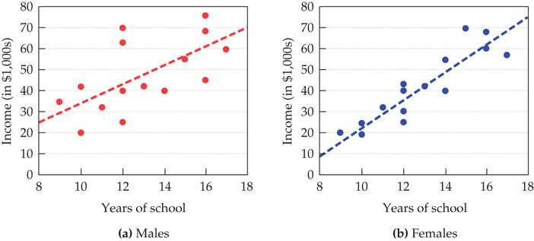
Strength of Correlation
Notes:
One plot for males, one for females
Each point depicts education and income
Correlation stronger when points closely form line
Female correlation between education and income is much stronger since points closer to line
Because this is based on (variation from) the straight line, this is a linear relationship

Slide 10
Direction of Correlation
Positive correlation
Relationships in the SAME direction
As one variable increases, the other variable increases
As one variable decreases, the other variable decreases
Negative correlation
relationships in the OPPOSITE direction; inverse relationship
as the score for one variable increases, the other decreases (vice versa)

Slide 11
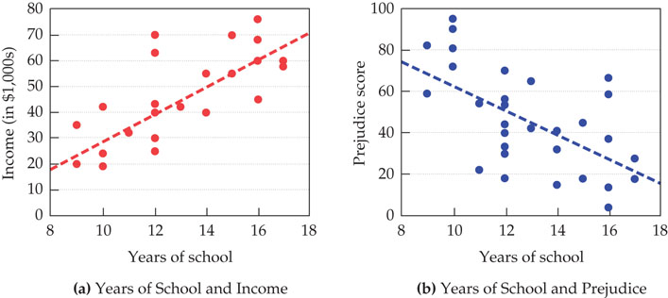
Direction of Correlation
Notes:
Figure (a): relationship between education and income has positive correlation
Figure (b): relationship between education and prejudice has negative correlation
Another linear relationship

Slide 12
NOte: Nonlinear Relationships
Not all relationships between X and Y form a straight line/are linear
Curvilinear correlation
one variable increases as the other increases until the relationship reverses itself
Notes:
For this, we violate the assumption of linearity… X isn’t related to Y but perhaps X^2 or X^3 is related to Y

Slide 13
Pearson’s Correlation Coefficient (r)
r
Ranges from -1.0 to +1.0

Slide 14
Pearson’s Correlation Coefficient (r)
Strength:
The closer to ±1.0, the stronger the relationship
Direction:
Ranges from -1.0 to +1.0
Negative: negative correlation
Positive: positive correlation
-0.7 and +0.7 have the same strength, but different directions

Slide 15
Correlation Strength Cutoffs (Cohen 1988)
Weak/Small Correlation
r less than/equal to |.29| (r ≤ |.29|)
Moderate Correlation
r between |.30| and |.49| (|.30| ≤ r ≤ |.49|)
Strong Correlation
r greater than/equal to |.50| (r ≥ |.50|)

Slide 16
Calculating the Pearson’s Correlation Coefficient (r)

Slide 17
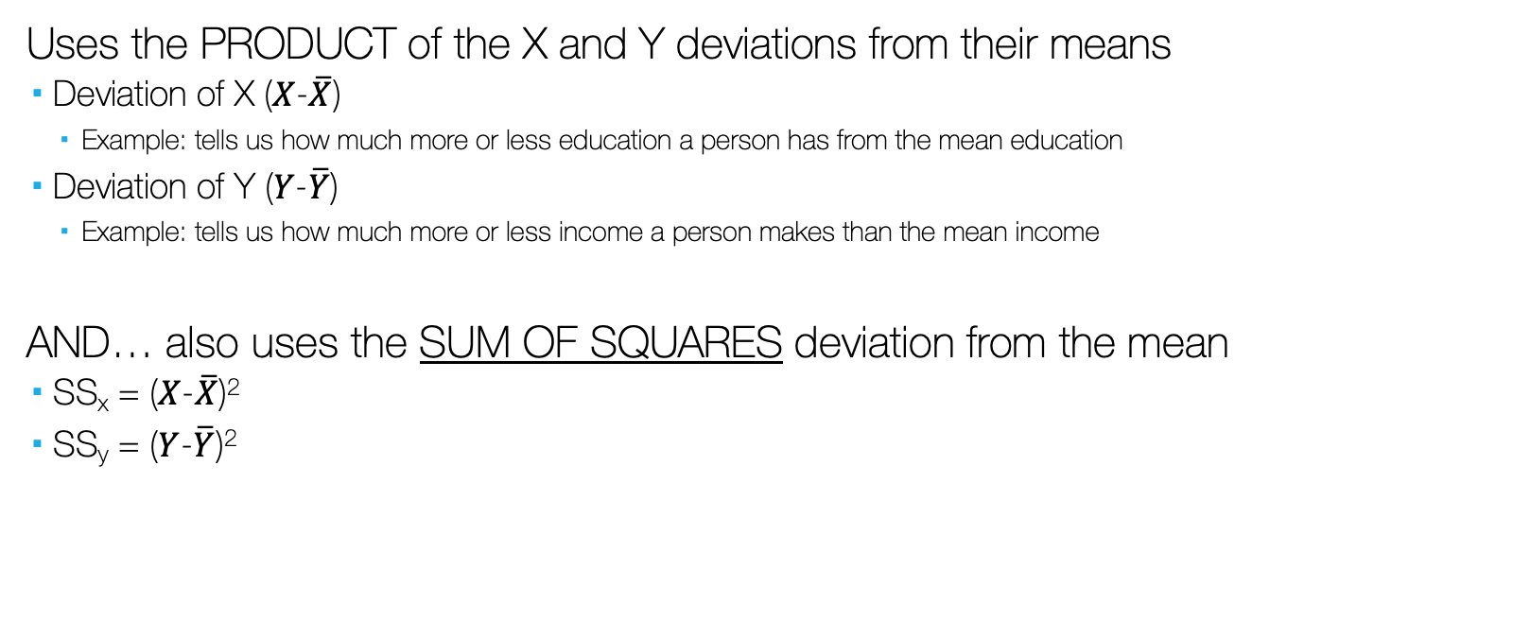
Calculating the Pearson’s Correlation Coefficient (r)
Uses the PRODUCT of the X and Y deviations from their means
Deviation of X ($X$-$\overline{X}$)
Example: tells us how much more or less education a person has from the mean education
Deviation of Y ($Y$-$\overline{Y}$)
Example: tells us how much more or less income a person makes than the mean income
AND… also uses the SUM OF SQUARES deviation from the mean
SS_{x} = ($X$-$\overline{X}$)²
SS_{y} = ($Y$-$\overline{Y}$)²

Slide 18

Calculating the Pearson’s Correlation Coefficient (r)
Notes:
Interacting relationship of deviations from expectation/mean – how much variation found in relationship between two
Divided by
Overall expected deviations from mean (squared to get a measure of total variation) – how much total variation expected from relationship
Doing so constrains value to 1…

Slide 19
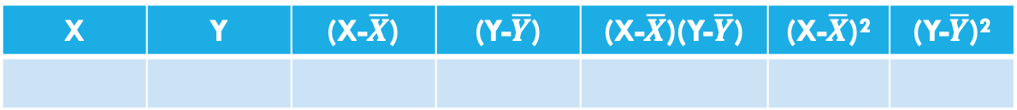
Calculating the Pearson’s Correlation Coefficient (r)
X | Y | (X-$\overline{X}$) | (Y-$\overline{Y}$) | (X-$\overline{X}$)(Y-$\overline{Y}$) | (X-$\overline{X}$)² | (Y-$\overline{Y}$)²
Notes:
Interacting relationship of deviations from expectation/mean – how much variation found in relationship between two
Divided by
Overall expected deviations from mean (squared to get a measure of total variation) – how much total variation expected from relationship
Doing so constrains value to 1…

Slide 20

Another Calculation for Pearson’s r

Slide 21

Correlation (Hypotheses)
H₀: No relationship between the variables (in the population)
$ρ=0$
H₁: There is a relationship between the variables (in the population)
$ρ≠0$

Slide 22
Correlation ASSUMPTIONS (cannot be violated)
Linearity
Variables move together in a linear fashion.
Visual inspection of scatterplot
Normality
Distribution must be relatively normal
Visual inspection of…
Scatterplot
Histogram
Normality (Q-Q) plots
Box-and-Whiskers plots
Absence of Range Restrictions
Values on variables cannot be restricted to small range
Absence of Heterogeneous Subsamples
Not having groups that have extremely different values (e.g. for which a t-test/ANOVA might appropriately identify)
Notes:
If one is violated should be okay. But should make adjustments if necessary.
Don’t have triple whammy (violating final 3 – equal sample sizes, homogeneity of variances, and normality of distribution). You can violate 2 of 3 and still be okay, though.

Slide 23

Correlation and the r-distribution
The r-distribution (sort of like normal distribution) has multiple curves
Each curve based on degrees of freedom (e.g. sample size)
Looks more like normal distribution if sample size is large enough (N $≥$ 30)
df = $N−2$

Slide 24
Hypothesis Testing (Is the r extreme?)
The logic is the same as usual, compare our calculated r (obtained) value to the critical r value (r Table)
If r_{obtained} > r_{critical}, reject the null hypothesis
If r_{obtained} < r_{critical}, fail to reject the null hypothesis

Slide 25

Hypothesis Testing (Is the r extreme?)
To find critical r, we need alpha ($α$) and degrees of freedom df.
Select the column based on $α$ (usually $α$ = .05)
Select the row based on df (df = N-2)
Where they intersect is the critical r value, r_{critical}
If r_{obtained} > r_{critical}, reject H₀

Slide 26
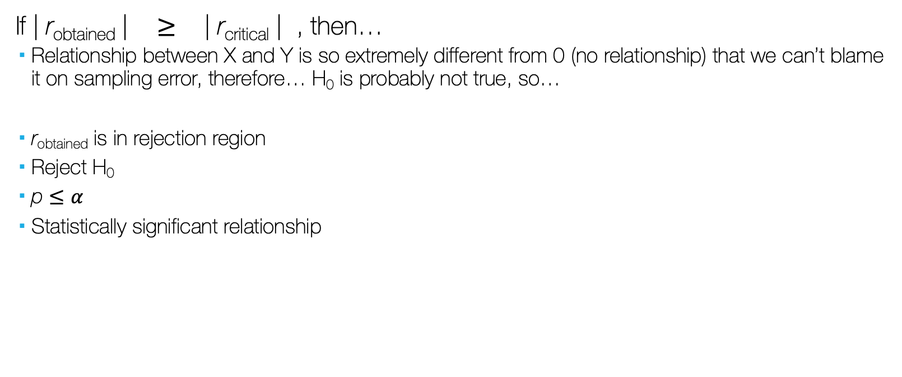
Hypothesis Testing (Is the r extreme?)
If | r_{obtained} | $≥$ | r_{critical} | , then…
Relationship between X and Y is so extremely different from 0 (no relationship) that we can’t blame it on sampling error, therefore… H₀ is probably not true, so…
r_{obtained} is in rejection region
Reject H₀
p $≤α$
Statistically significant relationship

Slide 27
Hypothesis Testing (Is the r extreme as a t-test)
We can also convert our r_{obtained} test into a t-test, and use the t-test instead (t Table)
If t_{obtained} > t_{critical}, reject the null hypothesis
If t_{obtained} < t_{critical}, fail to reject the null hypothesis

Slide 28

Hypothesis Testing (Is the r extreme as a t-test)
To convert r test into a t-test, we do the following:
$t= \frac{r \sqrt{N−2}}{\sqrt{1 − r^{2}}}$ = $\frac{r \sqrt{df}}{\sqrt{1 − r^{2}}}$

Slide 29

Hypothesis Testing (Is the r extreme as a t-test)
Then we need to find critical t, using alpha ($α$) and degrees of freedom df.
Select the column based on $α$ (usually $α$ = .05)
Select the row based on df (df = n1 + n2 – 2; df = N – 2)
Where they intersect is the critical t value, t_{critical}
If t_{obtained} > t_{critical}, reject H₀

Slide 30

Hypothesis Testing (Is the r extreme as a t-test)
So, applied to t-Test:
If | t_{obtained} | $≥$ | t_{critical} | , then…
Relationship between X and Y is so extremely different from 0 (no relationship) that we can’t blame it on sampling error, therefore… H₀ is probably not true, so…
t_{obtained} is in rejection region
Reject H₀
p $≤α$
Statistically significant difference

Slide 31
Hypothesis Testing
Next, we use a critical r (r Table), or critical t (t Table) based on our alpha level (α = .05)
Table will help us determine whether or not our obtained r is significant at either the .05 level
Select the column associated with our α value and the row associated with our df value, we find the value that intersects both. This is our critical r or critical t.
If our obtained r is larger than the critical r, we know our obtained r is significant (at least at the p=.05 level)

Slide 32
Reporting r
Report
The test used
If you reject or fail to reject the null hypothesis
The variables used in the analysis
The degrees of freedom, calculated value of the test, and p-value
r(df) = r_{obtained}, p-value
“Using the Pearson correlation, I reject/fail to reject the null hypothesis that there is no relationship between the independent variable and the dependent variable, in the population, r(?) = ?, p ? .05”
(if significant, follow with…)
“We have a [strength] [direction] relationship between [X] and [Y]”

Slide 33
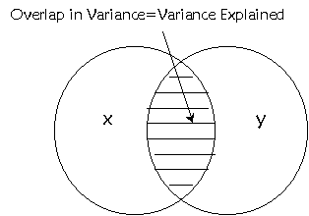
Pearson’s r and r² (Effect Size)
Pearson’s product moment correlation coefficient is the basis for regression analysis.
In correlation we find r, in regression we use r, but we square it to tell us “how much variation in Y is explained by variation in X”
This is known as effect size (r²), tells us how much X affects Y
r² tells us how much percent of variation in Y is explained by variation in X
r² is a proportion, so convert it to percentage
If r² = .159, that means that 15.9% of the variation in Y is explained by variation in X
15.9%

