Slide 1
Introduction to quantitative analysis
Notes:
Everyday, we make educated guesses about how our choices affect our futures – to plan for situation
Social researcher does the same… but not to just make educated guesses about their own lives, but about human behavior & social reality overall.

Slide 2
Empirical Social Science
Social scientists do empirical research by…
examining relationships between variables, across many observations, and develop explanations for these relationships
Notes:
And these variables are measured at different levels.

Slide 3
Empirical Social Science
Observations + Explanation

Slide 4
Observations

Slide 5
Observations
Units of Analysis
The level of social life under investigation
Individual Level
Person (people)
Aggregate Level
Family
Organization
City, County, State, etc.

Slide 6
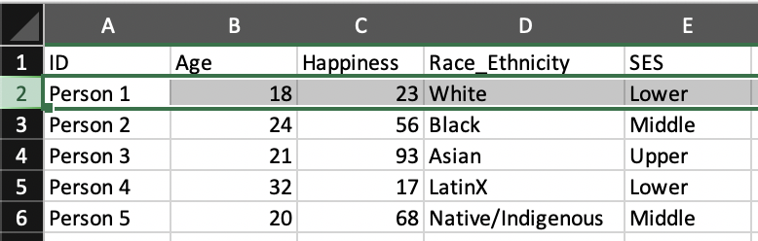
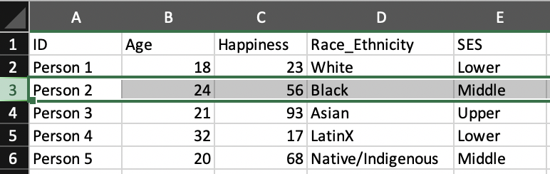
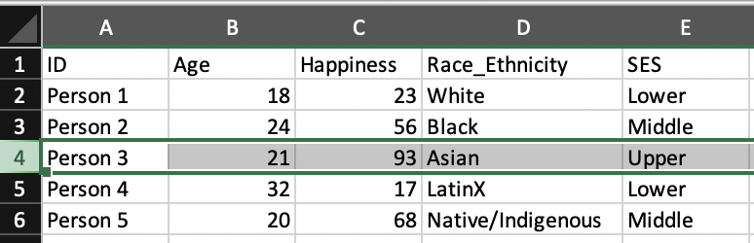
Observations
Observations on ROWS

Slide 7
Observations
What is the unit of analysis here?

Slide 8
Observations
Every observation under investigation has many variables…

Slide 9
Observations: Variables
Properties of observations that are different (vary) across observations.
Social class
Age
Gender
Sex
Race

Slide 10
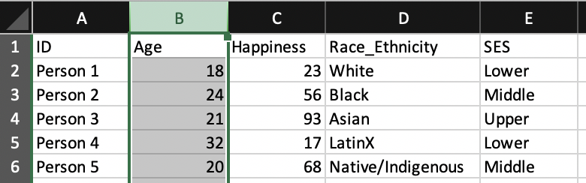
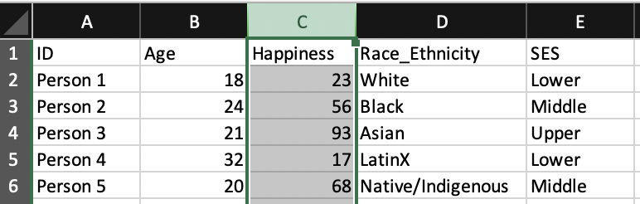
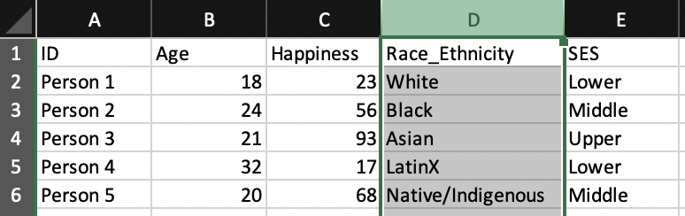
Observations
Variables on COLUMNS

Slide 11
Observations
Every observation under investigation has many variables…
… and each variable has many attributes

Slide 12
Observations: Variables and Attributes
Variables:
Properties of observations that are different (vary) across observations
e.g. Race/Ethnicity
Attributes:
Specific characteristics or qualities that describe each observation, can be grouped into variables
Black, White, LatinX, etc.

Slide 13
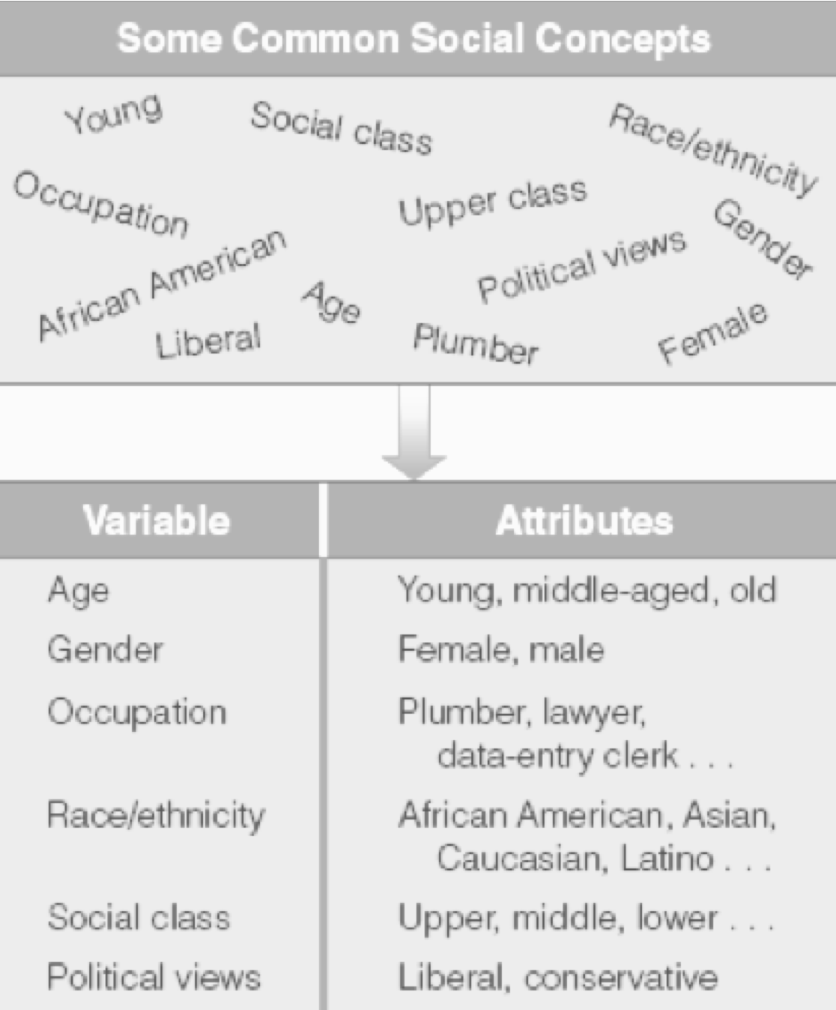
Variables and Attributes

Slide 14
Observations
What are the attributes for the variable SES?

Slide 15
Quantitative Observations

Slide 16
Observations: Types
Quantitative
Numerical data used to represent some social phenomenon

Slide 17
Observations: Levels of Measurement
Nominal
Ordinal
Interval-Ratio

Slide 18
Observations: Nominal (Most Basic)
A set of categories for the purpose of naming, labeling, or classifying, but cannot be ranked
Political party
Religion
Gender
Major
Dichotomous/Binary Variable:
Special type of nominal variable that has only two values
Yes/No, Non-White/White, Student/Teacher
Notes:
Must be:
mutually exclusive (people can only select ONE category)
Exhaustive (everyone is able to select at least ONE category)

Slide 19
Observations: Ordinal (Moderate)
Variables with attributes that name, label, or classify, and can be ranked
Social class/SES
Upper
Middle
Working
Conservativeness
Can assign numbers, but lack an associated numerical value

Slide 20
Observations: Interval-Ratio (Highest, Most Specific)
Variable whose attributes classify, can be ranked, and have an equal numerical distance between values
Age
Income
SAT scores
Ratio variables have a natural zero point

Slide 21
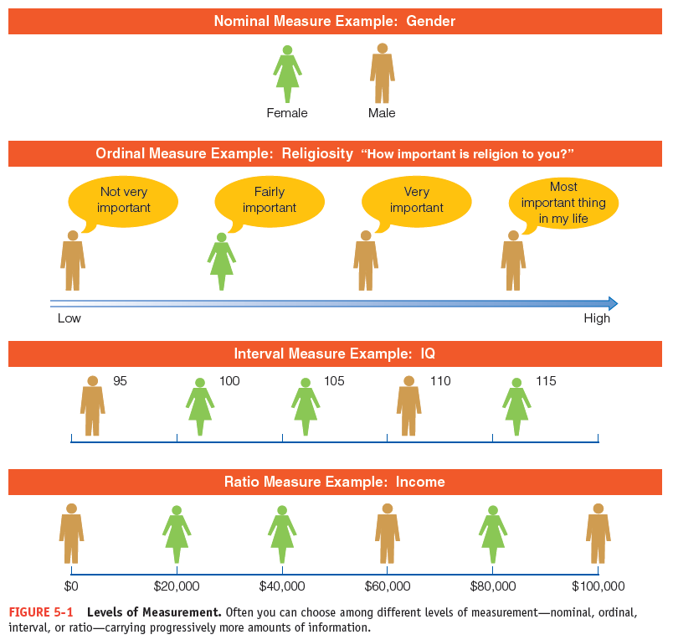
Observations: Levels of Measurement
Notes:
Treating some ordinal variables as interval
Sometimes we treat ordinal variables as interval when their ordered categories are fairly evenly spaced
Discrete vs. Continuous
Discrete
Have properties that have a limited number of values.
Nominal/Ordinal (and Integer Interval level variables)
The number of children per family
Continuous
Can theoretically have unlimited numerical values in a given interval.
Interval level variables
Length

Slide 22
Observations: Levels of Measurement
The variable SES is what level of measurement?

Slide 23
The Functions of Quantitative Analysis (Statistics)

Slide 24
Types of Analysis
Quantitative Analysis
Search for statistical relationships between numerically-measured variables

Slide 25
Population vs. Sample
Notes:
Populations can be large or small…

Slide 26
Population vs. Sample
Population
The total set of observations/units of analysis (cases, individuals, groups, objects, events) that exist for a specific topic
Sample
A subset of the observations/units of analysis in the population
Notes:
Populations can be large or small…

Slide 27
The Functions of Quantitative Analysis (Statistics)
Description (Descriptive Statistics)
Characterize the distribution of data by reducing to a smaller, more manageable amount
Decision making (Inferential Statistics)
Make decisions based on data collected on only a small portion (sample) of the larger group we want to study (population)
Can we generalize our findings from our sample to the population?

Slide 28
Inferential Statistics (Decision-Making)
Statistic
Estimate (for what’s going on in population) based on the sample
Parameter
Actual measurement value for what’s going on in population

Slide 29
Reminder:
Social scientists do empirical research by…
examining relationships between variables, across many observations, and develop explanations for these relationships
Notes:
And these variables are measured at different levels.

Slide 30
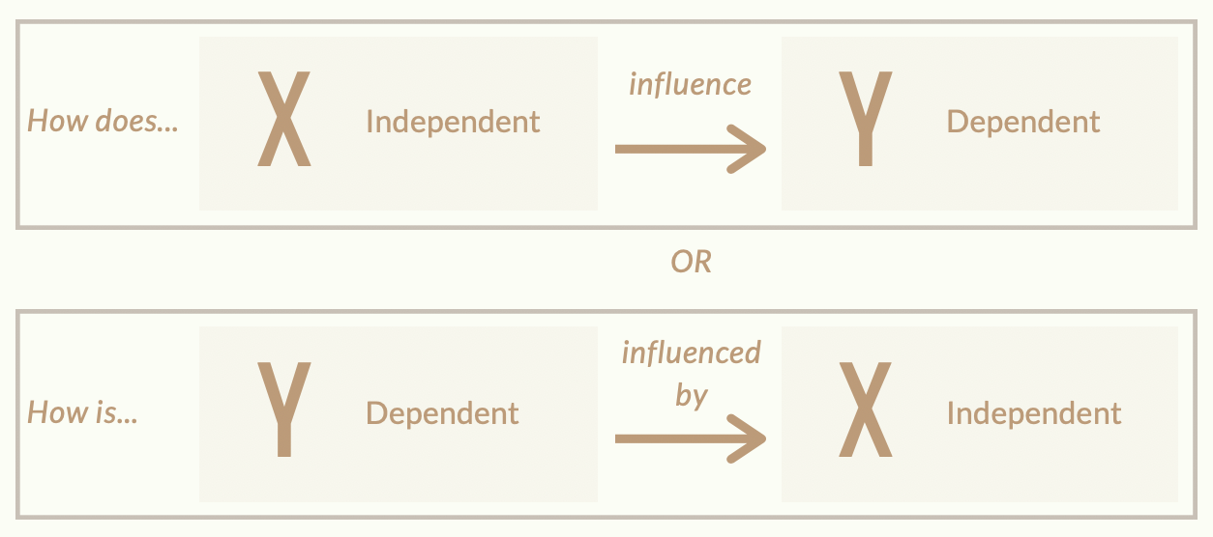
Relationships between Variables
Notes:
And these variables are measured at different levels.

Slide 31
Dependent and Independent Variables
Dependent
The variable to be explained
The “effect”
The “Y” variable
The outcome
Independent
The variable expected to account for/explain the dependent variable
The presumed “cause”
The “X” variable
The predictor

Slide 32
Three Criteria for Cause and Effect: The Purpose of Empirical Research
Association:
Must be an empirical relationship between the cause and effect
Time ordering:
Cause must precede the effect
Non-spuriousness:
This relationship cannot be explained by other factors

