Slide 1
CHAPTER 6 INDEXES, SCALES, AND TYPOLOGIES

Slide 2
Chapter Outline
Introduction
Indexes versus Scales
Index Construction
Scale Construction
Typologies
Chapter Summary
Questions

Slide 3
Indexes versus Scales (slide 1 of 3)
Why do quantitative researchers use composite measures?
No clear, unambiguous single indicators
Use ordinal measure
Efficient for data analysis

Slide 4
Indexes versus Scales (slide 2 of 3)
Commonalities
Both scales and indexes are ordinal measures of variables.
Both scales and indexes are composite measures of variables – measurements based on more than one data item.

Slide 5
Indexes versus Scales (slide 3 of 3)
Differences
Index – A type of composite measure that summarizes and rank-orders several specific observations and represents some more general dimensions.
Scale – A type of composite measure composed of several items that have a logical or empirical structure among them.

Slide 6
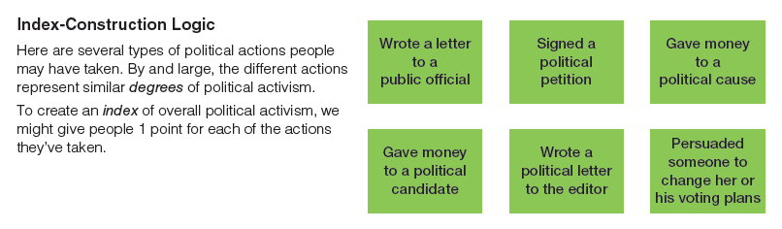
Figure 6-1 (top)
Indexes versus Scales
Both indexes and scales seek to measure variables such as political activism. Whereas indexes count the number of indication of the variable, scales take account of the differing intensities of those indicators.

Slide 7
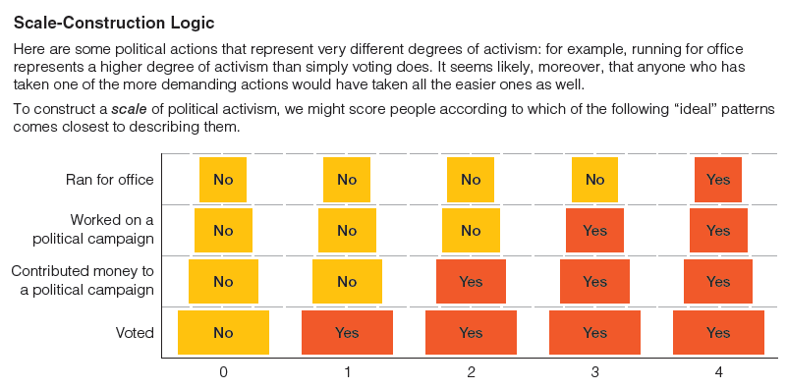
Figure 6-1 (bottom)
Indexes versus Scales
Both indexes and scales seek to measure variables such as political activism. Whereas indexes count the number of indication of the variable, scales take account of the differing intensities of those indicators

Slide 8
Indexes versus Scales
Scales are generally superior to indexes, because scales take into consideration the intensity with which different items reflects that variable being measured.
Misconceptions
Whether the combination of several data items results in a scale almost always depends on the particular sample of observations under study.
The use of specific scaling techniques does not ensure the creation of a scale.

Slide 9
Index Construction (slide 1 of 3)
Item Selection
Examination of Empirical Relationships
Index Scoring
Handling Missing Data
Index Validation

Slide 10
Index Construction (slide 2 of 3)
Item Selection
Face Validity
Unidimensionality
General or Specific
Variance

Slide 11
Index Construction (slide 3 of 3)
Examination of Empirical Relationships
An empirical relationship is established when respondents’ answers to one question help us predict how they will answer other questions.
Bivariate Relationships – A relationship between two variables.
Multivariate Relationships – A relationship between more than two variables.

Slide 12
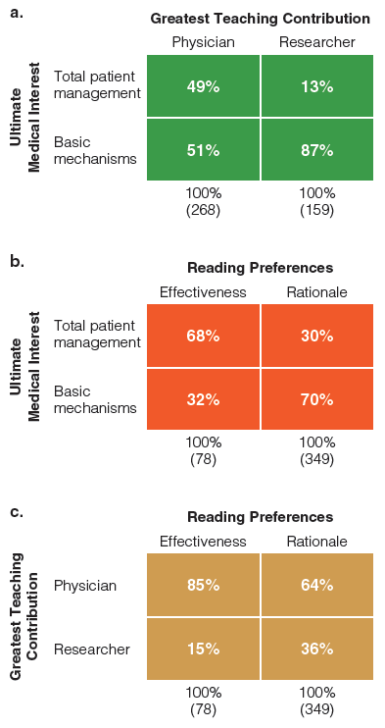
Figure 6-2
Bivariate Relationships among Scientific Orientation Items
If several indicators are measures of the same variable, then they should be empirically correlated with one another, as you can observe in this case. Those who choose the scientific orientation on one item are more likely to choose the scientific orientation on another item.

Slide 13
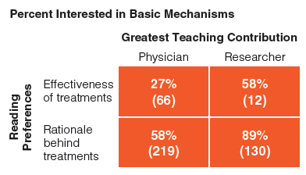
Figure 6-3
Trivariate Relationships among Scientific Orientation Items
Indicators of the same variable should be correlated in a multivariate analysis as well as in bivariate analyses. Those who chose the scientific responses on greatest teaching contribution and reading preferences are the most likely to choose the scientific response on the third item.

Slide 14
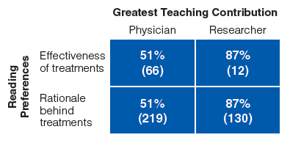
Figure 6-4
Hypothetical Trivariate Relationship among Scientific Orientation Items
This hypothetical relationship would suggest that not all three indicators would contribute effectively to a composite index.

Slide 15
Index Construction (slide 1 of 3)
Index Scoring
Determine the desirable range of the index scores.
Conflicting desire for a range of measurement in the index and an adequate number of cases at each point in the index.
Determine whether to give each item in the index equal or different weights.
Standard: items should be weighted equally unless there are compelling reasons for differential weighting.

Slide 16
Index Construction (slide 2 of 3)
Handling Missing Data
If there are few cases with missing data, you may decide to exclude them from the construction of the index and analyses.
Treat missing data as one of the available responses.
Analyze the missing data to interpret their meaning.
Assign missing data the middle value, or the mean value
Assign values to the proportion of variables scored.

Slide 17
Index Construction (slide 3 of 3)
Index Validation
Item Analysis – An assessment of whether each of the items included in a composite measure makes an independent contribution or merely duplicates the contribution of other items in the measure.
External Validation – The process of testing the validity of a measure, such as an index or score, by examining its relationship to other, presumed indicators of the same variable.

Slide 18
Scale Construction (slide 1 of 2)
Bogardus Social Distance Scale – A measurement technique for determining the willingness of people to participate in social relations – of varying degrees of closeness – with other kinds of people.
Thurstone Scales – A type of composite measure constructed in accord with the weights assigned by “judges” to various indicators of some variables.

Slide 19
Scale Construction (slide 2 of 2)
Likert Scaling – A type of composite measure, designed to improve the levels of measurement in social research through the use of standardized response categories to determine the relative intensity of different items.
Semantic Differential – A questionnaire format in which the respondent is asked to rate something in terms of two, opposite adjectives.

Slide 20
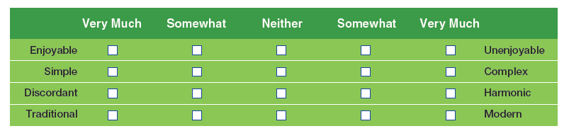
Figure 6-5
Semantic Differential: Feelings about Musical Selections
The sematic differential asks respondents to describe something or someone in terms of opposing adjectives.

Slide 21
Scale Construction
Guttman Scaling – A type of composite measure used to summarize several discrete observations and to represent some more-general variable.

Slide 22
Typologies
Typology – The classification of observations in terms of their attributes on two or more variables.

Slide 23
Chapter Summary
Distinguish between indexes and scales as they are used in social research.
Learn the steps involved in constructing and validating an index.
Name and describe several of the scales commonly used in social research.
Differentiate typologies from scales and indexes, giving examples of typologies.

Slide 24
Questions

Slide 25
Question 1
1. In order to achieve broad coverage of various dimensions of a concept, researchers need to make:
single observations
field research observations
multiple observations

Slide 26
Answer 1
ANSWER: C.
In order to achieve broad coverage of various dimensions of a concept, researchers need to make multiple observations.

Slide 27
Question 2
2. Which of the following are common characteristics shared by both indexes and scales?
both are ordinal measures
both rank-order units in terms of specific variables
both are composite measures
all of the above

Slide 28
Answer 2
ANSWER: D.
The following are common characteristics shared by both indexes and scales: both are ordinal measure, both rank-order units in terms of specific variables, and both are composite measures.

Slide 29
Question 3
3. Which of the following represent steps in the construction of an index?
selecting possible items
examining empirical relationships
scoring the index
all of these choices

Slide 30
Answer 3
ANSWER: D.
The following represent steps in the construction of an index: selecting possible items, examining empirical relationships and scoring the index.

Slide 31
Question 4
4. An empirical relationship is established when respondents’ answers to one question help us:
observe a statistical correlation between the two variables.
determine their current level of tolerance.
explain away the observed correlation.
predict how they will answer other questions.

Slide 32
Answer 4
ANSWER: D.
An empirical relationship is established when respondents’ answers to one question help us predict how they will answer other questions.

Slide 33
Question 5
5. Which of these represents a questionnaire format in which the respondent is asked to rate something in terms of two?
cross-sectional studies
longitudinal studies
likert scales
semantic differential

Slide 34
Answer 5
ANSWER: D.
Semantic differential represents a questionnaire format in which the respondent is asked to rate something in terms of two.

Slide 35
Question 6
6. We construct a/n _____ simply by accumulating scores assigned to individual attributes.
study
measurement
scale
index

Slide 36
Answer 6
ANSWER: D.
We construct an index simply by accumulating scores assigned to individual attributes.

Slide 37
Question 7
7. _____ is the process of testing the validity of a measure by examining its relationship to other indicators of the same variable.
Theoretical analysis
Internal validation
External validation
Conceptualization

Slide 38
Answer 7
ANSWER: C.
External validation is the process of testing the validity of a measure by examining its relationship to other indicators of the same variable.

