Slide 1
CHAPTER 7 the logic of sampling
Notes:
Survey sampling is an important part of the research process. Especially when it comes to things like election polls, we want to get a reasonable prediction about who will win. However, in order to get accurate estimates, we need to go out and ask a bunch of people who they intend to vote for… we cant ask just one person and try to generalize their results to the population. However, we also don’t want to spend the time and energy trying to ask 115 million voters… so what do we do? We take a large, representative sample of the population of voters, and generalize that way.
How many do we need? Most times, it’s less than 2000 people to generalize.

Slide 2
Chapter Outline
Introduction
A Brief History of Sampling
Nonprobability Sampling
The Logic and Techniques of Probability Sampling
Populations and Sampling Frames
Types of Sampling Designs
Multistage Cluster Sampling
Probability Sampling in Review
The Ethics of Sampling
Chapter Summary
Questions

Slide 3
A Brief History of Sampling
Sampling – The process of selecting observations.
“President” Alf Landon (R)
Literary Digest poll, 1936
Two million ballots mailed to people listed in telephone directory and auto owners
Problems?
“President” Thomas E. Dewey
Gallup’s quota sampling
Problems?
Notes:
To generalize findings from a sample to a larger population, you need probability sampling and random selection – which both entail everyone having an equal probability of being selected for the sample, but randomly selecting people from the population to be in the sample. FDR (D/I), Up til that time, literary digest had correctly predicted the 1924, 1928, and 1932 election outcomes. Sampling frame (drawn from telephone subscribers and auto registrations) selected a disproportionately wealthy sample (who tended to vote Republican) while excluding poor people. FDR won in a landslide.
While Literary Digest failed, and subsequently went out of business, George Gallup, a young-independent pollster, correctly predicted that FDR would beat Landon in the 1936 election. He used quota sampling, which selects a sample to match population characteristics, such as the same proportion of women, blacks, poor, young, etc. Gallup’s 1936 poll was better because it had the right proportion of all income levels. His quota sampling worked well for the 1936, 1940, and 1944 elections but failed in 1948, selecting Dewey as the winner. The biggest problem was that Gallup’s quota sampling relied on population statistics taken from the decennial Census, which was from 1940– 8 years removed. In that time, the war efforts drastically changed the American landscape, as more people migrated to cities for work. People living in cities tend to vote more democratic (as a result of environment, or because Dems are more likely to move to cities), but Gallups 1948 poll underestimated the size of cities… and his sample had an overrepresentation of rural populations… biasing his results.

Slide 4
Nonprobability Sampling (slide 1 of 6)
Nonprobability Sampling – Any technique in which samples are selected in some way not suggested by probability theory.
Available subjects
Purposive sampling
Snowball sampling
Quota sampling

Slide 5
Nonprobability Sampling (slide 2 of 6)
Reliance on Available Subjects
Convenience sampling
Does not allow for control over representativeness.
Only justified if less risky methods are unavailable.
Researchers must be very cautious about generalizing when this method is used.
When might this method be appropriate?
Notes:
Availability is extremely risky. Does not allow for control over the representativeness of the sample. Only useful if the researcher wants to generalize only to their sample (which is in effect the population) of people, who passed a street corner, in LA, at 3pm, on a Wednesday, in May. Do not generalize beyond the sample.

Slide 6
Nonprobability Sampling (slide 3 of 6)
Purposive or Judgmental Sampling – A type of nonprobability sampling in which the units to be observed are selected on the basis of the researcher’s judgment about which ones will be the most useful or representative.
Small subsets of a population
Two-group comparison
Deviant cases
When might this method be appropriate?
Notes:
Purposive – selecting SPECIFIC cases for the purpose of the study – you want to study student movement leadership but can’t sample all leaders so you select enough leaders to reach a general conclusion about student movement leadership. This type should also not be generalized and should count as exploratory research.

Slide 7
Nonprobability Sampling (slide 4 of 6)
Snowball Sampling – A nonprobability sampling method whereby each person interviewed may be asked to suggest additional people for interviewing.
Often used in field research, special populations
When might this method be appropriate?
Notes:
Snowball sampling – person interviewed is asked to refer or suggest another potential respondent who shares the attributes important to the study. In a study of homelessness, it’s difficult to reach an entire or even subset of the population. As such, you interview one homeless person and ask him/her to suggest another, then the following suggests another… and so on, like a snowball that accumulates snow, you accumulate respondents.

Slide 8
Nonprobability Sampling (slide 5 of 6)
Quota Sampling – A type of nonprobability sampling in which units are selected into a sample on the basis of pre-specified characteristics, so that the total sample will have the same distribution of characteristics assumed to exist in the population being studied.
Similar to probability sampling, but has problems: quota frame must be accurate, selection of sample elements may be biased
When might this method be appropriate?
Notes:
Quota sampling – starts with characteristics of target population (proportions of various social groups), [and you decide on a sample size, and collect exact proportions of your sample to match the proportions found in the target population… or,] you collect data for an undetermined (but large) number of people, taking down their characteristics and matching them to a particular category of characteristics. Whatever characteristics they match, you weight their responses accordingly (so if blacks men are 2% of the population and you have 2 black men in your sample, you give their responses a weight of 2% for the total sample). Must have accurate population information for the data to make sense.
Say you want to interview various members of a student group but ensure that you have representation by all types of members… quota sampling is best. However, you should not use quota sampling if you want to do statistical analysis, since your sample is not randomly drawn as expected by probability… you’re still biased in the way you approach respondents (you’re looking for specific types of people to fit into categories and then weighting if you get more or less of a particular category). All nonprobability methods should be used for qualitative work, not quantitative.

Slide 9
Nonprobability Sampling (slide 6 of 6)
Selecting Informants
Informant – Someone who is well versed in the social phenomenon that you wish to study and who is willing to tell you what s/he knows about it.
Notes:
While respondents are people who are interviewed/surveyed and asked questions about themselves, informants are people in a group we’re interested in knowing about, and can talk directly about the group/people and provide information about it for us... Without us having to actually talk to people in the group about themselves.

Slide 10
The Logic and Techniques of Probability Sampling
Probability Sampling – The general term for samples selected in accord with probability theory.
Often used for large-scale surveys.
If all members of a population were identical in all respects there would be no need for careful sampling procedures. However, this is rarely the same.
A sample of individuals from a population must contain the same variations that exist in the population.
Notes:
If researchers want statistical descriptions (not qualitative ones) and want a sample that is guaranteed to be representative of the larger population, they turn to probability sampling.
Probability sampling includes a “random selection” mechanism.
The sample must contain the same variations that exist in the popuation

Slide 11
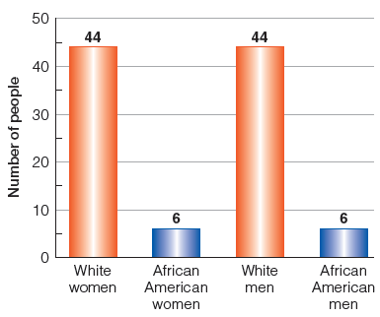
Figure 7-2
A Population of 100 Folks
Typically, sampling aims at reflecting the characteristics and dynamics of large populations. For the purpose of some simple illustrations, let’s assume our total population has only 100 members.

Slide 12
The Logic and Techniques of Probability Sampling
Conscious and Unconscious Sampling Bias
Bias – Those selected are not typical nor representative of the larger population.
Notes:
For example, if you want to do a study using a sample of 100 students, if you just wait at one corner of campus and talk to the first 100 who pass you, you’re introducing bias into the sample. It’s inevitable when you have no probabilistic method to sampling.

Slide 13
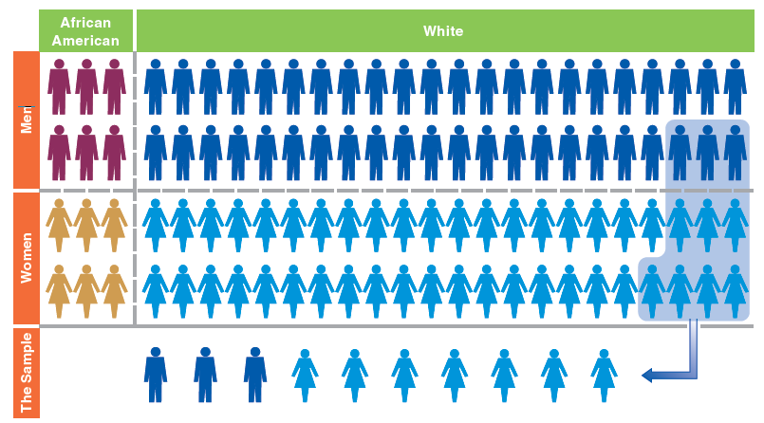
Figure 7-3
A Sample of Convenience: Easy, but Not Representative
Selecting and observing those people who are most readily at hand is the simplest method, perhaps, but it’s unlikely to provide a sample that accurately reflects the total population.

Slide 14
The Logic and Techniques of Probability Sampling (slide 1 of 6)
Representativeness and Probability of Selection
Representativeness – The quality of a sample of having the same distribution of characteristics as the population from which it was selected.
Samples need not be representative in all respects, only those relevant to the research.
Notes:
If population has 23% of white, married, pregnant women… then your sample should have “close to” 23% of white, married, pregnant, women.
But if race, marital status, fertility, or gender are not important for your study, you may not need to worry about getting a close enough sample to match the population proportions of this very specific group.

Slide 15
The Logic and Techniques of Probability Sampling (slide 2 of 6)
A sample will be representative of the population from which it is selected if all members of the population have an equal chance of being selected in the sample.
EPSEM (Equal Probability of Selection Method)

Slide 16
The Logic and Techniques of Probability Sampling (slide 3 of 6)
Advantages of Probability Sampling
Probability samples are typically more representative than other types of samples because biases are avoided.
Probability theory permits researchers to estimate the accuracy or representativeness of the sample.

Slide 17
The Logic and Techniques of Probability Sampling (slide 4 of 6)
Element – That unit of which a population is composed and which is selected in a sample.
Population – The theoretically specified aggregation of the elements in a study.
Notes:
Element is like he unit of analysis… but you can call it the unit of data collection (lol)… if you’re studying latino, and the unit of analysis is individual, the element is one latino.
Obviously the population is the aggregate… so black males in general.

Slide 18
The Logic and Techniques of Probability Sampling (slide 5 of 6)
Random Selection – Each element has an equal change of selection independent of any other event in the selection process.
Notes:
So if studying latino males in LA, every latino male in LA should have an equal chance of being selected for the study.

Slide 19
The Logic and Techniques of Probability Sampling (slide 6 of 6)
Probability Theory, Sampling Distributions, and Estimates of Sampling Error
Parameters and Statistics
Parameter – A summary description of a given variable in a population.
Notes:
Mean income of the US is a parameter… for the US population…
When researchers generalize from a sample, they are using sample observations (statistics) to estimate population parameters.
Probability theory allows them to reasonably estimate these parameters – so they can use 2000 observations of voters to estimate how the population of voters will vote, as well as specify margins of error in their estimates.
Probability theory gets margins of errors through sampling distributions. One sample from a population will give an estimate of the population parameter, and other samples can give the same or slightly different estimates… Probability theory tells us about the distribution/spread/differences between these estimates

Slide 20

Figure 7-4
A Population of 10 People with $0-$9
Let’s imagine a population of only 10 people with differing amounts of money in their pockets—ranging from $0-$9.
Notes:
Ten people population each with 0-9 dollars … so population parameter is mean income of 4.50. But in research, we don’t want to collect data from the entire population, we want just a sample. Lets start with 10 samples of 1 person each.

Slide 21
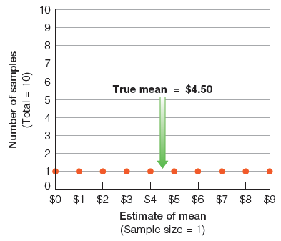
Figure 7-5
The Sampling Distribution of Samples of 1
In this simple example, the mean amount of money these people have is $4.50 ($45/10). If we picked 10 different samples of 1 person each, our “estimates” of the mean would range all across the board.
Notes:
The dots represent each sample, the ten samples of 1 person each, with the sample’s mean income. The plot is a sampling distribution of all samples

Slide 22
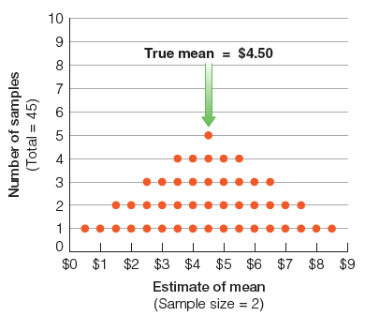
Figure 7-6
The Sampling Distribution of Samples of 2
After merely increasing our sample size to 2, the possible samples provide somewhat better estimates of the mean. We couldn’t get either $0 or $9, and the estimates are beginning to cluster around the true value of the mean: $4.50.
Notes:
Now if we take samples of 2 people each (from the population each having 0-9$) this is the sampling distribution. Mean is still 4.50, but there are 45 possible samples… (0,1; 0,2; 0,3; 0,4; … 9,6; 9,7; 9,8).
As we see, increasing the sample size improves the distribution of estimates of the mean. The larger the sample, the more accurate it is as an estimate of the population.

Slide 23
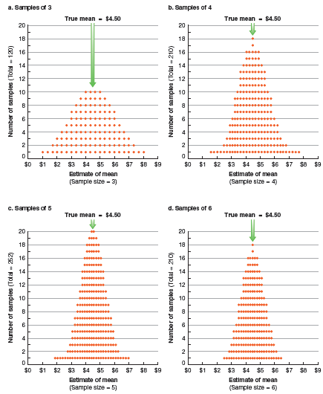
Figure 7-7
The Sampling Distributions of Samples of 3, 4, 5, and 6
As we increase the sample size, the possible samples cluster ever more tightly around the true value of the mean. The chance of extremely inaccurate estimates is reduced at the two ends of the distribution, and the percentage of the samples near the true value keeps increasing.

Slide 24
The Logic and Techniques of Probability Sampling
Statistic – the summary description of a variable in a sample, used to estimate a population parameter.
Sampling Error – The degree of error to be expected of a given sample design.
Notes:
S = sqrt((P*Q)/n). If 60% approve, and you’re looking about percent approval.. P = .6 and Q = .4.

Slide 25

Figure 7-8
Range of Possible Sample Study Results
Shifting to a more realistic example, let’s assume that we want to sample student attitudes concerning a proposed conduct code. Let’s assume that 50 percent disapproves—though the researcher doesn’t know that.

Slide 26
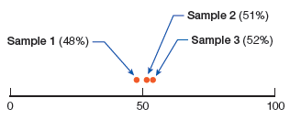
Figure 7-9
Results Produced by Three Hypothetical Studies
Assuming a large student body, let’s suppose that we selected three different samples, each of substantial size. We would not necessarily expect those samples to perfectly reflect attitudes in the whole student body, but they should come reasonably close.

Slide 27
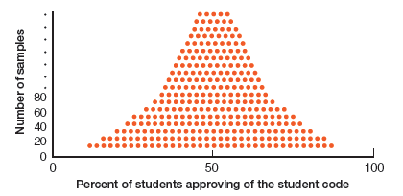
Figure 7-10
The Sampling Distribution
If we were to select a large number of good samples, we would expect them to cluster around the true value (50 percent), but given enough such samples, a few would fall far from the mark.
Notes:
As we collect more samples of 100 students, our estimate gets closer and closer to the true population value of 50%. This is because if we draw more and more samples, probability theory suggests that the samples will be normally distributed around the true population value. This curve structure is called the normal curve.
More important for statistical work, approximately 34% of all sample estimates fall one standard error increment above or below the population parameter (a total of 68%). 95% fall within two, and 99% fall within 3.
And because the standard error formula is a sqrt, a sample size of 4x (400 instead of 100) is required to diminish the standard error by half (from 5 to 2.5).

Slide 28
The Logic and Techniques of Probability Sampling
Confidence Levels and Confidence Intervals
Confidence Level – The estimated probability that a population parameter lies within a given confidence interval.
Confidence Interval – The range of values within which a population parameter is estimated to lie.
Notes:
Confidence levels have to do with the number of standard errors you’re including in your result.
Confidence interval has to do with the low end and high end of your confidence levels…
Say your S.E. is 5% points, and the estimated parameter is 50%. You can say with 68% confidence that the true population parameter lies between 45% and 55% approving. Or 95% confident that it lies between 40% and 60% approval, or 99% confident that it lies between 35% and 65% approval. But if we want better estimates (less error, less range), we must increase the sample size.

Slide 29
Populations and Sampling Frames (slide 1 of 2)
Sampling Frame – A list of units composing a population from which a sample is selected.
If the sample is to be representative of the population, it is essential that the sampling frame include all members of the population.
Notes:
So if the population is current students at university X, the sampling frame is a list of all students who currently go to university X.

Slide 30
Populations and Sampling Frames (slide 2 of 2)
Guidelines for Populations and Sampling Frames
Findings based on a sample represent only the aggregation of elements that compose the sampling frame.
Sampling frames do not include all the elements their names might imply. Omissions are inevitable.
To be generalized, all elements must have equal representation in the frame.

Slide 31
Types of Sampling Designs (slide 1 of 2)
Simple Random Sampling
Systematic Sampling
Stratified Sampling
Implicit Stratification in Systematic Sampling

Slide 32
Types of Sampling Designs (slide 2 of 2)
Simple Random Sampling – A type of probability sampling in which the units composing a population are assigned numbers. A set of random numbers is generated and the units having those numbers are included in the sample.
Not necessarily the most accurate sampling method.
Notes:
Because you will need to structure the sample based on population characteristics.

Slide 33
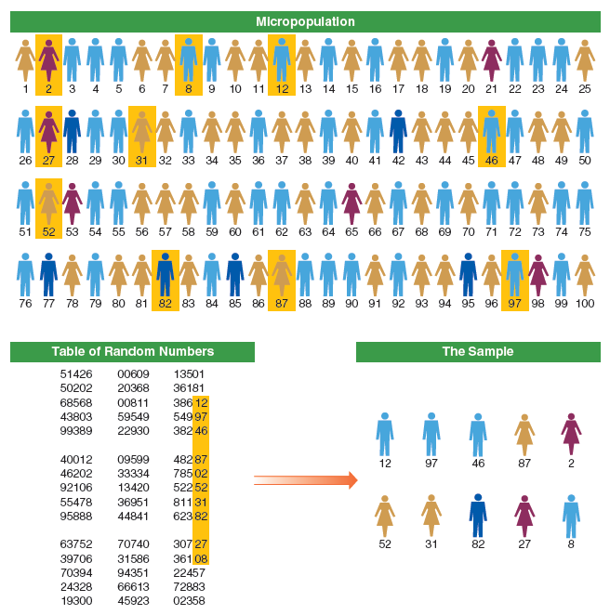
Figure 7-11
A Simple Random Sample
Having numbered everyone in the population, we can use a table of random numbers to select a representative sample from the overall population. Anyone whose number is chosen from the table is in the sample.

Slide 34
Types of Sampling Designs (slide 1 of 3)
Systematic Sampling – A type of probability sampling in which every k^{th} unit in a list is selected for inclusion in the sample.
Slightly more accurate than simple random sampling.
Notes:
You should select the first element at random to eliminate bias… and to be truly systematic and random, the list may need to be randomly rearranged.

Slide 35
Types of Sampling Designs (slide 2 of 3)
Sampling Interval – The standard distance between elements selected from a population in the sample.
Sampling Ratio – the proportion of elements in the population that are selected to be in a sample.
Notes:
No need to remember this… but if you are collecting your own data, and you are doing a systematic sample, you should list how you selected people… the sampling interval, (“from the sampling frame, I randomly rearranged the list, then selected the 15th observation in the list, then selected every 7th observation thereafter).
And you should list the final number of elements in your analytical sample compared to the sampling frame (or pop size) == sampling ratio…

Slide 36
Types of Sampling Designs (slide 3 of 3)
Stratified Sampling
Stratification – The grouping of the units composing a population into homogenous groups (strata) before sampling.
Slightly more accurate than simple random sampling.
Stratification is a modification to simple random and systematic sample methods.
Notes:
To get a stratified random sample of college students, you would first get the entire list, but then organize the list by subgroups… freshmen listed first, then soph… all the way up to seniors. By doing so, sampling error based on class size is reduced to zero.

Slide 37
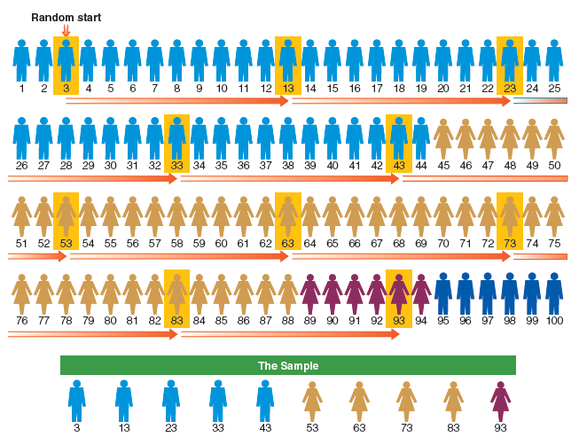
Figure 7-12
A Stratified, Systematic Sample with a Random Start
A stratified, systematic sample involves two stages. First the members of the population are gathered into homogeneous strata; this simple example merely uses gender and race as stratification variables, but more could be used. Then every kth (in this case, every tenth) person in the stratified arrangement is selected into the sample.
Notes:
More than any other sample, the stratified systematic sample is going to be more representative of the general population.

Slide 38
Types of Sampling Designs
Implicit Stratification in Systematic Sampling
Illustration: Sampling University Students
Sampling Modification
Notes:
U of Hawaii wanted to study students… and were stratified by class (fr, so, jr, sr), and thereafter stratified by ID numbers (which were social security numbers, which begin differently for each state)… therefore the researchers implicitly also stratified by geographic region.
As such, ordered lists can be more useful than unordered ones.
Read the example on sampling university students on page 230 in the old book.
Also, note that after you begin your project it’s okay to modify your sampling plan based on the feasibility of the design (see pg 230-231 on probably the only reason to modify your design).

Slide 39
Multistage Cluster Sampling
Cluster Sampling – A multistage sampling in which natural groups are sampled initially with the members of each selected group being sub-sampled afterward.
Used when it is not practical or possible to create a list of all elements that compose the target population.
Highly efficient, but less accurate.
Notes:
In cluster sampling, it is impossible or impractical to compile an exhaustive list of the elements in a target population (such as the homeless or church members). In a cluster sample, the churches or the homeless shelters would be sampled in a random or stratified, systematic way. Then each of the sampled shelters or churches would be asked for lists of its members/patrons, and they would be sampled for study.
Its efficient but less accurate because it’s subject to more than one level of error. Simple random sampling is subject to a single standard error, but a two-stage cluster sample is subject to two errors.
If you’re gonna select clusters, you should select a large number of clusters, and clusters that are very much homogenous (alike).

Slide 40
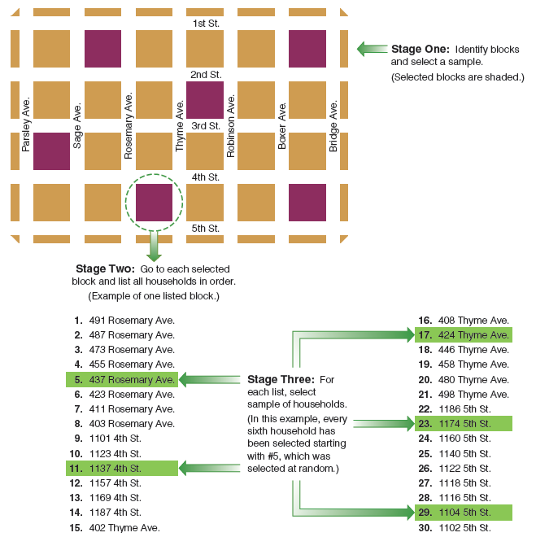
Figure 7-13
Multistage Cluster Sampling
In multistage cluster sampling, we begin by selecting a sample of the clusters (in this case, city blocks). Then, we make a list of the elements (households, in this case) and select a sample of elements from each of the selected clusters.
Notes:
See page 231 in old book for example of multistage cluster sampling… where you list all the blocks in a city, then sample the blocks, then list all the households on the sampled blocks, then sample the households, then list all the people living in the sampled households, then sample the people.

Slide 41
Multistage Cluster Sampling (slide 2 of 2)
Disproportionate Sampling and Weighting
Weighting – Assigning different weights to cases that were selected into a sample with different probabilities of selection.
Notes:
You may sample subpopulations disproportionately to ensure sufficient numbers (like only 10% of a county are city dwellers but you really want to study city-dwellers). As long as you analyze them separately, or down-weight the larger number of city-dwellers in your sample to match the actual proportions of the county, then you’re fine.

Slide 42
Probability Sampling in Review
Remains the most effective method for selection of study elements because:
Allows researchers to avoid biases in element selection
Permits estimates of error

Slide 43
The Ethics of Sampling
When nonprobability-sampling methods are used, researchers must take care not to mislead readers into confusing variations with what’s typical in the population.

Slide 44
Chapter Summary (slide 1 of 2)
Be able to highlight some of the key events in the development of sampling in social research.
Describe what is meant by “nonprobability sampling” and identify several techniques.
Identify and explain the key elements in probability sampling.
Explain the relationship between populations and sampling frames in social research.

Slide 45
Chapter Summary (slide 2 of 2)
Identify and describe several types of probability sampling designs.
Describe the steps involved in selecting a multistage cluster sample.
Discuss the key advantages of probability sampling.
Explain how the sampling design of a study could have ethical implications.

Slide 46
Questions

Slide 47
Question 1
1. One of the most visible uses of survey sampling lies in _____.
political polling
probability sampling
core sampling
nonprobability sampling
Notes:
ANSWER: A.
One of the most visible uses of survey sampling lies in political polling.

Slide 48
Question 2
2. _____ sampling occurs when units are selected on the basis of pre-specified characteristics.
Snowball
Quota
Purposive
Probability
Notes:
ANSWER : B.
Quota sampling occurs when the units are selected on
the basis of pre-specified characteristics.

Slide 49
Question 3
3. _____ describes a sample whose aggregate characteristics closely approximate the aggregate characteristics of the population.
Exclusion
Probability sampling
EPSEM
Representativeness
Notes:
ANSWER : D.
Representativeness describes a sample whose
aggregate characteristics closely approximate the
aggregate characteristics of the population.

Slide 50
Question 4
4. A _____ is the list of elements from which a probability sample is selected.
confidence level
confidence interval
sampling frame
systematic sample
Notes:
ANSWER : C.
A sampling frame is the list of elements from which a probability sample is selected.

Slide 51
Question 5
5. _____ is the general term for samples selected in accord with probability theory.
Nonprobability analysis
Correlation
Probability sampling
Notes:
ANSWER : C.
Probability sampling is the general term for samples selected in accord with probability theory.

Slide 52
Question 6
6. A _____ population is that aggregation of elements from which a sample if actually selected.
theoretical
small
large
concept
study
Notes:
ANSWER : E.
A study population is that aggregation of elements from which a sample if actually selected.

Slide 53
Question 7
7. Cluster sampling may be used when it is impossible to compile an exhaustive list of the elements composing the target population.
True
False
Notes:
ANSWER : A.
Cluster sampling may be used when it is impossible to compile an exhaustive list of the elements composing the target population.

