Slide 1
CHAPTER 8 experiments

Slide 2
Chapter Outline (slide 1 of 2)
Introduction
Topics Appropriate for Experiments
The Classical Experiment
Selecting Subjects
Variations on Experimental Design
Examples of Experimentation
Web-Based Experiments

Slide 3
Chapter Outline (slide 2 of 2)
“Natural” Experiments
Strengths and Weaknesses of the Experimental Method
Ethics and Experiments
Chapter Summary
Questions

Slide 4
Topics Appropriate for Experiments
Experiments involve:
Taking action
Observing consequences of that action
Well-suited for projects involving limited and well-defined concepts and propositions.
Hypothesis testing
Better suited for explanatory than descriptive
Small group interaction

Slide 5
The Classical Experiment (slide 1 of 3)
Major Components
Independent and Dependent Variables
Pre-testing and Post-testing
Experimental and Control Groups
Independent and Dependent Variables
Independent – Takes the form of a stimulus (present or absent), cause
Dependent – Effect, outcome

Slide 6
The Classical Experiment (slide 2 of 3)
Pre-testing – The measurement of a dependent variable along subjects.
Post-testing – The measurement of a dependent variable among subjects after they have been exposed to an independent variable.

Slide 7
The Classical Experiment (slide 3 of 3)
Experimental Group – A group of subjects to whom an experimental stimulus is administered.
Control Group – A group of subjects to whom no experimental stimulus is administered and who should resemble the experimental group in all other respects.

Slide 8
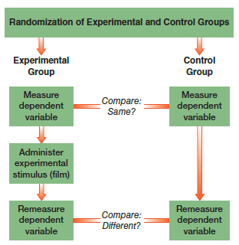
Figure 8-1
Diagram of Basic Experimental Design
The fundamental purpose of an experiment is to isolate the possible effect of an independent variable ) called the stimulus in experiments) on a dependent variable. Members of the experimental group(s) are exposed to the stimulus and those in the control group(s) are not.

Slide 9
The Classical Experiment
Hawthorne Effect
The Double-Blind Experiment – An experimental design in which neither the subjects nor the experimenters know which is the experimental and which is the control group.

Slide 10
Selecting Subjects
Role of college students
Generalizability?
Probability Sampling
Randomization – A technique for assigning experimental subjects to experimental and control groups.
Matching – The procedure whereby pairs of subjects are matched on the basis of their similarities on one or more variables, and one member of the pair is assigned to the experimental group and the other to the control group.

Slide 11
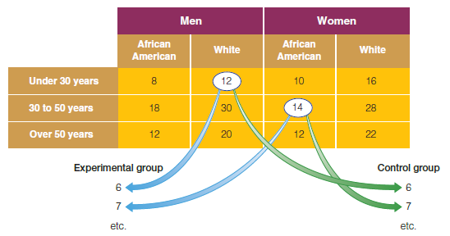
Figure 8-2
Quota Matrix Illustration
Sometimes the experimental and control groups are created by finding pairs of matching subjects and assigning one to the experimental group and the other to the control group.

Slide 12
Variations on Experimental Design
Pre-experimental Research Designs
One-shot case study – A single group of subjects is measured on a dependent variable following an experimental stimulus.
One-group pre-test post-test design – A pre-test is added for the experimental group but lacks a control group.
Static-group comparison – Includes experimental and control groups, but no pre-test.

Slide 13
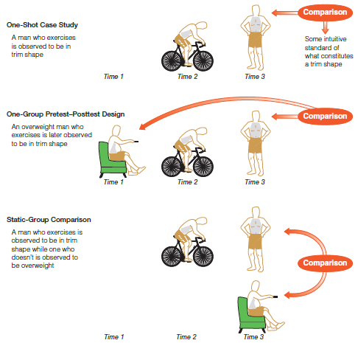
Figure 8-3
Three Preexperimental Research Designs
These preexperimental designs anticipate the logic of true experiments but remain open to errors of interpretation. Can you see the errors that might be made in each of these designs? The various risks are solved by the addition of control groups, pretesting, and posttesting.

Slide 14
Variations on Experimental Design
Validity Issues in Experimental Research
Internal Validity – The possibility that the conclusions drawn from experimental results may not accurately reflect what went on in the experiment itself.
Sources: history, maturation, testing, instrumentation, statistical regression, selection bias, experimental mortality, causal time order, diffusion or imitation of treatments, compensation, compensatory rivalry, demoralization
External Validity – The possibility that conclusions drawn from experimental results may not be generalizable to the “real” world

Slide 15
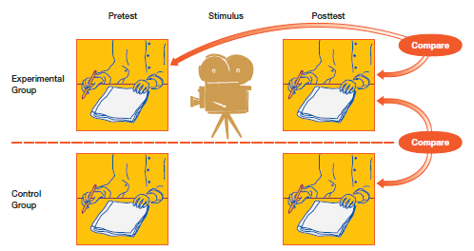
Figure 8-4
The Classical Experiment: Using a Muslim History Film to Reduce Prejudice
This diagram illustrates the basic structure of the classical experiment as a vehicle for testing the impact of a film on prejudice. Notice how the control group, the pretesting, and the posttesting function.

Slide 16
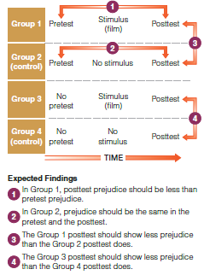
Figure 8-5
The Solomon Four-Group Design
The classical experiment runs the risk that pretesting will have an effect on subjects, so the Solomon four-group design adds experimental and control groups that skip the pretest. Thus, it combines the classical experiment and the after-only design or “static-group comparison.”

Slide 17
Examples of Experimentation
Field Experiments

Slide 18
Web-Based Experiments
Representative samples are not essential…therefore, volunteers may be used.

Slide 19
“Natural” Experiments
Experiments that occur outside controlled settings.

Slide 20
Strengths and Weaknesses of the Experimental Method
Strengths of Experimental Method
Isolation of experimental variable’s impact over time.
Replication
Weaknesses of Experimental Method
Artificiality of laboratory settings

Slide 21
Ethics and Experiments
Experiments typically involve deceiving subjects.
Because they are intrusive, experiments open the possibility of inadvertently causing damage to subjects.

Slide 22
Chapter Summary (slide 1 of 2)
Give examples of topics well suited to experimental studies and topics that would not be appropriate.
Diagram and explain the key elements in the classical experiment.
Discuss three methods for selecting and assigning subjects in an experiment.
Understand several types of experimental designs.
Provide examples illustrating the use of the experimental model in social research.

Slide 23
Chapter Summary (slide 2 of 2)
Discuss the advantages and disadvantages of web-based experiments.
Describe what is meant by “natural” experiments, giving examples to illustrate.
Identify and discuss both the strengths and weaknesses of experiments in social research.
Explain some of the ethical issues involved in the use of the experimental model.

Slide 24
Questions

Slide 25
Question 1
1. In the simplest experimental design, subjects are measured in terms of a/n _____ variable exposed to a/n _____ variable.
pre-test; post-test
post-test, pre-test
independent; dependent
dependent; independent

Slide 26
Answer 1
ANSWER: D.
In the simplest experimental design, subjects are measured in terms of a dependent variable exposed to an independent variable.

Slide 27
Question 2
2. _____ groups are groups of subjects to whom an experimental stimulus is administered.
Control
Experimental
Purposive
Pre-test

Slide 28
Answer 2
ANSWER: B.
Experimental groups are groups of subjects to whom
an experimental stimulus is administered.

Slide 29
Question 3
3. _____ is a technique for assigning experimental subjects to experimental and control groups randomly.
Nonprobability analyses
Matching
Randomization
Controlling

Slide 30
Answer 3
ANSWER: C.
Randomization is a technique for assigning experimental subjects to experimental and control groups randomly.

Slide 31
Question 4
4. Experiments are especially well-suited for research projects involving:
limited concepts
well-defined concepts
hypothesis testing
all of the above choices

Slide 32
Answer 4
ANSWER: D.
Experiments are especially well-suited for research projects involving limited concepts, well-defined concepts, and hypothesis testing.

Slide 33
Question 5
5. _____ refers to the possibility that the conclusion drawn from experimental results may not accurately reflect what has gone on in the experiment itself.
Exclusion
Internal validity
External validity
Representativeness

Slide 34
Answer 5
ANSWER: B.
Internal validity refers to the possibility that the conclusion drawn from experimental results may not accurately reflect what has gone on in the experiment itself.

Slide 35
Question 6
6. Which of the following is the chief advantage of a controlled experiment?
They require little time.
They require little money.
They are artificial.
The experimental variable is isolated.

Slide 36
Answer 6
ANSWER: D.
The isolation of the experimental variable is the chief advantage of a controlled experiment.

