Slide 1
CHAPTER 11 UNOBTRUSIVE RESEARCH

Slide 2
Chapter Outline
Introduction
Content Analysis
Analyzing Existing Statistics
Comparative and Historical Research
Ethics and Unobtrusive Measures
Chapter Summary
Questions

Slide 3
Content Analysis (slide 1 of 3)
Unobtrusive Research – Methods of studying social behavior without affecting it.
Types of Unobtrusive Research
Content Analysis
Analysis of Existing Statistics
Comparative and Historical Analysis
Notes:
Content analysis: analyzing the content of social artifacts (written documents/newspaper editorials)
Existing statistics: Demographic data published by governments (Durkheim’s study of suicide rates)
Comparative historical:
Example, wanting to know which paintings at a museum are most popular: instead of surveying people to find out which ones they liked better, or watching people go into each exhibit and counting them (all of which could have some effect on the people and their responses), the researchers observed the wear-and-tear on the ground in front of each exhibit (the one with the most wear was the most popular)… and finding which ones kids like more… look for mucus on glass in front of exhibit…
-its like you’re a crime detective… looking for clues of relationships without having been there

Slide 4
Content Analysis (slide 2 of 3)
Content Analysis – The study of recorded human communications (e.g., books, newspapers, websites, paintings, laws).
Appropriate Topics
“Who says what, to whom, why, how, and with what effect?”
Notes:
What is the role of movements in the legalization of marijuana? Take newspaper articles about legalization, and code for the presence of the movement, and what it says about marijuana legalization… and the proportion that is dominated by the movement, compared to other factors…
Or, like Ida B. Wells, who wanted to understand whether black men were primarily being lynched for assaulting white women… she looked at newspaper articles on over 700 lynchings reported during the previous 10 years… and found that black lynched were only accused of white women assault in 1/3 of cases (not proven guilty)…

Slide 5
Content Analysis (slide 3 of 3)
Example: violence on TV
Develop operational definitions
Decide what to observe
Decide how to code/analyze data
Notes:
How will you measure your key variables?
What stations? What days and for how long? What hours?
Gabriel Rossman noticed that there might be bias in movie ratings in newspapers if newspaper and movie production company are both owned by the same conglomerate. Findings were supported… ratings were significantly higher for a movie in a paper owned by the same parent company than ratings 1) ratings of movies not of the same parent company and 2) for the same movie in a different paper (not-owned by the same parent company).

Slide 6

Figure 11-1
A Few Possible Units of Analysis for Content Analysis

Slide 7
Content Analysis
Identify the unit of analysis:
You are interested in how children’s literature portrays gender roles.
You are interested in popular film’s use of drugs and alcohol.
You are interested in sociology textbooks’ definition of race.
You are interested in the content of Internet blogs.
Notes:
Units (the book, the movie, the textbook, the blog)
Pg 352 example…

Slide 8
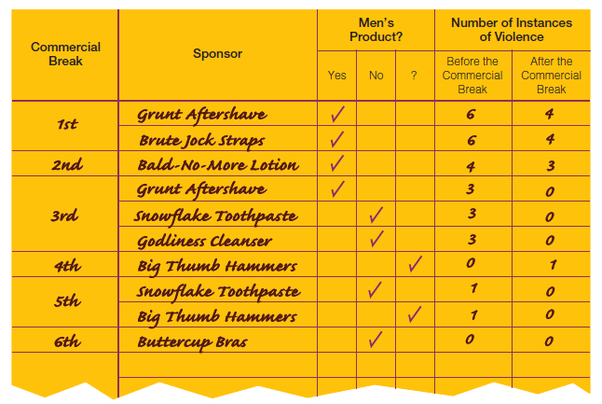
Figure 11-2
Example of Recording Sheet for TV Violence

Slide 9
Content Analysis (slide 1 of 3)
Sampling Techniques
Any conventional sampling technique may be used for content analysis.
Notes:
Simple random sample of childrens books, if you have the sampling frame. Stratified random or systematic sampling if you have strata that are important.

Slide 10
Content Analysis (slide 2 of 3)
Coding in Content Analysis
Coding – The process whereby raw data are transformed into standardized form suitable for machine processing and analysis.
Notes:
e.g. Newspaper can be coded as liberal or conservative, books as romantic or not, etc

Slide 11
Content Analysis (slide 3 of 3)
Manifest Content – The concrete terms contained in a communication.
Latent Content – The underlying meaning of communication.

Slide 12

Figure 11-3
Manifest Coding of Materials (Objective)
Manifest coding involves the counting of specific elements, such as the word love, to determine whether and to what degree the passage should be judged “romantic.”
Notes:
Trying to measure how romantic a novel is, you count the number of times the word love, kiss, hug, etc show up in the text. Manifest is just measuring actual things that are written, in a standardized form (all words in this list count as romantic).
Very reliable, because we know precisely how romance is measured. However, just counting these words might not get at the true character of romance… so while reliable, they might not be valid measures of romance.

Slide 13

Figure 11-3 (cont’d)
Latent Coding of Materials (Subjective)
Latent coding calls for the researcher to view the entire unit of analysis (a paragraph in this case) and make a subjective assessment regarding whether and to what degree it is “romantic.”
Notes:
Coding for it’s underlying meaning. Might read a sample of a paragraph/few lines, and make a subjective interpretation of whether or not the section is “truly” romantic. While your interpretation may be based on “the number of times the word love shows up”, it’s not the be-all, end-all measure.
Although you may be getting at the true nature of romance in novels, you lose some points for reliability (since other researchers might interpret the same passage differently).
If possible, use both methods.

Slide 14
Content Analysis
Conceptualization and the Creation of Code Categories
Attributes
Levels of Measurement
Counting and Record Keeping
The end product of coding must be numerical.
Numerical coding needs a denominator.
Notes:
The operational definition also relates to the attributes of a measure… and these attributes need to be both mutually exclusive (can’t mark more than one) and exhaustive…. (or if like race, if an article has more than one category of a variable, you can use a checklist).
Denominator, to see how important it is… yeah 87 mentions of the word love, is important, but it might be less important in a 50,000 word document compared to a 300 word document.

Slide 15
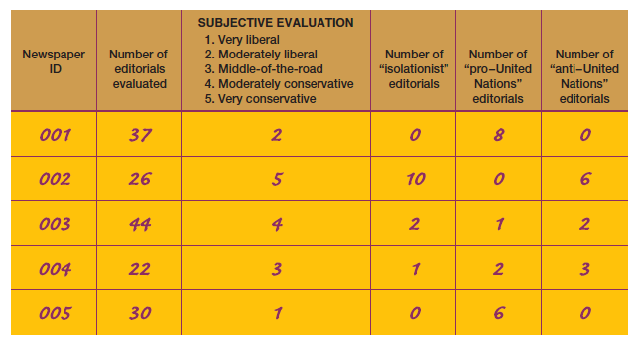
Figure 11-4
Sample Tally Sheet (Partial)

Slide 16
Content Analysis (slide 1 of 2)
Illustrations of Content Analysis
Notes:
Pg 360-361.

Slide 17
Content Analysis (slide 2 of 2)
Strengths of Content Analysis
Economy of time and money
Allowing for the correction of errors
Permits the study of processes occurring over time
Research has little (if any) effect on subjects
Reliability
Weaknesses of Content Analysis
Limited to recorded communications
Validity

Slide 18
Analyzing Existing Statistics (slide 1 of 4)
Existing statistics may be the main source of data or a supplemental source of data.
Example: Durkheim’s Study of Suicide
Notes:
Can be the same as secondary data analysis.
Durkheim wanted to study what social/environmental conditions encouraged/discouraged suicide.
Noticed that suicide rates were stable, same year to year. Found some potential patterns (temperature/summer) but found disconfirming evidence too (central latitudes), as well as patterns with age (35) and gender (men, 4:1).
Found increases during times of political turmoil in countries… so maybe it was about social stability/integration/equilibrium since suicide was occurring breaches in social equilibrium (turmoil).
Found that predominantly protestant countries had higher rates than catholic countries, but if religion had a genuine effect, we should also see it WITHIN countries… and that’s what he found (states with highest catholic pops had lowest suicides, and vice versa).
Combined these findings with the political arguments to argue that anomie (normlessness) was the cause, since catholic has strict regimented rules, structure (just like times of political stability does) so the lack of structure and stability is what pushed high suicide rates.

Slide 19
Analyzing Existing Statistics (slide 2 of 4)
Units of Analysis
By nature, existing statistics describe groups.
Ecological Fallacy
Notes:
Existing statistics rarely come at the individual level, so we have to make claims at higher levels. But he could make a pretty strong claim about individuals, without saying individuals or really studying them… by finding the pattern in countries, regions, and states…

Slide 20
Analyzing Existing Statistics (slide 3 of 4)
Problems of Validity
Logical Reasoning
Replication
Problems of Reliability
Quality of Existing Statistics
Notes:
Logical Reasoning: Although he couldn’t measure individuals, doing these levels of analysis.. He could reason that at the lowest level (states), that most of the suicides in a predominantly protestant region would be protestant.
Replication: doing it again could show how valid it is…
Crime rates, unreliable… all departments do things differently… more a measure of political pressure to do right or arrest more than of actual drug usage… arrests could also be function of individual’s attire, demeanor… and there are a bunch of crimes that are notoriously underreported.

Slide 21
Analyzing Existing Statistics (slide 4 of 4)
Sources of Existing Statistics
Statistical Abstract of the United States
Government Data
Demographic Yearbook

Slide 22
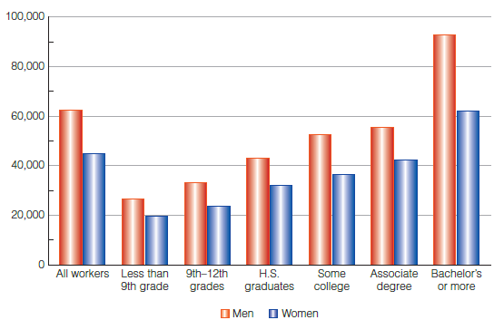
Figure 11-5
Graphic Display of Gender, Education, and Income

Slide 23
Ethics and Unobtrusive Measures
Even unobtrusive measures can raise the possibility of violating subjects’ privacy.
The general principles of honest observation, analysis, and reporting apply to all research techniques.

Slide 24
Chapter Summary
Understand the use of content analysis for both qualitative and quantitative social research.
Give examples of researchers analyzing existing statistics, to illustrate the strengths and weaknesses of this method.
Describe comparative and historical methods and give examples to illustrate.
Understand the ethical issues involved in the various methods of unobtrusive research.

Slide 25
Questions

Slide 26
Question 1
1. Which type of research does not require the researcher to intrude on what s/he is studying?
Quantitative Research
Qualitative Research
Survey Research
Unobtrusive Research
Notes:
ANSWER: D.
Unobtrusive research does not require the researcher to intrude on what s/he is studying?

Slide 27
Question 2
2. Which of the following may be examined in content analysis?
books
magazines
websites
all of the above
Notes:
ANSWER: D.
Books, magazines, and websites may be examined in content analysis.

Slide 28
Question 3
3. Which of the following are types of unobtrusive research methods?
content analysis
analysis of existing statistics
both of the above
Notes:
ANSWER: C.
Content analysis, analysis of existing statistics, and comparative and historical research are types of unobtrusive research methods.

