Slide 1
CHAPTER 12 Evaluation research

Slide 2
Chapter Outline
Introduction
Topics Appropriate for Evaluation Research
Formulating the Problem: Issues of Measurement
Types of Evaluation Research Designs
Social Indicators Research
Ethics and Evaluation Research
Chapter Summary
Questions

Slide 3
Topics Appropriate for Evaluation Research (slide 1 of 2)
Evaluation Research – Research undertaken for the purpose of determining the impact of some social intervention, such as a program aimed at solving a social problem.

Slide 4
Topics Appropriate for Evaluation Research (slide 2 of 2)
Needs assessment studies – Studies that aim to determine the existence and extent of problems, typically among a segment of the population.
Cost/Benefits Studies
Monitoring Studies
Appropriate topics are those with practical significance.

Slide 5
Formulating the Problem: Issues of Measurement
Measuring the “Unmeasurable”
Measuring Experimental Context
Specifying Interventions
Specifying the Population
New versus Existing Measures
Operationalizing Success/Failure

Slide 6
Types of Evaluation Research Designs
Experimental Designs
Quasi-Experimental Designs – Nonrigorous inquiries somewhat resembling controlled experiments but lacking key elements such as pre- and post-testing and/or control groups.

Slide 7
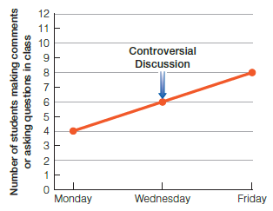
Figure 12-1
Two Observations of Class Participation: Before and After an Open Discussion

Slide 8
Types of Evaluation Research Designs
Time-Series Design – A research design that involves measurement made over some period.
Nonequivalent Control Groups – A control group that is similar to the experimental group but is not created by the random assignment of subjects.
Multiple Time-Series Designs – The use of more than one set of data that were collected over time, so that comparisons can be made.

Slide 9
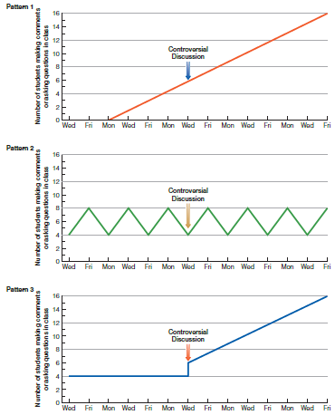
Figure 12-2
Three Patterns of Class Participation in a Longer Historical Period

Slide 10
Types of Evaluation Research Designs
Qualitative Evaluations
The most effective evaluation research combines qualitative and quantitative components.

Slide 11
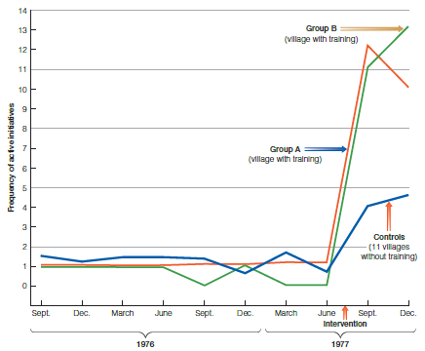
Figure 12-3
Active Initiatives over Time

Slide 12
Types of Evaluation Research Designs (slide 1 of 2)
Logistical Problems – Getting subjects to do what they are supposed to do.
Evaluation research occurs within the context of real life.

Slide 13
Types of Evaluation Research Designs (slide 2 of 2)
Use of Research Results
Why evaluation research results are not always put into practice:
Implications may not be presented in a way that is understandable to the non-researcher.
Results may contradict deeply held beliefs.
Researchers may have a vested interest in the results.

Slide 14
Social Indicators Research
Social indicators – Measurements that reflect the quality or nature of social life. Social indicators are often monitored to determine the nature of social change in a society.
The Death Penalty and Deterrence
Computer Simulation

Slide 15
Ethics and Evaluation Research
There are special ethical problems in evaluation research because it’s embedded in the day-to-day events of real life.
May bring added pressure to produce specific results, as desired by interested parties.
Unethical actions in an evaluation study can have more severe consequences than such actions in other types of research.

Slide 16
Chapter Summary
Provide examples of research topics that would be appropriate for evaluation research.
Illustrate the central role of measurement in evaluation research.
Identify and describe some of the different evaluation designs.
Understand social indicator research, discussing the main advantages and disadvantages.
Discuss some of the ethical issues that may arise in evaluation research.

Slide 17
Questions

Slide 18
Question 1
1. Why has evaluation research grown in popularity?
federal requirements demanding program evaluations
the availability of research funds to fulfill federal requirements
both of the above
none of the above

Slide 19
Answer 1
ANSWER: C.
Evaluation research has grown in popularity because of federal requirements demanding program evaluations, and the availability of research funds to fulfill federal requirements.

Slide 20
Question 2
2. _____ aim to determine the existence and extent of problems.
Longitudinal studies
Needs assessment studies
Cost-benefit studies
Monitoring studies

Slide 21
Answer 2
ANSWER: B.
Needs assessment studies aim to determine the existence and extent of problems.

Slide 22
Question 3
3. _____ provide a steady flow of information about something of interest.
Longitudinal studies
Needs assessment studies
Cost-benefit studies
Monitoring studies

Slide 23
Answer 3
ANSWER: D.
Monitoring studies provide a steady flow of information about something of interest.

Slide 24
Question 4
4. Besides making measurements relevant to the outcomes of a program, research must measure the _____.
primary cause
program intervention
tertiary effect
all of the above
none of the above

Slide 25
Answer 4
Answer: B.
Besides making measurements relevant to the outcomes of a program, research must measure the program intervention.

Slide 26
Question 5
5. A research design that involves measurements made over some period may be defined as:
time series designs
quasi experiments
multiple time series designs

Slide 27
Answer 5
ANSWER: A.
A research design that involves measurements made over some period may be defined as time series designs.

Slide 28
Question 6
6. _____ is a form of applied research.
Evaluation
Experimentation
Interviewing
Field research

Slide 29
Answer 6
ANSWER: A.
Evaluation is a form of applied research.

Slide 30
Question 7
7. _____ determine whether the results of a program can be justified by its expense.
Longitudinal studies
Needs assessment studies
Cost-benefit studies
Monitoring studies

Slide 31
Answer 7
ANSWER: C.
Cost-benefit studies determine whether the results of a program can be justified by its expense.

Slide 32
Question 8
8. A key variable for evaluation researchers is to measure the _____.
independent variable
dependent variable
response variable
none of the above

Slide 33
Answer 8
ANSWER: C.
A key variable for evaluation researchers is to measure the response variable.

Slide 34
Question 9
9. _____ are distinguished from “true” experiments primarily by the lack of random assignment of subjects to an experimental and a control group.
Time series designs
Quasi experiments
Multiple time series designs

Slide 35
Answer 9
ANSWER: B.
Quasi experiments are distinguished from “true”
experiments primarily by the lack of a random
assignment of subjects to an experimental and a
control group.

Slide 36
Question10
10. Professor Yee wants to do an evaluation study of the effects of a patient education program on patient anxiety. He uses one wing in a hospital for the experiment and compares the results with a similar group of patients in a similar wing in another hospital. Which design would be best?
classical
nonequivalent control group
time-series
posttest-only control group design

Slide 37
Answer 10
ANSWER: B.
Professor Yee wants to do an evaluation study of the
effects of a patient education program on patient
anxiety. He uses one wing in a hospital for the
experiment and compares the results with a similar
group of patients in a similar wing in another hospital.
The nonequivalent control group design would be
best.

Slide 38
Question 11
11. Evaluation researchers encounter more logistical problems than other researchers because evaluation research
occurs in the context of real life.
takes longer.
is more costly.
has more measurement problems.
examines more variables.

Slide 39
Answer 11
ANSWER: A.
Evaluation researchers encounter more logistical problems than other researchers because evaluation research occurs in the context of real life.

