Slide 1
CHAPTER 13 QUALITATIVE DATA ANALYSIS

Slide 2
Chapter Outline
Introduction
Linking Theory and Analysis
Qualitative Data Processing
Computer Programs for Qualitative Data
The Qualitative Analysis of Quantitative Data
Evaluating the Quality of Qualitative Research
Ethics and Qualitative Data Analysis
Chapter Summary
Questions

Slide 3
Linking Theory and Analysis (slide 1 of 5)
Qualitative analysis – The non-numerical examination and interpretation of observations, for the purpose of discovering underlying meanings and patterns of relationship.
Notes:
Qualitative analysis involves an interplay between data collection, analysis, and theory. All intertwine.
While some qualitative work is descriptive, qualitative analysis aims to explain patterns.

Slide 4
Linking Theory and Analysis (slide 2 of 5)
Discovering Patterns in Qualitative Data
Frequencies
Magnitudes
Structures
Processes
Causes
Consequences
Notes:
1: how often does child abuse occur in families in neighborhood under study?
2: what are levels/brutality of abuse?
3: what are the different types/categories (mental, physical, sexual)?
4: what is the process by which abuse occurs? Doe abusers begin with mental then move on to other types?
5: is abuse more common amongst certain groups (SES? Racial groups? Religious groups?)?
6: how does abuse affect victims?

Slide 5
Linking Theory and Analysis (slide 3 of 5)
Cross-case analysis –involves an examination of more than one case; looks for patterns occurring across several observations. Variable- or case-oriented
Variable-oriented analysis – An analysis that describes and/or explains a particular variable.
Case-oriented analysis – An analysis that aims to understand a particular case or several cases by looking closely at the details of each.
Notes:
Variable: looks at common variables that cuts across: gender, age, SES, parental expectations. Aims at a nomothetic explanation to develop a partial explanation (with a few variables) that cuts across cases to explain the outcome.
Case: idiographic, learn everything we can about one or a couple of cases, closely looking at all the factors that come into play for explaining the outcome (so understanding how a person votes… we say they are low income, liberal, etc)… tries to get a full explanation of a few cases... Doesn’t tell us why people generally vote how they do.

Slide 6
Linking Theory and Analysis (slide 4 of 5)
Grounded Theory – Inductive approach to research in which theories are generated solely from an examination of data rather than being derived deductively.
Constant Comparative Method – A component of Grounded Theory in which observations are compared with one another and with the evolving inductive theory.

Slide 7
Linking Theory and Analysis (slide 5 of 5)
Four Stages of Constant Comparative Method (Glaser and Strauss):
Comparing incident application to each category
Integrating categories and their properties
Delimiting the theory
Writing theory
Notes:
1: once a concept arises in one case, you look for evidence of the same concept in other cases
2: notes relationships between concepts/phenomena (e.g depression, researchers record age, gender, education, to see how they all relate to depression)
3: patterns become clearer over time, so you can ignore some of the concepts in favor of others (more important) ones
4: writing it up.

Slide 8
Linking Theory and Analysis (slide 1 of 3)
Semiotics – The study of signs and the meanings associated with them, “the science of signs.”
What is the meaning of:
…a blue ribbon?
…”say cheese”?
…a cross?
…a ghost emoji 👻👻👻
Notes:
Can include logos, animals, people, and consumer products… think about people who study paintings… one critic might interpret the “latent message” associated with a painting in one way, and other may have a completely different interpretation… thus, the study of semiotics can be extremely subjective.
But no one really does semiotics anymore.

Slide 9
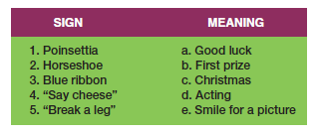
Figure 13-1
Matching Signs and Their Meanings

Slide 10
Linking Theory and Analysis (slide 2 of 3)
Conversation Analysis – A meticulous analysis of the details of conversation, based on a complete transcript that includes pauses, breaks, etc.
Notes:
Like ethnomethodology, which aims to understand the structure of social life by uncovering the taken-for-granted, implicit assumptions we have… conversation analysis tries to do that by looking closely at transcripts of conversations.

Slide 11
Linking Theory and Analysis (slide 3 of 3)
Fundamental Assumptions
Conversation is a socially constructed activity.
Conversations must be understood contextually.
Conversational analysis aims to understand the structure and meaning of conversation through excruciatingly accurate transcripts of conversations.

Slide 12
Qualitative Data Processing (slide 1 of 3)
Coding – Classifying or categorizing individual pieces of data, coupled with some kind of retrieval system.
Coding Units
Notes:
Usually, these will be large amounts of text notes that you’ve taken and maybe put into electronic format. Makes it easier to retrieve your data.
Coding units vary in size within units of analysis (from concept to concept) and between units of analysis (from cases to case if not just studying one unit)… if you’re studying political organizations: variables for mission will vary in size per organization, size of membership could be just a few words/numbers, ideology could all be about two lines.

Slide 13
Qualitative Data Processing (slide 2 of 3)
Creating Codes
Open Coding
the initial classification and labeling of concepts in qualitative data analysis.
a reanalysis of the results, aimed at identifying the important, general concepts.
Identify the central concept that organizes the other concepts.
Notes:
You want to create codes in such a way that you can “try to” test hypotheses from previous work.
You begin by reading a body of text (part of interview or whole), and reread it, and try to identify concepts contained within it… might be a good time for a concept map
“ I though the professor should have given me at least partial credit for the homework I turned in” contains: professor, homework, grading, student-faculty relations…
Read pages 424-426 for a good example of HOW coding goes on (under the term selective coding).

Slide 14
Qualitative Data Processing (slide 3 of 3)
Memoing – Writing memos that become part of the data for analysis. Memos can describe and define concepts, deal with methodologies issues, or offer initial theoretical formulations.
Code Notes
Theoretical Notes
Operational Notes
Concept Mapping – The graphic display of concepts and their interrelations, useful in the formulation of theory.
Notes:
Memos are notes for you and others… they help you to think through your ideas, and stimulate the writing process.
Code notes: give a code label and meaning of the label (e.g. “abomination” and what it means)
Theoretical notes: reflections on deeper meanings of concepts, relationships between (e.g. injunctions all talk about male behavior)
Operational notes: notes on data collection circumstances… like where it was collected from/pseudonym, etc.
Concept mapping is an important theoretical exercise: helps you think out relationships among concepts in a graphical format.

Slide 15
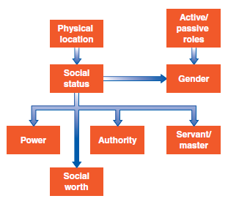
Figure 13-3
An Example of Concept Mapping

Slide 16
Computer Programs for Qualitative Data
QDA Programs:
Atlas.ti 
Dedoose 
Notes:
Just programs to help you organize and analyze your data. You can use something as simple as a spreadsheet or something more.

Slide 17
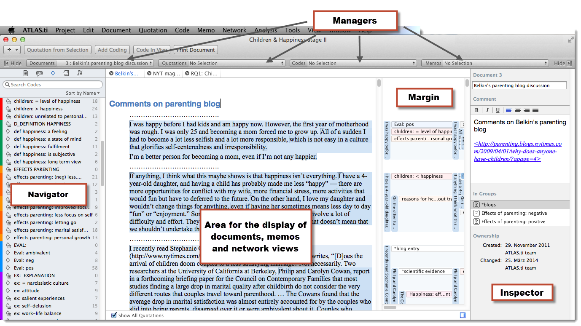
Atlas.ti

Slide 18
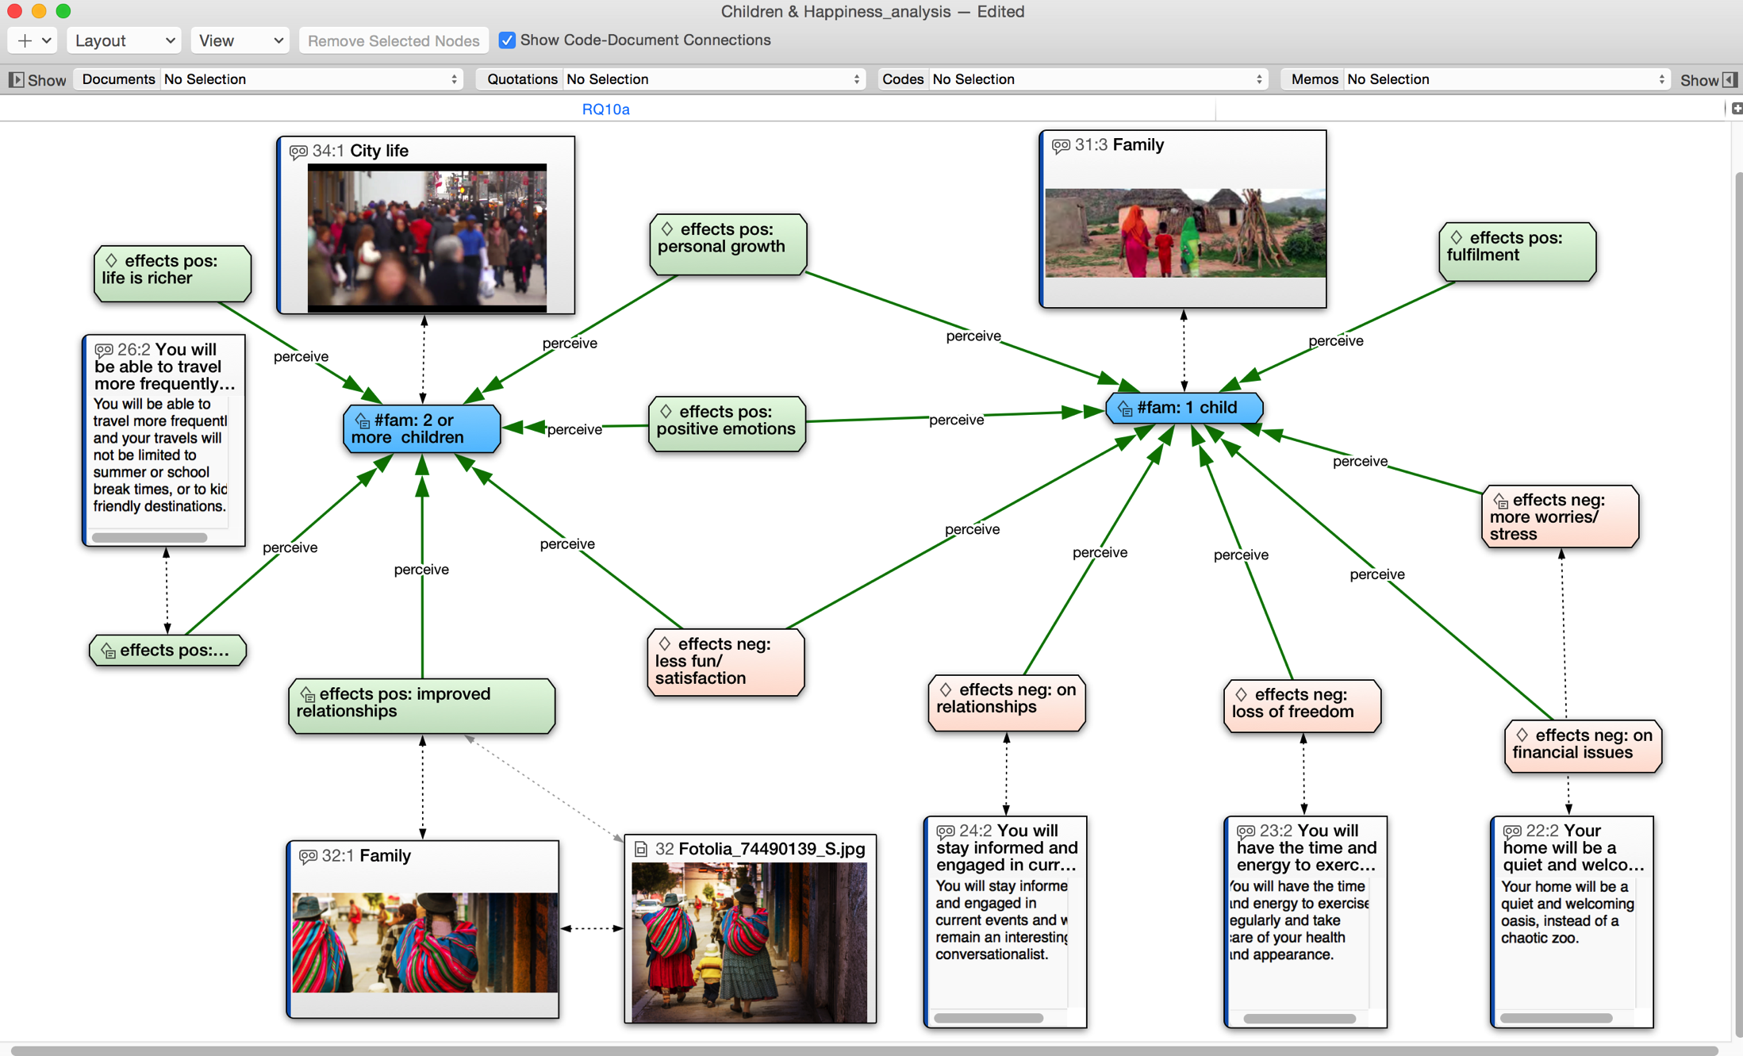
Atlas.ti
An Example of Concept Mapping in Atlas.ti

Slide 19
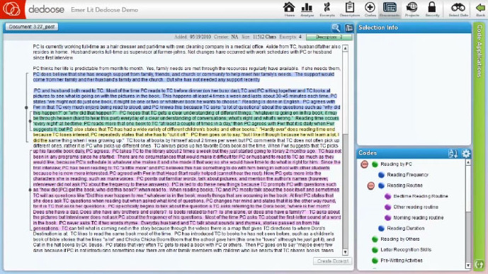
Dedoose

Slide 20
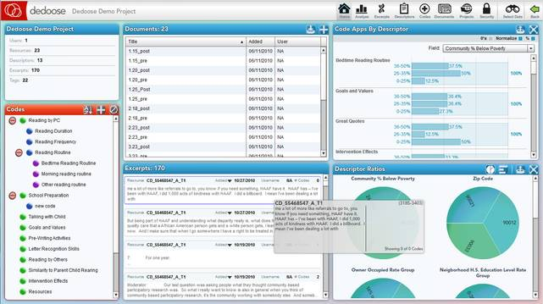
Dedoose

Slide 21
Evaluating the Quality of Qualitative Research (slide 1 of 4)
Validity
Reliability

Slide 22
Evaluating the Quality of Qualitative Research (slide 2 of 4)
Questions/Assessments for Evaluating Qualitative Research
How credible are the findings?
How has knowledge or understanding been extended by the research?
How well does the evaluation address its original aims and purpose?
How well is the scope for drawing wider inferences explained?
How clear is the basis of evaluative appraisal?
How defensible is the research design?
How well defended are the same design/target selection of cases/documents?

Slide 23
Evaluating the Quality of Qualitative Research (slide 3 of 4)
How well is the eventual sample composition and coverage described?
How well was the data collection carried out?
How well has the approach to, and formulation of, analysis been conveyed?
How well are the contexts of data sources retained and portrayed?
How well has diversity of perspective and content been explored?
How well has detail, depth, and complexity of the data been conveyed?

Slide 24
Evaluating the Quality of Qualitative Research (slide 4 of 4)
How clear are the links between data, interpretation, and conclusions?
How clear and coherent is the reporting?
How clear are the assumptions/theoretical perspectives/values that have shaped the form and output of the evaluation?
What evidence is there of attention to ethical issues?
How adequately has the research process been documented?

Slide 25
Ethics and Qualitative Data Analysis
The subjective element in qualitative data analysis provides an added challenge to avoiding bias in data interpretation.
Taking special steps to protect the privacy and identity of subjects is crucial.

Slide 26
Chapter Summary (slide 1 of 2)
Identify and explain the three methods for linking theory and analysis.
Describe the use of coding in the analysis of qualitative data.
Recognize some computer programs that can be used for qualitative analysis and explain how they work.

Slide 27
Chapter Summary (slide 2 of 2)
Provide examples of how quantitative data can be analyzed qualitatively.
Explain some of the ways researchers can assess the quality of qualitative data.
Summarize some of the ethical issues that can occur in qualitative research.

Slide 28
Questions

Slide 29
Question 1
1. _____ is an inductive approach to research in which theories are generated solely from an examination of data rather than being derived deductively.
Cross-case analysis
Grounded Theory Method
Constant comparative method
Monitoring studies
Notes:
ANSWER: B.
Grounded Theory Method is an inductive approach to research in which theories are generated solely from an examination of data rather than being derived deductively.

Slide 30
Question 2
2. _____ is an analysis that describes and/or explains a particular variable.
Variable-oriented analysis
Case-oriented analysis
Experimentation
Field research
Notes:
ANSWER: A.
Variable-oriented analysis is an analysis that describes and/or explains a particular variable.

