Slide 1
CHAPTER 13 QUALITATIVE DATA ANALYSIS

Slide 2
Chapter Outline
Introduction
Linking Theory and Analysis
Qualitative Data Processing
Computer Programs for Qualitative Data
The Qualitative Analysis of Quantitative Data
Evaluating the Quality of Qualitative Research
Ethics and Qualitative Data Analysis
Chapter Summary
Questions

Slide 3
Qualitative Analysis
Qualitative analysis
The non-numerical examination and interpretation of observations
To discover underlying meanings and patterns
Notes:
Qualitative analysis involves an interplay between data collection, analysis, and theory. All intertwine.
While some qualitative work is descriptive, qualitative analysis aims to explain patterns.

Slide 4
What is Qualitative Analysis for?
Discovering Patterns in Qualitative Data
Frequencies
Magnitudes
Structures
Processes
Causes
Consequences
Notes:
1: how often does child abuse occur in families in neighborhood under study?
2: what are levels/brutality of abuse?
3: what are the different types/categories (mental, physical, sexual)?
4: what is the process by which abuse occurs? Doe abusers begin with mental then move on to other types?
5: is abuse more common amongst certain groups (SES? Racial groups? Religious groups?)?
6: how does abuse affect victims?

Slide 5
Practice: Studying “Abuse”
Frequencies
Magnitudes
Structures
Processes
Causes
Consequences

Slide 6
Qualitative Analysis of Fieldwork Involves…
Cross-case analysis
More than one case; patterns occurring across cases
Variable-oriented?
Notes:
Variable: looks at common variables that cuts across: gender, age, SES, parental expectations. Aims at a nomothetic explanation to develop a partial explanation (with a few variables) that cuts across cases to explain the outcome.
Case: idiographic, learn everything we can about one or a couple of cases, closely looking at all the factors that come into play for explaining the outcome (so understanding how a person votes… we say they are low income, liberal, etc)… tries to get a full explanation of a few cases... Doesn’t tell us why people generally vote how they do.
Case-oriented analysis
aims to understand a particular case or several cases by looking closely at the details of each.

Slide 7
Qualitative Analysis of Fieldwork Involves…
Constant Comparative Method
observations are compared with one another and with the evolving inductive theory.
Four Stages of Constant Comparative Method (Glaser and Strauss):
Looking for evidence of similar incidents across cases
Notes relationships between concepts/phenomena, integrates details about cases and their properties
Delimiting the theory
Writing theory
Notes:
Built off grounded theory (theories generated from examination of data, inductively, rather than deductively)
1: once a concept arises in one case, you look for evidence of the same concept in other cases
2: notes relationships between concepts/phenomena (e.g depression, researchers record age, gender, education, to see how they all relate to depression)
3: patterns become clearer over time, so you can ignore some of the concepts in favor of others (more important) ones
4: writing it up.

Slide 8
What Other Work Involves Qualitative Analysis?
Semiotics
study of signs and the meanings associated with them, “the science of signs.”
Notes:
Can include logos, animals, people, and consumer products… think about people who study paintings… one critic might interpret the “latent message” associated with a painting in one way, and other may have a completely different interpretation… thus, the study of semiotics can be extremely subjective.
But no one really does semiotics anymore.

Slide 9
Practice: Semiotics… A Dead Tradition
What is the meaning of:
…a menorah?
…the middle finger?
…a ghost emoji? 👻👻👻

Slide 10
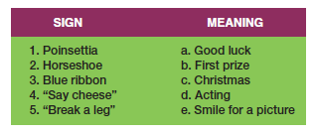
Figure 13-1
Matching Signs and Their Meanings

Slide 11
What Other Work Involves Qualitative Analysis?
Conversation Analysis
meticulous analysis of the details of conversation
based on complete transcript
pauses, breaks, etc.
Notes:
Like ethnomethodology, which aims to understand the structure of social life by uncovering the taken-for-granted, implicit assumptions we have… conversation analysis tries to do that by looking closely at transcripts of conversations.
Fundamental Assumptions
Conversation is socially constructed
Conversations must be understood contextually.
Need excruciatingly accurate transcripts of conversations to understand the structure and meaning of conversation

Slide 12
Qualitative Data Processing
Coding
Classifying or categorizing individual pieces of data, coupled with some kind of retrieval system.
Coding Units
Notes:
Usually, these will be large amounts of text notes that you’ve taken and maybe put into electronic format. Makes it easier to retrieve your data.
Coding units vary in size within units of analysis (from concept to concept) and between units of analysis (from cases to case if not just studying one unit)… if you’re studying political organizations: variables for mission will vary in size per organization, size of membership could be just a few words/numbers, ideology could all be about two lines.

Slide 13
Example: Studying CSUF Campus Organizations (Additional Information)
List of Campus Organizations can be found here:
https://fullerton.collegiatelink.net/organizations

Slide 14
Example: Studying CSUF Campus Organizations (Additional Information)
Mission
M.E.Ch.A.
Autism Speaks
Movimiento Estudiantil Chicano de Aztlán (M.E.Ch.A.) is a student organization that promotes higher education, cultura, and historia. MEChA was founded on the principles of self-determination for the liberation of our people. We believe that political involvement and education is the avenue for change in our society.
Each word in M.E.Ch.A. symbolizes a great concept in terms of la causa. Movimiento means that the organization is dedicated to the movement to gain self-determination for our people. Estudiantil, identifies the organization as a student group for we are part of our Raza's future. At the heart of the name is the use of the identity: Chicano. At first seen as a negative word, now taken for a badge of honor. In adopting their new identity, the students committed themselves to return to the barrios, colonias, or campos and together, struggle against the forces that oppress our gente. Lastly, the affirmation that we are Indigenous people to this land by placing our movement in Aztlan, the homeland of all peoples from Anahuak.
On campuses across Aztlan, M.E.Ch.A. and MEChistAs are often the only groups on campus Raza and non-Raza alike that seek to open the doors of higher education para nuestras comunidades and strive for a society free of imperialism, racism, sexism, and homophobia.
The purpose of Autism Speaks U - California State University, Fullerton is to further the mission of Autism Speaks by engaging the campus community and the local community through awareness, education, community service, and fundraising, and in so doing, positively affect the lives of those struggling with autism spectrum disorders and their families.

Slide 15
Example: Studying CSUF Campus Organizations (Additional Information)
Size
M.E.Ch.A.
Autism Speaks
14 Online Registered Members
48 Online Registered Members

Slide 16


Example: Studying CSUF Campus Organizations (Additional Information)
Web Docs
M.E.Ch.A.
Autism Speaks

Slide 17
Qualitative Data Processing
Creating Codes
Open Coding
the initial classification and labeling of concepts in qualitative data analysis.
a reanalysis of the results, aimed at identifying the important, general concepts.
Identify the central concept that organizes the other concepts.
Notes:
You want to create codes in such a way that you can “try to” test hypotheses from previous work.
You begin by reading a body of text (part of interview or whole), and reread it, and try to identify concepts contained within it… might be a good time for a concept map
“ I though the professor should have given me at least partial credit for the homework I turned in” contains: professor, homework, grading, student-faculty relations…
Read pages 424-426 for a good example of HOW coding goes on (under the term selective coding).

Slide 18
Practice: What are some codes for this Snippet from an Interview?
“… and I thought the professor should have given me at least partial credit for the homework I turned in...”
Notes:
Professor, Student, Homework, Grades, Tardiness, Perceptions of Fairness, Entitlement,

Slide 19
Qualitative Data Processing
Memoing/Notes
describe and define concepts (Code)
deal with methodological issues (Operational)
offer initial theoretical formulations (Theoretical)
Notes:
Memos are notes for you and others… they help you to think through your ideas, and stimulate the writing process.
Memos become part of the data for analysis
Code notes: give a code label and meaning of the label (e.g. “abomination” and what it means)
Theoretical notes: reflections on deeper meanings of concepts, relationships between (e.g. injunctions all talk about male behavior)
Operational notes: notes on data collection circumstances… like where it was collected from/pseudonym, etc.

Slide 20
Qualitative Data Processing
Concept Mapping
The graphic display of concepts and their interrelations, useful in the formulation of theory.
Notes:
Concept mapping is an important theoretical exercise: helps you think out relationships among concepts in a graphical format.

Slide 21
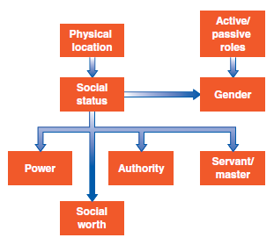
Figure 13-3
An Example of Concept Mapping

Slide 22
Computer Programs for Qualitative Data
QDA Programs:
Atlas.ti 
Dedoose 
MAXQDA 
Notes:
Just programs to help you organize and analyze your data. You can use something as simple as a spreadsheet or something more.

Slide 23
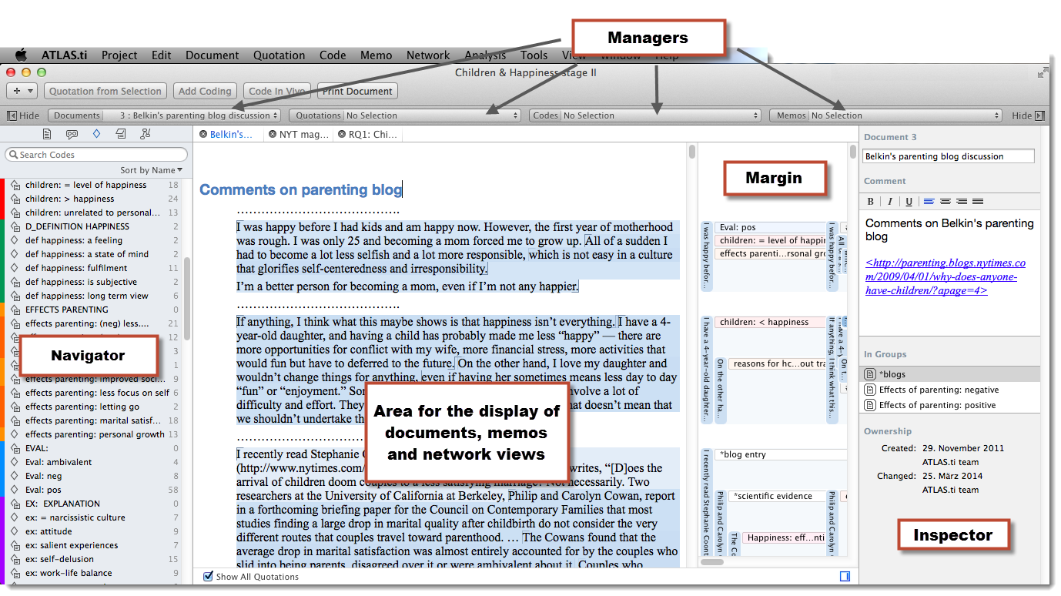
Atlas.ti

Slide 24
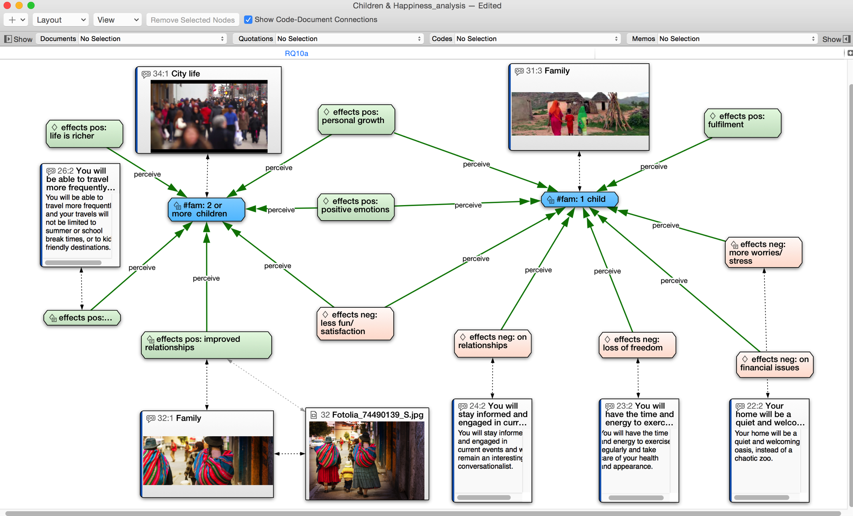
Atlas.ti
An Example of Concept Mapping in Atlas.ti

Slide 25
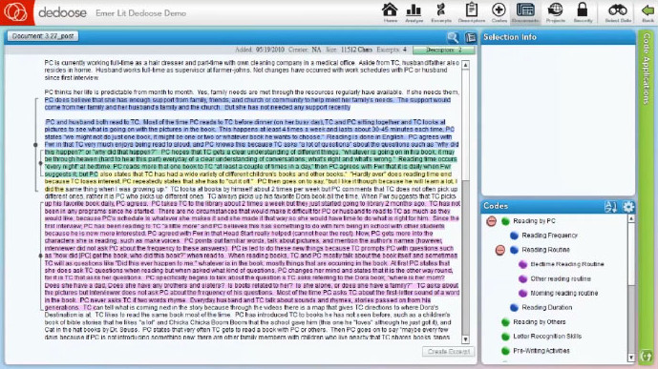
Dedoose

Slide 26
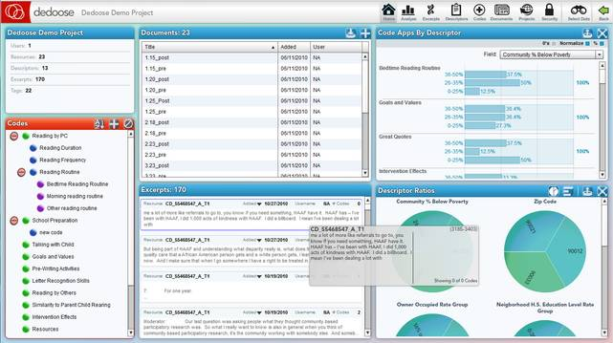
Dedoose

Slide 27
Evaluating the Quality of Qualitative Research
How credible are the findings?
How has knowledge or understanding been extended by the research?
How well does the evaluation address its original aims and purpose?
How well is the scope for drawing wider inferences explained?
How clear is the basis of evaluative appraisal?
How defensible is the research design?
How well defended are the same design/target selection of cases/documents?
How well is the eventual sample composition and coverage described?
How well was the data collection carried out?
How well has the approach to, and formulation of, analysis been conveyed?
How well are the contexts of data sources retained and portrayed?
How well has diversity of perspective and content been explored?
How well has detail, depth, and complexity of the data been conveyed?
How clear are the links between data, interpretation, and conclusions?
How clear and coherent is the reporting?
How clear are the assumptions/theoretical perspectives/values that have shaped the form and output of the evaluation?
What evidence is there of attention to ethical issues?
How adequately has the research process been documented?

Slide 28
Ethics and Qualitative Data Analysis
The subjective element in qualitative data analysis provides an added challenge to avoiding bias in data interpretation.
Taking special steps to protect the privacy and identity of subjects is crucial.

Slide 29
Chapter Summary
Identify and explain the three methods for linking theory and analysis.
Describe the use of coding in the analysis of qualitative data.
Recognize some computer programs that can be used for qualitative analysis and explain how they work.
Provide examples of how quantitative data can be analyzed qualitatively.
Explain some of the ways researchers can assess the quality of qualitative data.
Summarize some of the ethical issues that can occur in qualitative research.

Slide 30
Questions

Slide 31
Question 1
_____ is an inductive approach to research in which theories are generated solely from an examination of data rather than being derived deductively.
Cross-case analysis
Grounded Theory Method
Constant comparative method
Monitoring studies
Notes:
ANSWER: B.
Grounded Theory Method is an inductive approach to research in which theories are generated solely from an examination of data rather than being derived deductively.

Slide 32
Question 2
_____ is an analysis that describes and/or explains a particular variable.
Variable-oriented analysis
Case-oriented analysis
Experimentation
Field research
Notes:
ANSWER: A.
Variable-oriented analysis is an analysis that describes and/or explains a particular variable.

