Slide 1
CHAPTER 14 Quantitative data analysis

Slide 2
Chapter Outline
Introduction
Quantification of Data
Univariate Analysis
Subgroup Comparisons
Bivariate Analysis
Introduction to Multivariate Analysis
Sociological Diagnostics
Ethics and Quantitative Data Analysis
Chapter Summary
Questions

Slide 3
Quantification of Data
Quantitative Analysis
The numerical representation of observations for the purpose of describing and explaining the phenomena that those observations reflect.
Notes:
Quantification – converting your data into numbers, and making them usable for computers.
Univariate: one variable
Bivariate: two variables
Multivariate: more than two variables, with a bunch of independent variables and one dependent variable.

Slide 4
Coding Quantitative Data
Age
1 = 1
2 = 2
3 = 3
4 = 4
5 = 5
Sex
Male = 1
Female = 2
Political Affiliation
Democrat = 1
Republican = 2
Independent = 3
Region of Country
West = 1
Midwest = 2
South = 3
Northeast = 4

Slide 5
Coding Quantitative Data
Develop Code Categories
Use well-developed coding scheme.
Generate codes from your data.
Notes:
Developing categories is important, and using theoretically relevant coding schemes is important.
Say you want to code the variable occupation (you ask people what is your occupation). Of course you could list all occupations, but in order to do quantitative analysis, you will have to clump the answers into a bunch of categories (so you have multiple responses in each category), so using established coding schemes is important:
Like distinguishing occupations based on whether or not they are professional or managerial positions, clerical or semiskilled occupations… or you can base your coding scheme on sectors of the economy: manufacturing, education, commerce, etc. You need to cluster.
Also, it needs to be theoretically relevant because, maybe you’re interested in gender pay gaps, but how the pay gaps vary by industry: so maybe a simple white collar or blue collar distinction is enough… but if you want to know how the gap varies by sector of the economy, you’ll need a much more elaborate scheme, like the one used by the Census.
Pg 445 - So you can begin with the coding scheme used by others, or you can generate one based on your data… say you ask students on a survey, in an open-ended question about problems facing current students, and they can respond with anything… again, it’s important to cluster their responses into categories like financial concerns, administrative concerns, concerns about the schools facilities…

Slide 6
Coding Quantitative Data
Codebook
A document that lists the assignments of codes to the attributes composing the variables (meanings of codes, and code labels).
Purposes of the Codebook
Primary guide in the coding processes

Slide 7
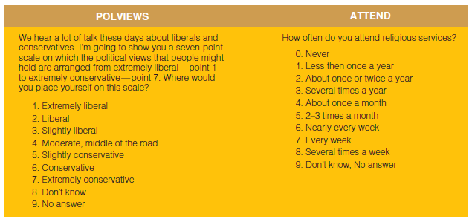
Figure 14-1
Partial Codebook

Slide 8
Abbreviated Variable Name
ATTEND
How often do you attend religious services?
0. Never
1. Less than once a year
2. About once or twice a year
3. Several times a year
4. About once a month
5. 2-3 times a month
6. Nearly every week
7. Every week
8. Several times a week
9. Don’t know, No answer
Definition of the Variable
Numerical Label
Variable Attributes

Slide 9
Coding Quantitative Data
Continuous Variable
A variable whose attributes form a steady progression
Interval variables: age, income
Discrete/Categorical Variable
A variable whose attributes are separate from one another
Nominal or ordinal variables: gender, political affiliation, socio-economic status.

Slide 10
Coding Quantitative Data
“Collapsing” Response Categories
Handling “Don’t Knows”

Slide 11
Coding Quantitative Data
Data entry in widely-usable format
Excel (.csv)
Analysis software
SPSS
STATA
R

Slide 12
Univariate Statistics
Univariate Statistics
The description of a single variable
frequencies
measures of central tendency
measures of dispersion

Slide 13
Univariate Statistics
Frequency Distributions
The number of times the various attributes of a variable are observed in a sample.
Usually in percentage

Slide 14
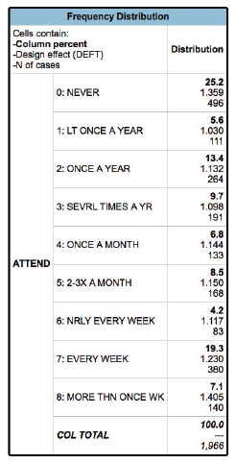
Figure 14-3
Attendance at Religious Services, 2012
Notes:
Usually percentages

Slide 15
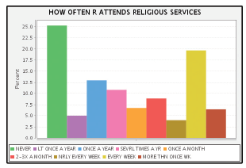
Figure 14-4
Bar Chart of GSS ATTEND, 2012

Slide 16
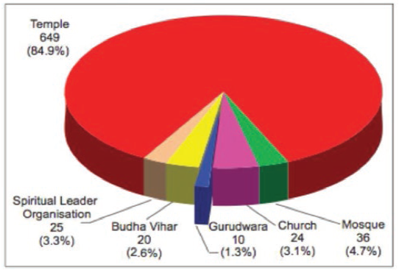
Figure 14-5
Pie Chart showing Number and Percentage of Religious Institutions by Type

Slide 17
Example: Number of Students in Class using Laptops/Tablets
Variable:
Student Laptop Use
Information:
Student Total: 39
With Laptops:
Without Laptops:
Variable Type?
Frequency Distribution (in percentage)?

Slide 18
Univariate Statistics
Measures of Central Tendency
Univariate ways of describing the data
Mean
Median
Mode

Slide 19
Univariate Statistics
Mode
the most frequently observed value or attribute. Can be used for all variable types: nominal, ordinal, and interval.
Median
the value of the “middle” case in a rank-ordered set of observations. Should only be used for two variable types: ordinal, and interval.
Mean
computed by summing the values of several observations and dividing by the number of observations. Should only be used for interval variables

Slide 20
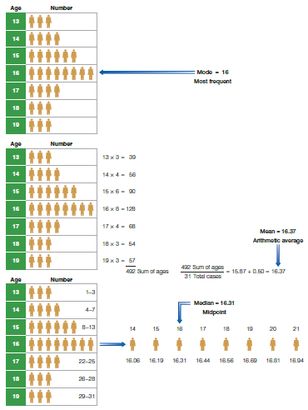
Figure 14-6
Three “Averages”
Notes:
Some measures of central tendency (mean) are more susceptible to error because of extreme values.. Which is why for some interval variables, we use median instead of mean.
You could get the mean income of orange county, and it could be $1 million.. That might not be the lived reality. But it may be affected because Elon Musk moved in, and he’s a billionaire… so his high value is gonna pull the mean up… even if 96% of the population makes less than $500,000.

Slide 21
Example: Number of Students in Class using Laptops/Tablets
Variable:
Student Laptop Use
Information:
Student Total: 39
With Laptops:
Without Laptops:
Measure of Central Tendency?

Slide 22
Univariate Statistics
Dispersion
The distribution/spread of values around a measure of central tendency.
Only used for interval level variables
Range
Standard Deviation
Notes:
Higher standard deviation means that the data are more dispersed; lower means they’re more clustered.

Slide 23
Univariate Statistics
Range:
distance between highest and lowest value
Standard Deviation:
A measure of dispersion around the mean, calculated so that approximately 68 percent of the cases will lie within plus or minus one standard deviation from the mean, 95 percent within two, and 99.9 percent within three standard deviations.
Notes:
Higher standard deviation means that the data are more dispersed; lower means they’re more clustered.

Slide 24
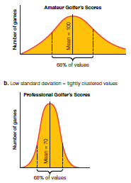
Figure 14-7
High and Low Standard Deviations

Slide 25
Bivariate Statistics
Bivariate Statistics
The analysis of two variables simultaneously, for the purpose of determining an empirical relationship between them.
Notes:
If the bivariate table on 459, is percentaged down, then you make statements about the relationship across… women are more likely than men to attend church services weekly.

Slide 26
Bivariate Statistics
Constructing a Bivariate Table
Determine logical direction of relationship (independent variable and dependent variable).
Example: Gender and Attitude toward Sexual Equality
The cases are divided into men and women.
Each gender subgrouping is described in terms of approval or disapproval of sexual equality.
Men and women are compared in terms of the percentages approving of sexual equality.

Slide 27
Bivariate Analysis
Contingency Table – Another name for bivariate tables, the percentage of the dependent variable are contingent upon values of the independent variable.

Slide 28
Bivariate Statistics
 | Dependent Variable
Independent Variable | Discrete/Categorical | Continuous
Discrete/Categorical | Chi-Square | T-Test or ANOVA
Continuous | N/A | Correlation

Slide 29
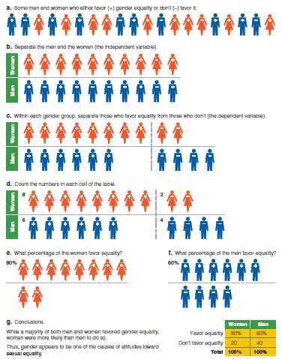
Figure 14-8
Percentaging a Table

Slide 30
Bivariate Tables
Guidelines for Presentation of Tables
A table should have a heading or title that describes what is contained in the table.
Original content should be clearly presented.
The attributes of each variable should be clearly indicated.
The base on which percentage are computed should be indicated.
Missing data should be indicated in the table.

Slide 31
Multivariate Statistics
Multivariate Statistics
The analysis of the simultaneous relationships among several variables.
Regressions (Multiple/Linear/OLS, Binomial Logistic, Multinomial Logistic, Poisson, Negative Binomial, Event History/Survival Analysis, Time-Series)
Notes:
Have multiple independent variables to see their relationship with the one dependent variable. Gets you closer to causality because, while bivariate relationships can tell you if two variables are associated/correlated, multivariate analysis can address spuriousness in the relationship between variables.

Slide 32
Multivariate Statistics
Multivariate techniques allow the researcher to measure multiple variables at the same time
Can be used to better explain why women make less than men in the job market

Slide 33
Ethics and Quantitative Data Analysis
Unbiased analysis and reporting is an ethical concern for quantitative analysis as well as in qualitative analysis.
The privacy of subjects must be protected in analysis and reporting.

Slide 34
Chapter Summary (slide 1 of 2)
Provide an example illustrating the quantification of data.
Identify and discuss the several aspects of univariate analysis.
Explain what is gained when subgroup comparisons are used instead of univariate analyses.
Describe and illustrate the difference between subgroup comparisons and bivariate analyses.

Slide 35
Chapter Summary (slide 2 of 2)
List and explain the added advantages of multivariate analysis over bivariate analysis.
Outline an example of sociological diagnostics and how it might be used in relation to social causes.
Define ways in which ethical issues may arise in connection with quantitative analyses.

Slide 36
Questions

Slide 37
Question 1
1. The process of converting data to numerical format is called _____.
feminist research
qualification
quantification
Notes:
ANSWER: C.
The process of converting data to numerical format is called quantification.

Slide 38
Question 2
2. Which of the following are basic approaches to the coding process?
You can begin with a well developed coding scheme.
You can generate codes from your data.
both of the above
none of the above
Notes:
ANSWER: C.
The following are basic approaches to the coding process: you can begin with a well developing coding scheme and/or you can generate codes from your data.

Slide 39
Question 3
3. A _____ is a document that describes the locations of variables and lists the assignments of codes to the attributes composing those variables.
cross-case analysis
codebook
constant comparative method
monitoring study
Notes:
ANSWER: B.
A codebook is a document that describes the locations of variables and lists the assignments of codes to the attributes composing those variables.

Slide 40
Question 4
4. The _____ is an average computed by summing the values of several observations and divided by the number of observations.
frequency
mean
median
mode
Notes:
ANSWER: B.
The mean is an average computed by summing the values of several observations and divided by the number of observations.

