Slide 1
CHAPTER 1 HUMAN INQUIRY AND SCIENCE

Slide 2
Chapter Outline
Introduction
Looking for Reality
The Foundation of Social Science
Some Dialectics of Social Research
Chapter Summary
Questions
Notes:
Research methods not about what we know, but how we know it (e.g. how do we know that unprotected sex can result in HIV contraction?)
Basis of knowing is agreement, since you cant experience everything personally, you have to rely on others doing the work for you, either through tradition or experts
So the contrast to agreement is personal experience -- observation

Slide 3
Looking for Reality (slide 1 of 5)
Knowledge from Agreement Reality
Assertions must be both logical and empirical.
Epistemology – The science of knowing.
Methodology – A subfield of epistemology. Science of finding out.
Notes:
So how do we know if something’s real if we haven’t personally experienced it? We rely on agreement.
Scientists say that assertions about a reality that they have not experienced themselves have to meet certain criteria… those are that the assertion must have both LOGICAL and EMPIRICAL support: it has to make sense, and it cannot contradict actual observations.
Why do scientists agree that it’s cold on the dark side of the moon? Well, 1) it makes sense, since the sun isn’t shining on that side and 2) actual measurements confirm the assertion/claim/expectation
Methodology – science of finding out
Social science methodology – how social scientists find out about human social life

Slide 4
Looking for Reality (slide 2 of 5)
Ordinary Human Inquiry
Humans want to predict the future. Why?
We recognize that the future is caused in part by the present.
But also that cause and effect patterns are probabilistic in nature.
Prediction versus Understanding
Tradition
Authority
Notes:
Future caused by present – studying hard will result in better grades
But patterns are probabilistic – studying hard will not ALWAYS result in good grades
Predictions must be paired with understanding – you can’t just say that because you find that the 3rd ranked horse in the 3rd race of the day always wins, because as scientists, we must provide reasoning why it works out that way (e.g. we can’t just not care).
Tradition and Authority are two ways that scientists acquire knowledge that they have not directly experienced themselves, but both can be double-edged swords.
Tradition is easy but can be detrimental – we accept what everyone knows, taken for granted, and it helps us avoid the overwhelming task of asking questions and answering them from scratch… but we rarely gain new/fresh understandings if we rely on tradition (and any inquiry that seeks a fresh understanding could be viewed as foolish).
Authority helps scientists accept new knowledge – we’re more likely to believe new discoveries based on the status of the discoverers (we’ll believe new findings about kissing and the common cold from an epidemiologist than our uncle). But problems include 1) we must accept that even specialists can make errors, and 2) we can only trust the authority of a person within their given field of expertise (we can’t trust a pastor for his proclamation about the negative neurochemical effects of marijuana).

Slide 5
Looking for Reality (slide 3 of 5)
Errors in Inquiry and Some Solutions
Inaccurate Observations
Measurement devices offer accuracy.
Overgeneralizations
Large and representative samples are a safeguard against overgeneralization.
Replication – Repeating a research study to test and either confirm or question the findings of an earlier study.
Notes:
When we try to step away from tradition and authority, we sometimes err on our own, as well. But scientific inquiry has some safeguards.
Inaccurate Observations – Mistakes in observations/no recall | Making deliberate observations reduces error. Measurement devices add some precision to estimates.
Overgeneralization – Observing a few similar events and assuming they’re evidence of a general pattern/overgeneralize on basis of limited observations | drawing sufficiently large samples, and replication.

Slide 6
Looking for Reality (slide 4 of 5)
Selective Observations
Avoid looking for “deviant” cases.
Illogical Reasoning
“Gambler’s fallacy”
Notes:
Selective observation – once we conclude that a pattern exists, we then seek out data/events/situations that confirm that general pattern, ignoring those that don’t | to guard against this, we look for deviant cases, or those that don’t fit the general pattern.
Illogical reasoning – the exception that proves rule/exception that draws attention to rule but in no system of logic can it prove the rule it contradicts (e.g. gambler’s fallacy, where gambler who is on a streak of good or bad luck thinks that the opposite is just around the corner) | using systems of logic can help, conscious logical reasoning.

Slide 7
Looking for Reality (slide 5 of 5)
What’s Really Real?
The Premodern View – Things are as they seem.
The Modern View – Acknowledgement of human subjectivity.
The Postmodern View – There is no objective reality.
Notes:
Section on the philosophy of reality:
Premodern – things are as they seem, and any deviation/diversity of opinion is wrong (those who believe differently are stupid).
Modern – reality is subjective/diverse, diversity is legitimate. (some may view dandelions as beautiful, others as annoying weed – both are legitimate viewpoints imposed on the plant).
Postmodern – there is no objective reality… nothing is out there in the world, all that’s real are our perceptions of images we get through our POV. (there is no “book” just various images of it from different POVs)

Slide 8
The Foundations of Social Science
The foundations of social science are logic and observation.
Notes:
Logic (makes sense) and observation (empirically verifiable).
These two relate to three concepts in science: theory, data collection, and data analysis.

Slide 9
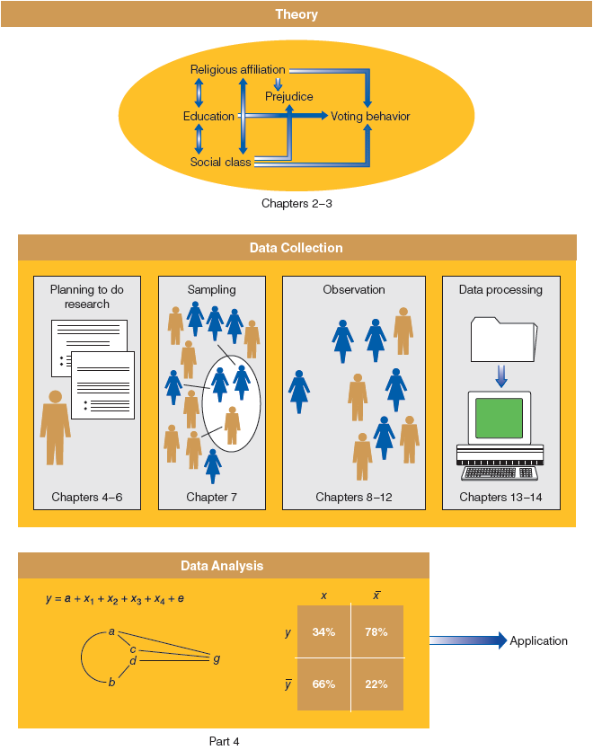
Figure 1-1
Social Science = Theory + Data Collection + Data Analysis
This figure offers a schematic overview of the major stages of social research, indicating where each is discussed in this book.
Notes:
Theory deals with logic
Data collection deals with observation
Data analysis deals with patterns in observation/comparisons between what is logically expected and what is observed

Slide 10
The Foundations of Social Science (slide 1 of 4)
Theory, Not Philosophy or Belief
Social theory has to do with what is, not with what should be.
Theory – A systematic explanation for the observations that relate to a particular aspect of life.
Social science can help us know what is and why.
Notes:
Theory cannot settle debates of value.. (e.g. is something better than the other/capitalism better than socialism). It has to do with how things are and why.
Because science can rarely agree on a given criterion, science is rarely useful in settling debates.

Slide 11
The Foundations of Social Science (slide 2 of 4)
Social Regularities
Exceptions?
Social regularities represent probabilistic patterns.
Notes:
Social norms/restrictions regulate social behavior.
Because social regularities represent probabilistic patterns, it doesn’t matter if the pattern isn’t reflected in 100% of observable cases. It doesn’t matter that despite men tending to make more money than women, some women make more than men. Social scientists ask WHY this is the case.

Slide 12
The Foundations of Social Science (slide 3 of 4)
Aggregates, Not Individuals
The collective actions and situations of many individuals.
Focus of social science is to explain why aggregated patterns of behavior are regular even when individuals change over time.
Notes:
Social scientists study social patterns, not individual ones. Reflect aggregates, not individuals, per se. Although social scientists might study the actions and motivations of individuals, they create theories about the nature of group life (groups to which classes of individuals belong… e.g. women, middle class, latinos).
Social scientists aren’t trying to explain individuals per se, but instead try to understand the systems in which people operate. The elements in this system can also be explained as variables.

Slide 13
The Foundations of Social Science (slide 4 of 4)
Concepts and Variables
Attributes – Characteristics or qualities that describe an object.
Variables – Logical groupings of attributes. The larger category to which those attributes belong.
Notes:
Characteristics (of an individual) can be placed into a larger set of qualities, such as someone saying that women belong in the kitchen… …this one person is a bigot or old-fashioned, but this characteristic can be placed into a set of attributes called bigotry… which is a measurable variable.
The larger set of qualities is how social scientists make sense of more than just one person, towards a class or set of people to which this one person belongs. You find out about people who are “like hiim/her”… in this way, the scientists aren’t studying bigots, but bigotry.
Variables, like bigotry, vary. Scientists are interested in understanding the system of variables that cause bigotry to vary.
Attributes: female, asian, conservative, farmer, honest
Variables: gender or sex, race/ethnicity, political orientation, occupation, class,

Slide 14
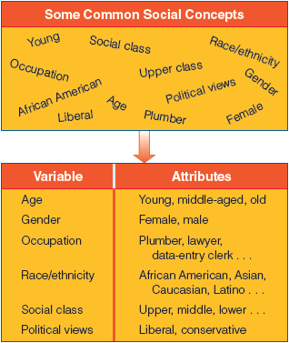
Figure 1-2
Variables and Attributes
Variables like education and prejudice and their attributes (educated/uneducated, prejudiced/unprejudiced) provide the foundation for examining causal relationships in social research.

Slide 15
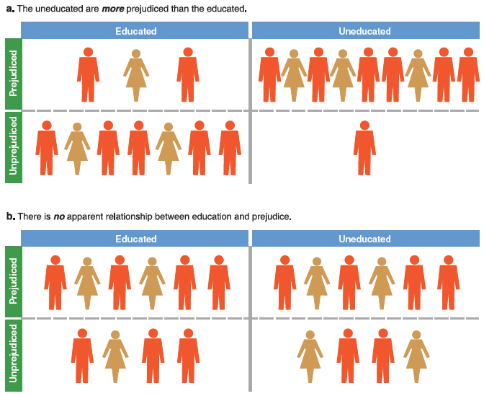
Figure 1-3
Illustration of Relationship between Two Variables (Two Possibilities)
Variables such as education and prejudice and their attributes (educated/uneducated, prejudiced/unprejudiced) are the foundation for the examination of causal relationships in social research.
Notes:
We see the difference between the relationship between two variables: a visualization of an apparent relationship b/w the two, and one without.
More often, we’re concerned with how attributes on one variable cause their attributes on another variable.

Slide 16
The Foundations of Social Science (slide 1 of 2)
Independent Variable – A variable with values that are taken as simply given. A variable that influences another. Predictor.
Dependent Variable – A variable assumed to depend on or be caused by another. Outcome.
Notes:
Religiousity is a function of sex/gender? Which is DV? Which is IV?
Depending on the explanation, a variable might be a DV in one analysis, but and IV in the next (religiosity influencing crime).

Slide 17
The Foundations of Social Science (slide 2 of 2)
The Purposes of Social Research
Mapping out a topic that may warrant further study later (exploratory)
Describing the state of social affairs (descriptive)
Providing reasons for phenomena, in terms of causal relationships (explanatory)
The Ethics of Human Inquiry
Ethical dimension presented throughout the text.
Notes:
Social research has several functions: can be exploratory, descriptive, or explanatory.
Exploratory – learning something new about a political group (lay research, non-publishable)
Descriptive – describes current situations like crime in cities, opinions on marijuana (reports from research firms, etc).
Explanatory – explains why a social phenomenon is occurring, using causal relationships, like why the employment rate is so high in a city. (high quality research)

Slide 18
Some Dialectics of Social Research (slide 1 of 2)
Idiographic and Nomothetic Explanation
Idiographic – explanation that exhausts the many idiosyncratic causes for a particular event.
Nomothetic – explanation that identifies one or a few causal factors that generally impact a class of events.
Notes:
Idiographic -- Causal explanation limited to that event only.
Nomothetic -- Causal explanation large, but settles for partial explanation.

Slide 19
Some Dialectics of Social Research (slide 2 of 2)
Inductive and Deductive Theory
Induction – logical argument in which general principles are developed from specific observations/data.
Deduction – logical argument in which specific expectations of hypotheses are developed on the basis of general principles/other theories.
Notes:
Induction – moves from specific observations/data to discovery of a general pattern that represents the order in the data. This just tells you that a pattern exists, but not why it does. Moves from ``whether’’ something occurs to ``why’’ it does.
Deduction – moves from a general pattern that may be logically or theoretically expected to specific observations designed to test whether the pattern really occurs. Moves from ``why’’ something is generally expected to occur to ``whether’’ it actually does.

Slide 20
Some Dialectics of Social Research
Qualitative and Quantitative Data
Qualitative Data – non-numerical data
Quantitative Data – numerical data

Slide 21
Chapter Summary
Identify the different ways people decide what’s real.
Explain the fundamental nature of social science.
Understand the basic options for conducting social science research.

Slide 22
Questions

Slide 23
Question 1
1. The two foundations of science are:
tradition and observation.
observation and logic.
logic and theory.
theory and observation.
logic and generalization.
Notes:
Answer: B.
The two foundations of science are observation and logic.

Slide 24
Question 2
2. Science…
deals with what should be and not with what is.
can settle debates on value.
is exclusively descriptive.
has to do with disproving philosophical beliefs.
has to do with how things are and why.
Notes:
Answer: E.
Science has to do with how things are and why.

Slide 25
Question 3 (bonus)
3. When social scientists study variables, they focus on
attributes.
groups.
people.
characteristics.
relationships.
Notes:
Answer: E.
When social scientists study variables, they focus on relationships.

Slide 26
Question 4
4. _____ is the science of knowing.
Intelligence
Exam taking
Epistemology
Methodology
Relationships
Notes:
Answer: C.
Epistemology is the science of knowing.

Slide 27
Question 5
5. Which of the following are true of tradition and authority?
They both assist human inquiry.
They both hinder human inquiry.
Both of the above are true.
Neither of the above are true.
Notes:
Answer: C.
Tradition and authority both assist and hinder human
inquiry.

Slide 28
Question 6
6. _____ explanations seek to exhaust the idiosyncratic causes of a particular condition of event.
Idiographic
Latent
Manifest
Nomothetic
Notes:
Answer: A.
Idiographic explanations seek to exhaust the idiosyncratic causes of a particular condition or event.

