Slide 1
CHAPTER 2 PARADIGMS, THEORY, AND RESEARCH

Slide 2
Chapter Outline
Introduction
Some Social Science Paradigms
Two Logical Systems Revisited
Deductive Theory Construction
Inductive Theory Construction
The Links between Theory and Research
The Importance of Theory in the “Real World”
Research Ethics and Theory
Chapter Summary
Questions

Slide 3
Social Science and Theory
“Patterns happen.”
Logical explanations are what theories seek to provide.
Theories prevent our being taken in by flukes.
Theories makes sense of observed patterns.
Theories shape and direct research efforts.
Notes:
An interesting thing about some relationships is that some outcomes can be predicted by completely unrelated phenomena. For example, some theatres can predict presidential winners based on the popcorn they give out, or farmers choice in grain can predict the same… but these are oddities… we know that patterns exist in nature, but the connections between two patterns (or the ability for one to predict the other) may be mere flukes, or chance occurrences… This is why we need good, logical explanations for the patterns we find. This is through theory.
If we can’t explain a finding, then people will think it’s a fluke.
If we make sense of it, why something – especially bad – happens, then we can understand HOW to fix it
If we understand the theory, then we know where’s a good place to look for discoveries (if we had to find our keys, theory – our memory/understanding of where we last had the keys – will direct us where best to look).

Slide 4
Social Science Paradigms (slide 1 of 16)
Paradigm
Framework for understanding social relations
Shapes what we “see” and how we understand it
Some Paradigms:
Positivism, Conflict, Symbolic Interactionism, Structural Functionalism, Feminist paradigms, Critical Race Theory, etc
Notes:
The theories we develop are shaped by the paradigms we work under…
Positivism, Conflict, Symbolic Interactionism, Structural Functionalism, Feminist paradigms, Critical Race Theory,

Slide 5
Social Science Paradigms (slide 2 of 16)
When we recognize that we are operating within a paradigm, two benefits accrue.
We can better understand seemingly bizarre views and actions of others who are operating under different paradigms.
We can profit from stepping outside of our paradigm.
Notes:
Paradigms play a fundamental role in science.
Paradigms are neither true nor false.

Slide 6
Social Science Paradigms (slide 4 of 16)
Macrotheory – A theory aimed at understanding the “big picture” of institutions, whole societies, and the interactions among societies.
Examples: class struggles, international relations, and interrelations between social institutions
Microtheory – A theory aimed at understanding social life on the intimate level of individuals and their interactions.
Examples: dating behavior, jury deliberations, student-faculty interactions
Notes:
Levels of analysis that theories are able to explain

Slide 7
Social Science Paradigms (slide 5 of 16)
Mesotheory – References an intermediate level between macro and micro.
Examples: organizations, communities, and social categories.
Notes:
Levels of analysis that theories are able to explain

Slide 8
Social Science Paradigms (slide 5 of 16)
Read section on ``Rational Objectivity Reconsidered’’

Slide 9
Two Logical Systems Revisited
The Traditional Model of Science
Theory
Operationalization – Developing operational definitions.
Operational Definition – Specific definition of something in terms of the operations by which observations are to be categorized.
Observation – Measuring a variable.
Testable Hypotheses
Notes:
A hypothesis is something derived from theory. It is a specified, testable expectation about empirical reality. If the theory is correct, then this specific relationship should hold in the real world. . Theory about the causes of delinquency… that delinquency is related to social class... (that variation in social class is related to variation in delinquency)... A hypothesis could be something like: social class is inversely related to delinquency (as class goes up, delinquency goes down).
Operationalization differs for every variable that exists. Different ways of measuring the same thing, so your operational definition is important… why you chose to measure that way.
Observation is making the measurements
Good hypotheses are disconfirmable.

Slide 10
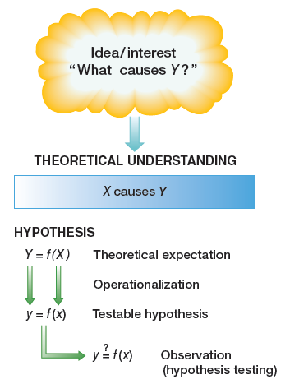
Figure 2-2
The Traditional Model of Science
The deductive model of scientific inquiry begins with a sometimes vague or general question, which is subjected to a process of specification, resulting in hypotheses that can be tested through empirical observations.
Notes:
Check out the ``Hints for stating hypotheses’’ section ~p48-49.

Slide 11
Two Logical Systems Revisited
Deductive and Inductive Reasoning
Deductive = Traditional Model of Science
A Case Illustration (Glock, Ringer, and Babbie, 1967)
Comfort Hypothesis
Notes:
Read the case illustration ~p50-51

Slide 12
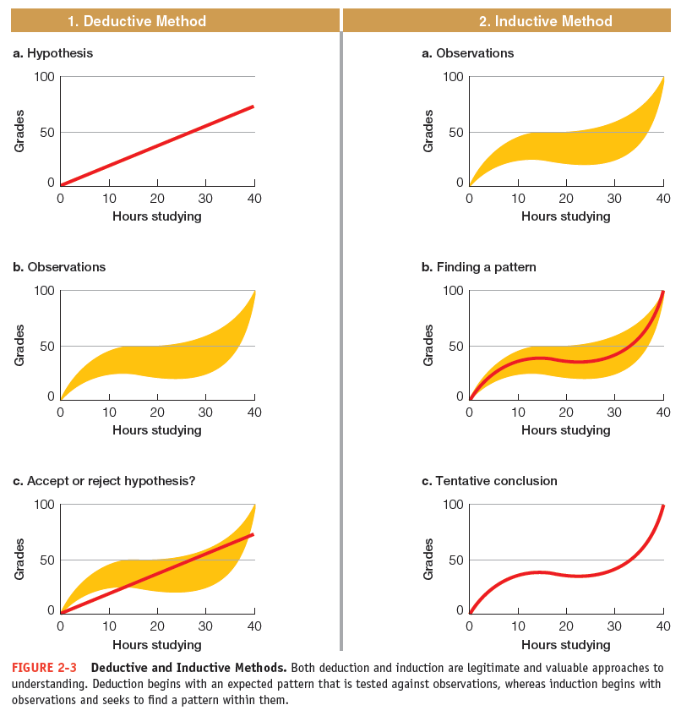
Figure 2-3
Deductive and Inductive Methods
Both deduction and induction are legitimate and valuable approaches to understanding. Deduction begins with an unexpected pattern that is tested against observations, whereas induction begins with observations and seeks to find a pattern within them.

Slide 13
Deductive Theory Construction
Specify the topic.
Specify the range of phenomena your theory addresses.
Identify and specify your major concepts and variables.
Find out what is known about the relationships among those variables.
Reason logically from those propositions to the specific topic you are examining.

Slide 14
Inductive Theory Construction
Observing aspects of social life and seeking to discover patterns that may point to relatively universal principles.
Field Research
Grounded Theory or Theory Development
Notes:
Actually, both begin with a sense/or intuition about a relationship, based on past reading of literature on the case or theories.
Then you collect data, and see who things pan out, according to your intuition, then develop theory

Slide 15
The Links Between Theory and Research
Deductive Model – research is used to test theories.
Inductive Model – theories are developed from analysis of data.

Slide 16
The Importance of Theory in the “Real World”
“Just as pure sociology aims to answer the questions What, Why, and How, so applied sociology aims to answer the question What for. The former deals with facts, causes, and principles; the latter with the object, end, or purpose.” (Lester Ward, 1906)

Slide 17
Research Ethics and Theory
Theoretical paradigms encourage particular conclusions
Bias is controlled by research techniques and the peer review process

Slide 18
Chapter Summary
Be able to name and explain the main social science paradigms.
Be able to explain the difference between deductive and inductive methods as they are used in social research.
Give an example to illustrate the use of deductive analysis.
Give an example to illustrate the use of inductive analysis.

Slide 19
Chapter Summary
Explain how theory and research methods impact each other.
Give an example of how social theory shows up in everyday life.
Give an example of how theory choices might raise issues of research ethics.

Slide 20
Questions

Slide 21
Question 1 (bonus)
1. The three main elements of the traditional model of science are:
theory, operationalization, and observation.
operationalization, hypothesis testing, and theory.
observation, experimentation, and
operationalization.
theory, observation, and hypothesis testing.
experimentation, hypothesis testing, and theory.
Notes:
ANSWER: A.
The three main elements of the traditional mode of
science are theory, operationalization, and
observation.

