Slide 1
CHAPTER 4 research design

Slide 2
Chapter Outline (slide 1 of 2)
Introduction
Three Purposes of Research
The Logic of Nomothetic Explanation
Necessary and Sufficient Causes
Units of Analysis
The Time Dimension

Slide 3
Chapter Outline (slide 2 of 2)
How to Design a Research Project
The Research Proposal
The Ethics of Research Design
Chapter Summary
Questions

Slide 4
A Few Points for Review
3 purposes or types of research?
2 Types of explanations in research?
Inductive versus deductive approaches?
Why is theory important?
Why do we have ethical guidelines?

Slide 5
Three Purposes of Research (slide 1 of 3)
Exploration
To satisfy the researcher’s curiosity and desire for better understanding
To test the feasibility of undertaking a more extensive study
To develop the methods to be employed in any subsequent study
Examples?
Notes:
For researcher to familiarize with a topic, or when the subject of study is relatively new.
E.g. a taxpayers revolt sparks, people refusing to pay taxes, then you want to know more about the movement: how widespread? How organized? What kinds of people are active in it? Exploratory study will help you find out approximate answers.
Can use focus groups to find out trends, like market research.
They seldom provide satisfactory answers to questions, but can hint at directions

Slide 6
Three Purposes of Research (slide 2 of 3)
Description
Describe situations and events through scientific observation
Examples?
Notes:
Researcher observes, and describes what they observe.
Example: US Census, counting or tallying, with no explanation of why. It just reports WHAT IS.

Slide 7
Three Purposes of Research (slide 3 of 3)
Explanation
Descriptive studies answer questions of what, where, when, and how
Explanatory studies answer questions of why
Examples?
Notes:
Explains why trends or an event or data occur – why do people plan to vote for candidate A over candidate B.

Slide 8
The Logic of Nomothetic Explanation
Goal: to find a few factors that can account for many of the variations in a given phenomenon.
Notes:
Or a class of phenomena:
Most explanatory work employs a nomothetic model.. That is, identifying a few variables that can explain a general class of events/outcomes (not just looking at all the factors that contribute to one case - idiographic).

Slide 9
Example: Legalization of Marijuana
Idiographic Approach
Nomothetic Approach
Asking one person what influenced her views:
Parents, teachers, clergy, previous experiences
Finding out about the numerous (cross-cutting) factors that influence general opinion
Political orientation, gender, occupation, education

Slide 10
The Logic of Nomothetic Explanation
Criteria for Nomothetic Causality
The variables must be correlated
The cause takes place before the effect
The variables are nonspurious
Spurious Relationship – A coincidental statistical correlation between two variables shown to be caused by some third variable
Notes:
Correlation – An empirical relationship between two variables such that changes in one are associated with changes in the other, or particular attributes in one are associated with particular attributes in the other.
Cause/Effect – Time ordering.
Spuriousness – the relationship between two variables must be non-spurious, meaning that the relationship between the two cannot be explained by a third variable (e.g. the positive correlation between shoe size and math skill is actually explained by age or how as age increases, shoe size increases, and also how when age increases, math skill tends to increase).

Slide 11
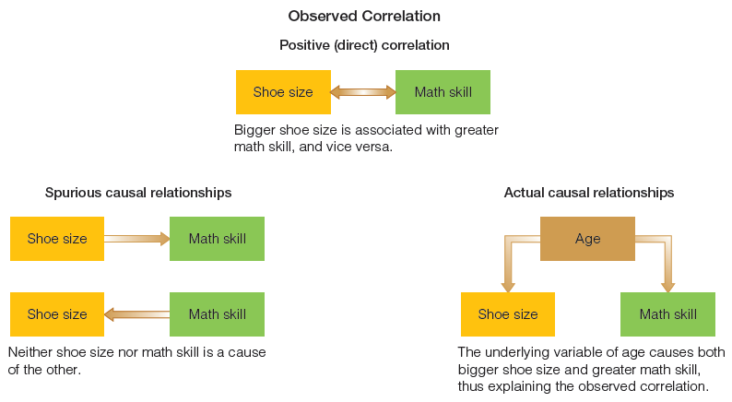
Figure 4-1
An Example of a Spurious Causal Relationship
Finding an empirical correlation between two variables does not necessarily establish a causal relationship. Sometimes the observed correlation is the incidental result of other causal relationships, involving other variables.

Slide 12
The Logic of Nomothetic Explanation (slide 1 of 2)
Nomothetic Causal Analysis and Hypothesis Testing
Hypotheses are not required in nomothetic research.
To test a hypothesis:
Specify variables you think are related
Specify measurement of variables
Hypothesize correlation, strength of relationship, statistical significance
Specify tests for spuriousness
Notes:
Hypothesizing that two variables are related to each other, you could specify the strength of the relationship. This is understood in terms of statistical significance… or the probability that the relationship is not caused by chance.

Slide 13
The Logic of Nomothetic Explanation (slide 2 of 2)
False Criteria for Nomothetic Causality
Complete Causation
Exceptional Cases
Majority of Cases
Notes:
In popular understandings of nomothetic explanations/research causality, there are falsehoods that spread around. These are criteria that are spread around but not true
Complete causation: nomothetic explanations are probabilistic and usually incomplete… e.g. political orientation is ONE OF the causes of support for legalization, but not the only one.
Exceptional cases: extreme cases don’t disprove findings/causal relationships. e.g. a nomothetic finding can be that women, on average, make less than men. This isn’t disproven because you know or find a few women that make more than men.
Majority of Cases: nomothetic explanations can be true even if the relationship doesn’t occur in the majority of cases. E.g. lack of supervision can cause delinquency, even if the majority of unsupervised kids don’t become delinquent, the pattern suggests that those lacking supervision are simply MORE LIKELY TO BE delinquent.

Slide 14
Necessary and Sufficient Causes
A necessary cause represents a condition that must be present for the effect to follow.
A sufficient cause represents a condition that, if present, guarantees the effect in question.
Most satisfying outcomes in research include both necessary and sufficient causes.
Notes:
Necessary = you must have this condition for the outcome to occur
Sufficient means that it is one way to achieve the outcome, but it is only one way (it’s not the only way), and having this condition doesn’t guarantee that the outcome will occur.

Slide 15
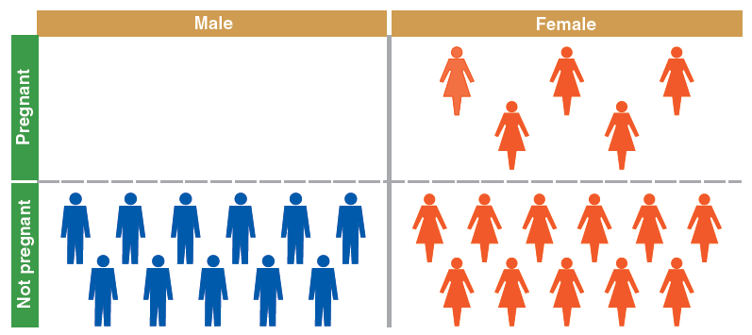
Figure 4-2
Necessary Cause
Being female is a necessary cause of pregnancy, that is, you can’t get pregnant unless you’re female.
Notes:
Necessary = you must have this condition for the outcome to occur
Sufficient means that it is one way to achieve the outcome, but it is only one way (it’s not the only way), and having this condition doesn’t guarantee that the outcome will occur.

Slide 16
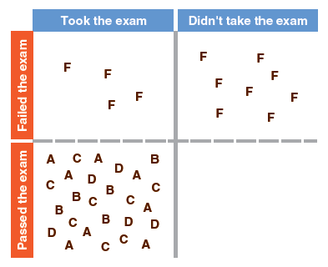
Figure 4-3
Sufficient Cause
Not taking the exam is a sufficient cause of failing it, even though there are other ways of failing (such as answering randomly).
Notes:
Necessary = you must have this condition for the outcome to occur
Sufficient means that it is one way to achieve the outcome, but it is only one way (it’s not the only way), and having this condition doesn’t guarantee that the outcome will occur.

Slide 17
Units of Analysis (slide 1 of 2)
Aggregates versus Individuals
Individuals
Most common unit of analysis for social research
Groups
Organizations
Social Interactions

Slide 18
Units of Analysis (slide 2 of 2)
Individuals
Students, voters, parents, children, Catholics
Groups
Gang members, families, married couples, friendship groups
Organizations
Corporations, social organizations, colleges
Social Interactions
Telephone calls, dances, online chat rooms, fights
Social Artifacts
Social Artifact – any product of social beings or their behavior.

Slide 19
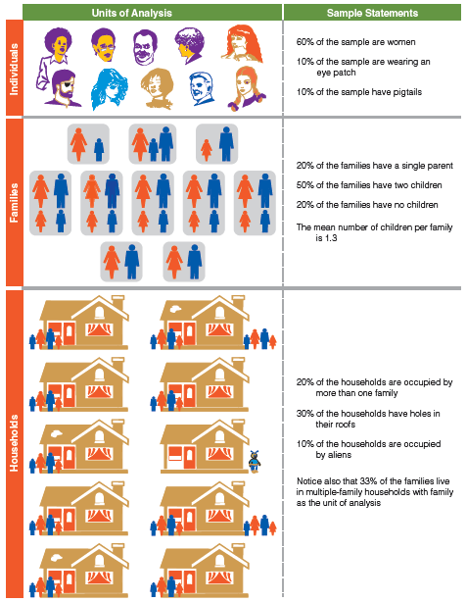
Figure 4-4
Illustration of Units of Analysis
Units of analysis in social research can be individuals, groups, or even nonhuman entities.

Slide 20
Units of Analysis
Faulty Reasoning about Units of Analysis
The Ecological Fallacy
erroneously drawing conclusions about individuals solely from the observations of larger units of analysis.
Reductionism
erroneously drawing conclusions about a phenomenon by looking at aspects of lower level concepts.
Notes:
Ecological fallacy – saying something that you find about blacks at the county level is true for all black individuals in that county. Ex: we find that younger precincts tended to show greater support for the female candidate. Saying that youth or young voters supported the candidate is wrong, since it could have been older voters in relatively young precincts holding the relationship.
Reductionism: predicting the teams that will win the NBA title by looking at the individual strengths of individual players (because you are leaving out critical group-level aspects, including ownership, coaching, loyalty, facility, funding, etc).
Sociobiology – a paradigm based in the view that social behavior can be explained solely in terms of genetic characteristics and behavior

Slide 21
The Time Dimension (slide 1 of 2)
Cross-Sectional Study – A study based on observations representing a single point in time, a cross section of a population.
Notes:
Taking a snapshot of the conditions/population

Slide 22
The Time Dimension (slide 2 of 2)
Longitudinal Study – A study design involving the collection of data at different points in time.
Trend Study – A study in which a given characteristic of some population is monitored over time.
Cohort Study – A study in which some specific subpopulation, or cohort, is studied over time.
Panel Study – A study in which data are collected from the same set of people at several points in time.
Notes:
Trend study: models changes in opinion/etc over time (using various people/samples of different sizes and makeups over time).
Cohorts: examines a subpop, like an age group or time grouping, studied over time, with different people from the same subpop
Panel: studies the same people, over time (attrition is a problem)

Slide 23
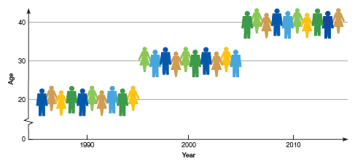
Figure 4-5
A Cohort Study Design
Each of the three groups shown here is a sample representing people who were born in 1970.

Slide 24
The Time Dimension
Comparing Types of Longitudinal Studies, Example: Religious Affiliation
Trend Study
looks at general shifts in religious affiliation over time.
Cohort Study
follows shifts in religious affiliation among those born during the Depression.
Panel Study
follows the shifts in religious affiliation among a specific group of people over time.

Slide 25
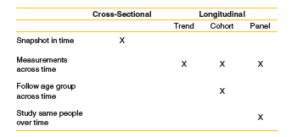
Figure 4-6
Comparing Types of Study Design
Notes:
Approximating Longitudinal Studies (through cross-sectional data)
Researchers can draw approximate conclusions about longitudinal processes even when cross-sectional data are available.
Imply processes over time
Make logical inferences
Ask individuals to recall past behavior
Cohort analysis

Slide 26
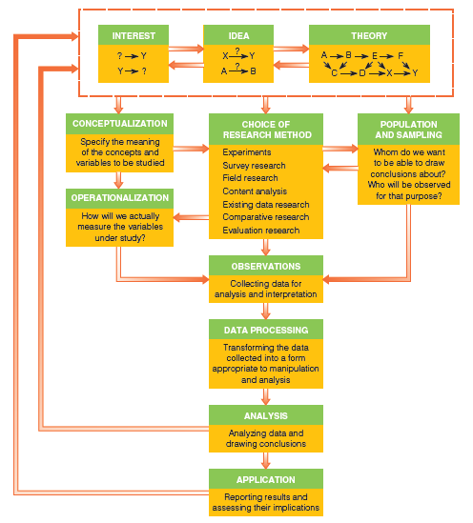
Figure 4-7
The Research Process
Here are some of the key elements that we’ll be examining throughout this book: the pieces that make up the whole of social research.
Notes:
Interest and idea and theory pages are most important, that’s where the researcher comes up with an idea that they’re interested in, reads up about it to get general knowledge about theory.

Slide 27
How to Design a Research Project
Define the purpose of your project – exploratory, descriptive, or explanatory?
Specify the meanings of each concept you want to study
Select a research method
Determine how you will measure the results
Determine whom or what to study
Collect empirical data
Process the data
Analyze the data
Report your findings

Slide 28
A General Research Proposal Outline
Elements of a Research Proposal
Problem or Objective
Literature Review
Subjects for Study
Measurement
Data Collection Methods
Analysis
Schedule
Budget
Institutional Review Board
Notes:
Read up about the research proposal

Slide 29
The Ethics of Research Design
Research design should indicate how your study will abide by the ethical strictures of social research
May be appropriate for an institutional review board to review your research proposal
Notes:
As designated by chapter 3 (about why it’s important).

Slide 30
Chapter Summary (slide 1 of 2)
Discuss the role of exploration, description, and explanation in social research.
Discuss the logic and procedures of idiographic explanation.
Name and discuss the legitimate and false criteria for nomothetic explanation.
Distinguish between necessary and sufficient causes, giving examples.
Identify some of the common units of analysis in social research and explain why that concept is important.

Slide 31
Chapter Summary (slide 2 of 2)
Identify and describe some common study designs based on the time dimension.
Explain and illustrate some advantages of mixed-mode designs.
Identify and discuss the key elements in the design of a research project.
Describe the elements and structure of a research proposal.
Give examples of how research design can have ethical implications.

Slide 32
Questions

Slide 33
Question 1
1. Social researchers tend to choose _____ as their units of analysis.
social interactions
social artifacts
groups
individuals
aggregates
Notes:
ANSWER: D.
Social researchers tend to choose individuals as their units of analysis.

Slide 34
Question 2
2. Scientific inquiry comes down to
making observations.
interpreting what you have observed.
both of the above
none of the above
Notes:
ANSWER: C.
Scientific inquiry comes down to making observation and interpreting what you have observed.

Slide 35
Question 3
3. A _____ is an empirical relationship between two variables such that changes in one are associated with changes in the other.
nomothetic explanation
regression analysis
correlation
spurious relationship
Notes:
ANSWER: C.
A correlation is an empirical relationship between two variables such that changes in one are associated with changes in the other.

Slide 36
Question 4
4.Which of these are among the purposes of research?
exploration
description
explanation
All of the above
Notes:
ANSWER: D.
Exploration, description, and explanation are all
among the purposes of research.

Slide 37
Question 5
5. What do social researchers means when they say there is a causal relationship between education and racial tolerance?
There is a statistical correlation between the two variables.
A person’s educational level occurred before their current level of tolerance.
There is no third variable that can explain away the observed correlation.
all of these choices
none of the these choices
Notes:
ANSWER: D.
When social researchers say there is a casual relationship between education and racial tolerance they mean: there is a statistical correlation between the two variables, a person’s educational level occurred before their current level of tolerance, and there is no third variable that can explain away the observed correlation.

Slide 38
Question 6
6. A _____ is probabilistic and usually incomplete.
nomothetic explanation
correlation
spurious relationship
theory
Notes:
ANSWER: A.
A nomothetic explanation is probabilistic and usually incomplete.

Slide 39
Question 7
7. A _____ represents a condition that, if present, guarantees the effect in question.
hypothesis
sufficient cause
practical issue
necessary cause
dependent variable
Notes:
ANSWER: B.
A sufficient cause represents a condition that, if present, guarantees the effect in question.

