Slide 1
Chapter 5 Conceptualization, Operationalization, and Measurement

Slide 2
Chapter Outline
Introduction
Measuring Anything That Exists
Conceptualization
Definitions in Descriptive and Explanatory Studies
Operationalization Choices
Criteria of Measurement Quality
The Ethics of Measurement
Chapter Summary
Questions

Slide 3
Measuring Anything That Exists
Observation versus Measurement
Measurement
Careful, deliberate observations
of the real world for the purpose of describing objects and events in terms of the attributes composing the variable.
Notes:
One of the two pillars of science is observation, but that word kinda seems like a passive activity. Scientists prefer the term measurement, which is more careful and deliberate.
The things we want to measure rarely have just one, objective/unambiguous meaning. And in studying human social behavior, our concepts are not real like rocks are real. Meanings are subjective.
For party affiliation, we could ask what people are registered as, or we can also ask what party they identify with.

Slide 4
Measuring Anything That Exists
How would you measure…
political party affiliation?
age?
grade point average?
religious affiliation?
Notes:
For party affiliation, we could ask what people are registered as, or we can also ask what party they identify with.

Slide 5
Measuring Anything That Exists
How would you measure…
prejudice?
compassion?

Slide 6
Measuring Anything That Exists
Direct Observables
Things we observe ourselves (e.g. color of the desk)
Indirect Observables
Things we’re not around to see, but can infer from something that is observable (e.g. gender, from a checkmark on a questionnaire next to “female”)
Constructs
Theoretical creations, not observed directly or indirectly but having agreed upon meanings (e.g. intelligence)
Notes:
Everyone has different mental images of concepts/constructs. Such that, if I had a paper of a list of all the things I make up prejudice, it might be different from yours. These mental images of constructs/concepts are our subjective interpretations/conceptions of that construct/concept.

Slide 7
Measuring Anything That Exists
Concepts
constructs derived by mutual agreement from mental images.
Conceptions
our individual understandings of seemingly related observations and experiences
Conceptualization
Notes:
Everyone has different mental images of concepts/constructs. Such that, if I had a paper of a list of all the things I make up prejudice, it might be different from yours. These mental images of constructs/concepts are our subjective interpretations/conceptions of that construct/concept.
Although constructs aren’t real in the way trees or rocks are real, they can still help us make predictions about real things… because they have a definite relationship to things that ARE REAL and OBSERVABLE.
Constructs have no intrinsic reality, only the meaning we agree to give it.

Slide 8
Conceptualization
Conceptualization
process of specifying what we mean (agreeing upon a meaning. terms) for a concept in research.
We cannot meaningfully answer a question without a working agreement about the meaning of the outcome.
Notes:
However we disagree, the process of coming to an agreement on what we mean by a particular concept is called conceptualization.

Slide 9
Conceptualization
How would you conceptualize…
prejudice?
compassionate?
Notes:
Everyone has different mental images of concepts/constructs. Such that, if I had a paper of a list of all the things I make up prejudice, it might be different from yours. These mental images of constructs/concepts are our subjective interpretations/conceptions of that construct/concept.
Although constructs aren’t real in the way trees or rocks are real, they can still help us make predictions about real things… because they have a definite relationship to things that ARE REAL and OBSERVABLE.
Constructs have no intrinsic reality, only the meaning we agree to give it.

Slide 10
Conceptualization
Indicators and Dimensions
Indicator
An observation we choose as a reflection of a concept/construct/variable
Dimension
A grouping of a concept/construct/variable.
Multiple indicators can make up a single dimension (amongst multiple dimensions) of a concept/variable
Notes:
Variable/concept <- dimension <- indicator
Indicator of religiosity could be “# of religious services attended in last week”
Dimension of religiosity could be “ritual” “activism” “belief” or “devotion”
Concepts can be broken/divided into several dimensions.

Slide 11
Conceptualization
Indicators and Dimensions of Religiosity
Notes:
Variable/concept <- dimension <- indicator
Indicator of religiosity could be “# of religious services attended in last week”
Dimension of religiosity could be “ritual” “activism” “belief” or “devotion”
Concepts can be broken/divided into several dimensions.

Slide 12
Conceptualization
Identify appropriate indicators and dimensions for…
college success
political activity
poverty
binge drinking
fear of crime
Notes:
Binge drinking…
Social, dependency/addiction:
# of drinks you had last week?
# of drinks you had in one sitting?

Slide 13
Conceptualization
The Interchangeability of Indicators
If several indicators accurately represent the same concept, all of them should reach the same result.
Can use different subsets of indicators to accurately measure the concept
Notes:
Say we have two people looking at a list of 50 indicators of religiosity, and disagreeing about which ones actually measure religiosity. One says only a certain 25 actually measure it, the other says the other 25 are better measures… the idea of interchangeability means that if all 50 indicators show the same relationship (can measure religiosity), then it doesn’t matter

Slide 14
Conceptualization
Operational Definition
specifies precisely how a concept will be measured – that is, the operations we will perform.
Notes:
Nominal definition of compassion could be plucking feathers off helpless birds… doesn’t really measure it. Not as important.
Operational definition is more important.

Slide 15
Conceptualization
Conceptualization – Practice
Anomie
Notes:
Pg 142-143: an example of conceptualization: the concept of anomie.

Slide 16
Conceptualization
Definitions can be problematic
Unemployment rate
Who is employed?
Who is in the labor force?
What do other definitions include?
Notes:
If we want to report/describe the unemployment rate in a city, “being unemployed” is critical…
definition of the labor force… since it’s probably not wise to include babies as unemployed.
Also, we may want to use the census version of 14 or above as labor force… and of those,
people who have not been looking for work for a week or more are unemployed.

Slide 17
Operationalization Choices
Conceptualization versus Operationalization Processes
Operationalization
defining measurement procedures to represent concepts
Range of Variation
Trying to study all aspects/levels of a concept
Notes:
Say you want to look at income: do you constrict your categories or do you try to create categories for everyone to fit in? Do you need to go in 10k increments all the way to above 1million per year or can you simply say 250k or more? Same for lower ranges (is 0 really a good income, or can you say below 5k?). Think about the normal curve, only very few people will fall at the extremes, so clumping/clustering wont hurt your results much.
Important to understand range of variation because for some concepts, such as opinion on nuclear energy, you can’t just create a attitudinal scale ranging from ``do not favor at all’’ to ``favor very much’’ since some people are more than not favoring… they actively oppose it. So think about your research question and the concepts involved and whether or not its wise to include all possible measurements.

Slide 18
Operationalization Choices
Precision
deciding how precise/fine-grained to be in your measurement
Notes:
Degree of precision is important… how fine-grained your measurements will be… if you’re looking at age, is saying “30s” good enough, or should you go with a more precise option of yearlong estimates (e.g. 37).
Its generally best to be more fine grained, and aggregate up to larger more encompassing categories… because it’s much harder the other way (e.g. if you write down that the respondent was in her 30s, if you need a more precise measurement for a quantitative analysis, you wouldn’t be able to get it… however, the reverse is not true)

Slide 19
Operationalization Choices
Attributes
characteristic or quality of something (ex: female, old, student)
Variable
logical set of attributes (ex: gender, age)
Defining Variables and Attributes
The attributes composing variables should be exhaustive.
Attributes must be mutually exclusive.
Notes:
Exhaustive means that you’re including options for all possible attributes of a variable, in order to correctly classify all respondents. For party affiliation, you need to list out all possible party affiliations so that each respondent has the opportunity to select their party
Mutually exclusive (with exceptions for things like race/ethnicity, which should be a checkbox/select all that apply) means that every response should be classified in terms of only ONE attribute… (e.g. they are EITHER employed or unemployed, not both).

Slide 20
Operationalization Choices
How can we operationally define ____ (both exhaustive and mutually exclusive)?
Party Affiliation
Notes:
Exhaustive means that you’re including options for all possible attributes of a variable, in order to correctly classify all respondents. For party affiliation, you need to list out all possible party affiliations so that each respondent has the opportunity to select their party
Mutually exclusive (with exceptions for things like race/ethnicity, which should be a checkbox/select all that apply) means that every response should be classified in terms of only ONE attribute… (e.g. they are EITHER employed or unemployed, not both).

Slide 21
Operationalization Choices
Levels of Measurement
Nominal
Ordinal
Interval
Ratio

Slide 22
Operationalization Choices
Nominal
Variables whose attributes have only the characteristics of exhaustiveness and mutually exclusiveness. Simple categories. Attributes that classify, but cannot be ranked!
Examples: gender, religious affiliation, college major, hair color, birthplace, nationality, party affiliation

Slide 23
Operationalization Choices
Ordinal
Variables with attributes we can logically rank order. Variables whose attributes that classify and can be ranked but lack an associated numerical value.
Examples: socioeconomic status, level of conflict, prejudice, conservativeness, hardness

Slide 24
Operationalization Choices
Interval
Variables for which the actual distance between attributes has meaning. Variables whose attributes classify, can be ranked ordered, and have an equal numerical distance between values.
Examples: temperature (Fahrenheit), IQ score

Slide 25
Operationalization Choices
Ratio
Variables whose attributes meet the requirements of a interval measure, and has a true zero point.
Examples: temperature (Kelvin), age, length of time, number of organizations, number of groups, number of A’s received in college
Notes:
Mostly, people in social science call interval variables “interval-ratio” variables.

Slide 26
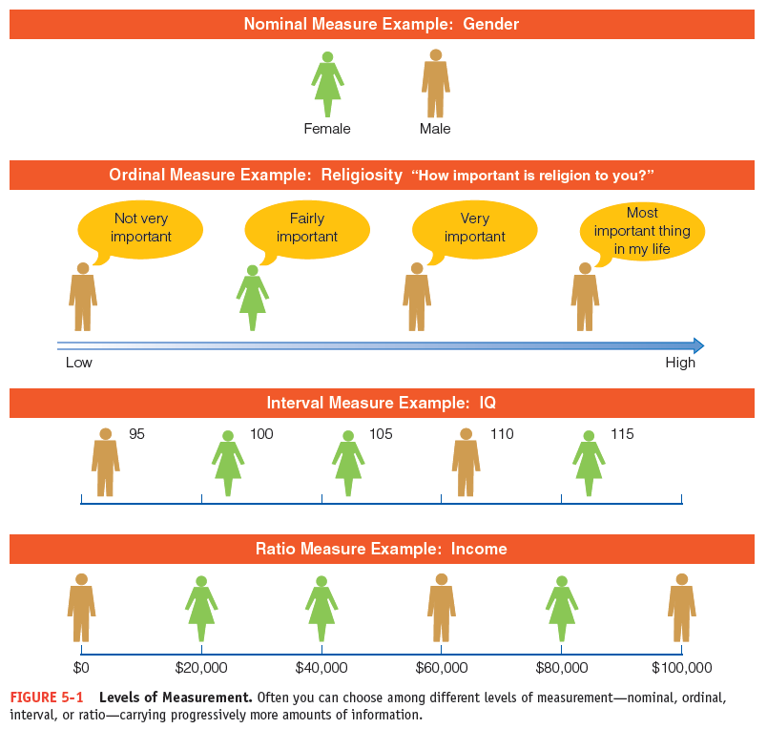
Figure 5-1
Levels of Measurement
Often you can choose among different levels of measurement—nominal, ordinal, interval, or ratio—carrying progressively more amounts of information.

Slide 27
Operationalization Choices
Implications of Levels of Measurement
some analyses require minimum levels of measurement
some variables can be treated as multiple levels of measurement
Single or Multiple Indicators
Notes:
Age can be treated, based on it’s operational definition, as either ordinal (30s, 40s, etc) or interval.
Some variables only need a single indicator: like sex, family size, or weight
Other variables need multiple indicators (usually things that can’t be directly observed, so constructs/concepts): college performance, or compassion.

Slide 28
Operationalization Choices
How can we measure _____ at multiple levels?
Age
Income
Notes:
Age can be treated, based on it’s operational definition, as either ordinal (30s, 40s, etc) or interval.
Some variables only need a single indicator: like sex, family size, or weight
Other variables need multiple indicators (usually things that can’t be directly observed, so constructs/concepts): college performance, or compassion.

Slide 29
Criteria of Measurement Quality
Precision and Accuracy
Precise measures are superior to imprecise ones.
Reliability
same data would be collected/same results would occur in repeated observations of the same phenomenon.
Notes:
Reliable weight measurement is, I step on the scale and it says the same thing for every repeated observation. (if you made your scale report +5lbs every time, its reliable, but also biased/not valid).

Slide 30
Criteria of Measurement Quality
Test-Retest Method
To make the same measurement more than once.
Split-Half Method
Multiple sets of randomly assigned variables should produce the same classifications
Established Measures
Reliability of Research Workers
Notes:
Split half, if there are 10 items that we think correctly classify compassion, we randomly assign 5 to the midterm, and 5 to the final… if they are both reliable measures, both sets of items should classify people in the same way.
Established measures means using items that have shown reliable measurements in the past (MMPI min multiphasic personality inventory, SATs)
Reliability of workers means interrater-reliability, getting multiple trained researchers to code the same data, and see if they classify the data in the same way.

Slide 31
Criteria of Measurement Quality
Validity
measurement that accurately reflect the concept it is intended to measure.
Face Validity
Measurement that seems to make reasonable sense
Criterion-Related Validity
Measurement related to some external criterion
Notes:
Face validity: it makes sense, e.g. IQ seems like a way to measure intelligence rather than using than time spent at library… or the number of grievances has something to do with morale in an occupation, although we may disagree if it’s the BEST measure.
Criterion related validity: it has been shown to relate to some outcome (college board exams are good measures of college success, success on a written DMV test is a good predictor of clean driving records).

Slide 32
Criteria of Measurement Quality
Construct Validity
The degree to which a measure relates to other variables as expected within a system of theoretical relationships.
Content Validity
measure that covers the range of meanings included within a concept.
Notes:
Construct: Marital satisfaction variables should relate to other variables, such as marital fidelity (more satisfied couples should be less likely to cheat). Since that makes sense theoretically.
Content: should cover the range of the concept/variable (math ability measurements should measure more than just ability on addition or subtraction but a whole swath of math abilities).

Slide 33
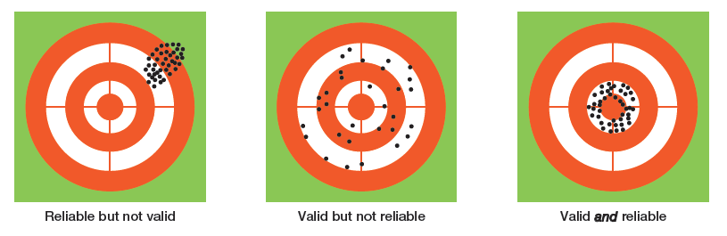
Figure 5-2
An Analogy to Validity and Reliability
A good measurement technique should be both valid (measuring what it is intended to measure) and reliable (yielding a given measurement dependably).

Slide 34
The Ethics of Measurement
Conceptualization and measurement must not be guided by bias or preferences for particular research outcomes

Slide 35
Chapter Summary (slide 1 of 2)
Explain and illustrate how conceptions, concepts, and constructs relate to reality.
Describe the steps involved in the process of conceptualization.
Discuss the assertion that definitions are more critical in descriptive than in explanatory studies.

Slide 36
Chapter Summary (slide 2 of 2)
Identify and illustrate the many choices you may have in operationalizing variables.
Distinguish among precision, accuracy, reliability, and validity and discuss how they affect the quality of a measurement technique.
Explain how measurement decisions can have ethical implications.

Slide 37
Questions

Slide 38
Question 1
1. It is truly possible to measure the stuff of life.
True
False
Notes:
ANSWER: A.
It is truly possible to measure the stuff of life.

Slide 39
Question 2
2. _____ refer to mental images.
Perspectives
Theories
Conceptions
Methods
Notes:
ANSWER: C.
Conceptions refer to mental images.

Slide 40
Question 3
3. The mental processes whereby fuzzy and imprecise notions are made more specific and precise is called:
construction
reification
conceptualization
operationalization
Notes:
ANSWER: C.
The mental processes whereby fuzzy and imprecise
notions are made more specific and precise is called
conceptualization.

Slide 41
Question 4
4. Which of the following are examples of nominal measures?
gender
religious affiliation
political party affiliation
birthplace
all of the above
Notes:
ANSWER: E.
Gender, religious affiliation, political affiliation, and
birthplace are examples of nominal measures.

Slide 42
Question 5
5. _____ is the degree to which a measure covers the range of meanings included within a concept.
Construct validity
Criterion-related validity
Face validity
Content validity
Notes:
ANSWER: D.
Content validity is the degree to which a measure covers the range of meanings included within a concept.

Slide 43
Question 6
6. In social research, the process of coming to an agreement about what terms mean is:
hypothesizing
conceptualization
variable determination
operationalization
Notes:
ANSWER: B.
In social research, the process of coming to an agreement about what terms mean is conceptualization.

Slide 44
Question 7
7. The _____ of concepts in scientific inquiry depends on nominal and operational definitions.
specification
interchangeability
functioning
network
Notes:
ANSWER: A.
The specification of concepts in scientific inquiry depends on nominal and operational definitions.

Slide 45
Question 8
8. A level of measurement describing a variable whose attributes are rank-ordered and have equal distances between adjacent attributes are _____ measures.
ratio
interval
nominal
ordinal
Notes:
ANSWER: B.
A level of measurement describing a variable whose attributes are rank-ordered and have equal distances between adjacent attributes are interval measures.

