Slide 1
CHAPTER 9 survey research

Slide 2
Chapter Outline (slide 1 of 2)
Introduction
Topics Appropriate for Survey Research
Guidelines for Asking Questions
Questionnaire Construction
Self-Administered Questionnaires
Interview Surveys
Telephone Surveys
Online Surveys
Mixed-Mode Surveys

Slide 3
Chapter Outline (slide 2 of 2)
Comparison of the Different Survey Methods
Strengths and Weaknesses of Survey Research
Secondary Analysis
Ethics and Survey Research
Chapter Summary
Questions

Slide 4
Topics Appropriate for Survey Research
Descriptive, exploratory, and explanatory
Units of analysis = respondents
Respondents – A person who provides data for analysis by responding to a survey questionnaire.
Large samples, original data, measuring attitudes and orientations

Slide 5
Guidelines for Asking Questions (slide 1 of 3)
Questionnaire – A document containing questions and other types of items designed to solicit information appropriate for analysis.

Slide 6
Guidelines for Asking Questions (slide 2 of 3)
Choose Appropriate Question Forms
Questions and Statements
Open-Ended and Closed-Ended Questions
Open-Ended Questions – Questions for which the respondent is asked to provide his/her own answers.
Closed-Ended Questions – Survey questions in which the respondent is asked to select an answer from among a list provided by the researcher.

Slide 7
Guidelines for Asking Questions (slide 3 of 3)
Make Items Clear
Avoid Double-Barreled Questions
Respondents Must Be Competent to Answer
Respondents Must Be Willing to Answer
Questions Should Be Relevant
Short Items are Best
Avoid Negative Items
Avoid Biased Items and Terms

Slide 8
Questionnaire Construction
General Questionnaire Format
Uncluttered
One question per line
Consistent format

Slide 9
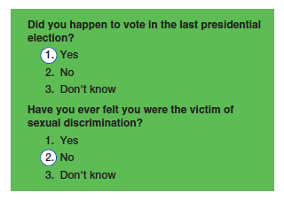
Figure 9-1
Circling the Answer

Slide 10
Questionnaire Construction
Contingency Question – A survey question intended for only some respondents, determined by their responses to some other question.

Slide 11
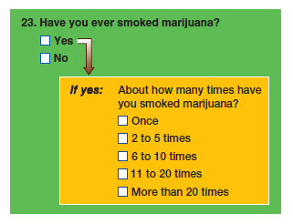
Figure 9-2
Contingency Question Format
Contingency questions offer a structure for exploring subject areas logically in some depth.

Slide 12
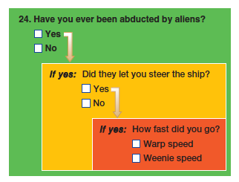
Figure 9-3
Contingency Table
Sometimes it will be appropriate for certain kinds of respondents to skip over inapplicable questions. To avoid confusion, you should provide clear instructions to that end.

Slide 13
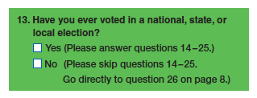
Figure 9-4
Instructions for Skipping Questions

Slide 14
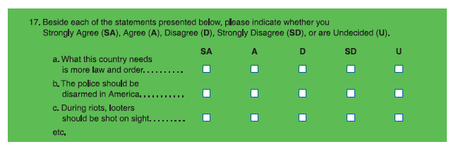
Figure 9-5
Matrix Question Format
Matrix questions offer an efficient format for presenting closed-ended questionnaire items that have the same response categories.

Slide 15
Questionnaire Construction
Ordering Items in a Questionnaire
Appearance
Open-Ended or Closed-Ended First?
Randomized Ordering
Sensitivity to the Problem
Demographic questions should go at the end
Questionnaire Instructions
Introductory comments and clear instructions
Pre-testing the Questionnaire

Slide 16
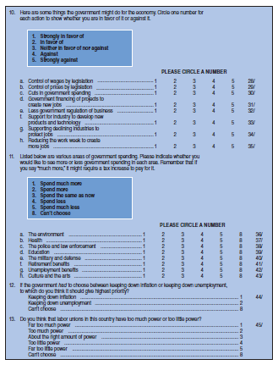
Figure 9-6
A Sample Questionnaire
This questionnaire excerpt is from the General Social Survey, a major source of data for analysis by social researchers around the world.

Slide 17
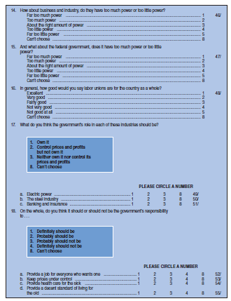
Figure 9-6 (cont’d)
A Sample Questionnaire
This questionnaire excerpt is from the General Social Survey, a major source of data for analysis by social researchers around the world.

Slide 18
Self-Administered Questionnaires (slide 1 of 2)
Questionnaires in which respondents are asked to complete the questionnaire by themselves.
Mail Distribution and Return
Why do people not return questionnaires?
Monitoring Returns
Follow-Up Mailings

Slide 19
Self-Administered Questionnaires (slide 2 of 2)
Response Rate – The number of people participating in a survey divided by the number selected in the sample.
Ideal = higher than 70%
Why is a low response rate bad?
What can be done to improve response?

Slide 20
Interview Surveys (slide 1 of 3)
Interview – A data-collection encounter in which one person (interviewer) asks questions of another (respondent).
The Role of the Survey Interviewer
Interviewers solicit higher response rates (80-85%) than mail surveys.
Interviews minimized “don’t know” and “no answer.”
Interviewers serve as a guard against confusion.
Interviewers can observe respondents while completing the questionnaire.

Slide 21
Interview Surveys (slide 2 of 3)
General Guidelines for Survey Interviewing
Dress appropriately
Be familiar with questionnaire
Follow question working exactly
Record responses exactly
Probe when necessary
Probe – a technique employed interviewing to solicit a more complete answer to a question.

Slide 22
Interview Surveys (slide 3 of 3)
Coordination and Control
Training
General guidelines
How to handle difficult situations
Practice interviews
“Real” interviews

Slide 23
Telephone Surveys (slide 1 of 3)
Advantages
95.5% of households have a telephone
Time and money
Control
Personal safety
Disadvantages
Bogus surveys
Unlisted phone numbers
Cell phones
Answering machines/voicemail/caller ID

Slide 24
Telephone Surveys (slide 2 of 3)
Random-Digit Dialing (RDD) – A sampling technique in which random numbers are selected from within the ranges of numbers assigned to active telephones.
Computer-Assisted Telephone Interviewing (CATI) – A data-collection technique in which a telephone-survey questionnaire is stored in a computer, permitting the interviewer to read the questions from the monitor and enter the answers on the computer keyboard

Slide 25
Telephone Surveys (slide 3 of 3)
Response Rates in Interview Surveys

Slide 26
Online Surveys (slide 1 of 2)
Representative?

Slide 27
Online Surveys (slide 2 of 2)
DO use consistent wording.
DO use simple language.
DON’T force excessive scrolling.
DO offer to share select result with respondents.
DO plan time and day of initial mailing.
DO be aware of technical limitations.
DO test incentives, rewards, and prizes.
DO limit studies to less than 15 minutes.

Slide 28
Mixed Mode Surveys
Combine different research techniques
Example: A survey combined with a review of existing data and in-depth field observations and interviews.

Slide 29
Comparison of the Different Survey Methods (slide 1 of 2)
Self-Administered Questionnaires
Cheaper and faster than face-to-face interviews
National is the same cost as local mailings
Requires small staff
More willingness to answer controversial items
Interview Surveys
Fewer incomplete questionnaires
More effective for complicated questionnaires
Face-to-face is more intimate

Slide 30
Comparison of the Different Survey Methods (slide 2 of 2)
Telephone Surveys
Cheaper and more time efficient
Online Surveys
Available software and websites

Slide 31
Strengths of Survey Research
Strengths
Useful in describing large populations
Make large samples possible
Surveys are flexible
Standardized questions

Slide 32
Weaknesses of Survey Research
Weaknesses
Round pegs in square holes
Seldom deal with context of social life
Inflexible
Artificial
Weak on validity (but strong on reliability)

Slide 33
Secondary Analysis
Secondary Analysis – A form of research in which the data collected and processed by one researcher are reanalyzed by another.
Example: General Social Survey
Advantages: cheaper and faster than primary data collection
Disadvantages: validity

Slide 34
Ethics and Survey Research
Surveys often ask for private information, which must be kept confidential.
Because asking questions can cause psychological discomfort or harm to respondents, researchers should minimize this risk.

Slide 35
Chapter Summary (slide 1 of 3)
Identify research topics that are well suited for survey research.
Explain the key rules for asking questions in a survey questionnaire.
Discuss some of the key concerns in the construction of a survey questionnaire.
Explain the steps involved in the execution of a self-administered survey.

Slide 36
Chapter Summary (slide 2 of 3)
Describe the steps involved in the execution of an interview survey.
Summarize the steps involved in the execution of a telephone survey.
Discuss the advantages and disadvantages of online surveys.
Provide examples of mixed-mode surveys and explain the advantages you might gain.

Slide 37
Chapter Summary (slide 3 of 3)
Understand which research projects are most suitable to each of the different survey methods.
Identify the key strengths and weaknesses of survey research in general.
Explain what secondary analysis is and its key advantages and disadvantages.
Discuss some of the ethical problems that might be raised in survey research.

Slide 38
Questions

Slide 39
Question 1
1. When is survey research the best method available?
when collecting original data
when describing a population too large to observe directly
when measuring attitudes
all of the above

Slide 40
Answer 1
ANSWER: D.
Survey research the best method available when collecting original data, when describing a population too large to observe directly, and when measuring attitudes.

Slide 41
Question 2
2. _____ questions have a respondent select an answer from among a list provided.
Open-Ended
Pretest
Experimental
Closed-Ended

Slide 42
Answer 2
ANSWER: D.
Closed-ended questions have a respondent select an answer from among a list provided.

Slide 43
Question 3
3. As a general rule, a questionnaire should be:
spread out
uncluttered
relevant
all of the above

Slide 44
Answer 3
ANSWER: D.
As a general rule, a questionnaire should be spread out, uncluttered, and relevant.

Slide 45
Question 4
4. Which of these are among the many advantages that underlie the growing popularity of telephone surveys?
money
time
convenience
all of the above choices
none of the above choices

Slide 46
Answer 4
ANSWER: D.
Money, time, and convenience are among the many advantages that underlie the growing popularity of telephone surveys.

Slide 47
Question 5
5. Which is not an advantage of survey research?
increased validity
increased reliability
increased generalizability
increased flexibility in analysis

Slide 48
Answer 5
ANSWER: A.
Increased validity is not an advantage of survey research.

Slide 49
Question 6
6. The major problem with secondary analysis pertains to:
theory
hypotheses
validity
sampling
empirical generalization

Slide 50
Answer 6
ANSWER: C.
The major problem with secondary analysis pertains to validity.

