Slide 1
CHAPTER 1 HUMAN INQUIRY AND SCIENCE

Slide 2
Chapter Outline
Introduction
Looking for Reality
The Foundation of Social Science
Some Dialectics of Social Research
Chapter Summary
Questions
Notes:
Research methods not about what we know, but how we know it (e.g. how do we know that unprotected sex can result in HIV contraction?)
Basis of knowing is agreement, since you cant experience everything personally, you have to rely on others doing the work for you, either through tradition or experts
So the contrast to agreement is personal experience -- observation

Slide 3
Looking for Reality
Epistemology
The science of knowing
Methodology
Science of finding out (subfield of epistemology)

Slide 4
Looking for Reality
Ordinary Human Inquiry
We desire to predict the future
future is caused/affected by the present
Ordinary human inquiry lacks understanding
Prediction must be paired with understanding
Must incorporate probabilistic patterns
Notes:
Future caused by present – studying hard will result in better grades
But patterns are probabilistic – studying hard will not ALWAYS result in good grades
Predictions must be paired with understanding – you can’t just say that because you find that the 3rd ranked horse in the 3rd race of the day always wins, because as scientists, we must provide reasoning why it works out that way (e.g. we can’t just not care).
Tradition and Authority are two ways that scientists acquire knowledge that they have not directly experienced themselves, but both can be double-edged swords.
Tradition is easy but can be detrimental – we accept what everyone knows, taken for granted, and it helps us avoid the overwhelming task of asking questions and answering them from scratch… but we rarely gain new/fresh understandings if we rely on tradition (and any inquiry that seeks a fresh understanding could be viewed as foolish).
Authority helps scientists accept new knowledge – we’re more likely to believe new discoveries based on the status of the discoverers (we’ll believe new findings about kissing and the common cold from an epidemiologist than our uncle). But problems include 1) we must accept that even specialists can make errors, and 2) we can only trust the authority of a person within their given field of expertise (we can’t trust a pastor for his proclamation about the negative neurochemical effects of marijuana).

Slide 5
Looking for Reality
Errors in Human Inquiry and Some Solutions
Inaccurate Observations
measurement devices offer accuracy.
Overgeneralizations
large and representative samples are a safeguard against overgeneralization.
replication – Repeating a research study to test and either confirm or question the findings of an earlier study.
Notes:
When we try to step away from tradition and authority, we sometimes err on our own, as well. But scientific inquiry has some safeguards.
Inaccurate Observations – Mistakes in observations/no recall | Making deliberate observations reduces error. Measurement devices add some precision to estimates.
Overgeneralization – Observing a few similar events and assuming they’re evidence of a general pattern/overgeneralize on basis of limited observations | drawing sufficiently large samples, and replication.

Slide 6
Looking for Reality
Selective Observations
look for “deviant” cases.
Illogical Reasoning (e.g. “Gambler’s fallacy”)
consistently use logic to guide your thinking
Notes:
Selective observation – once we conclude that a pattern exists, we then seek out data/events/situations that confirm that general pattern, ignoring those that don’t | to guard against this, we look for deviant cases, or those that don’t fit the general pattern.
Illogical reasoning – the exception that proves rule/exception that draws attention to rule but in no system of logic can it prove the rule it contradicts (e.g. gambler’s fallacy, where gambler who is on a streak of good or bad luck thinks that the opposite is just around the corner) | using systems of logic can help, conscious logical reasoning.

Slide 7
Looking for Reality
Ordinary human inquiry differs from scientific inquiry

Slide 8
Looking for Reality
Scientific inquiry about the social world
Assertions must be both logical and empirical.
Notes:
So how do we know if something’s real if we haven’t personally experienced it? We rely on agreement.
Scientists say that assertions about a reality that they have not experienced themselves have to meet certain criteria… those are that the assertion must have both LOGICAL and EMPIRICAL support: it has to make sense, and it cannot contradict actual observations.
Why do scientists agree that it’s cold on the dark side of the moon? Well, 1) it makes sense, since the sun isn’t shining on that side and 2) actual measurements confirm the assertion/claim/expectation

Slide 9
The Foundations of Social Science
Logic
makes sense
Observation
Empirically verifiable
Notes:
Relationships/reality make sense and are empirically verifiable
These two relate to three concepts in science: theory, data collection, and data analysis.

Slide 10
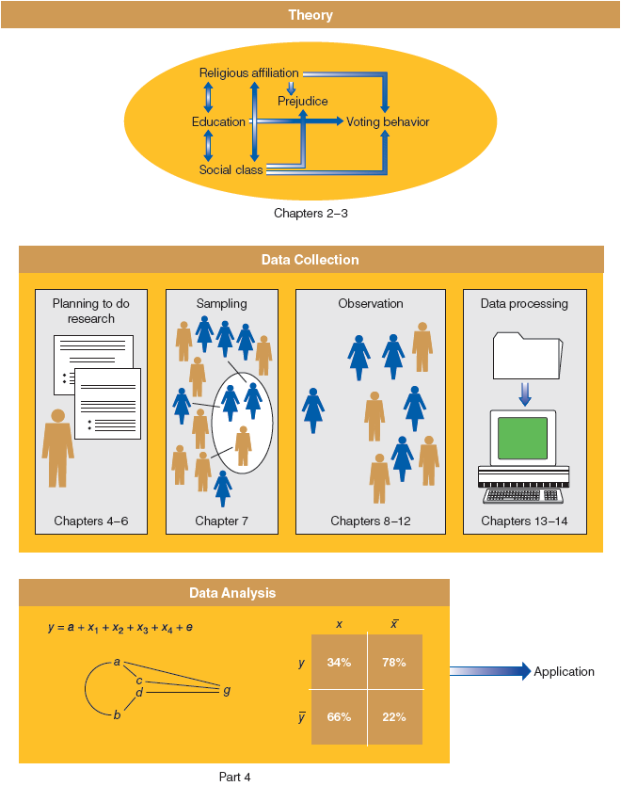
Figure 1-1
Social Science = Theory + Data Collection + Data Analysis
This figure offers a schematic overview of the major stages of social research, indicating where each is discussed in this book.
Notes:
Theory deals with logic
Data collection deals with observation
Data analysis deals with patterns in observation/comparisons between what is logically expected and what is observed

Slide 11
The Foundations of Social Science
Theory
A systematic explanation for our observations
Social Theory
A systematic explanation for the observations we see in social life
Notes:
Unlike philosophy or belief, social theory has to do with what is…
Theory cannot settle debates of value.. (e.g. is something better than the other/capitalism better than socialism). It has to do with how things are and why.
Because science can rarely agree on a given criterion, science is rarely useful in settling debates.

Slide 12
The Foundations of Social Science
Social theory has to do with what is, not with what should be
Social science can help us know what is and why
Social science cannot settle debates of value
Notes:
Unlike philosophy or belief, social theory has to do with what is…
Theory cannot settle debates of value.. (e.g. is something better than the other/capitalism better than socialism). It has to do with how things are and why.
Because science can rarely agree on a given criterion, science is rarely useful in settling debates.

Slide 13
The Foundations of Social Science
What do we study/observe?
Patterns/Social Regularities
and the norms that regulate/restrict social behavior
Notes:
Because social regularities represent probabilistic patterns, it doesn’t matter if the pattern isn’t reflected in 100% of observable cases. It doesn’t matter that despite men tending to make more money than women, some women make more than men. Social scientists ask WHY this is the case.

Slide 14
The Foundations of Social Science
Aggregates (not individuals)
the collective actions and situations of many individuals.
to explain why aggregated patterns of behavior are regular even when individuals change over time.
Notes:
Social scientists study social patterns, not individual ones. Reflect aggregates, not individuals, per se. Although social scientists might study the actions and motivations of individuals, they create theories about the nature of group life (groups to which classes of individuals belong… e.g. women, middle class, latinos).
Social scientists aren’t trying to explain individuals per se, but instead try to understand the systems in which people operate. The elements in this system can also be explained as variables.

Slide 15
The Foundations of Social Science
Concepts as Variables
Attributes
Characteristics or qualities that describe an object.
Variables
Logical groupings of attributes. The larger category to which those attributes belong
Notes:
Characteristics (of an individual) can be placed into a larger set of qualities, such as someone saying that women belong in the kitchen… …this one person is a bigot or old-fashioned, but this characteristic can be placed into a set of attributes called bigotry… which is a measurable variable.
The larger set of qualities is how social scientists make sense of more than just one person, towards a class or set of people to which this one person belongs. You find out about people who are “like hiim/her”… in this way, the scientists aren’t studying bigots, but bigotry.
Variables, like bigotry, vary. Scientists are interested in understanding the system of variables that cause bigotry to vary.
Attributes: female, asian, conservative, farmer, honest
Variables: gender or sex, race/ethnicity, political orientation, occupation, class,

Slide 16
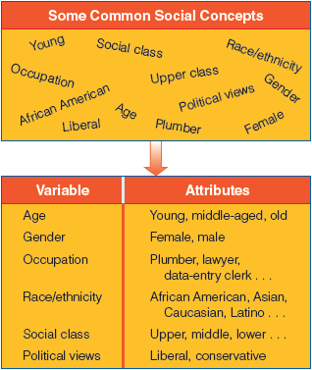
Figure 1-2
Variables and Attributes
Variables like education and prejudice and their attributes (educated/uneducated, prejudiced/unprejudiced) provide the foundation for examining causal relationships in social research.

Slide 17
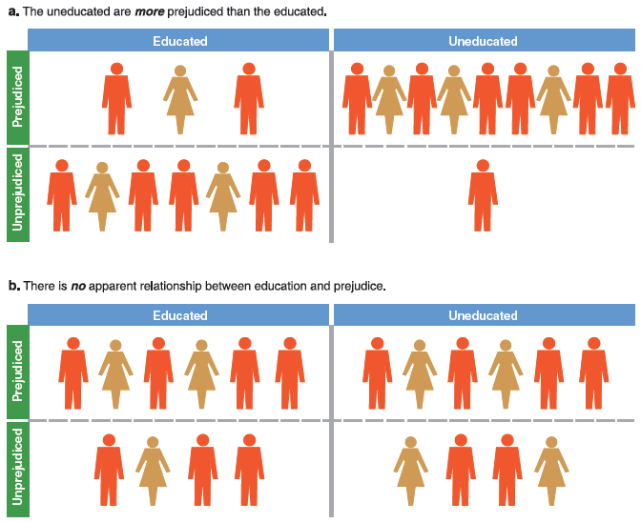
Figure 1-3
Illustration of Relationship between Two Variables (Two Possibilities)
Variables such as education and prejudice and their attributes (educated/uneducated, prejudiced/unprejudiced) are the foundation for the examination of causal relationships in social research.
Notes:
We see the difference between the relationship between two variables: a visualization of an apparent relationship b/w the two, and one without.
More often, we’re concerned with how attributes on one variable cause their attributes on another variable.

Slide 18
The Foundations of Social Science
Studying Concepts using Variables
Independent Variable
A variable that influences another
Predictor
Dependent Variable
A variable that depends on another
Outcome
Notes:
Religiosity is a function of sex/gender? Which is DV? Which is IV?
Depending on the explanation, a variable might be a DV in one analysis, but and IV in the next (religiosity influencing crime).

Slide 19
The Foundations of Social Science
The Purposes of Social Research
Exploratory
Mapping out a topic that may warrant further study later
Descriptive
Describing the state of social affairs
Explanatory
Providing reasons for phenomena, in terms of causal relationships
Notes:
Social research has several functions: can be exploratory, descriptive, or explanatory.
Exploratory – learning something new about a political group (lay research, non-publishable)
Descriptive – describes current situations like crime in cities, opinions on marijuana (reports from research firms, etc).
Explanatory – explains why a social phenomenon is occurring, using causal relationships, like why the employment rate is so high in a city. (high quality research)

Slide 20
Some Dialectics of Social Research
Types of Explanations in Explanatory Research
Idiographic
explanation that exhausts the many idiosyncratic causes for a particular event
Nomothetic
explanation that identifies one or a few causal factors that generally impact a class of events
Notes:
Idiographic -- Causal explanation limited to that event only.
Nomothetic -- Causal explanation large, but settles for partial explanation.

Slide 21
Comparison
Idiographic versus nomothetic explanation path diagram

Slide 22
Some Dialectics of Social Research
Types of logic used in theory
Induction
logical argument in which general principles are developed from specific observations/data.
Deduction
logical argument in which specific expectations of hypotheses are developed on the basis of general principles/other theories.
Notes:
Induction – moves from specific observations/data to discovery of a general pattern that represents the order in the data. This just tells you that a pattern exists, but not why it does. Moves from ``whether’’ something occurs to ``why’’ it does.
Deduction – moves from a general pattern that may be logically or theoretically expected to specific observations designed to test whether the pattern really occurs. Moves from ``why’’ something is generally expected to occur to ``whether’’ it actually does.

Slide 23
Comparison
Inverted pyramid diagram

Slide 24
Some Dialectics of Social Research
Types of data
Qualitative Data
non-numerical data (e.g. text, conversations, correspondence)
Quantitative Data
numerical data (e.g. numbers used to represent some social phenomenon)

Slide 25
Chapter Summary
Identify the different ways people decide what’s real.
Explain the fundamental nature of social science.
Understand the basic options for conducting social science research.

Slide 26
Questions

Slide 27
Question 1
The two foundations of science are:
tradition and observation.
observation and logic.
logic and theory.
theory and observation.
logic and generalization.
Notes:
Answer: B.
The two foundations of science are observation and logic.

Slide 28
Question 2
Science…
deals with what should be and not with what is.
can settle debates on value.
is exclusively descriptive.
has to do with disproving philosophical beliefs.
has to do with how things are and why.
Notes:
Answer: E.
Science has to do with how things are and why.

Slide 29
Question 3
When social scientists study variables, they focus on
attributes.
groups.
people.
characteristics.
relationships.
Notes:
Answer: E.
When social scientists study variables, they focus on relationships.

Slide 30
Question 4
_____ is the science of knowing.
Intelligence
Exam taking
Epistemology
Methodology
Relationships
Notes:
Answer: C.
Epistemology is the science of knowing.

Slide 31
Question 5
Which of the following are true of tradition and authority?
They both assist human inquiry.
They both hinder human inquiry.
Both of the above are true.
Neither of the above are true.
Notes:
Answer: C.
Tradition and authority both assist and hinder human
inquiry.

Slide 32
Question 6
_____ explanations seek to exhaust the idiosyncratic causes of a particular condition of event.
Idiographic
Latent
Manifest
Nomothetic
Notes:
Answer: A.
Idiographic explanations seek to exhaust the idiosyncratic causes of a particular condition or event.

