Slide 1
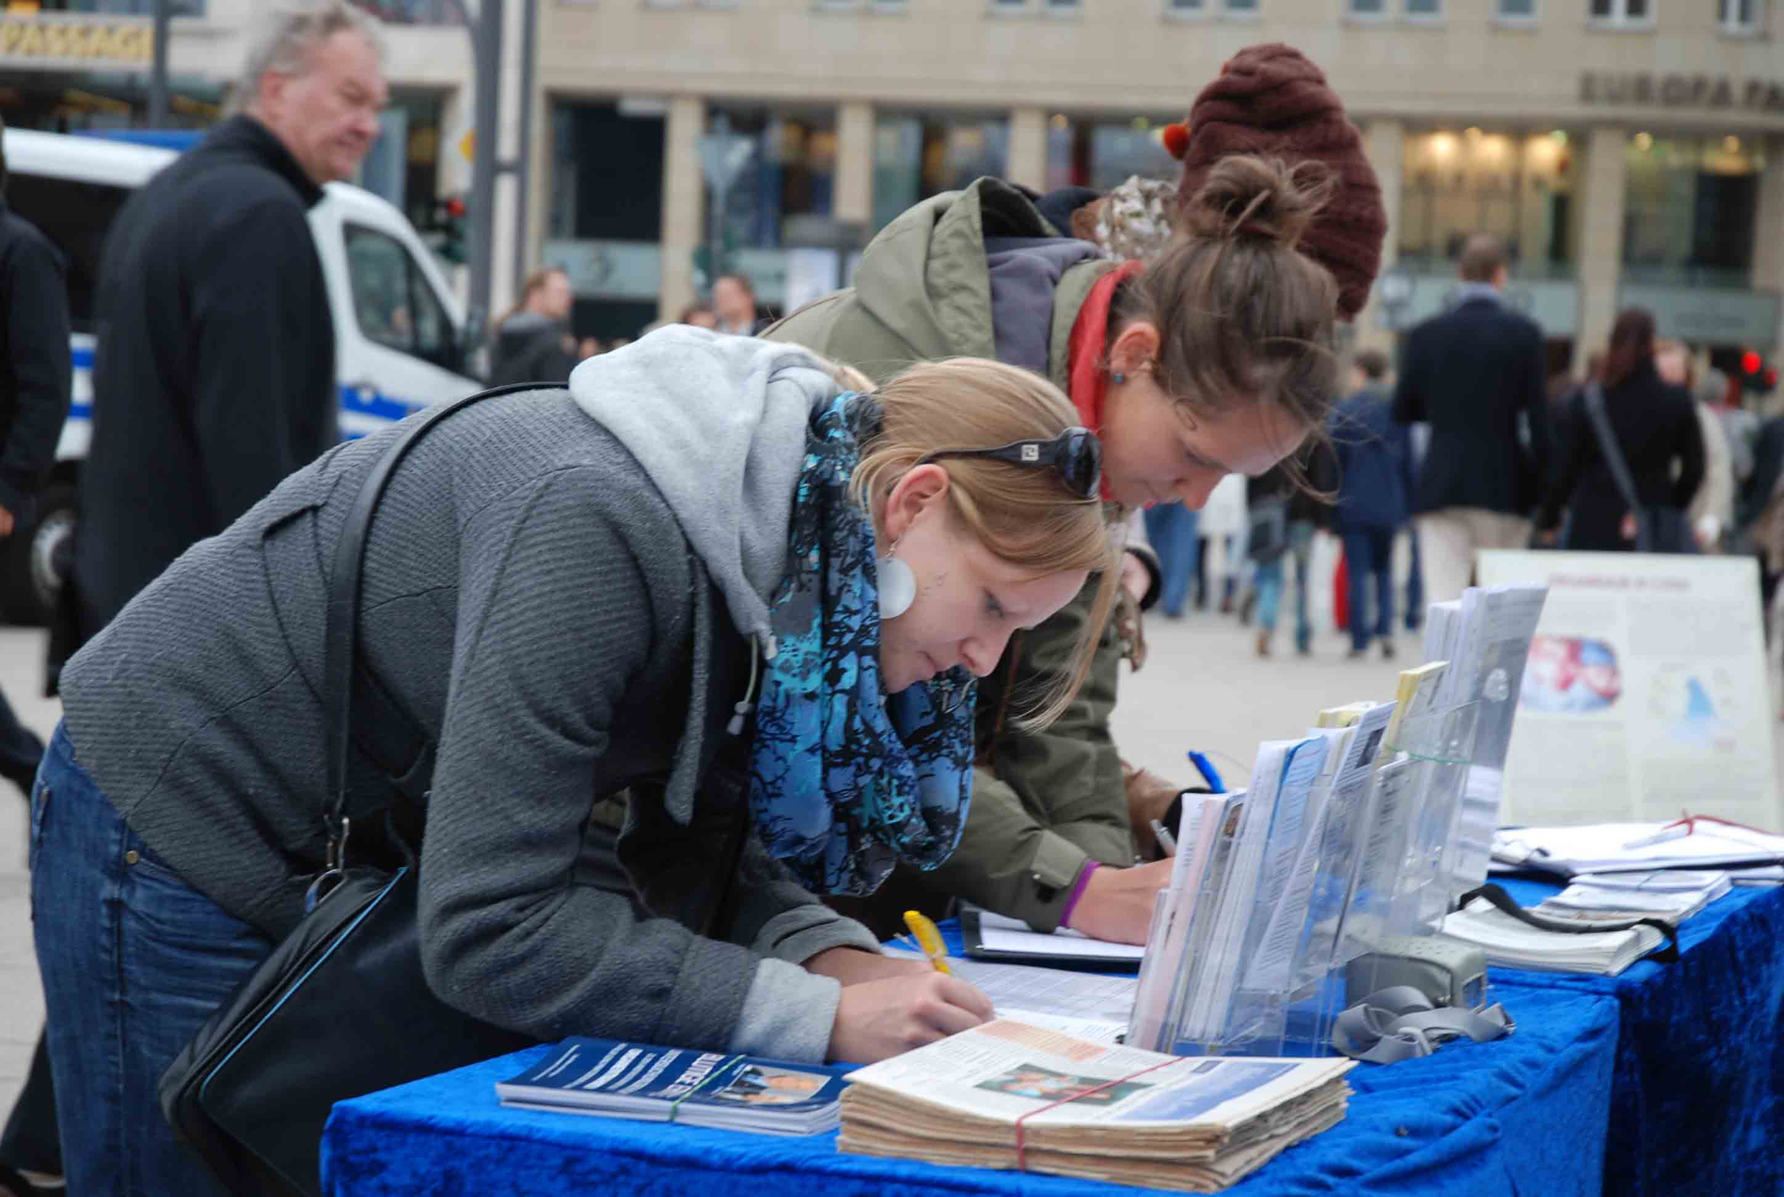
Participation

Slide 2
Questions about Participation
Why do some people participate in social movements while others do not?
How is participation sustained?
Why do people disengage?

Slide 3
To Participate or Not to Participate
Obstacles to participation
Costs versus Risks

Slide 4
Costs versus Risks
Cost
Subtracting something good
Money, time
Risk
Adding something bad
Harm, surveillance

Slide 5
Direct versus Indirect
Direct
something you experience at the time of participation
Indirect
happens outside the site of movement activity/participation

Slide 6
Direct and Indirect Costs and Risks
Cost
Direct: Time spent protesting in DC (when you have a paper due)
Indirect: Lost wages for skipping work for protest
Risk
Direct: Police brutality at protest event
Indirect: Surveillance because of past participation

Slide 7
Variation in Costs and Risks
Freedom Summer in 1964

Slide 8
Variation in Costs and Risks
Type of Risk/Type of Cost | Low Risk | High Risk
Low Cost | Signing a petition in the contemporary U.S. | Signing a pro-communist petition during the McCarthy Era
High Cost | Traveling to Washington, D.C. for a protest | Traveling to South (as a Californian) to participate in Freedom Summer in 1964

Slide 9
Exercise: Variable Risks and Costs
On a sheet of paper, write down at least one example from one of the cells in the previous table
Low risk, low cost
Low risk, high cost
High risk, low cost
High risk, high cost
Type of Risk/Type of Cost | Low Risk | High Risk
Low Cost | Signing a petition in the contemporary U.S. | Signing a pro-communist petition during the McCarthy Era
High Cost | Traveling to Washington, D.C. for a protest | Traveling to South (as a Californian) to participate in Freedom Summer in 1964

Slide 10
Commitment
High Commitment
High Risk/High Cost Activism
Notes:
Can range low to high
Those who are highly committed to a movement might more likely to bear the costs and risks associated with activism

Slide 11
Commitment
High Commitment
High Risk/High Cost Activism
Notes:
Can range low to high
Those who are highly committed to a movement might more likely to bear the costs and risks associated with activism
Or participation might encourage high commitment

Slide 12
Research Questions within Participation Literature

Slide 13
Question 1
Why do some people participate while others don’t?

Slide 14
Differential Recruitment and Participation
Structural Factors
Social Psychological Factors
Biographical Factors

Slide 15
Differential Recruitment and Participation
Structural Factors
Social Psychological Factors
Biographic Factors

Slide 16
Structural Factors
Social networks
Organizational Affiliations

Slide 17
Structural Factors
Why social networks and organizational affiliations?
Makes you more likely to interact with movement members who will (1) inform you about social movements and (2) ask you to participate

Slide 18
Exercise: Structural Factors for Participation
Think back to when you participated in an event
Protest
Meeting
Party
How did you hear about the event?
Who asked to you show up?

Slide 19
Differential Recruitment and Participation
Structural Factors
Social Psychological Factors
Biographic Factors

Slide 20
Social Psychological Factors
Collective Efficacy
Collective Identity

Slide 21
Social Psychological Factors
Personal Efficacy
Belief that you have the capacity to make a difference
Collective Efficacy
Belief that you can make a difference by working together, collectively

Slide 22
Social Psychological Factors
Collective Identity
Sense of shared experiences with others
Can empathize with you
Strong sense of identification with social category

Slide 23
Social Psychological Factors
Why collective efficacy and collective identity?
You’re more likely to participate if you believe that (1) by working together, with (2) others who share a sense of “one-ness” with you, you can bring about your desired outcome

Slide 24
Differential Recruitment and Participation
Structural Factors
Social Psychological Factors
Biographic Factors

Slide 25
Biographic Factors
Socialization
Prior History with Politics and Movements
Biographical Availability

Slide 26
Biographic Factors
Socialization
Raised to know and appreciate political activity as one of your norms/values
Comes from parents or primary groups

Slide 27
Exercise: Socialization
How many of you vote?
How many of your parents vote?
What kinds of things did your parents say about voting, in general?

Slide 28
Biographic Factors
Prior engagement in politics
Those who are interested, knowledgeable about, and enjoy discussion about politics are more likely to participate

Slide 29
Biographical Factors
Biographic availability
Lifestyle characteristics that alter the costs and risks associated with participation
Absence of personal constraints on time
Marriage
Kids
Full-time employment

Slide 30
Biographic Factors
Why socialization, past experiences, and availability?
In the past or in the present, you are/were (1) open to participating in politic or movements and (2) you have/had the time to do so

Slide 31
Incentives for Participating
Read up on incentives, pages 132-140

Slide 32
Question 2
What accounts for persistent/sustained participation?

Slide 33
Sustained Participation
Commitment
Correspondence of self interest and group interest

Slide 34
Sustained Participation
Building commitment
Social isolation
Conversion (e.g. religion)
Specific dress codes
Confession
Surrendering/donating personal resources
ingroup-/outgroup

Slide 35
Question 3
Why do people disengage?

Slide 36
Disengagement
Insufficient gratification
Declining commitment
Precipitating event
Notes:
Not reaching goals, unpleasent,
Fight with other participant, defection of friend, shift toward radical action

