Slide 1
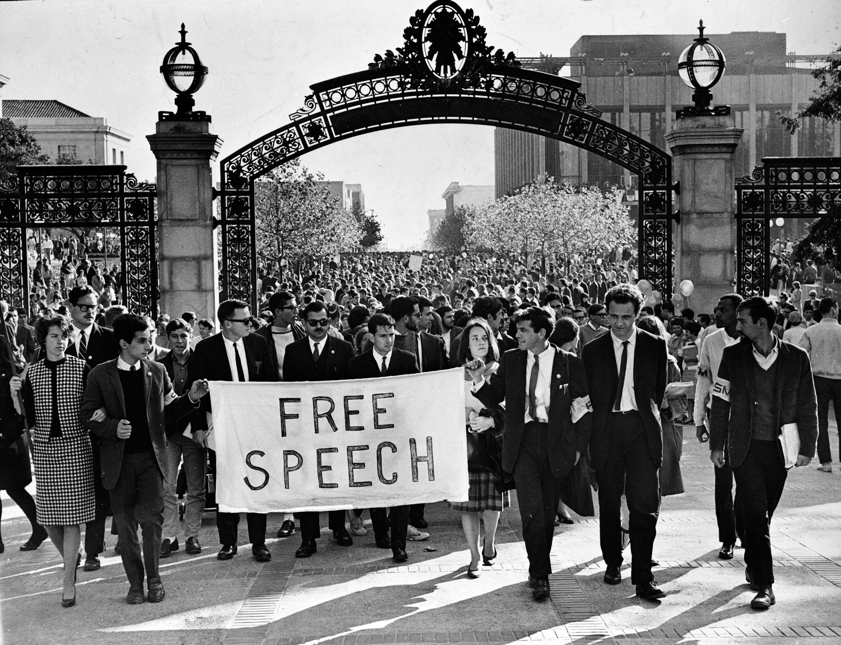
Dynamics and Tactics

Slide 2
Concept Quiz #3
Choose one of the following, and explain why it is critical for social movement participation
Social Networks
Collective Identity
Collective Efficacy
Biographical Availability
Socialization

Slide 3
Social Movement Dynamics and Tactics
What do movements do after they emerge?
Interact with their local environment
Change

Slide 4
Social Movement Dynamics
The interactions in which social movements are embedded…
Authorities
Businesses
Allied or Oppositional Movements
…and where these interactions take place
Environments

Slide 5
Social Movement Dynamics: Organizational Environments
Social Movement Organizations (SMO)
Social Movement Industries (SMI)
Social Movement Sectors (SMS)

Slide 6

SMOs
Bounded entities of individuals coming together because of shared goals over grievances
Formal organizations
Notes:
IDA is an organization that works to protect the rights, welfare, and habitats of animals

Slide 7




SMIs
All SMOs in the same geographic vicinity working on similar issues
All animal rights organizations working in Santa Barbara

Slide 8
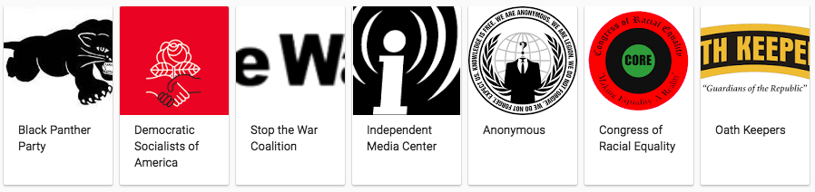

SMS’
All SMOs, of all issues, in a geographic vicinity

Slide 9
How do movements interact?
Coalitions
Conflict
Notes:
Coalitions and conflict can occur both within movements and outside movements….

Slide 10
Coalitions
Collaboration between SMOs
Implies SMOs have shared goal
Can be built on prior bonds (or not)
Feminist, pro-choice
Notes:
Even if the goal is not the primary goals of each individual group.

Slide 11
Conflict
Competition for resources
Money, time, energy, prestige
When only a few SMOs in SMI, there will be enough resources to go around
Resources diminish with more SMOs
As SMOs fail/stagnate, successful SMOs grow and become more centralized in SMI

Slide 12
Exercise: CSUF Student Parking
Collaboration (which SMOs)?
Within movement
Outside movement
Conflict (which SMOs)?
Within movement
Outside movement

Slide 13
How do movements change?
Organization’s Life
Leadership
Organization’s Form/Structure

Slide 14
Organization’s Life
Survive/grow
Stagnate
Become new organizations

Slide 15
Leadership
Charismatic leader(s)
Division of labor
Notes:
Charismatic leaders are nice, but they are not necessary.
One leader can take care of all the administrative tasks (reaching out to politicians/bureaucrats) the other can build solidarity amongst members and recruits by speaking to their ideological commitments and intellectual interests… engenders enthusiasm and stimulates passion.

Slide 16
Organization’s Forms/Structure
Bureaucratize/Formalize
Hierarchical Structures, Rules
Notes:
Private and public separated. People occupy positions within the bureaucracy and receive a salary.

Slide 17
What else changes?
Strategies
Tactics

Slide 18
Strategy
Broad organizing plan/scheme for accomplishing a goal
Nonviolence, Assertive Political Action, Violence
Notes:
Nonviolence entails avoidance of violence and not provoking it…
Violence is targeted violence or inciting it

Slide 19
Tactic
Reflection of strategy
Specific techniques through which strategies are implemented
Sit-ins and boycotts, endorsing candidates and bills, riots and burning buildings
Notes:
Nonviolent strategy favors certain tactics, such as marches and demonstrations, sit ins, boycotts
Violent strategy favors destroying facilities, harming targets, etc

Slide 20
Why do Strategies/Tactics Change (Internally)?
Based on underlying goals, values, beliefs… of the leaders and members
What is most effective?
What is most appropriate for our cause?
What kind of organization do we want to be?
What do I like as a tactic?

Slide 21
Why do Strategies/Tactics Change (Externally)?
Repertoires of contention
Portrayals/perceptions of movement
Policing
Innovation, Adaptation, Diffusion
Notes:
Rep of contention: what are widely accepted modes of action? What is everyone else doing? What is beyond the scope of “acceptable” movement action?

Slide 22
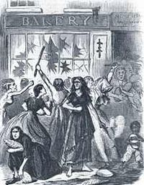
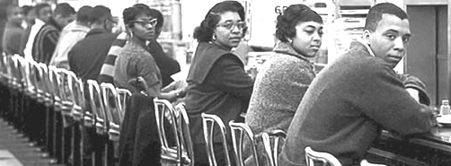

Repertoires of Contention
Clustering or patterning of tactics in time periods and cultural space
Food riots, grain seizures (1800s-1900s)
Labor strikes (1900s-1940s)
Sit-ins, boycotts, marches (1950s-1970s)
Retweets, hacktivism (2000s-present)

Slide 23
Exercise: CSUF Student Parking
What tactic would you choose and why?
Would prior repertoires work for the movement?
How could you incorporate current repertoires?

Slide 24
Repertoires of Contention
Historically constrained by three factors:
Social structure
Mostly labor strikes when we were agrarian society
New movements with alternative goals
Conservative movements sought legal mobilization over street protest
Technological developments
Email, radio, printing press, internet all create new possibilities for tactical change

Slide 25
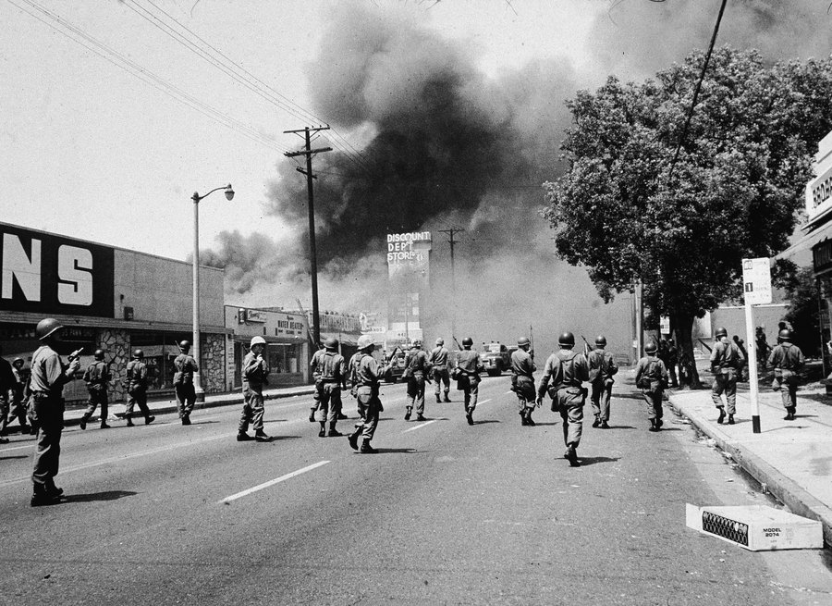
Portrayals of the Movement
Tactical options depend on how movement is defined by those in position to react to it
Public
Government
If viewed poorly, rioting will only further delegitimize the movement

Slide 26
Policing
Different tactical options have different policing consequences
Some more harsh forms of protest, and those that aren’t negotiated in advance, invite harsher action from police.
Leads to movements choosing one form over others

Slide 27
Innovation, Adaptation, Diffusion
Innovation
Devising tactics that overcome the SMO’s powerlessness
disruption, gaining media attention
Adaptation
Responding to the external environment
Authorities respond to offset power gained by SMO, then SMO adapts, using a new tactic
Diffusion
Spread or flow of tactic/information about new tactic through social system by actors
Between activists in connected or allied SMOs

