Slide 1
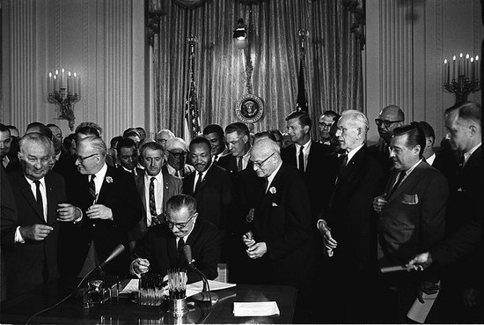
Consequences of Social Movements

Slide 2
Targets Matter
Almost always target one system of authority to influence or block change

Slide 3
Targets
Political
State, politicians, policy, religious denominations, businesses
Cultural
Discourse, understandings, beliefs, attitudes, practices, objects/matreial

Slide 4
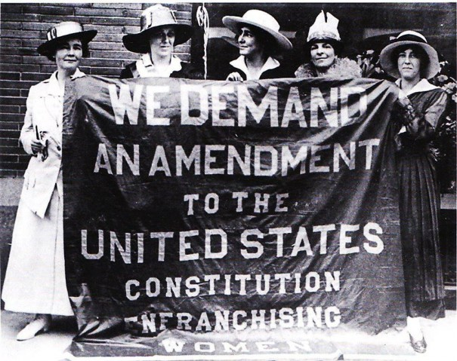
Ex: Women’s Suffrage
Notes:
Targeted politicians to say “hey, women have a unique perspective on politics that needs to be taken into account” and targeted public saying “women’s roles are not solely confined to the home…”

Slide 5
Exercise
Select a contemporary social movement…
What sorts of political outcomes could they impact?
What sorts of cultural outcomes could they impact?

Slide 6
Goals versus Outcomes/Consequences?
Problems with focusing on goals
Movements have many goals
Goals change over time
Many never attain all goals (succeed)
Notes:
Therefore a focus on goals is misguided… since many don’t ever achieve their goals…

Slide 7
Consequences
Movements often fail
Movements often do worse than fail (repression, counter-movements, backlash)
When they do succeed, outcomes may be outside their stated goals
Notes:
This is why we focus on consequences… since these might be unrelated to the movement’s stated goals… (implicit target… e.g. policy change implies support amongst citizens… so a change in perceptions might be unintended but positive consequence)… also might be unintended in form of backlash

Slide 8
Conceptualizing Consequences
Intended
Unintended
Notes:
Intended: something they expected to change; unintended: something they did not expect to change
These can be internal or external to the movement.

Slide 9
Consequence Types
 | Internal | External
Intended | Consciousness-raising amongst members | Desired policy passed
Unintended | Factions, fracturing, disputes, schisms within movement | Counter-mobilization, repression
Notes:
Intended Internal: deals with personal transformation, collective identity building, solidarity (religious movements, scientology, Buddhist movement)
Unintended Internal: disagreements about goals or strategies/tactics to achieve them, disputes about how to frame an issue, development of oppositional factions within SMO (SDS/Weather Underground)
Intended External: those that the movement explicitly fights for, for which they have no control or are not the system of authority (LGBT orgs fighting to halt SSM bans, Townsend movement influenced growth in support for national social security program)
Unintended External: those that the movement did not explicitly fight for, or desire or see coming (counter movements, repression, spillover)

Slide 10
Exercise: “Give Me Some Space” CSUF Parking Inequity Organization
 | Internal | External
Intended | Consciousness-raising amongst members | Desired policy passed
Unintended | Factions, fracturing, disputes, schisms within movement | Counter-mobilization, repression

Slide 11
What Can Movements Win?
Acceptance
Legitimacy
New advantages
Collective benefits (e.g. desired policy, monetary rewards)
Notes:
Acceptance means that the movement and its representatives are viewed as legitimate and are given a seat at the table where they can speak on issues, they are taken seriously, as are their demands.
New advantages are collective benefits that the movement is able to win for its members and constituents.

Slide 12
Factors Affecting Movement Consequences
Internal
External
Joint/Mediated

Slide 13
Internal Factors Affecting Movement Consequences
Organizational structure (tactical choice)
Access-Influence
Institutional action
Action-Reaction
Disruptive action
Collective action frames
Resonance with broader cultural environment/discourse
Notes:
Access-Influence: creates change by becoming a bargaining member with political officials… uses lobbying or litigation to get a seat at the table
Action-reaction/disruption: creates change because it interrupts/disrupts normal operating procedures of political officials/businesses– action leads to loss of revenue or ability to make policy so movements MUST be dealt with

Slide 14
External Factors Affecting Movement Consequences
Political Context
Elite allies
Divisions/competition among elites
Notes:
Elites give movements some legitimacy to help them clear various policy hurdles so that they don’t need a seat at the table… the seat is taken by a sympathetic politician.
Divisions create access points, opportunities to get politicians on one side of the issue on board with you.

Slide 15
Joint/Mediated Factors Affecting Movement Consequences
Interaction of Internal and External Factors
Mobilization (protest) and organizational structure (strength and tactical choice) provide necessary but not sufficient influence over outcomes
Sympathetic allies must interact with/respond to movement
Allies have final say on what is in the outcome
Notes:
Political Mediation model

Slide 16
Personal and Biographical Consequences
Movement participation affects participants themselves

Slide 17
Personal and Biographical Consequences
Activists of 1960s
Liberal
Remain activists in other movements over time
Employed in helping professions: teaching/social work
Episodic work histories
Lower incomes
Less likely (than conservative activists) to be married, have kids

Slide 18
Cultural Consequences of Social Movements
Changes in values, opinions, beliefs, ways of speaking about (framing/discourse)
Data must be tracked over time
Public opinion
Media coverage
Attitudes/Beliefs

Slide 19
Ex: Marijuana Legalization
Movement tries to change public opinion about legalization before policy change
Teach public about benefits of marijuana
Medical benefits
Revenue
Crime reduction

Slide 20
Cultural/Political Consequences: Free Speech Movement
Berkeley in the Sixties (1990)

