Slide 1
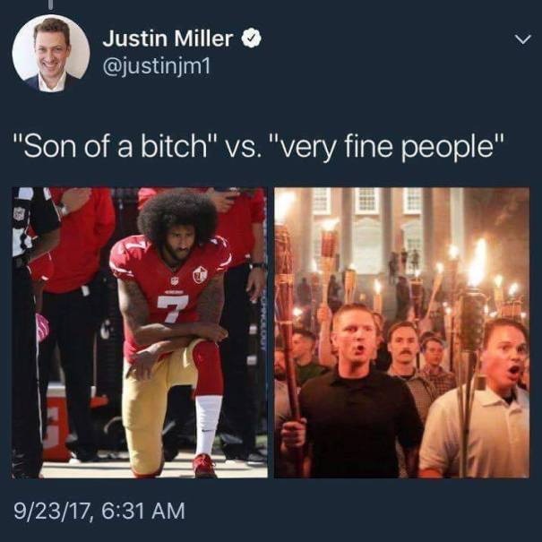
Framing

Slide 2
Concept Quiz #2
A. Describe the difference between everyday grievances and mobilizing grievances.
OR
B. Describe a characteristic of organizations during periods of abeyance.
OR
C. Why is variation within an organization’s structure (e.g. layers) important?

Slide 3
Attributing Meaning
Meanings don’t automatically attach to objects, events, experiences
Meaning generation requires interpretive work by social actors

Slide 4
Framing Types
Diagnostic
Prognostic
Motivational

Slide 5
Framing Types
Diagnostic
Claiming that an event, social condition, or other aspect of life is problematic
Identifying the source of/attributing blame for that problem
Notes:
*Problematize: troublesome, unjust, unacceptable, intolerable, and in need of repair or change

Slide 6
Framing Types
Prognostic
Proposing a solution to the problem
Notes:
Change policies to impact educational opportunities

Slide 7
Rights-based Movements
Focus on procedural rather than distributional issues to problematize
Claim that people don’t but should have equal chance at securing bigger piece of the “economic” pie
Argue that the rule of the game are rigged
Notes:
Not distributional: that they should have an EQUAL share of pie.

Slide 8
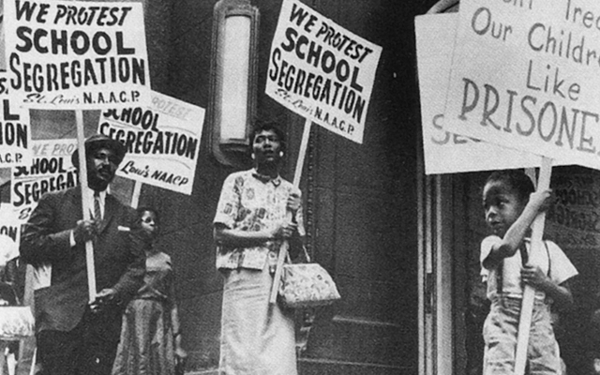
Rights-based Movements
Notes:
While CRM was really fighting to remedy distributional inequities (and had grievances about them), their framing centered on procedural inequities, such as the absence of equal educational opportunities for Blacks.

Slide 9
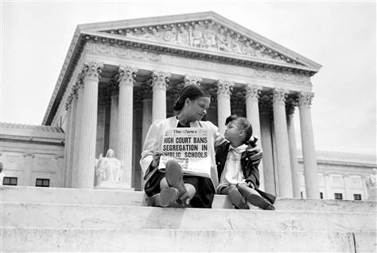
Rights-based Movements

Slide 10
Framing Types
Motivational
Call to arms to get people from the sidelines to engage in collective action
Urgency
Severity
Moral obligation
Efficacy
Greater benefit to society
Status enhancement (vanguard)

Slide 11
Framing and Discursive Fields
Framing occurs in contested “discursive fields”
Cultural environment where somethings resonate more than others
Framing occurs on several platforms
Media (news, print, social) and advertisements
Movement-generated objects (signs, pamphlets, posters)

Slide 12
Resonance
Effectiveness or potency of claims
Notes:
Shows how culture constrains the claims about mobilizing grievances

Slide 13
Actors in Competing in the Discursive Field
Protagonists
Activists/advocates who use challenging frames
Antagonists
Targets of protagonists, groups with competing interests, who engage in counter-framing
Bystanders
Those with no stake in the fight, but can be swayed into support for one side or the other

Slide 14
Example: Battling Against Authoritarianism in China
Student activists in pro-democracy movement walked tight rope
If framed grievances in counter-revolutionary terms, they would be repressed by gov’t
If framed as “bad,” would be ignored as whiny children
Combat dilemma by
Based claims of injustice (resulting from state economic reforms) on ideas of freedom and democracy blended with Chinese cultural values of Confucianism, communism, and nationalism
Taken seriously by broad swath of population
Deflected repression by tying to nationalistic pride

Slide 15
Exercise: Framing and Environments
Select one issue
Who are the actors in the discursive field?
Develop Frames (that you think would resonate)
Diagnostic
Prognostic
Motivational
Select a physical medium to disseminate your frames (e.g. newspaper)
Would your claims resonate? Why or why not?

